Slide 1
Adjudication pre-discussion
Audit | RM Agreement | RM Disagreements
Classification (100 decisions) | 81/100 — 81% | 19
Quantitative measure validity | 50/50 — 100% | 0
Quantitative quotation validity | 44/50 — 88% | 6

Slide 2
Consensus discussion - Adjudication
Add Rationale, suggested Consensus and Action for consensus

Slide 3
After the meeting
Can calculate human-AI agreement against the post-discussion adjudicated reference classifications.

Slide 4
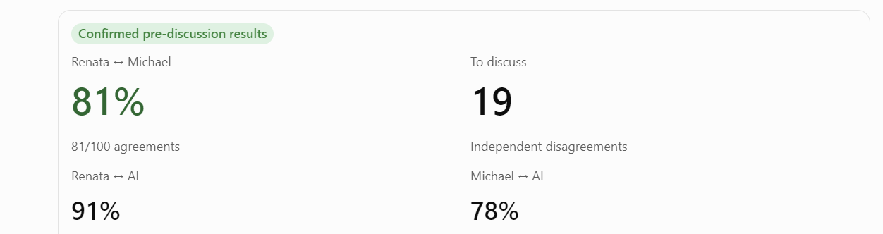
Prior to adjudication
Qualitative/Narrative evidence
Inter-rater agreement rater-AI agreement

