Slide 1
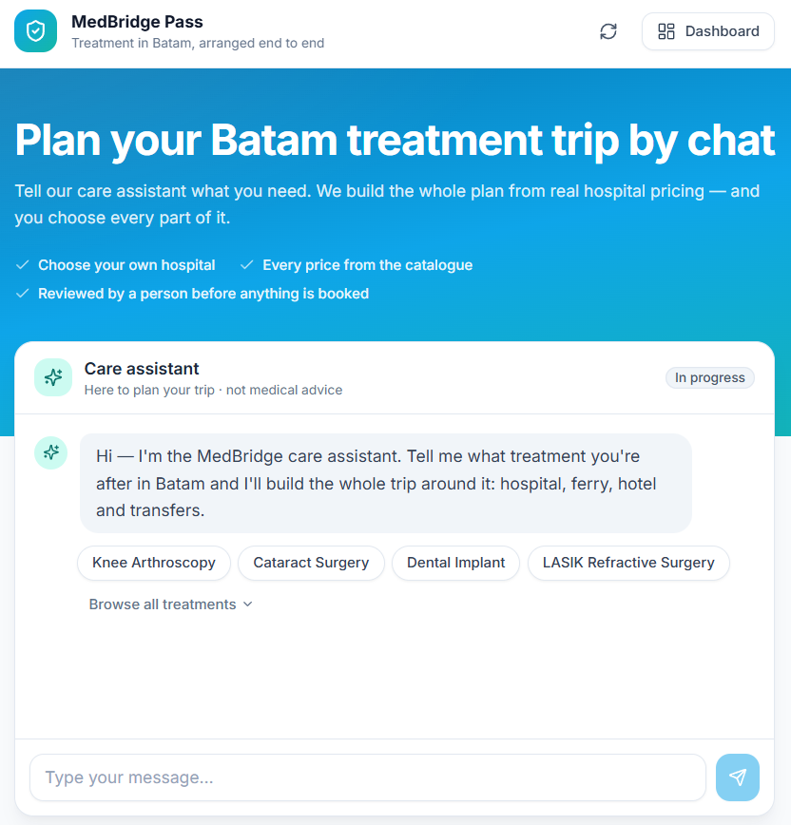
MEDICAL TRAVEL · SINGAPORE → BATAM
MedBridge Pass
One coordinated pass for cross-border care — treatment, specialist, ferry, transfer and recovery stay in a single priced bundle.
THE PROBLEM
Patients assemble their own care across four disconnected bookings — and nobody owns the journey.
THE PRODUCT
One conversation, one itemised price, one confirmation — approved by a named human before the patient sees it.
HOW THE MARKETPLACE EARNS
B2C · PATIENTS
Pay one price for the whole journey
Chat · edit the plan · confirm the pass
SaaS MARKETPLACE
MedBridge Pass
Take rate per line: treatment 12% · doctor 10% · hotel & transport 8% · ferry 5%
B2B · PARTNERS
Hospitals · ferries · hotels · transport
Own portal: arrivals, rates, caseload

Slide 2
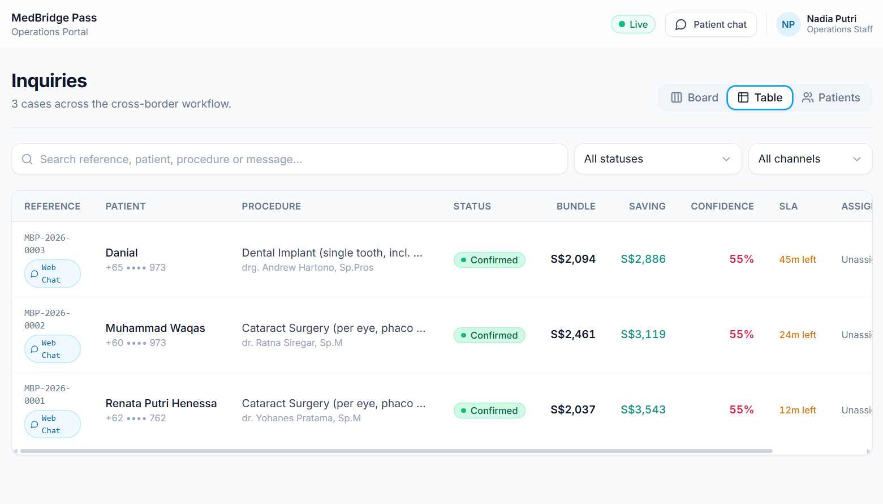
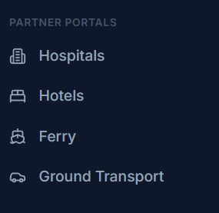
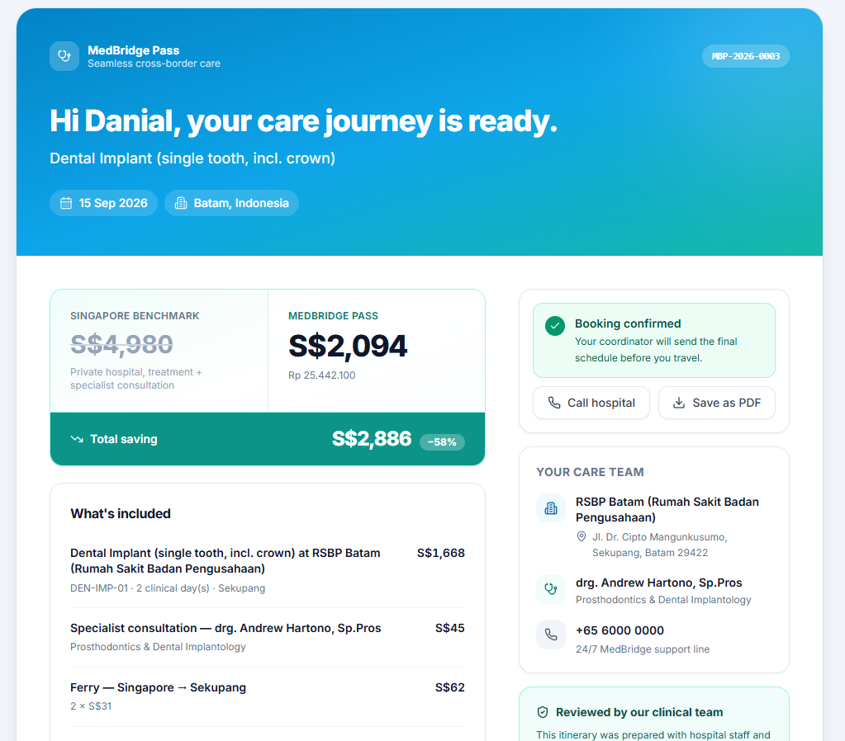
From a sentence to an approved pass
106
feature tests, all passing
AI does the understanding. A person does the deciding.
Visitor describes what they need
AI returns structured slots — never prose
Bundle priced from the catalogue
HUMAN APPROVAL the hard gate
Patient pass issued /itinerary/:token
No auto-approve. No bulk approve. No confidence-based release.
One endpoint mints a patient link, and it requires a named approver. A dead model degrades to a human, never to a dropped patient.

