Slide 1
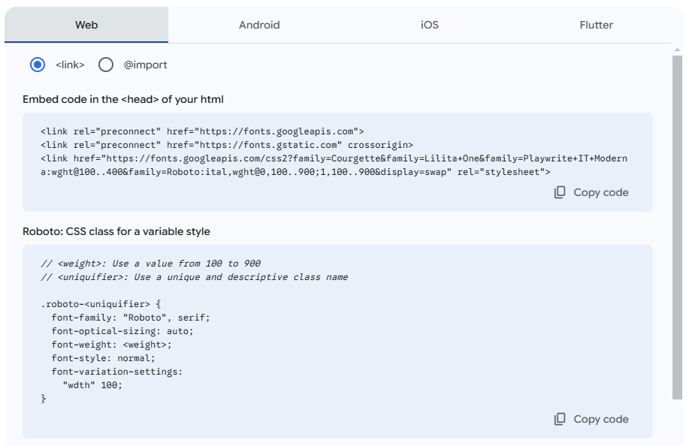

Slide 2
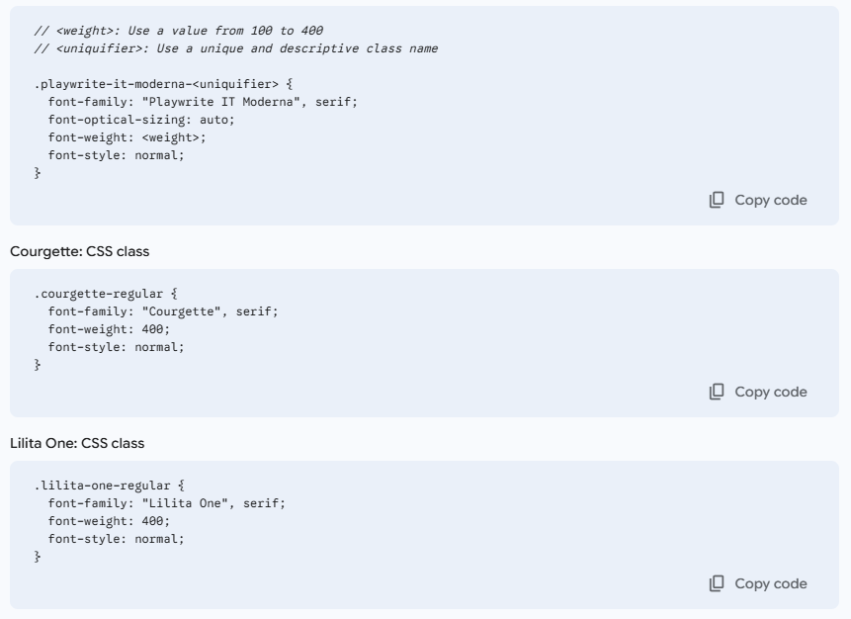

Slide 3
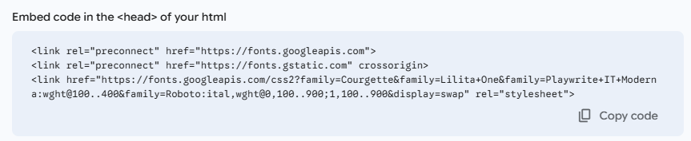
<link rel="preconnect" href="https://fonts.googleapis.com">
<link rel="preconnect" href="https://fonts.gstatic.com" crossorigin>
<link href="https://fonts.googleapis.com/css2?family=Courgette&family=Lilita+One&family=Playwrite+IT+Moderna:wght@100..400&family=Roboto:ital,wght@0,100..900;1,100..900&display=swap" rel="stylesheet">

Slide 4
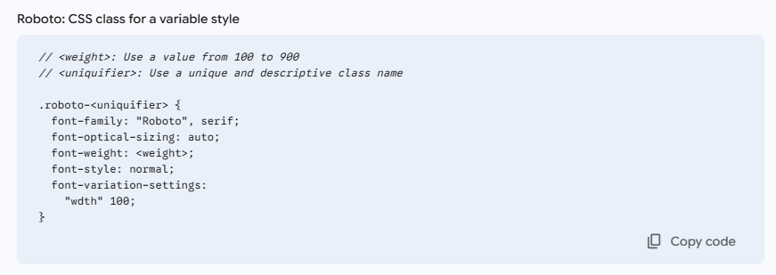
.roboto-<uniquifier> {
font-family: "Roboto", serif;
font-optical-sizing: auto;
font-weight: <weight>;
font-style: normal;
font-variation-settings:
"wdth" 100;
}

Slide 5


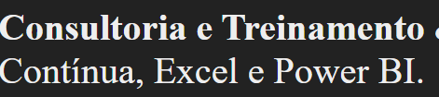
.playwrite-it-moderna-<uniquifier> {
font-family: "Playwrite IT Moderna", serif;
font-optical-sizing: auto;
font-weight: <weight>;
font-style: normal;
}
.courgette-regular {
font-family: "Courgette", serif;
font-weight: 400;
font-style: normal;
}
.lilita-one-regular {
font-family: "Lilita One", serif;
font-weight: 400;
font-style: normal;
}

