Slide 1
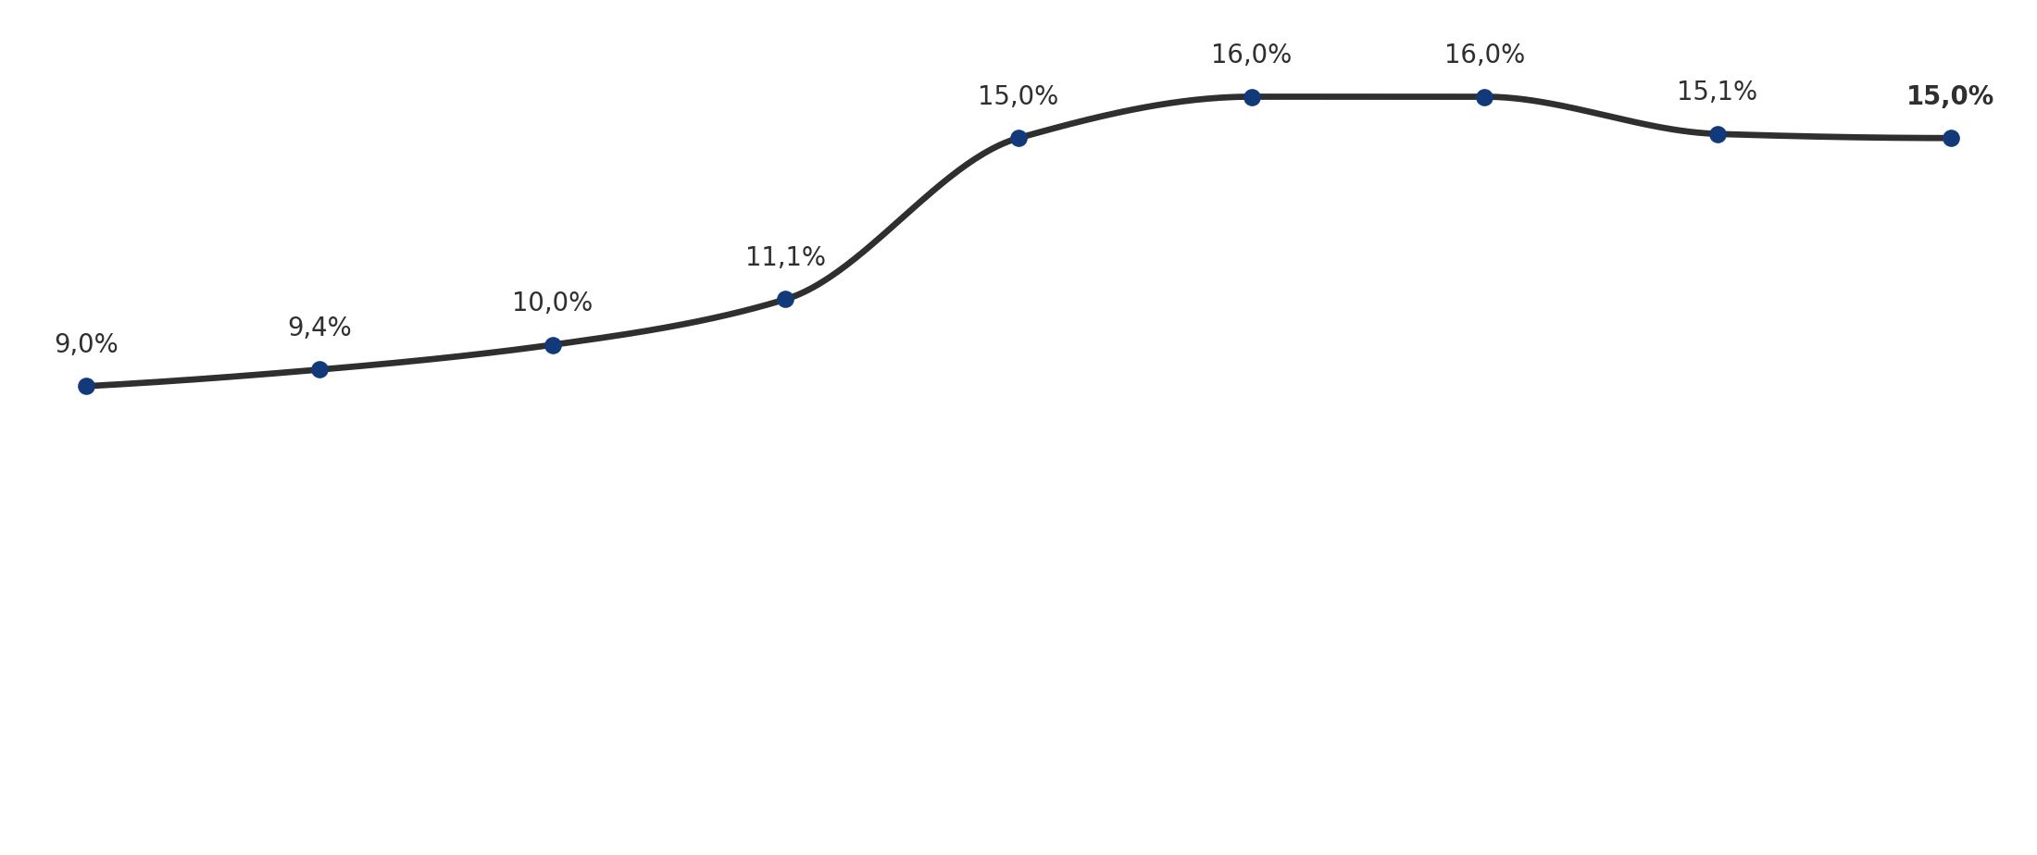
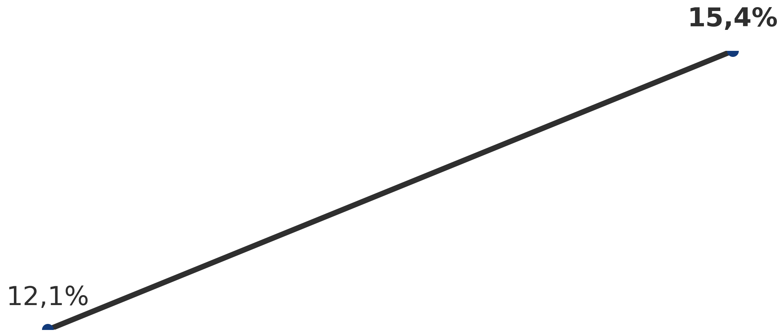
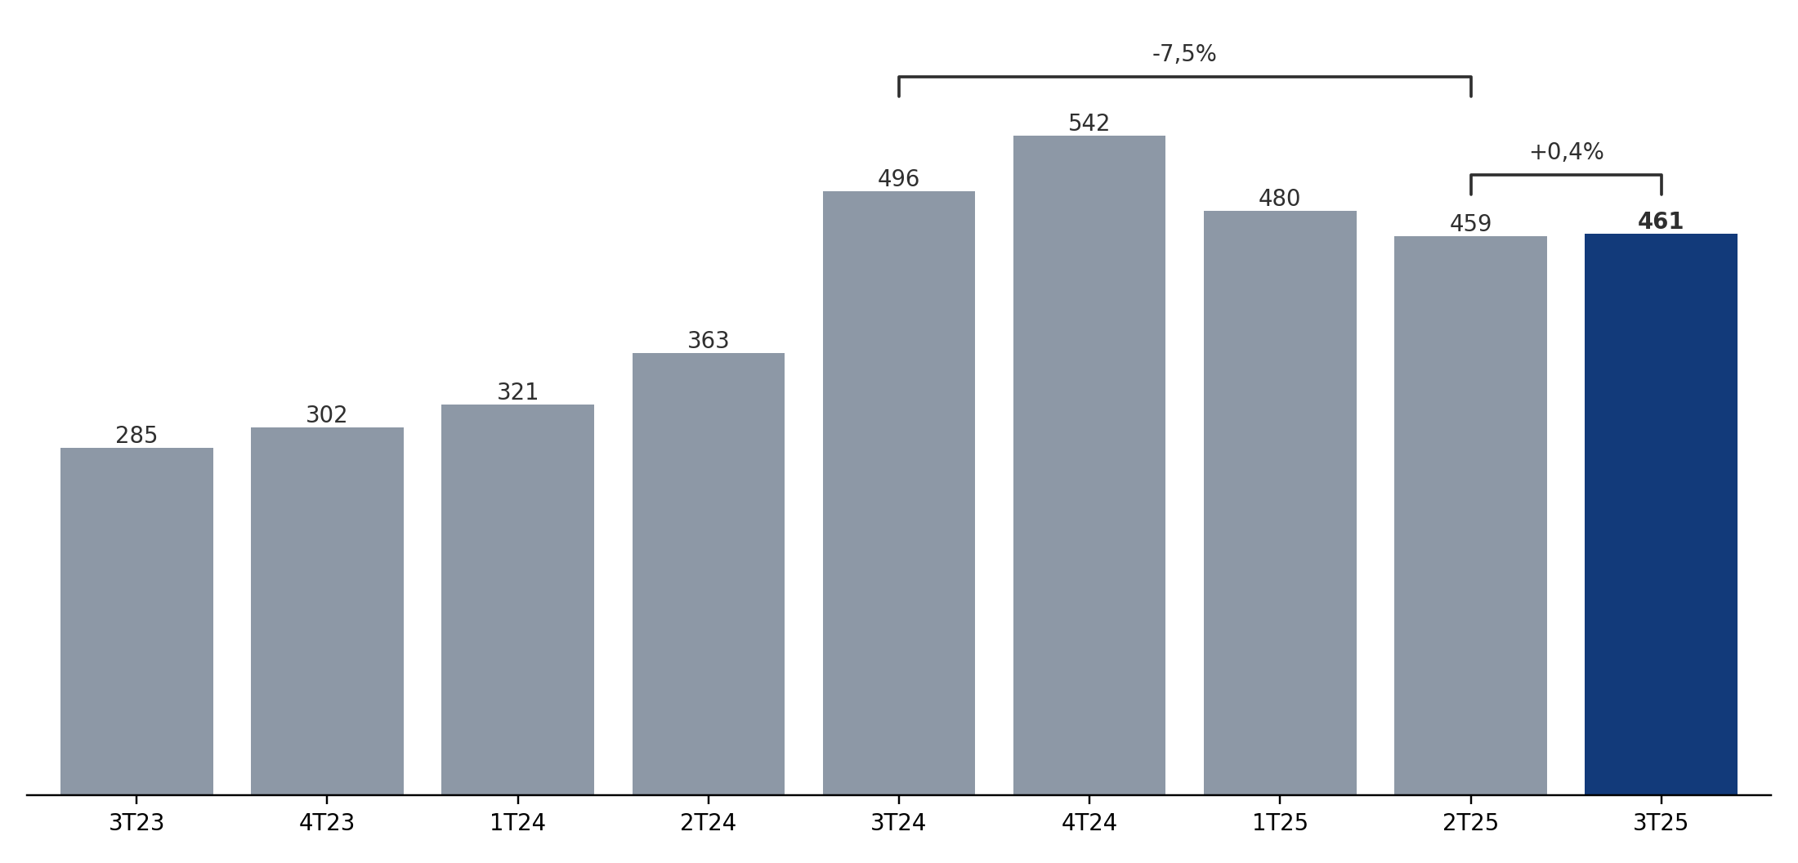
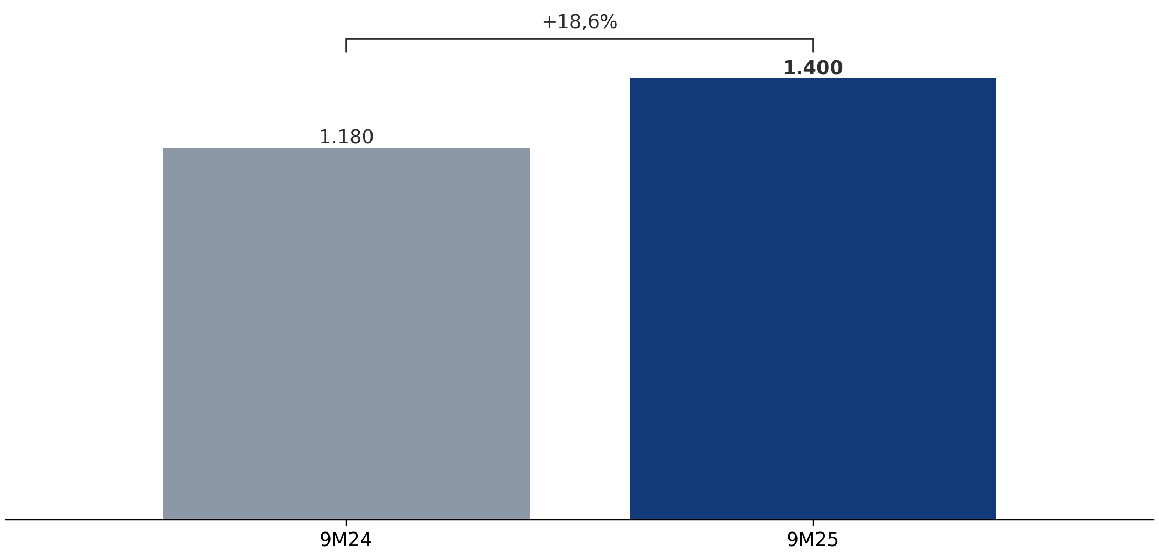
{{slide1_title}}
{{slide1_subtitle}}
{{ROE_RECORRENTE}}%
R$ {{LL_RECORRENTE}} milhòes
{{NIM1}}%
{{NIM2}}%
{{NIM3}}%
{{NIM4}}%
{{NIM5}}%
{{NIM6}}%
{{NIM7}}%
{{NIM8}}%
{{NIM9}}%
{{NIM10}}%
{{NIM11}}%

Slide 2
{{testing}}
{{text2}}

