Slide 1
Module 08: Implement API Management
Alex Ivanov
aivanov@microsoft.com
The slides are logically reordered vs Skillpipe

Slide 2

Module Agenda
Explore API Management

Slide 3
Lesson 1: Explore API Management

Slide 4
Introduction
After completing this module, you'll be able to:
Describe the components, and their function, of the API Management service.
Explain how API gateways can help manage calls to your APIs.
Secure access to APIs by using subscriptions and certificates.
Create a backend API.

Slide 5
Discover the API Management service (1 / 2)
The role of API management
API management provides core functions to ensure a successful API program through developer participation, business insight, analysis, security, and protection.
Each API consists of one or more operations, and each API can be added to one or more products.
The system is made up of the following components:
API gateway
Azure portal
The Developer portal
Notes:
The system is made up of the following components:
The API gateway is the endpoint that:
Accepts API calls and routes them to your backend(s).
Verifies API keys, JWT tokens, certificates, and other credentials.
Enforces usage quotas and rate limits.
Transforms your API on the fly without code modifications.
Caches backend responses where set up.
Logs call metadata for analytics purposes.
The Azure portal is the administrative interface where you set up your API program. Use it to:
Define or import API schema.
Package APIs into products.
Set up policies like quotas or transformations on the APIs.
Get insights from analytics.
Manage users.
The Developer portal serves as the main web presence for developers, where they can:
Read API documentation.
Try out an API via the interactive console.
Create an account and subscribe to get API keys.
Access analytics on their own usage.

Slide 6
Discover the API Management service (2 / 2)
Products
Products are how APIs are surfaced to developers.
Groups
Groups are used to manage the visibility of products to developers.
Developers
Developers represent the user accounts in an API Management service instance.
Policies
Allow the Azure portal to change the behavior of the API through configuration.
Developer portal
You can learn about your API, view and call operations, and subscribe to products.
Notes:
Products
Products are how APIs are surfaced to developers. Products in API Management have one or more APIs, and are configured with a title, description, and terms of use. Products can be Open or Protected. Protected products must be subscribed to before they can be used, while open products can be used without a subscription. Subscription approval is configured at the product level and can either require administrator approval, or be auto-approved.
Groups
Groups are used to manage the visibility of products to developers. API Management has the following immutable system groups:
Administrators - Azure subscription administrators are members of this group. Administrators manage API Management service instances, creating the APIs, operations, and products that are used by developers.
Developers - Authenticated developer portal users fall into this group. Developers are the customers that build applications using your APIs. Developers are granted access to the developer portal and build applications that call the operations of an API.
Guests - Unauthenticated developer portal users, such as prospective customers visiting the developer portal of an API Management instance fall into this group. They can be granted certain read-only access, such as the ability to view APIs but not call them.
In addition to these system groups, administrators can create custom groups or leverage external groups in associated Azure Active Directory tenants.
Developers
Developers represent the user accounts in an API Management service instance. Developers can be created or invited to join by administrators, or they can sign up from the Developer portal. Each developer is a member of one or more groups, and can subscribe to the products that grant visibility to those groups.
Policies
Policies are a powerful capability of API Management that allow the Azure portal to change the behavior of the API through configuration. Policies are a collection of statements that are executed sequentially on the request or response of an API. Popular statements include format conversion from XML to JSON and call rate limiting to restrict the number of incoming calls from a developer, and many other policies are available.
Developer portal
The developer portal is where developers can learn about your APIs, view and call operations, and subscribe to products. Prospective customers can visit the developer portal, view APIs and operations, and sign up. The URL for your developer portal is located on the dashboard in the Azure portal for your API Management service instance.

Slide 7
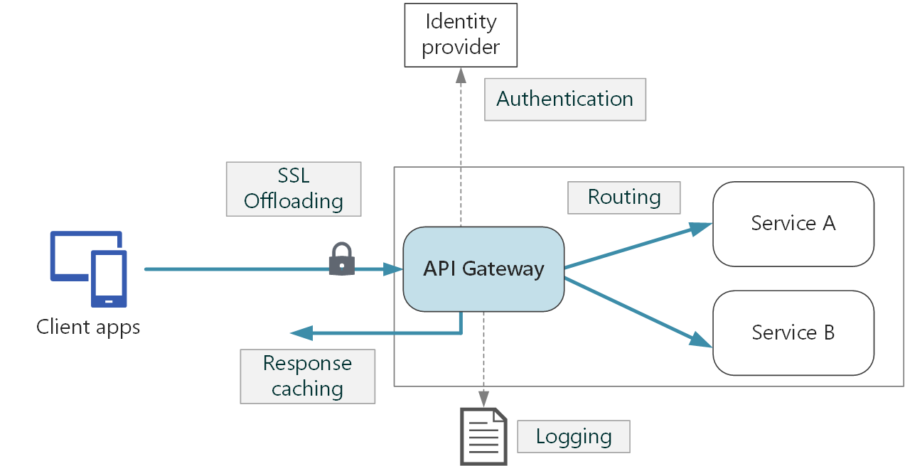
Explore API gateways (1 / 2)
API gateway role
An API gateway sits between clients and services.
It acts as a reverse proxy, routing requests from clients to services.
It may also perform tasks such as authentication, SSL termination, and rate limiting.
Explore API gateways

Slide 8
Explore API gateways (2 / 2)
Potential issues when deploying an API without a gateway
Lead to complex client code.
Create coupling between the client and the backend.
A single operation may need to call multiple services.
Every public-facing service must be dealt with.
The service must expose a client-friendly protocol.
Functional design patterns
Gateway routing: Use a gateway as a reverse proxy to route requests to one or more back-end services
Gateway aggregation: Use a gateway to aggregate multiple individual requests into one request.
Gateway Offloading: Use the gateway to offload functionality from individual services to the gateway, particularly cross-cutting concerns.
Notes:
Potential issues when deploying an API without a gateway
The client must keep track of multiple endpoints, and handle failures in a resilient way.
The client needs to know how the individual services are decomposed. That makes it harder to maintain the client and also harder to refactor services.
A single operation might require calls to multiple services. That can result in multiple network round trips between the client and the server, adding significant latency.
Each public-facing service must handle concerns such as authentication, SSL, and client rate limiting.
Services must expose a client-friendly protocol such as HTTP or WebSocket. This limits the choice of communication protocols.
Services with public endpoints are a potential attack surface and must be hardened.
Functional design patterns
A gateway helps to address these issues by decoupling clients from services.
Gateways can perform a number of different functions, and you may not need all of them.
Here are some examples of functionality that could be offloaded to a gateway:
SSL termination
Authentication
IP allow/block list
Client rate limiting (throttling)
Logging and monitoring
Response caching
GZIP compression
Servicing static content

Slide 9
Demo #1: Provision APIM from CLI
Notes:
API Management provides the core competencies to ensure a successful API program through developer engagement, business insights, analytics, security, and protection. APIM enables you to create and manage modern API gateways for existing back-end services hosted anywhere.
This revision of the course does not ship with demo instructions. For each demo, you will be given a list of specific tasks you should demonstrate to your students. The flow, content and structure of your demo is left to you to decide as an instructor.
In this demo, you should show students how to:
Create a new API Management instance
Observe the developer and publisher portals

Slide 10
Exercise: Create a backend API
Login to Azure
Create an API Management instance
Import a backend API
Configure the backend settings
Test the API
Clean up Azure resources
Notes:
Prerequisites
An Azure account with an active subscription. If you don't already have one, you can sign up for a free trial at https://azure.com/free.

Slide 11
Explore API Management policies (1 / 2)
The role of policies
Allows the publisher to change the behavior of the API through configuration.
A collection of statements that are executed sequentially in response to requests or responses to the API.
The policy is applied in the gateway between the API consumer and the managed API.
Policies can apply changes to inbound requests and outbound responses.
Policy configuration
The policy definition is a simple XML document that describes a series of inbound and outbound statements.
The configuration is divided into inbound, backend, outbound and error.
If an error occurs during the processing of the request, any remaining steps will be skipped, and the statement that jumps to the error section will be executed.

Slide 12
Explore API Management policies (2 / 2)
Policy examples
<policies>
<inbound>
<!-- statements to be applied to the
request go here -->
</inbound>
<backend>
<!-- statements to be applied before the
request is forwarded to
the backend service go here -->
</backend>
<outbound>
<!-- statements to be applied to the
response go here -->
</outbound>
<on-error>
<!-- statements to be applied if there
is an error condition go here -->
</on-error>
</policies>
<policies>
<inbound>
<cross-domain />
<base />
<find-and-replace from="xyz" to="abc" />
</inbound>
</policies>
Global policies are invoked here.
Notes:
Left example blank template
The policy definition is a simple XML document that describes a sequence of inbound and outbound statements. The XML can be edited directly in the definition window.
The configuration is divided into inbound, backend, outbound, and on-error. The series of specified policy statements executes in order for a request and a response.
Right example: policies specified at different scopes
If you have a policy at the global level and a policy configured for an API, then whenever that particular API is used both policies will be applied.
In the example policy definition above, the cross-domain statement would execute before any higher policies which would in turn, be followed by the find-and-replace policy.

Slide 13
Create advanced policies (2 / 2)
Examples
<limit-concurrency key="expression" max-count="number">
<!-- nested policy statements -->
</limit-concurrency>
<forward-request timeout="time in seconds" follow-redirects="true | false"/>
<log-to-eventhub logger-id="id of the logger entity" partition-id="index of the partition where messages are sent" partition-key="value used for partition assignment">
<!-- Expression returning a string to be logged -->
</log-to-eventhub>

Slide 14
Demo #2: Azure APIM policies
Notes:
In this demo you will configure the content and scope of a new inbound and outbound policy.
This revision of the course does not ship with demo instructions. For each demo, you will be given a list of specific tasks you should demonstrate to your students. The flow, content and structure of your demo is left to you to decide as an instructor.
In this demo, you should show students how to:
Create a new inbound and outbound policy for an API endpoint
Create an API-level policy and observe how it is propagated down to endpoints

Slide 15
Secure APIs by using subscriptions (1 / 3)
Subscription key scopes
Scope | Details
All APIs | Applies to every API accessible from the gateway
Single API | This scope applies to a single imported API and all of its endpoints
Product | A product is a collection of one or more APIs that you configure in API Management. You can assign APIs to more than one product. Products can have different access rules, usage quotas, and terms of use.
Note: API Management also supports other mechanisms for securing access to APIs, including: OAuth2.0, Client certificates, and IP allow listing.
Notes:
When you publish APIs through API Management, it's easy and common to secure access to those APIs by using subscription keys.
To get a subscription key for accessing APIs, a subscription is required. A subscription is essentially a named container for a pair of subscription keys.
A subscription key is a unique auto-generated key that can be passed through in the headers of the client request or as a query string parameter.

Slide 16
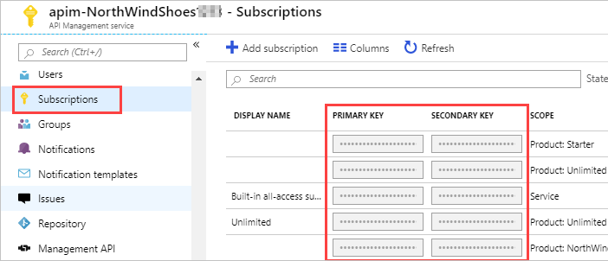
Secure APIs by using subscriptions (2 / 3)
Applications that call protected APIs
Must include the key in every request
You can regenerate these subscription keys at any time.
Every subscription has two keys, a primary and a secondary.

Slide 17
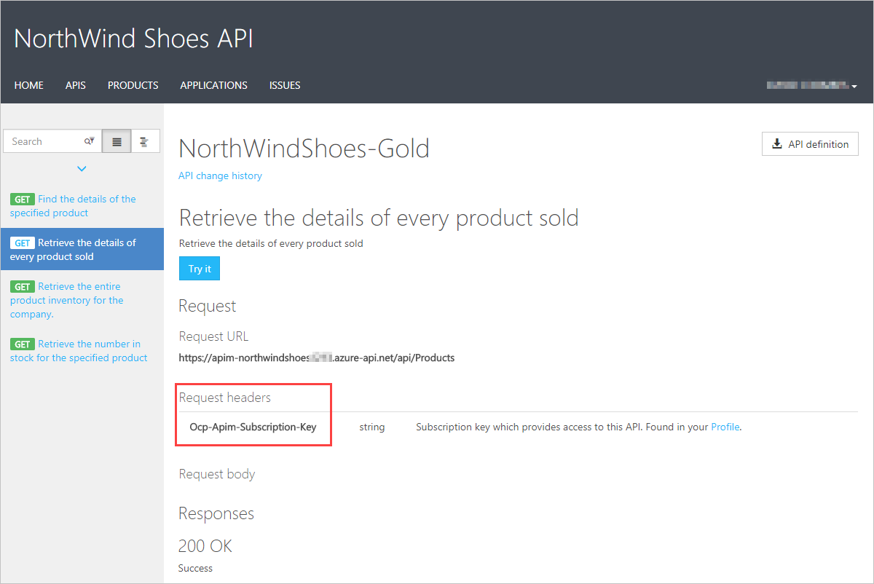
Secure APIs by using subscriptions (3 / 3)
Call an API with the subscription key
Keys can be passed in the request header, or as a query string in the URL.
The default header name is Ocp-Apim-Subscription-Key.
Use the developer portal to test out API calls
Notes:
Here's how you can pass a key in the request header using curl:
curl --header "Ocp-Apim-Subscription-Key: <key string>" https://<apim gateway>.azure-api.net/api/path
Here's an example curl command that passes a key in the URL as a query string:
curl https://<apim gateway>.azure-api.net/api/path?subscription-key=<key string>
If the key is not passed in the header, or as a query string in the URL, you'll get a 401 Access Denied response from the API gateway.

Slide 18
Secure APIs by using certificates (1 / 4)
Transport Layer Security client authentication
Property | Description
Certificate Authority (CA) | Only allow certificates signed by a particular CA
Thumbprint | Allow certificates containing a specified thumbprint
Subject | Only allow certificates with a specified subject
Expiration Date | Only allow certificates that have not expired
Two methods to verify a certificate:
Check who issued the certificate.
If the certificate is issued by the partner, verify that it came from them.
Notes:
Certificates can be used to provide Transport Layer Security (TLS) mutual authentication between the client and the API gateway.
You can configure the API Management gateway to allow only requests with certificates containing a specific thumbprint.
The authorization at the gateway level is handled through inbound policies.

Slide 19
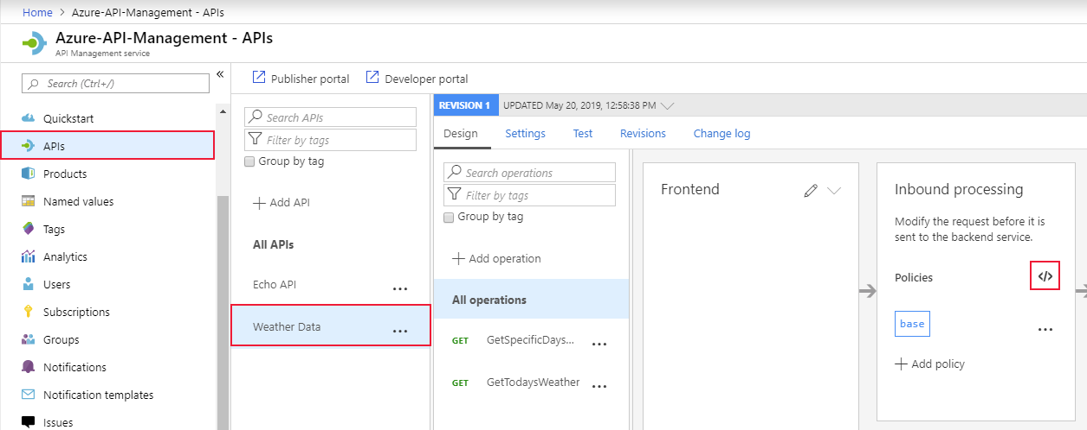
Secure APIs by using certificates (2 / 4)
Accepting client certificates in the Consumption tier
Certificate Authorization Policies
Check the thumbprint of a client certificate
Check the thumbprint against certificates uploaded to API Management
Check the issuer and subject of a client certificate
Notes:
Accepting client certificates in the Consumption tier
The Consumption tier in API Management is designed to conform with serverless design principals. If you build your APIs from serverless technologies, such as Azure Functions, this tier is a good fit. In the Consumption tier, you must explicitly enable the use of client certificates, which you can do on the Custom domains page. This step is not necessary in other tiers.
Certificate Authorization Policies
Create these policies in the inbound processing policy file within the API Management gateway (image shown on slide)
Check the thumbprint of a client certificate
Every client certificate includes a thumbprint, which is a hash, calculated from other certificate properties. The thumbprint ensures that the values in the certificate have not been altered since the certificate was issued by the certificate authority. You can check the thumbprint in your policy. The following example checks the thumbprint of the certificate passed in the request:
Check the thumbprint against certificates uploaded to API Management
Usually, each customer or partner company would pass a different certificate with a different thumbprint. To support this scenario, obtain the certificates from your partners and use the Client certificates page in the Azure portal to upload them to the API Management resource. Then add this code to your policy:
Check the issuer and subject of a client certificate
This example checks the issuer and subject of the certificate passed in the request:

Slide 20
Secure APIs by using certificates (3 / 4)
Examples
<!--Check the thumbprint of a client certificate-->
<choose>
<when condition="@(context.Request.Certificate == null || context.Request.Certificate.Thumbprint != "desired-thumbprint")" >
<return-response>
<set-status code="403" reason="Invalid client certificate" />
</return-response>
</when>
</choose>

Slide 21
Secure APIs by using certificates (4 / 4)
Examples
<!--Check the issuer and subject of a client certificate-->
<choose>
<when condition="@(context.Request.Certificate == null || context.Request.Certificate.Issuer != "trusted-issuer" || context.Request.Certificate.SubjectName.Name != "expected-subject-name")" >
<return-response>
<set-status code="403" reason="Invalid client certificate" />
</return-response>
</when>
</choose>

Slide 22
Create advanced policies (1 / 2)
API management policy
Control flow
Conditionally applied based on the evaluation result of the Boolean expression.
Forward request
Forward the request to the backend service.
Limit concurrency
Prevent policies from executing more than the specified number of requests at a time.
Log to Event Hub
Send the message in the specified format to the event center defined by the Logger entity.
Mock response
The pipeline execution is aborted and the simulated response is returned directly to the caller.
Retry
Retry the execution of the contained policy statement until the condition is met.
Notes:
Return response
The return-response policy aborts pipeline execution and returns either a default or custom response to the caller. Default response is 200 OK with no body. Custom response can be specified via a context variable or policy statements. When both are provided, the response contained within the context variable is modified by the policy statements before being returned to the caller.
Additional resources
Visit API Management policies for more policy examples.(https://docs.microsoft.com/en-us/azure/api-management/api-management-policies)
Error handling in API Management policies(https://docs.microsoft.com/en-us/azure/api-management/api-management-error-handling-policies)

Slide 23
Summary and knowledge check
In this lesson, you learned how to:
Describe the components, and their function, of the API Management service.
Explain how API gateways can help manage calls to your APIs.
Secure access to APIs by using subscriptions and certificates.
Create a backend API.
Notes:
Knowledge checks are in the student guide, if time allows this is a good opportunity to answer as a group and discuss.

Slide 24
Group discussion questions
The security team of Contoso Inc noticed a particular IP Address is firing thousands of the requests against your API. What would do?
You've setup API Management and a 3rd party partner is receiving 401 when calling your API. What can be the issue?
Contoso Inc is hosting APIs on App Service for 3rd party integration. What can you do to increase the security?
Notes:
Q1:

Slide 25
Lab 08: Create a multi-tier solution by using Azure services
http://aka.ms/az204labs
Duration
Lab 04: Constructing a polyglot data solution
http://aka.ms/az204labs

Slide 26
Closing slide

