Slide 1
IoT Real Time Analytics Assessment
Renato gusani
x19411076@student.ncirl.ie

Slide 2

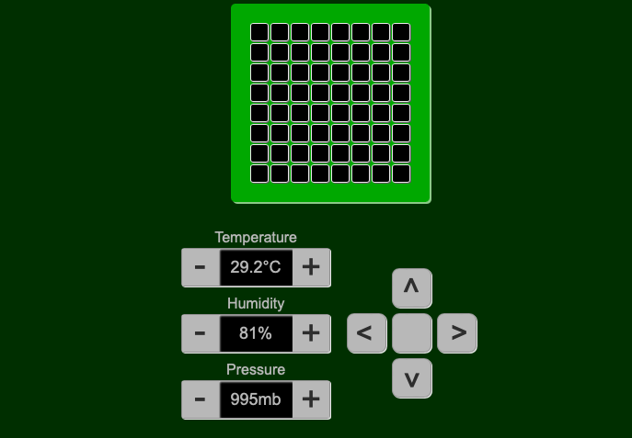
Visual of an IoT device
Notes:
Welcome to this demonstration of a cloud-based IoT system that uses Node-RED and AWS DynamoDB to access and analyze sensor data.
In just a few simple steps, I can build a system that publishes sensor data to the cloud and visualizes it in real-time using Node-RED.

Slide 3
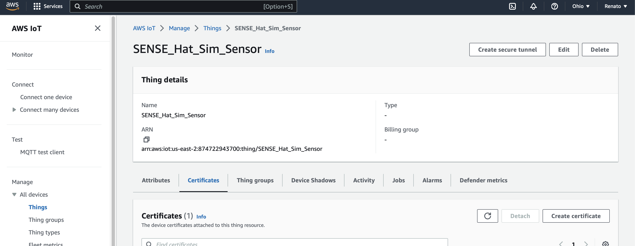
Visual of AWS IoT Core console
Notes:
The first step is to set up AWS IoT Core. I create a new Thing and download the Thing's certificate, public key, and private key.
I then create an IoT policy that grants the Thing permission to publish and subscribe to the desired topics and attach the policy to the Thing.

Slide 4
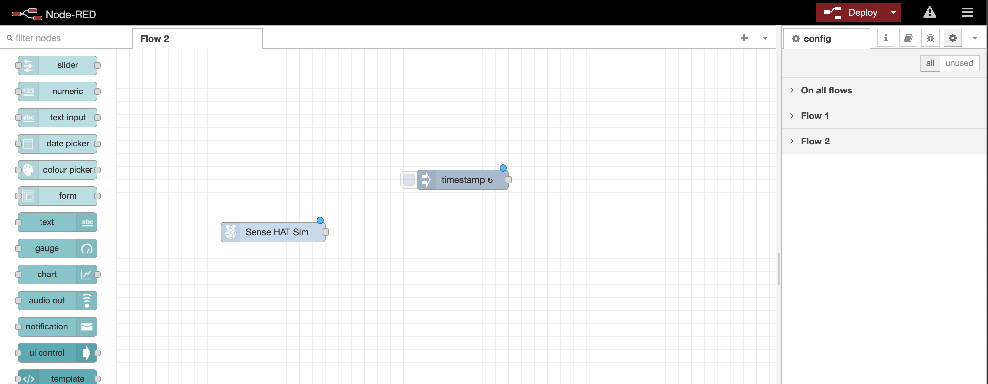
Visual of Node-RED editor
Notes:
Next, I install Node-RED on my computer and open the Node-RED editor.
I create a new flow and add an "inject" node that sends a message at my desired interval, which I set to every 5 seconds.
I then add a "Sense HAT" node that reads sensor data from the Sense HAT simulator.

Slide 5
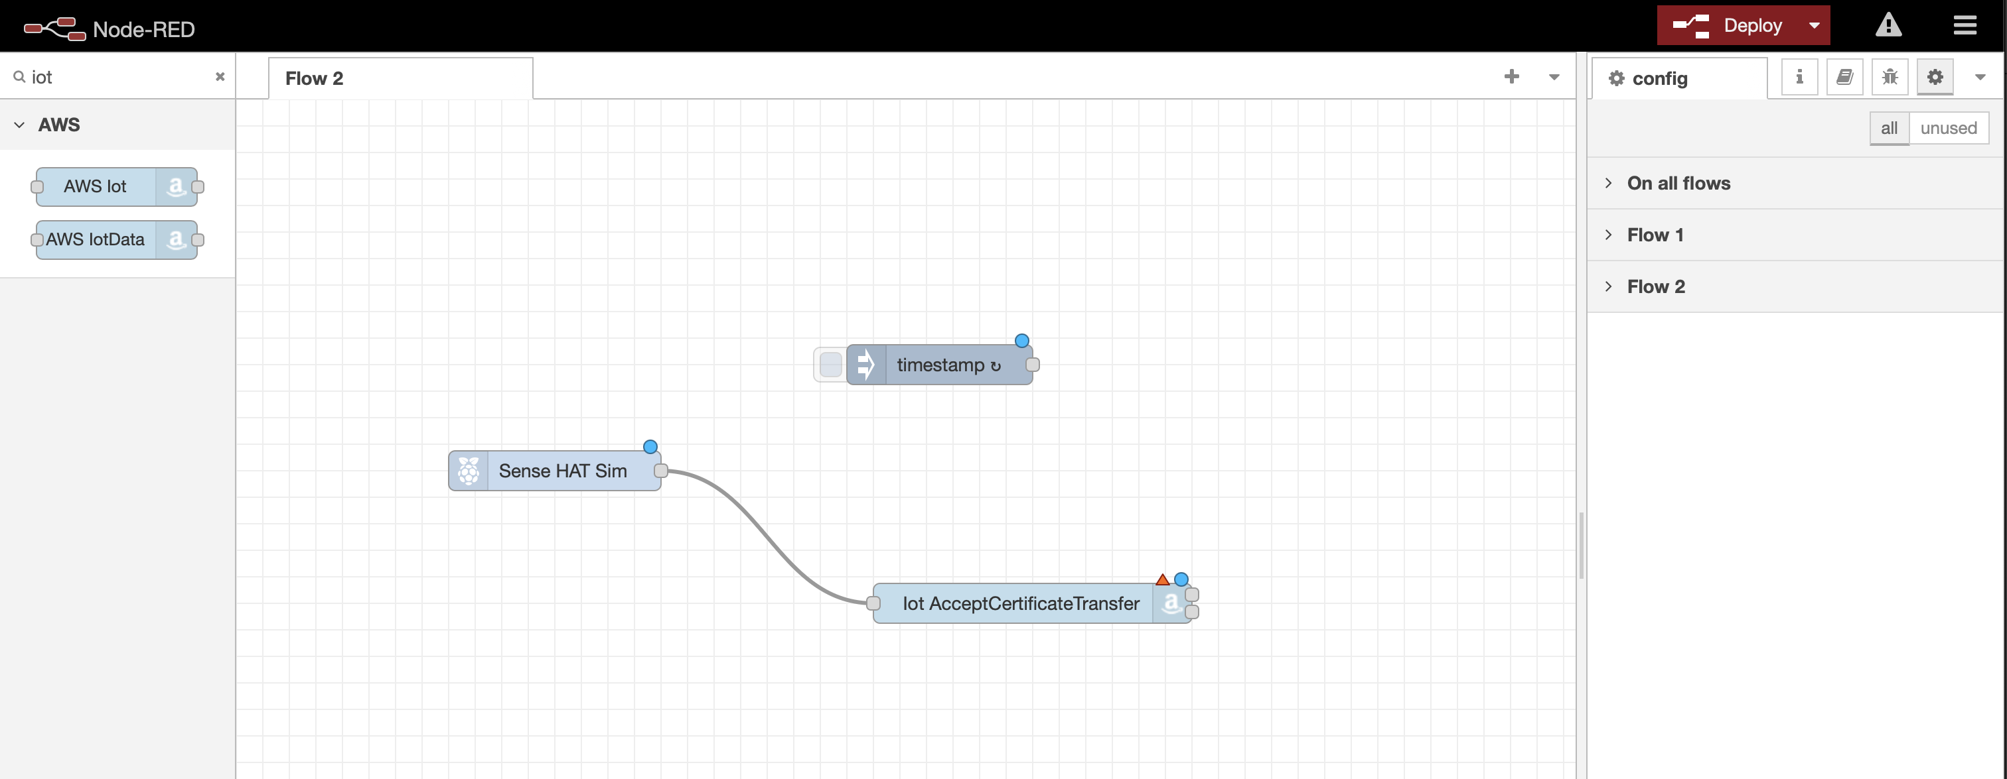
Visual of AWS IoT node
Notes:
Next, I connect the output of the "Sense HAT" node to the input of an "aws-iot" node that I configured with the Thing's certificate, public key, and private key.
I also select the desired topic to publish to.

Slide 6
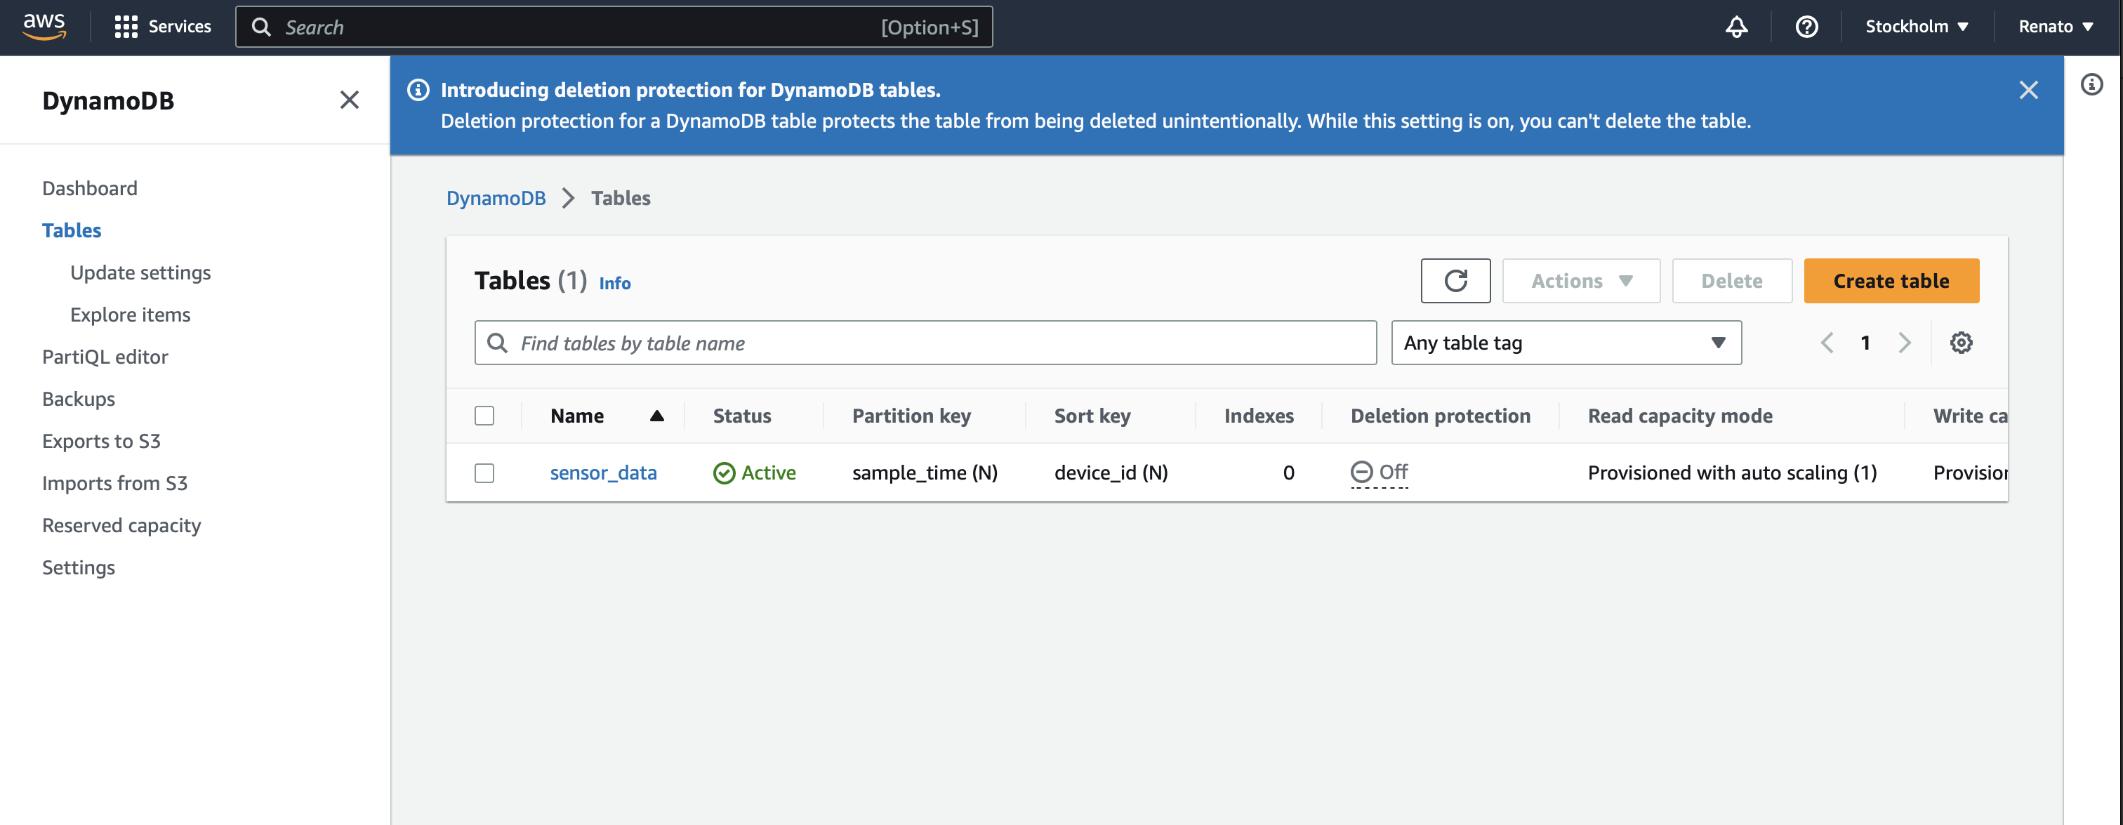
Visual of AWS DynamoDB Console
Notes:
I then set up AWS DynamoDB by creating a new table with a unique name and primary key.
I configure any desired settings, such as read and write capacity units.

Slide 7
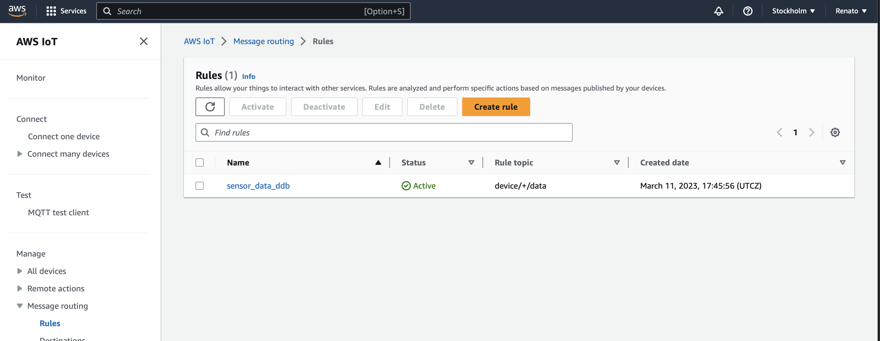
Visual of AWS IoT Core console
Notes:
Back in the AWS IoT Core console, I create a new rule that matches the desired topic that the Node-RED flow is publishing to.
I choose an action to take when a message matches the rule, which is to send the message to the DynamoDB table. I configure the mapping between the message payload and the DynamoDB item attributes.

Slide 8
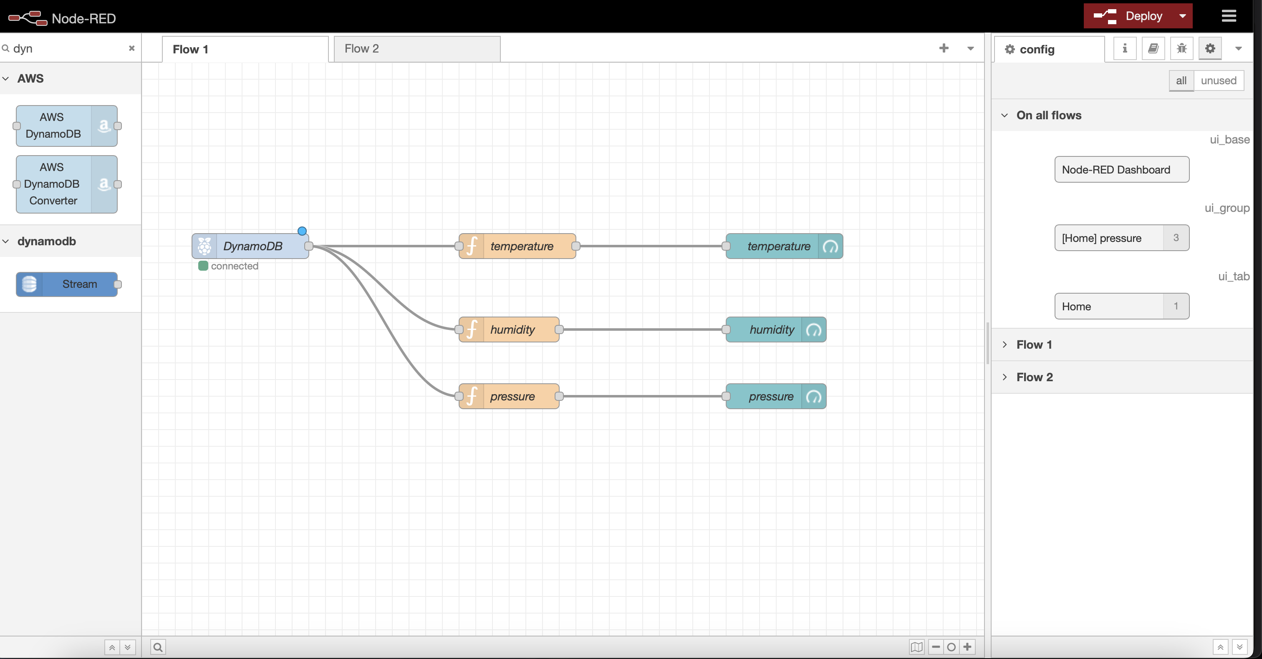
Visual of Node-RED editor
Notes:
I then create a new Node-RED flow that retrieves the sensor data from the DynamoDB table and visualizes it in a graph. I add a "dynamodb" node that reads from the table I created and connect it to a function node that extracts the sensor data from the DynamoDB item and formats it as an array.

Slide 9
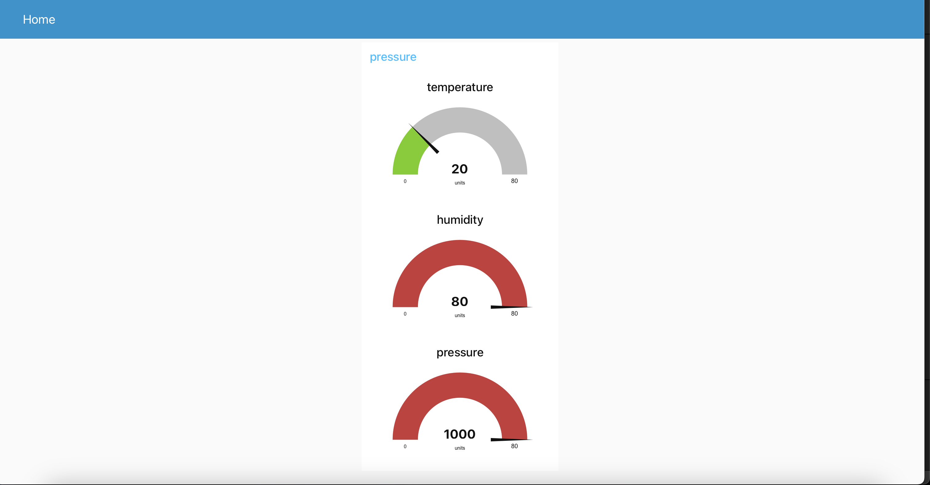
Visual of Node-RED dashboard
Notes:
Finally, I connect the output of the function node to multiple "ui_chart" nodes, one for each kind of data, which displays the sensor data as a line chart.
I also add a "ui_template" node that displays the latest values received from all the sensors and another "ui_template" node that displays aggregated values for each sensor during the last hour.
I configure the charts and templates with the desired settings and deploy the Node-RED flow.

Slide 10
Visual of IoT device
Notes:
And there you have it! A cloud-based IoT system that accesses and analyzes sensor data from the Sense HAT simulator using Node-RED and AWS DynamoDB.
This system can be used in a variety of applications, from monitoring temperature and humidity in a greenhouse to tracking air quality in a smart city.
Thank you for watching!

