Slide 1
The Socio-Economic Benefits of Augmented Observations
for Hurricane Forecasting
Diego Cardoso, Brian McNoldy,
Renato Molina* and Ivan Rudik
Grant: NA23OAR4590366-T1-01

Slide 2
Methods

Slide 3
Three-Stage Approach
Stage 1: Estimate the marginal cost of forecast errors
Stage 2: Quantify the contribution of AO to forecast precision
Stage 3: Project the economic value as counterfactual with/without AO

Slide 4
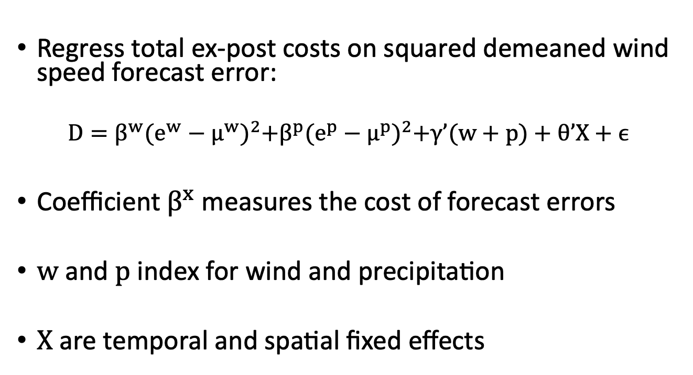
Stage 1: Marginal Cost of Forecast Errors
Regress total ex-post costs on squared demeaned wind speed forecast error:
$$D=β^{w}{(e^{w}−μ^{w})}^{2}+β^{p}{(e^{p}−μ^{p})}^{2}+γ’(w+p)+θ’X+ϵ$$
Coefficient $β^{x}$ measures the cost of forecast errors
$w$ and $p$ index for wind and precipitation
$X$ are temporal and spatial fixed effects

Slide 5
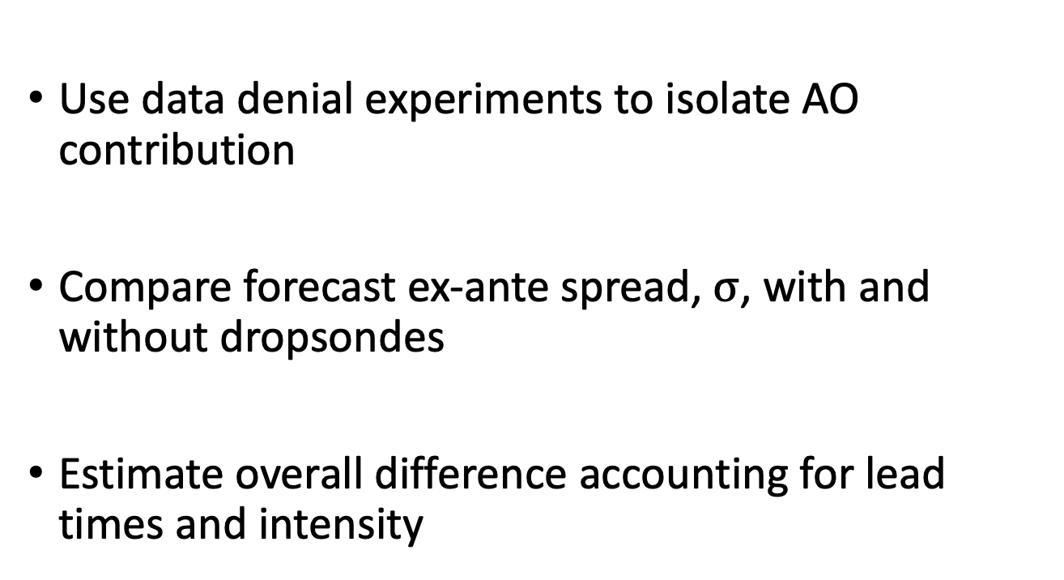
Stage 2: AO and Forecast Precision
Use data denial experiments to isolate AO contribution
Compare forecast ex-ante spread, $σ$, with and without dropsondes
Estimate overall difference accounting for lead times and intensity

Slide 6
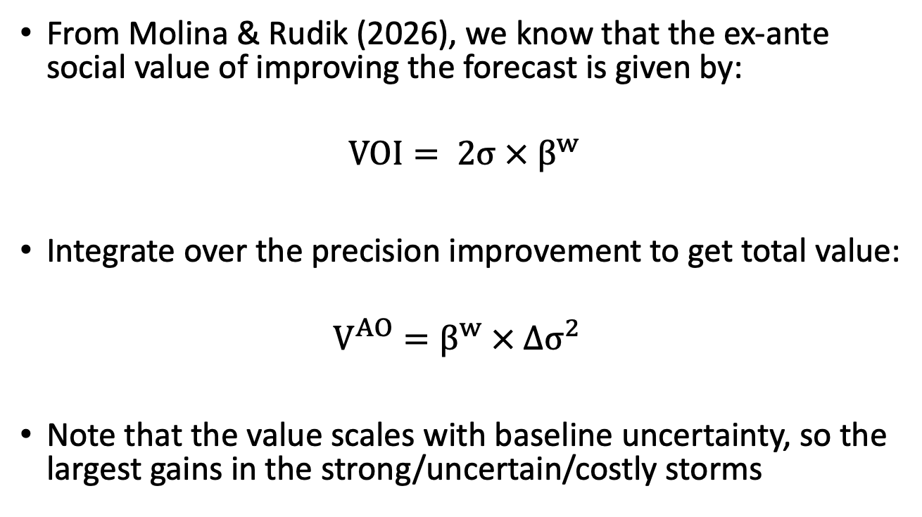
Stage 3: Projecting Economic Gains
From Molina & Rudik (2026), we know that the ex-ante social value of improving the forecast is given by:
$$VOI= 2σ ×{ β}^{w}$$
Integrate over the precision improvement to get total value:
$$V^{AO}=β^{w} × Δσ^{2}$$
Note that the value scales with baseline uncertainty, so the largest gains in the strong/uncertain/costly storms

Slide 7
Data

Slide 8
Economic Panel
31 landfalling U.S. hurricanes, 2005–2022
NHC track/intensity forecasts paired with best track verification
County-level damages from SHELDUS and FEMA Public Assistance
Total damages: $300 billion

Slide 9
Data Denial
8 U.S. landfalling hurricanes, 2017–2020
HWRF model run with "ALL" observations vs "NO" dropsonde observations
Provides ex-ante uncertainty by county, storm, and lead time

Slide 10
Results

Slide 11
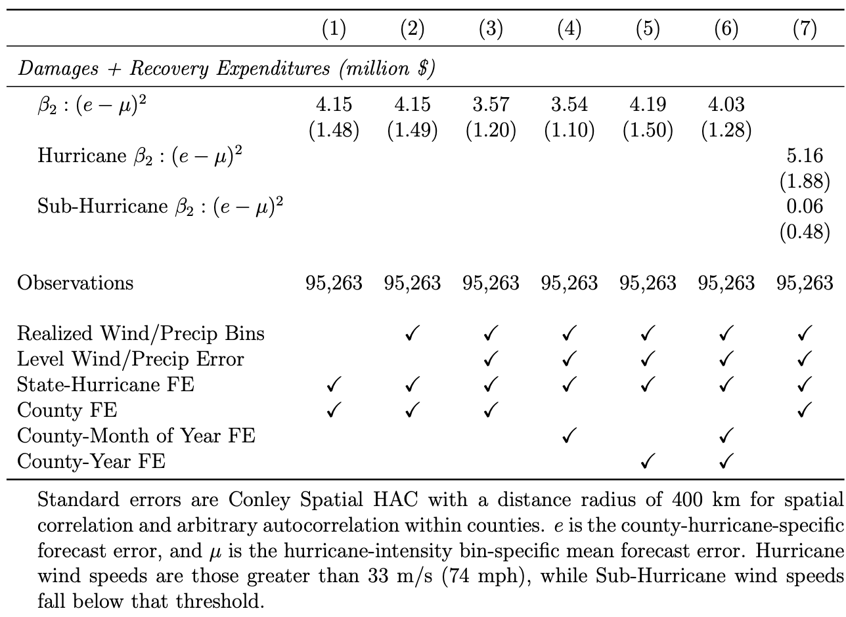
Ex-post analysis

Slide 12
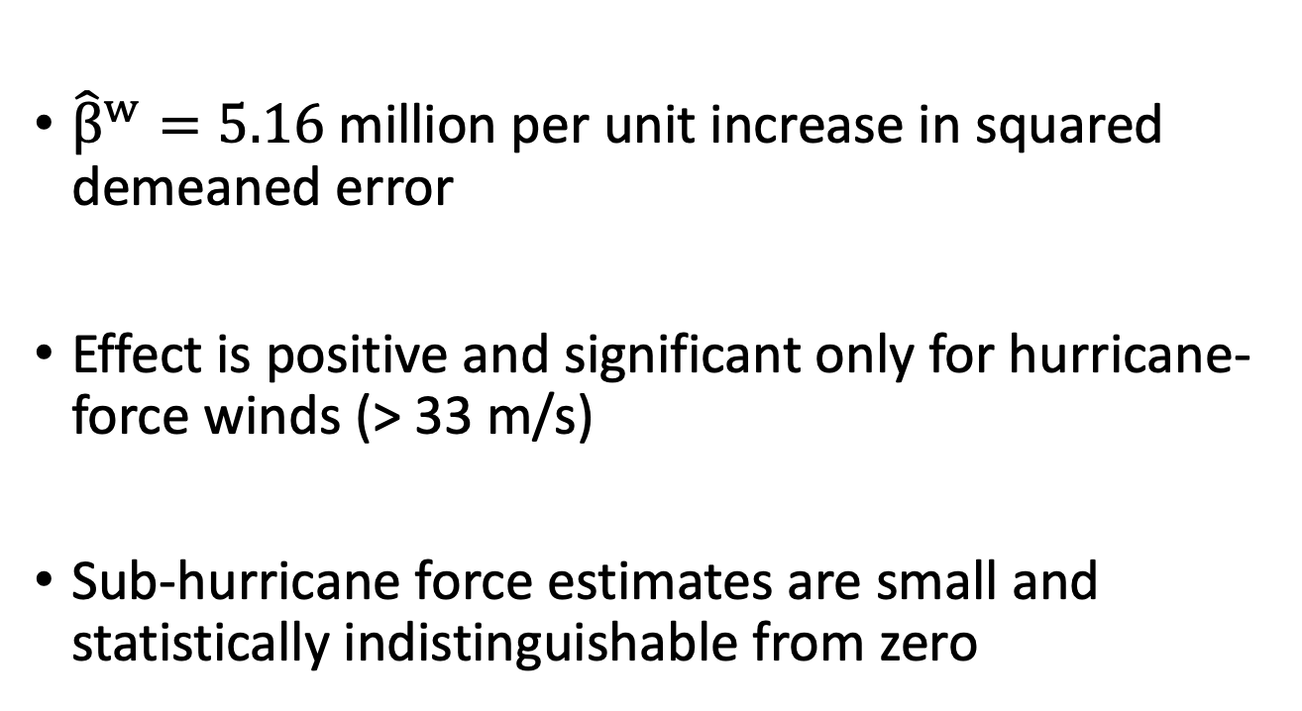
Marginal Cost of Forecast Errors
${\hat{β}}^{w}=5.16$million per unit increase in squared demeaned error
Effect is positive and significant only for hurricane-force winds (> 33 m/s)
Sub-hurricane force estimates are small and statistically indistinguishable from zero

Slide 13
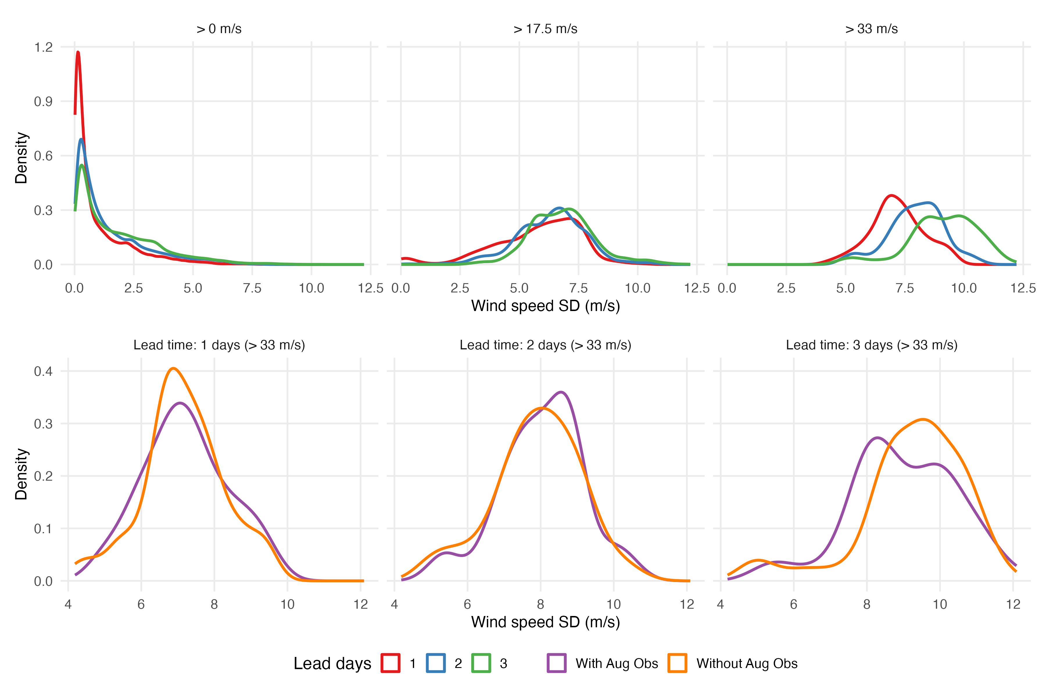
AO and ex-ante uncertainty
Top row: forecast uncertainty by lead time. Bottom row: with vs. without AO (hurricane-force, > 33 m/s).

Slide 14
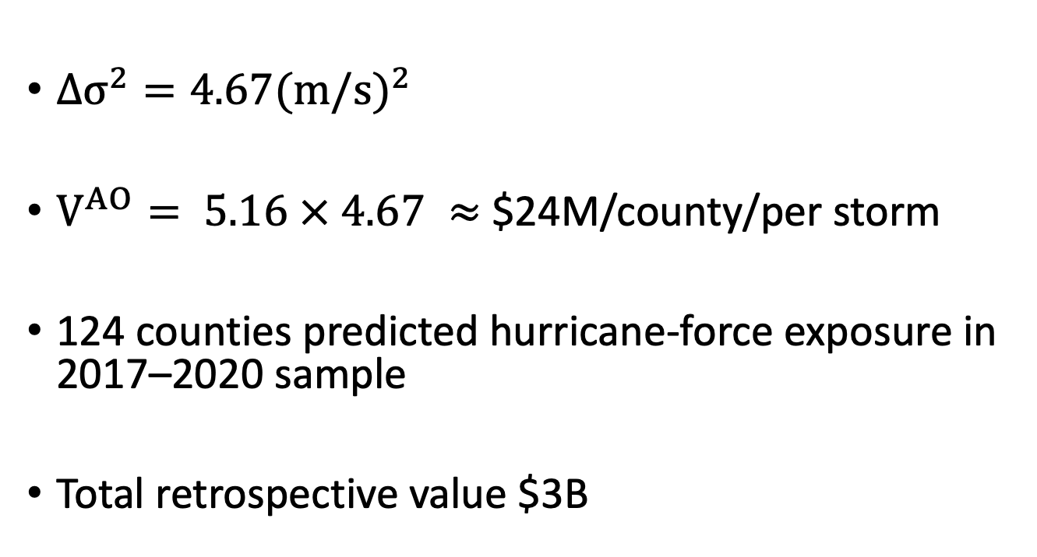
Economic Value of AO
$Δσ^{2}=4.67{(m/s)}^{2}$
$V^{AO}= 5.16 × 4.67 ≈$$24M/county/per storm
124 counties predicted hurricane-force exposure in 2017–2020 sample
Total retrospective value $3B

Slide 15
Cost-Benefit Analysis
Intensive deployment: 10 missions per storm with cost ranging $0.5–0.6M
Benefit per hurricane-force county: $24M
Benefit-to-cost ratio: > 50:1
Social value from a few seasons likely exceeds full cost of fleet recapitalization

Slide 16
Policy Recs
Institutionalize routine data-denial studies for all U.S. landfalling hurricanes
Standardize performance metrics to report ex-ante forecast variance reduction alongside traditional ex-post error tracks
Unify economic benefit analysis using the structural loss-function methodology
Create a biennial "Socio-Economic Impact Report" for the reconnaissance program to inform Congress, FEMA, and the meteorological community

Slide 17
Conclusion
AO systematically improve the forecast quality
These improvements have valuable implications in terms of avoided hurricane costs
Benefit-to-cost ratio far exceeds the operational cost of the airborne mission

