Slide 1
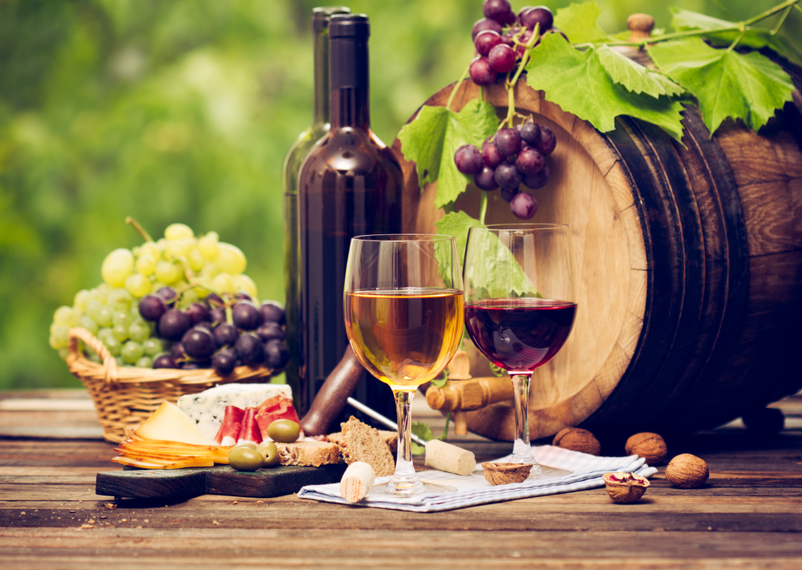
Wine: History and Analysis
By Team Pygeons:
Angel Alejandro, Kevin Beygi,
Matthew Hawk, Renato Mello

Slide 2

Wine: History and Analysis
By Team Pygeons:
Angel Alejandro, Kevin Beygi,
Matthew Hawk, Renato Mello

Slide 3
Motivation & Summary
Hypotheses:
1) Wine has become more and more popular with time.
2) Wine ratings play a significant role in their price
3)
Summary:
History of wine production and consumption
Wine in the US
Wine varieties
Map visualization

Slide 4
Our Data
Global Wine History Data
Source: Anderson, K. and V. Pinilla (with the assistance of A.J. Holmes), Annual Database of Global Wine Markets, 1835 to 2016, freely available in Excel at the University of Adelaide’s Wine Economics Research Centre, November 2017 www.adelaide.edu.au/wine-econ/databases/global-wine-history
Collection of Wine Reviews
Over 130,000 wine reviews done by Wine Enthusiast Magazine, https://www.kaggle.com/zynicide/wine-reviews

Slide 5
Questions
What is the global wine consumption/production in 2016?
How does the historical US wine consumption/import/production interrelated?
What is the correlation between wine ratings and price
How do average ratings compare among tasters?
Do tasters show a preference to review wines from certain varieties or countries?
Which wines are produced by Country/Region?
What is the correlation between regional wine production and price?

Slide 6
Data Wrangling
Global Wine Database
Extracted required data (10 worksheets)
Renaming of columns and skipping of header rows
Reviews data manipulation
Removed wines with missing country, price or rating
Lumping the wine varieties
From 700 to 9 main categories and 76 Sub-categories (using dictionary)

Slide 7
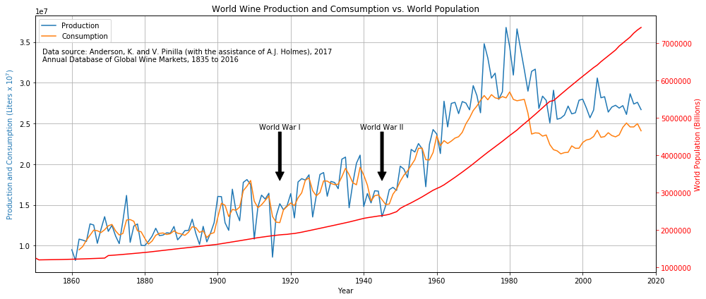
Global Wine Production and Consumption
Notes:
We assumed the wine consumption had increased consistently from World War II
We were surprised and decided to also plot the world population to compare. Used the TWINX call to allow for data with different Y scales to be plotted together.
Some research has been done over the fall in consumption, lead by the top consumers in Europe (Italy, France), mostly blamed on the mixing of cultures, leading to lower acceptable levels of drinking. Apparently beer has replaced a lot of the wine market share of alcoholic beverages as well.

Slide 8
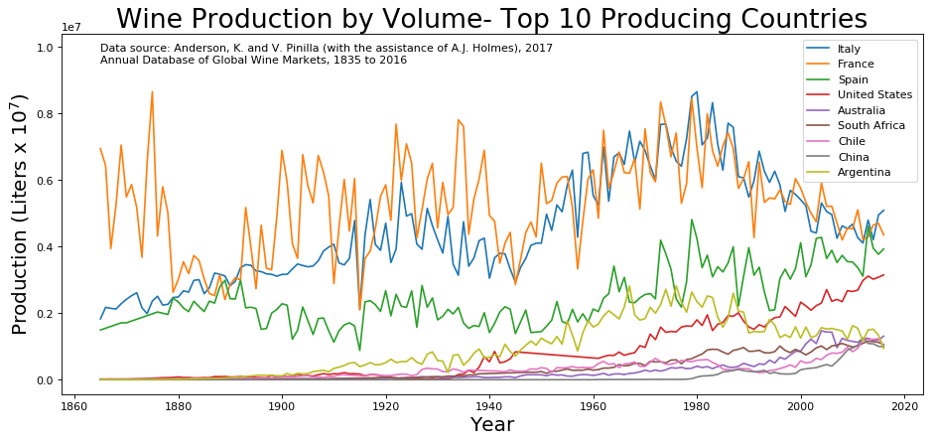
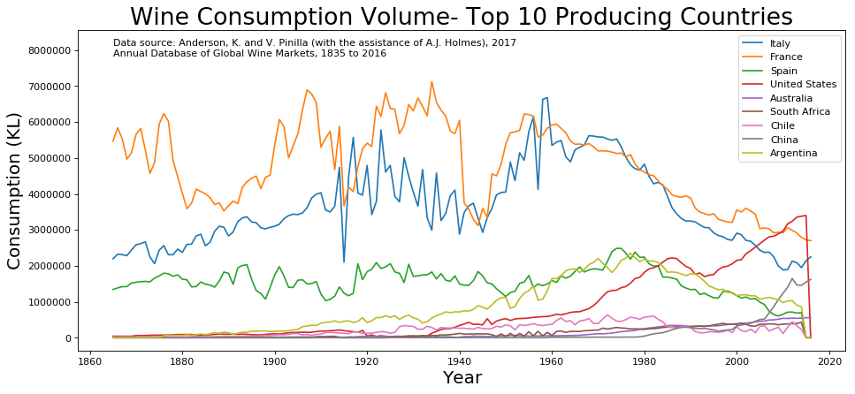
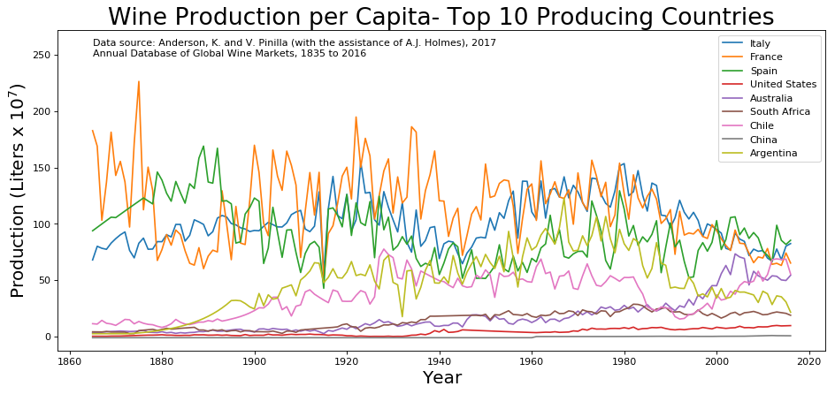
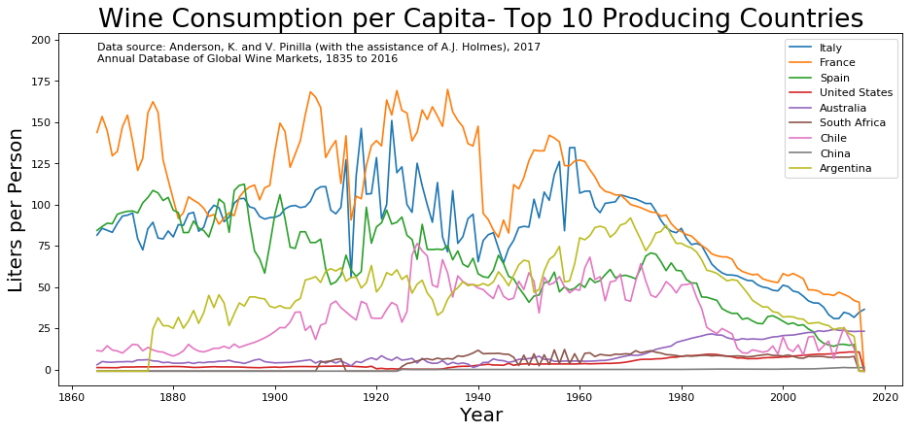
Comparative Analysis of 10 Countries
Global Wine Production
Global Wine Consumption
Total
Per Capita

Slide 9
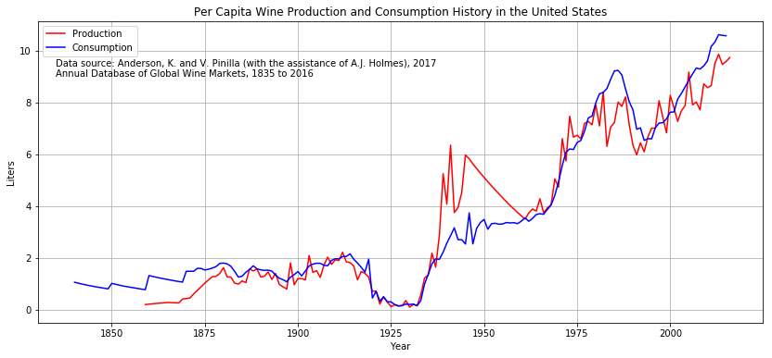
History of Wine Production and Consumption in the United States (1835-2016)
Notes:
We notice 2 periods of sharp drop in consumption and production (~1920-1933 and ~1985-1995). Does anybody know or guess why? (answers in the next slide)

Slide 10
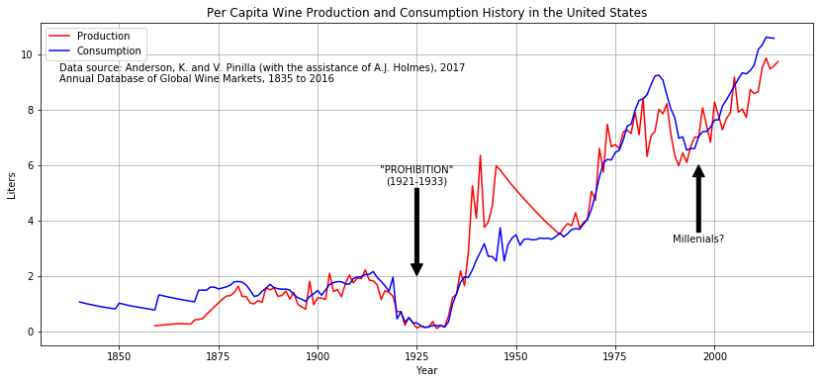
History of Wine Production and Consumption in the United States (1835-2016)
Notes:
The prohibition (1921-1933) can certainly be admitted as the cause of the first trough.
The second one was the subject of several studies, all pointing to multiple factors such as health conscious consumers as well as the aging of older drinkers, but the turn at about 1995 is mostly credited to millennials, who are currently (2017 numbers), 42% of the wine consumers.

Slide 11
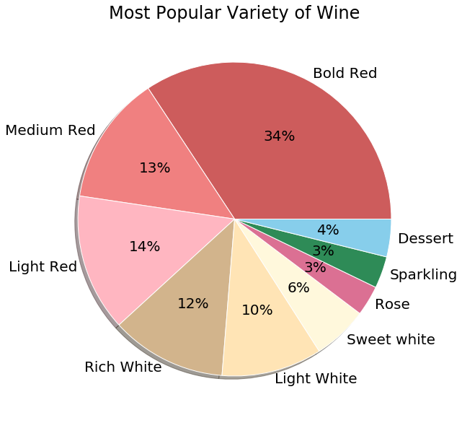
What is the Popular Variety of Wine?

Slide 12
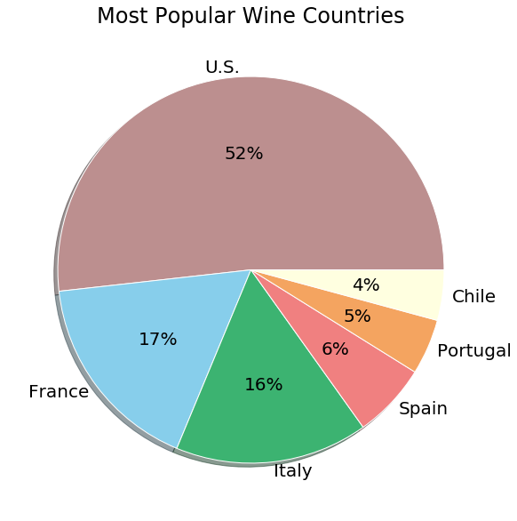
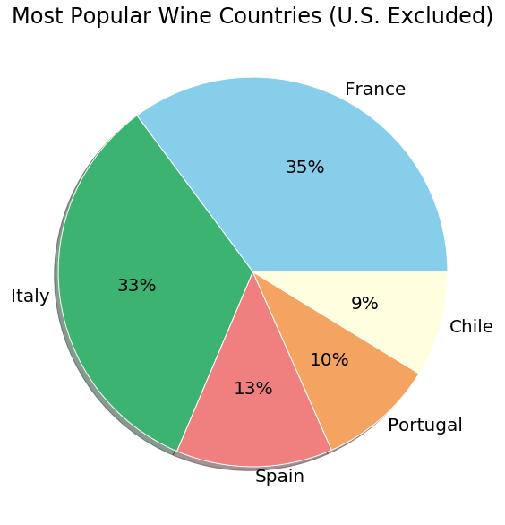
What is the Most Popular Country?

Slide 13
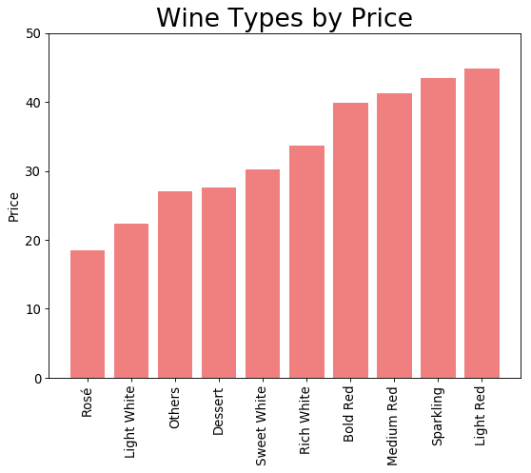

Slide 14
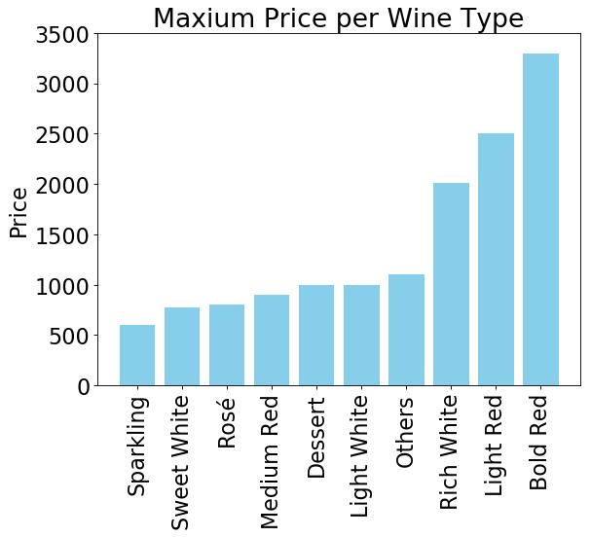
Bold Red:

Slide 15
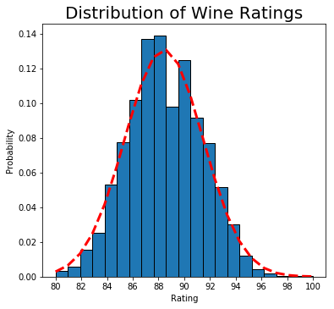
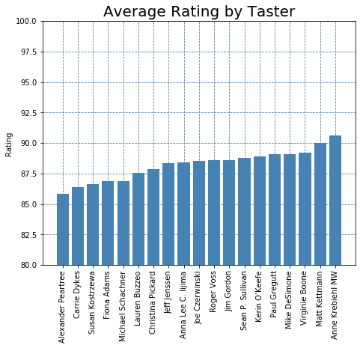
How do average ratings compare among tasters?
Mean = 88.4
Std Dev = 3.04
Notes:
Ratings are distributed normally
We do not see significant difference between testers average reviews

Slide 16
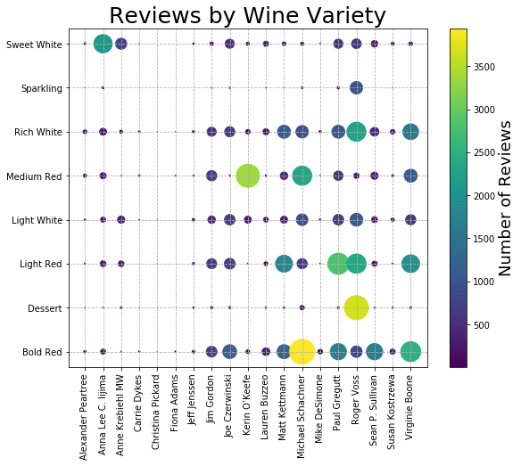
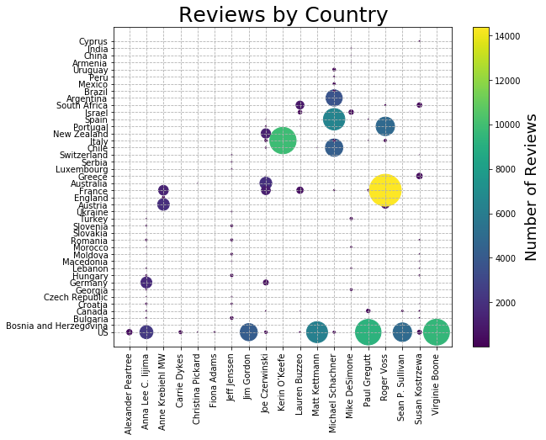
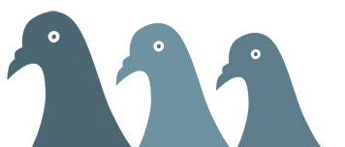
Do tasters show a preference to review wines from certain varieties or countries?
Notes:
Reviewers tends to review several varieties of wine, they don not seem to specialize in a few
Reviewers do show country specialization, for each reviewer the vast majority of the reviews are for 3 countries or less

Slide 17
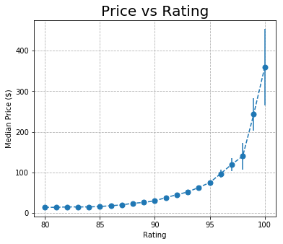
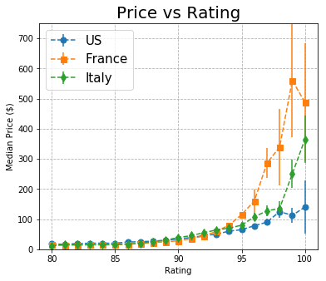
Relation Between Price and Rating

