Slide 1
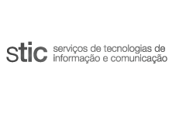

UA CRIS – Current Research Information System
PEI Milestone 1 – Group 4
Mentor: José Vieira

Slide 2

Context
All the information regarding the research work done in a university and its Investigation Units (IU) presents a invaluable value not only to the university itself but also to the funding agencies.
Current Research Information System (CRIS) - aggregates all information of a certain entity.
2

Slide 3
Problem
University of Aveiro (UA) already has a publication repository RIA (Repositório Institucional da Universidade de Aveiro).
However, such approach has limitations. RIA does not contain the remaining research information.
Therefore there is a need for a solution that synchronizes all research work information of UA in one single place – UA CRIS.
3

Slide 4
Goals
To concentrate all research work information developed at UA in one digital system.
This system should be flexible so that all IUs can incorporate the information in their own information system.
It should provide a simple way for researchers and IUs to register and maintain the research information in an easy way.
4

Slide 5
Tasks
Since developing a full CRIS is a very complex task, we will concentrate our work on the publications.
The main goal of the project is to ensure that all the publications from UA researchers is on RIA.
Design a platform that synchronizes RIA with other platforms such as ORCID to simplify the insertion of new publications on RIA.
5

Slide 6

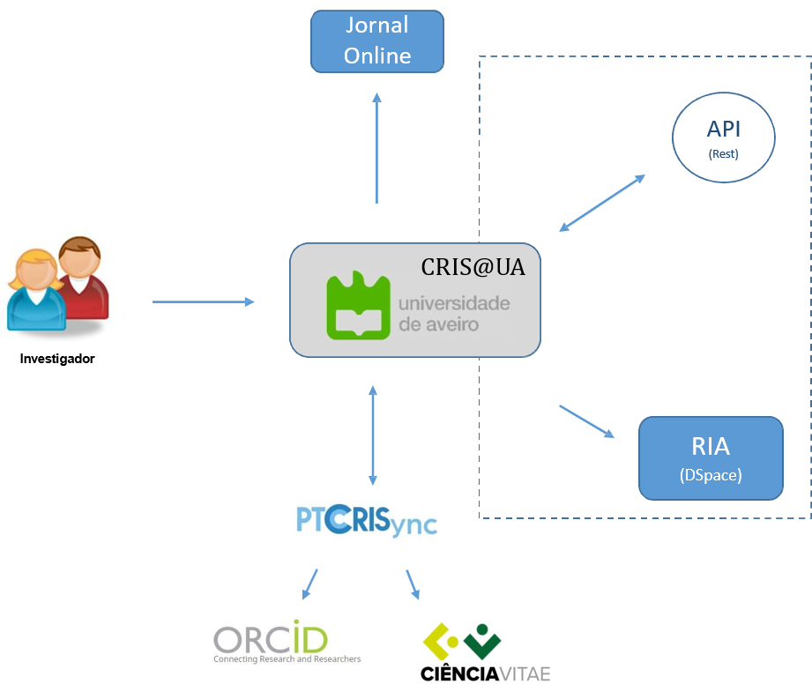
Expected Results
6

Slide 7
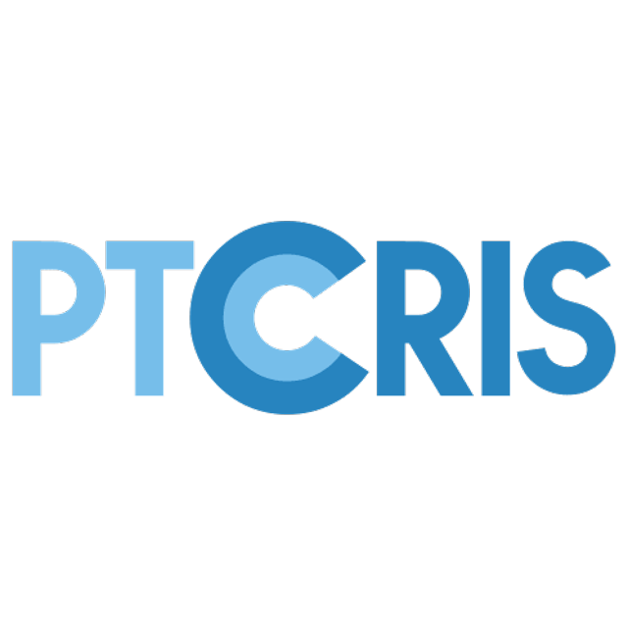


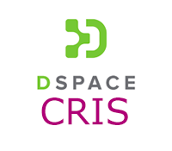
Related Work
This is not a new concept, there are many other platforms that have the same purpose, such as:
PTCRIS
EuroCRIS
DSpace - CRIS
Pure
7

Slide 8
Project Calendar
The project calendar, tasks, project schedule, milestones and deliverables can be consulted in:
https://renatovalente5.github.io/UA_CRIS/
8

