Slide 1
Energy/Performance Design
Memory Hierarchies in Intelligent Memories:
Wei Huang, Jose Renau, Seung-Moon Yoo and Josep Torrellas
University of Illinois at Urbana-Champaign
Notes:
25s
Good morning. My name is Jose Renau. I am a graduate student at the University of Illinois at...
In the last two years I have been working together with bla bla bla designing efficient memory hierarchies in Intelligent Memories.
We have mainly focused on Energy and Performance Design issues

Slide 2
Motivation
Advances in technology:
  Processor and Memory integration
  Many processors on a chip
How to design for high performance
Energy consumption is a big concern
Problems in cooling system
Notes:
50s
Continuous advances in technology have made possible the integration of memory and traditional logic in a single chip. Even better, the increasing number of transistors makes possible to integrate several of those embeded systems in a single chip.
All those modifications change the latency and the energy parameters. We need to evaluate the implications.
Also so many processors in a single chip could create a huge power consumption. We want to substitute some plain DRAM with this more advanced Inteligent Memory. Another problem is that current memory subsystem has been designed for lowpower, which forces to use a simple cooling system. As a result , our solution has to be more energy efficient.

Slide 3
Goals of this work
Evaluate trade-offs in memory hierarchy
  Energy consumption
  Performance
  Area requirements
Detailed energy consumption analysis
Notes:
30s
Different memory hierarchies implementations have been evaluated analyzing the energy consumption, the performance, and the area.
We implemented a simulator that calculates energy and performance. The energy consumption for each of the subblocks in the memory hierarchy has been calculated using spice models. This simulator includes a high detail in the memory subsystem, modeling all the details in the architecture.

Slide 4
Findings of the Work
Modest cache size is necessary
Easy modifications in memory reduce energy consumption
Notes:
15s
In this work we found that a modest cache size is necessary. A cache around 8Kbytes is enough.
Also small modifications in the traditional memory subsystem helps to increase the energy efficiency.

Slide 5
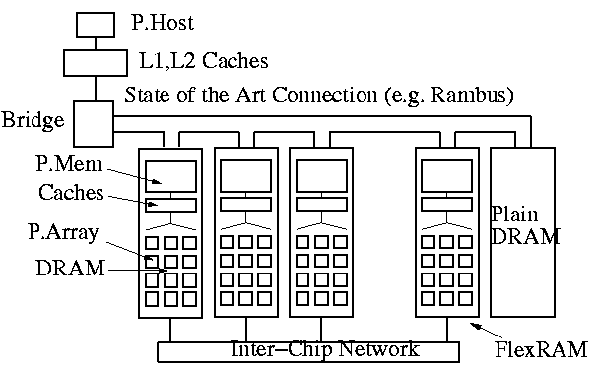
The FlexRAM Architecture
Yi Kang, Wei Huang, Seung-Moon Yoo, Diana Keen, Zhenzhou Ge, Vinh Lam, Pratap Pattanaik and Josep Torrellas - ICCD99
Notes:
40s
Our Intelligent Memory is the FlexRAM Architecture. This architecture proposes to substitute plain DRAM RAMBUS Chips with another chip that includes 64MBytes of DRAM and 64 processors. The remaining of the systems is not changed.
The FlexRAM architecture, introduced in ICCD98, calls P.Host to the the existing processor, and P.Mem to a special processor included in each chip.
To simplify the analysis we supress the delay and energy required by the P.Host, and the P.Mem. The resulting system behaves like a plain 64 processor with 64MBytes of DRAM integrated in a single chip.

Slide 6
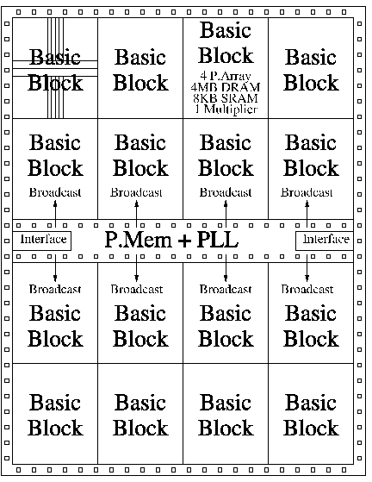
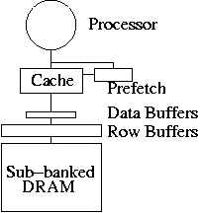
Chip Architecture
64 nodes, each one includes:
  2-issue processor @800Mhz
  1MByte DRAM (12 clk)
  Row Buffers (6 clk)
  Cache (1 clk)
Notes:
40s
The based chip architecture includes 64 processors. Each one is a 2-issue processor and clyces at 800MHz.
1MByte of DRAM is attached to each processor. For a 800Mhz processor the round trip for accesing a memory subbank is 12 cycles.
Depeding of the memory organization, that I’ll explain later, different number of rowbuffers are possible. In all the cases the round trip is 6 cycles.
Since the DRAM subbank and the Rowbuffer have high latencies, it is necessary to include a fast, 1 cycle, cache.

Slide 7
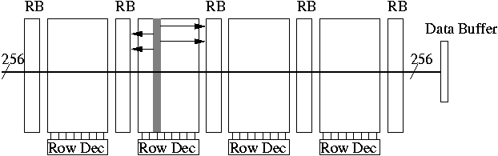
How a Memory Bank Works
4 Memory sub-banks, each 256KBytes
5 Row Buffers, each 1KByte
1 Data Buffer 256bits
Notes:
50s
This is a typical organization for a 1MByte memory bank.
The bank is divided in four subbanks, each one has 256KBytes. There are also five row buffers each one has 1KByte. All the row decoders share the same address lines.
A read to a memory bank proceeds as follows:
First, the appropiate row decoder activates the row in the subbank when detects that the address is local. The odd bits are transmited to one of the attached rowbuffers, and the even bits are transmited to other one. Once the data is in the rowbuffer it is transmited to the data buffer. Finally the data is transfer from the databuffer to the processor.
Note The data buffer has 256bits to match the cache line size.
The total time for accesing a memory bank is 11 cycles.

Slide 8
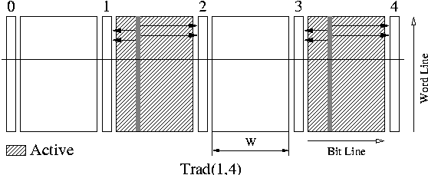
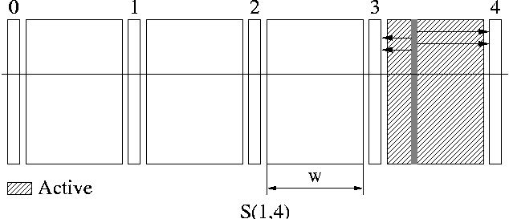
Small Area Memory Banks
+More Energy
+Less Spatial Locality
+More Localities
Notes:
90s
This picture shows a traditional 1 Mbyte DRAM memory bank with 4 subbanks. When the system does a read, two subbanks are activated simultaneously. In this example the rowbuffers 1,2,3, and 4 are loaded with valid data. Once that the data is in the rowbuffer it is transfered to the next level in the memory hierarchy. Note that it is not necessary to activate two memory banks simultaneously. The reson for activating the second bank is to accelerate in case that the processor is doing a sequential access.
A small modification over traditional memory banks that saves energy and increases the number of localities is shown in the new picture.This is what we call a segmented memory bank. In the same way that happens in the traditional configuration, for 1MByte of DRAM there are 4sub-banks. The only difference is when we do a read, we activate 1 subbank instead of 2. Only the subbank where the data resides is activated. This saves energy because it is necessary to do one transfer instead of two. As a side effect we increase the number of localities. To sumarize, a traditional memory bank has more spatial locality, but it requires near the double amount of energy. A segmented memory bank has more localities and saves energy.

Slide 9
Pipelining the requests
Faster memory system without increased energy consumption
Notes:
45s
Another easy modification could be done over S(1,4). Since transfering data from the memory bank to the row buffers requires 5 cycles, sometimes there is contention for reading the memory bank.
By implementing pipelining in S(1,4) we make possible to pipeline two reads when there is no conflict. For example, while the last subbank is doing a transfer to the rowbuffers, we can initiate another read in the first or the second subbank. We can not initiate another read to the third subbank because it shares the rowbuffer number 3 with the last subbank which is already doing a read.
With pipelining, we reduce the contention in the memory system without increasing the energy consumption.

Slide 10
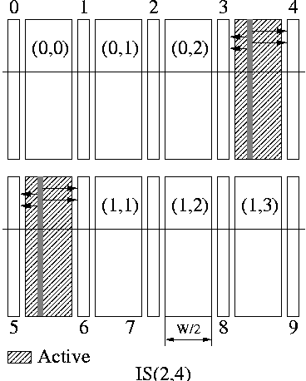
Advanced Memory Banks I
-Less Energy and Contention
+More Area
Notes:
50s
Interleaving is another way to improve more the performance. The picture shows 8 subbanks instead of the traditional 4 subbanks. In the configuration shown each of the subbanks has 128KBytes instead of the typical 256KB.
This modification has two effects:
First, a read operation requires less energy. Each subbank has half of the size. This makes a read operation more energy efficient.
Second, Two reads could be done simultaneously. For example, while a read is being done in the subbank (0,3), another read could be done simultaneously in the bank (1,0).
All those improvements have a cost. More area is required to implement the new rowbuffers and rowdecoders.
To summarize, interleaving reduces the energy and increases performances, but it requires more area for being implemented.

Slide 11
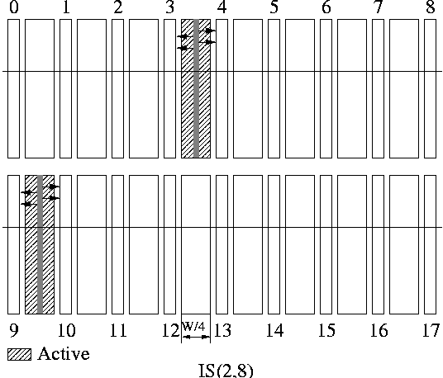
Advanced Memory Banks II
-Less Energy and Contention
+More area
Notes:
20s
Applying the same filosophy, we can increase the number of subanks by further slicing them. With Interleaving 2,8 each subbank has only 64KBytes. This reduces even more the energy required for a read.
This configuration increases the the total size of the rowbuffers. This increase improves the number of localities, but it requires another increase in area.

Slide 12
Terminology for Memory Systems
Trad(i,j): Traditional
S(i,j): Segmented
IS(i,j): Interleaved Segmented
ISP(i,j): Interleaved Segmented Pipelined
i : Degree of interleaving
j : Number of sub-banks per interleaving way
Notes:
30s
To understand the data shown in next slides it is necessary to introduce a little bit of terminology.
There are four possible configurations.
Trad stands for traditional
S stands for segmented
IS stands for Interleaved segmented
and finally ISP stands for interleaved segmented pipelined
In all the cases there are two numbers. The first indicates the degree of interleaving, and the second the number of sub-banks per interleaving way.

Slide 13
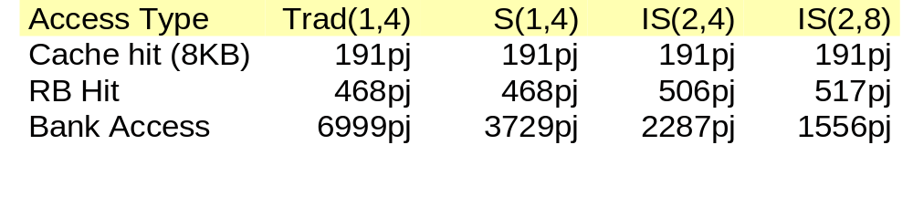
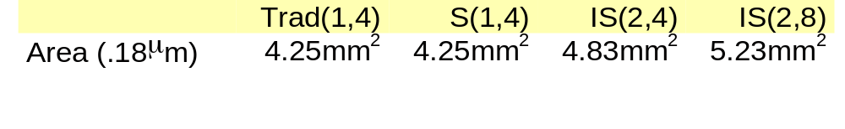
Energy and Area Issues
More advanced configurations:
  More Area
  Less Energy
Notes:
80s
The first table has the energy consumption for different configurations. In all the cases we suppose a 8KBytes cache. 191pj are required for a cache hit. The energy required for a rowbuffer hit is the same for traditional and S(1,4). 506pj energy is required in IS(2,4) instead of 468pj. A little bit more energy is required by IS(2,8), 517pj instead of 502pj.
The biggest difference in energy consumption comes from a bank access. While trad(1,4) requires nearly 7000pj, S(1,4) ony requires around 3700pj. Even less energy is required in IS(2,4) and IS(2,8) which consume around 2200pj and 1500pj respectively.
Note The energy numbers have been modeled after simulating the structures in spice.
Some of those reductions in energy consumption come at the expense of more area. Going from T(1,4) to IS(2,4) the area increases by a 14% approximatly.

Slide 14
Evaluation Environment
Fixed parameters:
  2-issue processor @800MHz
  Prefetch
  Cache, RB, Bank latencies (1,6,12 cycles)
Variable parameters:
  Cache sizes (256B,1KB,8KB,16KB)
  Memory Banks:
    Trad(1,4),S(1,4),SP(1,4)
    IS(2,4),ISP(2,4),IS(2,8),ISP(2,8)
Notes:
30s
What is the evaluation environment?
We have fixed some parameters. Always there are 64 2-issue processor cycling at 800MHz with a prefetch engine. In all the configurations the round trip time for accesing a cache is 1 cycle. 6 cycles for a row buffer hit, and 12 cycles for a memory sub-bank access.
The variable parameters are the different cache sizes and the different memory banks organizations.

Slide 15
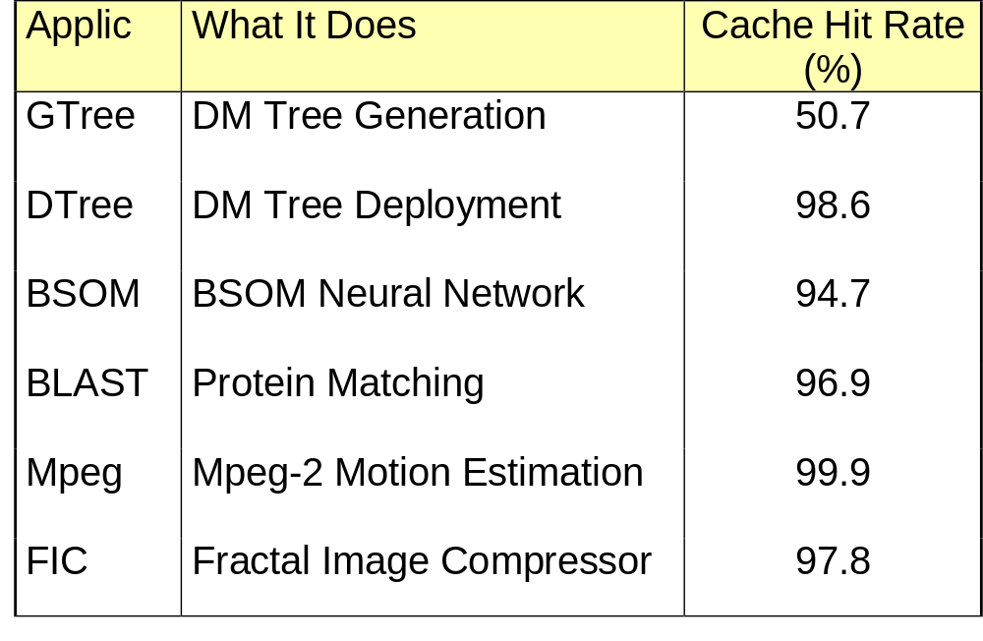
Applications
Notes:
20s
We have studied the effects with 6 different applications. Those applications have a different memory behavour. The cache hit rate in a 8KBytes cache goes from 50% to 99.9%.

Slide 16
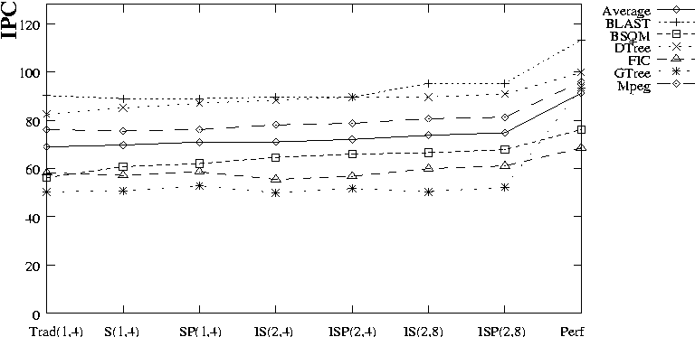
Performance: Memory Banks
Small performance improvement in advanced configurations with 1KByte cache
Notes:
45s
On the top right of the plot there is a legend that indicates what is the meaning of each one of the lines.
The first one is the average for all the applications, while the 6 remaining lines represent the different applications.
The plot show s the results obtained with 1KByte cache size. The Y-axes is the total IPC, the X-axes shows the different memory configurations.
The configurations change from left to right, from traditional to more advanced memory hierarchies. The right most point corresponds to perfect memory, where all the memory access are satisfied in 1 cycle.
We can see that only a small performance improvement as we move from left to right.

Slide 17
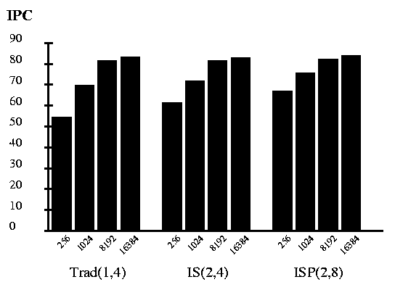
Performance: Cache Effect
Modest cache size is required for performance
Notes:
20s
Changing the cache size has a strong influence in performance.
The plot shows that the performance increases as we change the cache size in the three more representative memory hierarchies. Trad(1,4), IS(2,4), and ISP(2,8).
We can see that in three cases a cache of 8kbytes or 16kbytes is necessary for performance reasons.

Slide 18
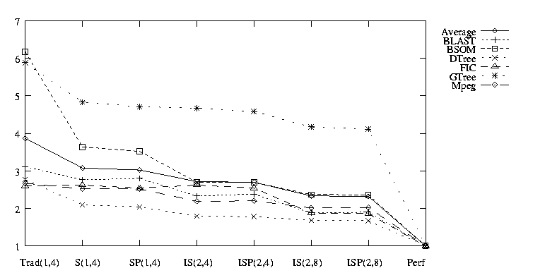
Energy-Delay Product
Big improvement in energy-delay product with more advanced memory configurations
Notes:
60s
The two previous slides have shown the performance. This slide shows the energy-delay procuct.
The legend in the top right is the same that the legend shown two slides ago.
The X-axes goes from Traditional to perfect memory. It maintains the same order in the memory hierarchies configurations as the previous plot. The difference is that here perfect memory means that the memory subsystem expends zero energy for a read. In addition it always has one cycle access time. This is the most ideal situation for E*D product. All the values shown are normalized against this ideal situation.
We see a big improvement in energy-delay product with more advanced memory configurations. The E*D product decreases as we go from left to right.

Slide 19
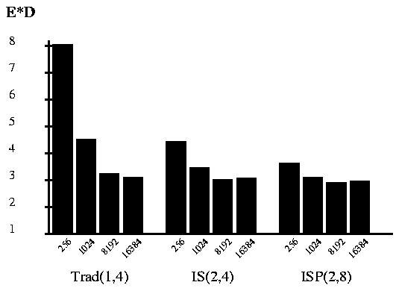
Energy-Delay Product: Cache
8KBytes have the best energy-delay product
Notes:
30s
In the same way that a cache is useful for increasing the performance. It is also useful for decreasing the E*D product.
This plot shows the change in the normalized energy-delay product as we increase the cache size in different memory configurations.
We can see that the best E*D product is obtained with 8KBytes in all the configurations but Trad(1,4). The reasons is that although 16KBytes has a better performance it also requires more energy. Tne increase in performance does not compensate the increase in energy consumption.

Slide 20
Conclusions
Modest size cache is enough (8KBytes)
  Improves performance
  Reduces energy consumption
Segmentation S(1,4)
  Reduces energy consumption
When area is available: use interleaving
  IS(2,4) increases by 14% the area
Notes:
40s
The main conclusion of this work is that modes size cache are required for two reasons. The first, They reduce the energy consumption by hiding the more expensive rowbuffer and memory bank access.
The second is that a modest cache increses performance.
We also recomend to implement S(1,4). Although does not improve performance it is useful for reducing energy consumption.
If we have a design with available area, the implementation of interleaving may be useful. Although it increases the area requirements by a 14%, it increases performance and reduces energy consumption.
This has been my presentation, do you have any questions?

Slide 21
Backup Slides

Slide 22
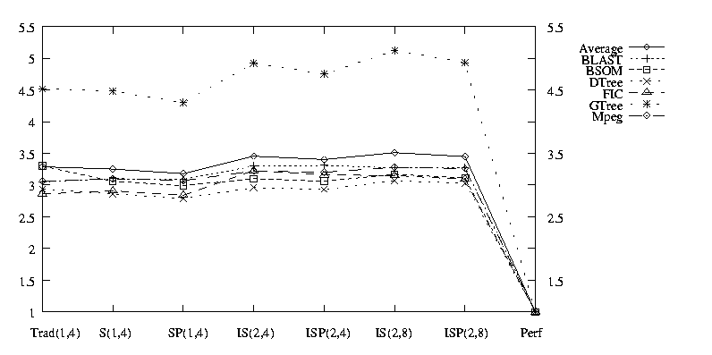
Area-Delay Product: MB
SP(1,4) best are utilization

Slide 23
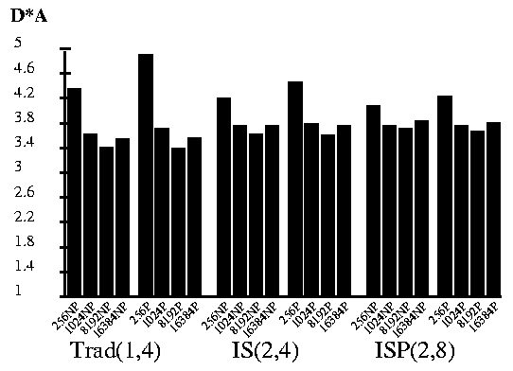
Area-Delay Product: Cache
8KBytes is a sweet point for area-delay product

Slide 24
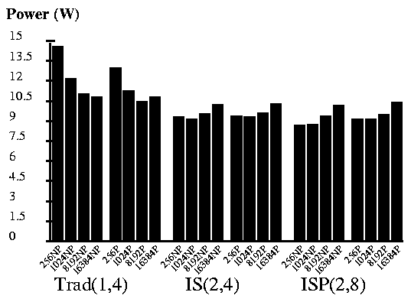
Power Consumption: Cache
Power is a bad metric, only useful as a constraint

Slide 25
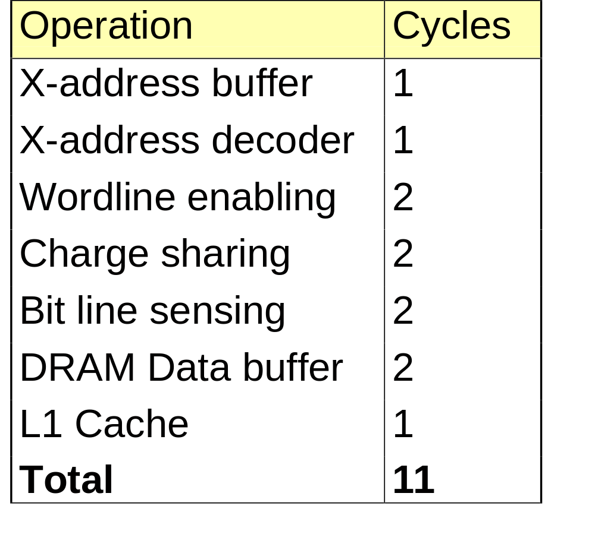
Memory Access Timing

Slide 26
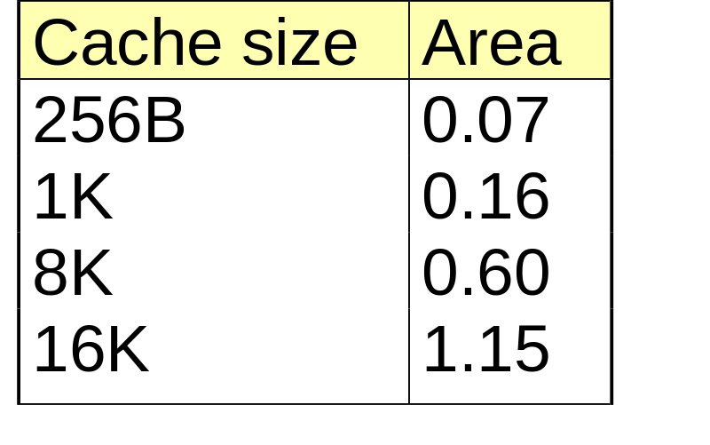
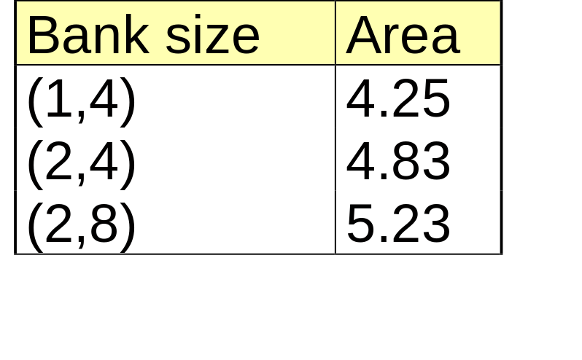
Area Requirements

Slide 27
Small Area Memory Banks
+Energy
+Spatial Locality
+Localities

Slide 28
Advanced Memory Banks
Less Energy and Contention
More area
Less Energy and Contention
Even more area

