Slide 1

L1 Data Cache Decomposition for Energy Efficiency
Michael Huang, Joe Renau, Seung-Moon Yoo, Josep Torrellas
University of Illinois at Urbana-Champaign
http://iacoma.cs.uiuc.edu/flexram

Slide 2
Objective
Reduce L1 data cache energy consumption
No performance degradation
Partition the cache in multiple ways
Specialization for stack accesses

Slide 3
Outline
L1 D-Cache decomposition
Specialized Stack Cache
Pseudo Set-Associative Cache
Simulation Environment
Evaluation
Conclusions

Slide 4
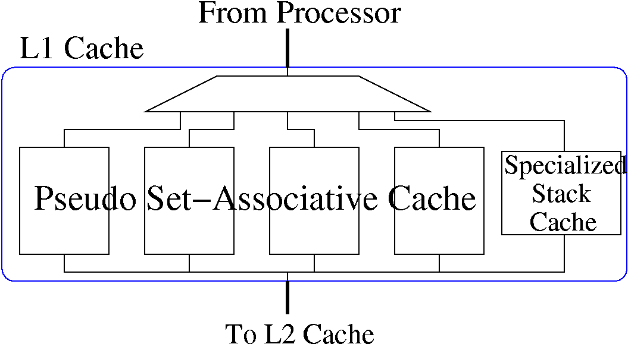
L1 D-Cache Decomposition
A Specialized Stack Cache (SSC)
A Pseudo Set-Associative Cache (PSAC)

Slide 5
Selection
Selection done in decode stage to speed up
  Based on instruction address and opcode
2Kbit table to predict the PSAC way
Opcode
Address
PSAC
SSC

Slide 6
Stack Cache
Small, direct-mapped cache
Virtually tagged
Software optimizations:
  Very important to reduce stack cache size
  Avoid trashing: allocate large structs in heap
  Easy to implement

Slide 7
SSC: Specialized Stack Cache
Pointers to reduce traffic:
TOS: reduce number write-backs
SRB (safe-region-bottom): reduce unnecessary line-fills for write miss
  Region between TOS & SRB is “safe” (missing lines are non initialized)
Infrequent access
TOS
TOS
TOS
TOS
SRB
SRB
SRB
Stack grows

Slide 8
Pseudo Set-Associative Cache
Partition the cache in 4 ways
Evaluated activation policies: Sequential, FallBackReg, Phased Cache, FallBackPha, PredictPha
Tag
Data

Slide 9
Sequential (Calder ‘96)
cycle 1
cycle 2
cycle 3

Slide 10
Fallback-regular (Inoue ‘99)
cycle 1
cycle 2

Slide 11
Phased Cache (Hasegawa ‘95)
cycle 1
cycle 2

Slide 12
Fallback-phased (ours)
Emphasis in energy reduction
cycle 1
cycle 2
cycle 3

Slide 13
Predictive Phased (ours)
Emphasis in performance
cycle 1
cycle 2

Slide 14
Simulation Environment
Baseline configuration:
Processor: 1GHz R10000 like
L1: 32 KB 2-way
L2: 512KB 8-way phased cache
Memory: 1 Rambus Channel
Energy model: extended CACTI
Energy is for data memory hierarchy only

Slide 15
Applications
Mp3dec: MP3 decoder
Mp3enc: MP3 encoder
Gzip: Data compression
Crafty: Chess game
MCF: Traffic model
Bsom: data mining
Blast: protein matching
Treeadd: Olden tree search
Multimedia
SPECint
Scientific

Slide 16
Adding a Stack Cache
For the same size the Specialized Stack Cache is always better
Notes:
WB: plain stack cache
Why performance improvement

Slide 17
Pseudo Set-Associative Cache
PredictPha has the best delay and energy-delay product

Slide 18
PSAC: 2-way vs. 4-way
For E*D, 4-way PSAC is better than 2-way

Slide 19
Pseudo Set-Associative + Specialized Stack Cache
Combining PSAC and SSC reduces E*D by 44% on average

Slide 20
Area Constrained: small PSAC+SSC
SSC + small PSAC delivers cost effective E*D design

Slide 21
Energy Breakdown
Notes:
4 points

Slide 22
Conclusions
Stack cache: important for energy-efficiency
SW optimization required for stack caches
Effective Specialized Stack Cache extensions
Pseudo Set-Associative Cache:
  4-way more effective than 2-way
  Predictive Phased PSAC has the lowest E*D
Effective to combine PASC and SSC
  E*D reduced by 44% on average

Slide 23
Backup Slides

Slide 24
Cache Energy

Slide 25
Extended CACTI
New sense amplifier
  15% bit-line swing for reads
Full bit-line swing for writes
Different energy for reads, writes, line-fills, and write backs
Multiple optimization parameters

Slide 26
SSC Energy Overhead
Small energy consumption required to use TOS and SRB
Registers updated at function call and return
Registers check on cache miss

Slide 27
Miss Rate

Slide 28
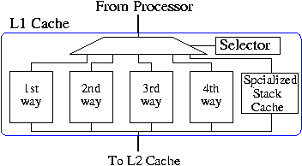
Overview

