Slide 1
Handbook Keepass Reader 1.6
Renaud HENRY

Slide 2
Contents
Create Blank Process => 2 steps
Add Librarys => 3 steps
Create Keepass File =8 steps
Use Keepass reader => 2 steps
Outputs => 1 step

Slide 3
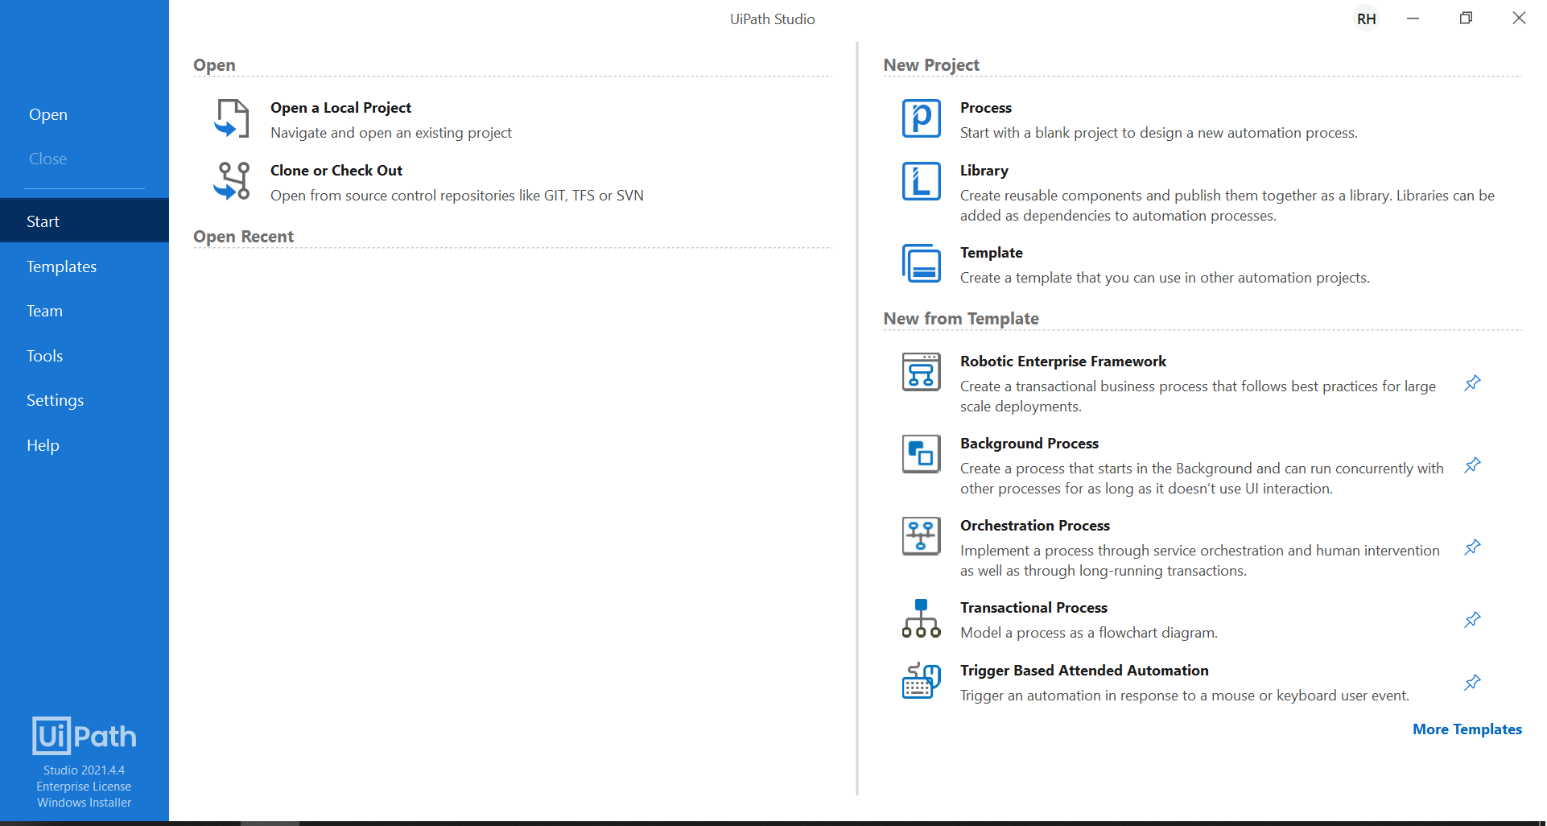
Create Blank Process : 1 / 2

Slide 4
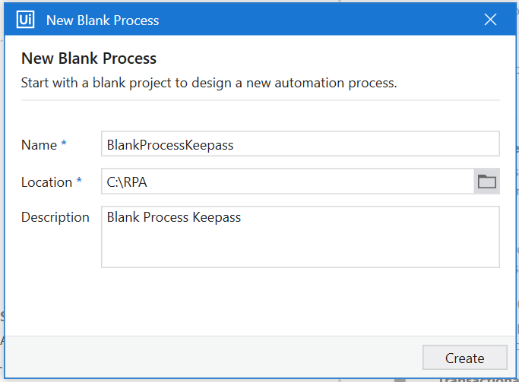
Create Blank Process : 2 / 2

Slide 5
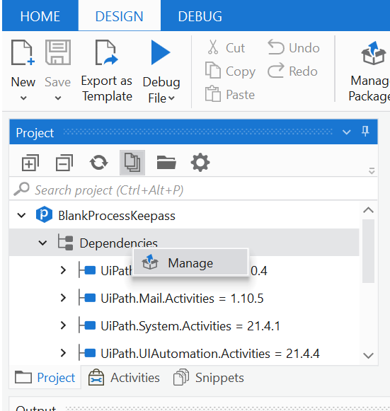
Add Librarys : 1 / 3

Slide 6
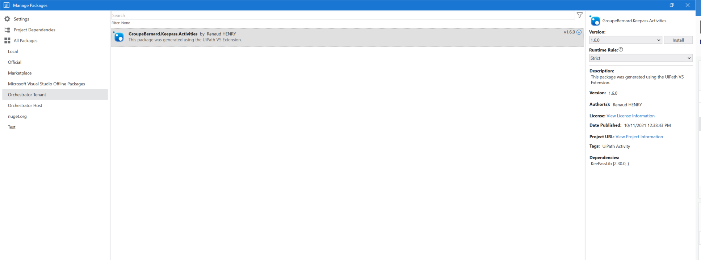
Add Librarys : 2 / 3

Slide 7
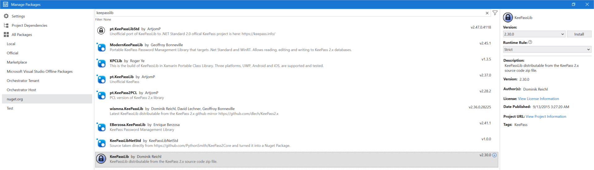
Add Librarys : 3 / 3

Slide 8
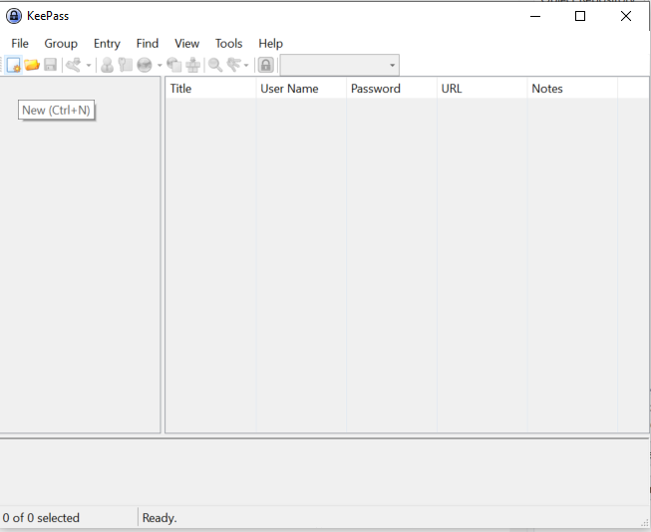
Create Keepass File : 1 / 8

Slide 9
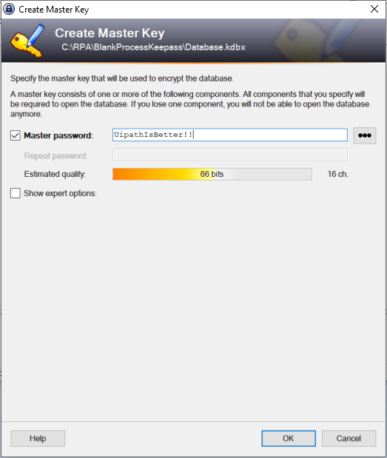
Create Keepass File : 2 / 8

Slide 10
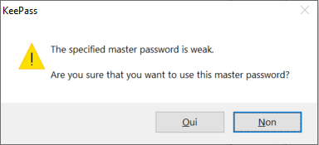
Create Keepass File : 3 / 8

Slide 11
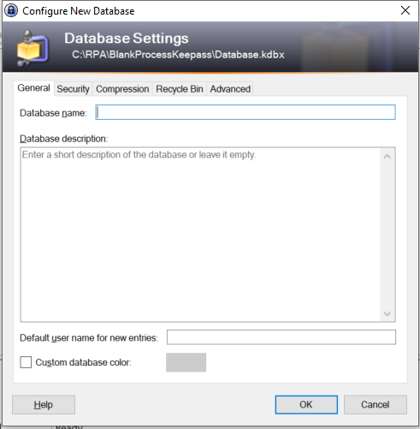
Create Keepass File : 4 / 8

Slide 12
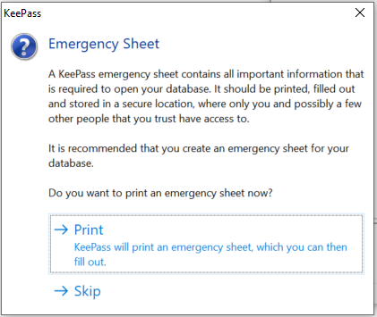
Create Keepass File : 5 / 8

Slide 13
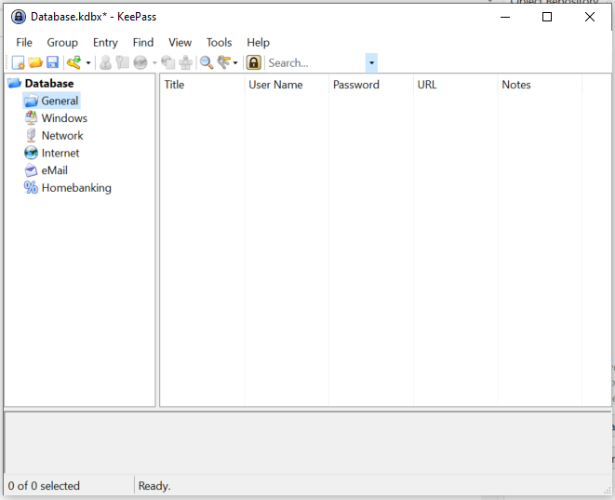
Create Keepass File : 6 / 8

Slide 14
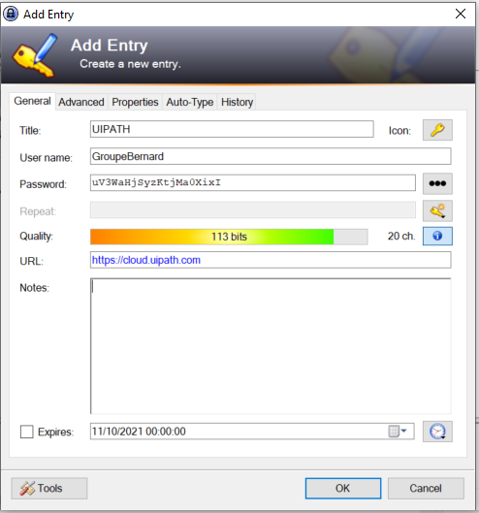
Create Keepass File : 7 / 8

Slide 15
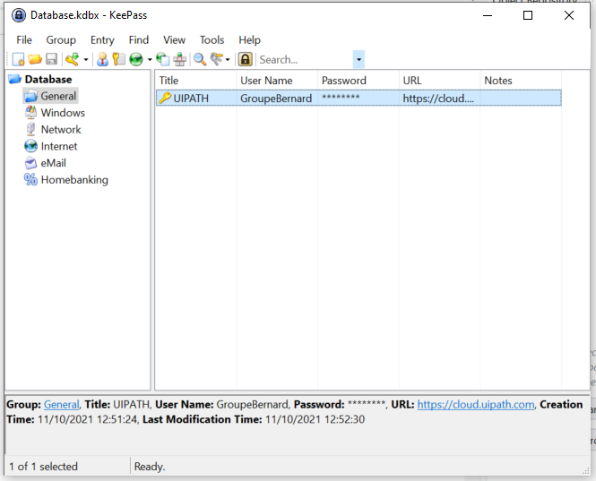
Create Keepass File : 8 / 8

Slide 16
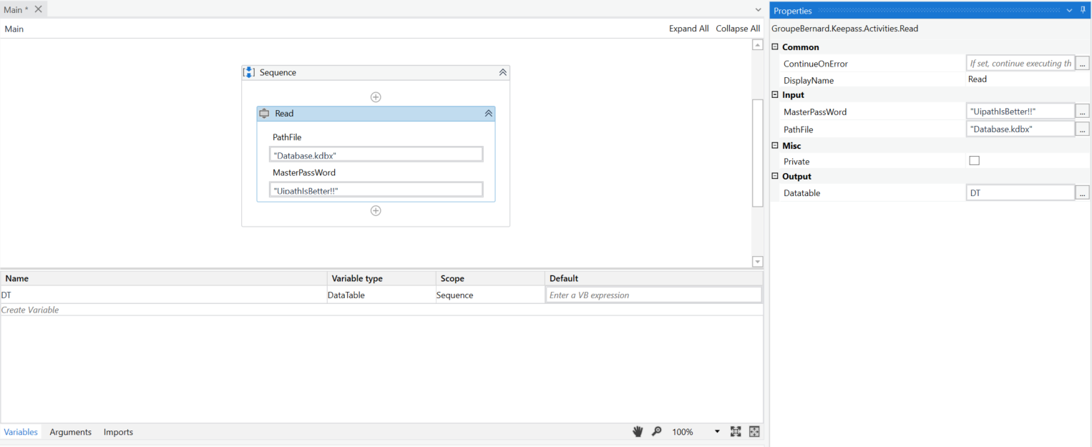
Use Keepass reader : 1 / 2

Slide 17
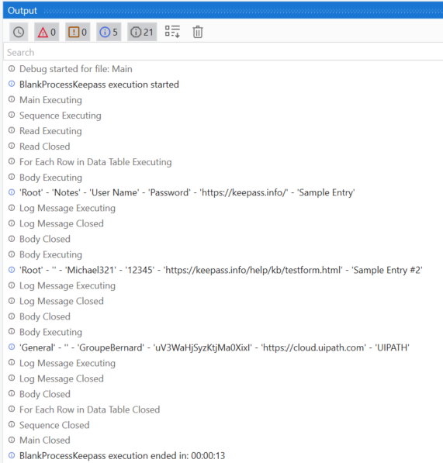
Outputs : 1 / 1

Slide 18
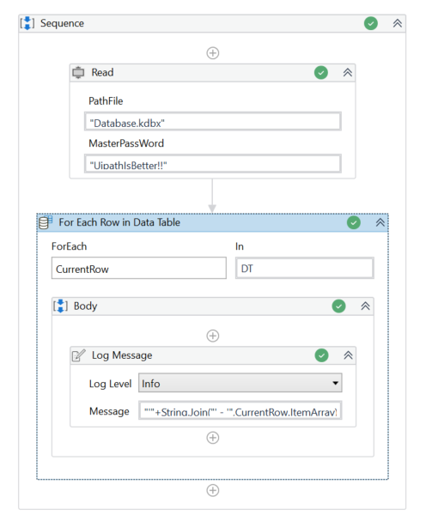
Use Keepass reader : 2 / 2
"'"+String.Join("' - '",CurrentRow.ItemArray)+"'"

