Slide 1
LTO4 tests
C. Curran, IT-FIO CERN
21 February 2008
17h17
Tests kindly hosted by CASPUR (A. Maslennikov et al)
http://www.caspur.it

Slide 2

LTO4 drive
Serpentine recording with 56 track sets (28 ‘out’ and 28 ‘back’)
896 tracks in all
~10 m/s fast search speed
Illustrated is an IBM LTO4 external drive
(picture available from www.ibm.com)

Slide 3


LTO4 cartridge
Exterior of a Sun brand cartridge
Cartridges used were Sony brand
End-of-tape capacity in test ~841 GB

Slide 4
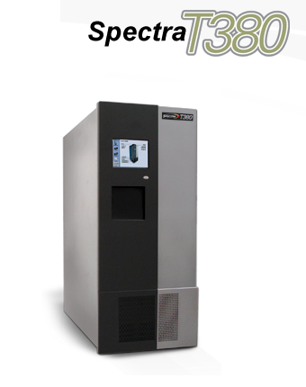
CASPUR Spectra Logic T380 library
This system was installed with:
5 Transfer elements (drives, LTO 4)
250 Storage element (slots)
10 Storage elements IMPORT/EXPORT

Slide 5
What tests has CERN done?
Some general drive characteristics
Data rate achieved on write, various blocksizes
Data rate achieved on read, various blocksizes
Reproducibility of the maximum capacity for one tape
Maximum capacity of several different tapes
Block positioning and rewind timing, full tape
ANSI labelled file positioning/rewind timing, full tape
Full tape is:
  3,224,000 +/- 3,000 blocks of 256K (262144 bytes)
  845 +/- 8 GB native, writing to end of tape (GB = 10⁹ bytes)
Initial tests were all with NO compression enabled, unless stated otherwise.

Slide 6
General characteristics, LTO4
Load ~7 s
Display VOL1 ~1 s
Rewind ~1 s
Unload ~15 s
L40003 used, times exclude any robotic activity
mt rewoffl to unload
mt load to load
dd if=/dev/nst0 ibs=80 obs=80 to display VOL1

Slide 7
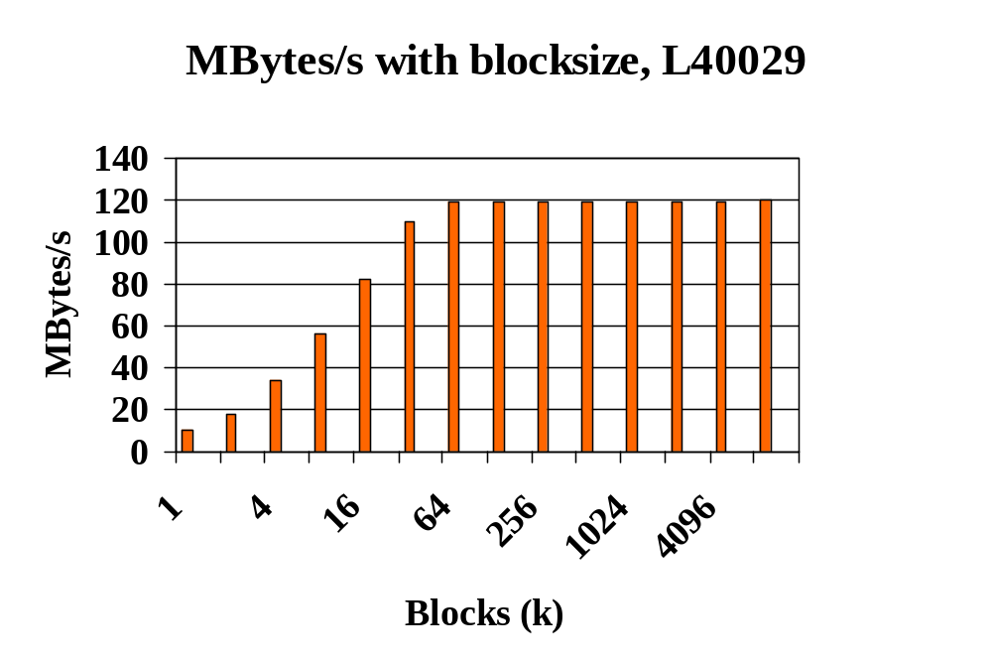
Data transfer rate (write)
No compression, 1k block=1024 bytes, 1MByte/s=10⁶ bytes/s
dd if=/dev/zero ibs=256k of=/dev/nst0 obs=256k count=1000000

Slide 8
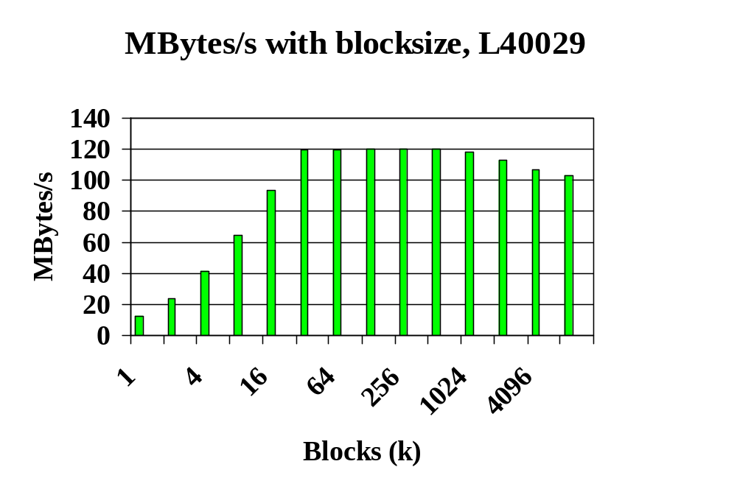
Data transfer rate (read)
No compression, 1k block =1024 bytes, 1MByte/s=10⁶ bytes/s
dd if=/dev/nst0 ibs=256k of=/dev/null obs=256k count=1000000

Slide 9
Single tape
Reproducibility of maximum capacity (GB = 10⁹)
L40032, block size 262144
Capacity, GB Blocks to physical EOT Time
841.88 3211523 7223 s
841.37 3209584 7054 s
841.45 3209901 7053 s
841.52 3210159 7054 s
841.53 3210205 7054 s
841.70 3210851 7054 s
841.84 3211371 7054 s
841.87 3211507 7053 s
841.90 3211613 7054 s
841.97 3211862 7056 s
Very consistent capacity, 841.70 +/- 0.22 GB (GB = 10⁹ bytes)

Slide 10
Several tapes
Maximum capacity (GB = 10⁹ bytes)
10 different tapes, block size 262144
Tape slot ID Capacity, GB Blocks to physical EOT Time
69 844.20 3220370 7056 s
68 845.89 3226829 7074 s
67 845.10 3223812 7056 s
65 845.45 3225161 7052 s
64 845.21 3224245 7052 s
62 845.76 3226346 7052 s
61 845.64 3225891 7052 s
60 844.68 3222201 7052 s
59 845.71 3226146 7052 s
58 844.73 3222398 7162 s

Slide 11
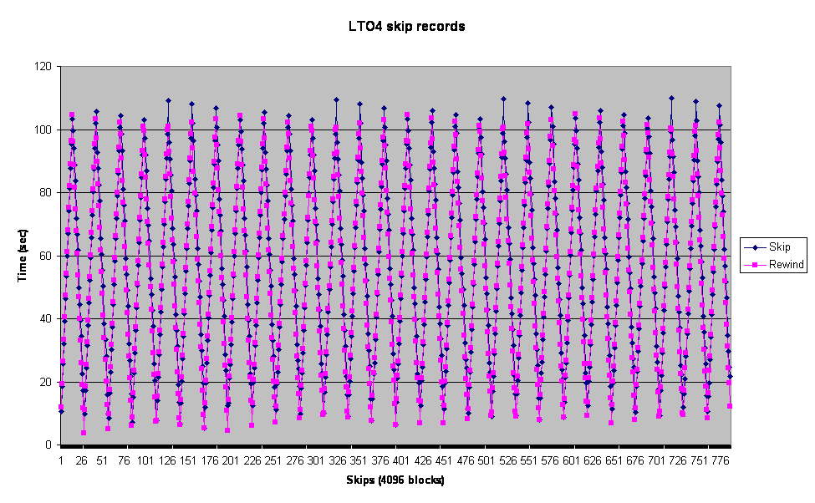
Block position/rewind times, full tape
~3221000 records on tape L40029, each 256 K.
Here the 56 serpentine track sets (28 out, 28 back) are visible
Command mt -f /dev/nst0 fsr n for n=4096 to ~3221000 (steps of 4096, 1.0 GB)
Command mt -f /dev/nst0 rewind

Slide 12
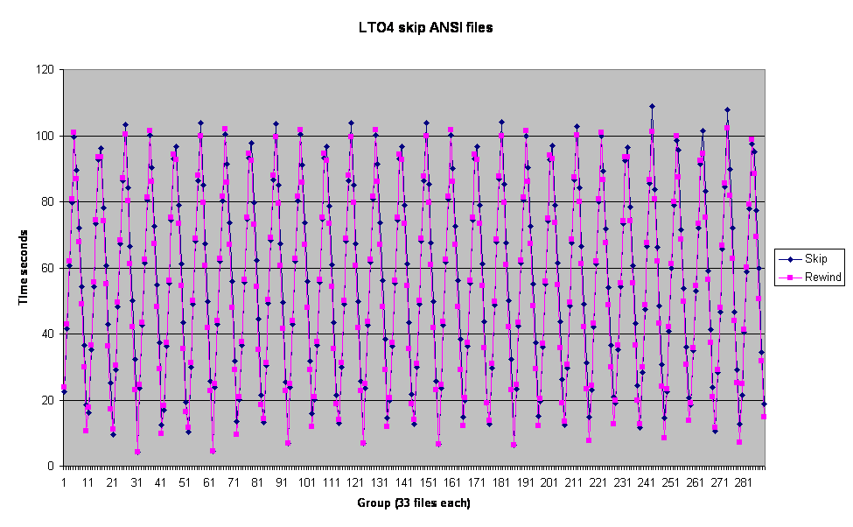
ANSI ‘labelled’ file position/rewind times
‘user’ files on tape L40029, each 80 MB (320 blocks of 256K), simulated labels
9537 files, 3051840 data blocks, so ‘labelled file’ adds ~18 data blocks, 4.5 MB?
Here the 56 serpentine track sets are also visible
Command mt -f /dev/nst0 fsf n (n groups of 33 labelled files)
Command mt -f /dev/nst0 rewind

Slide 13
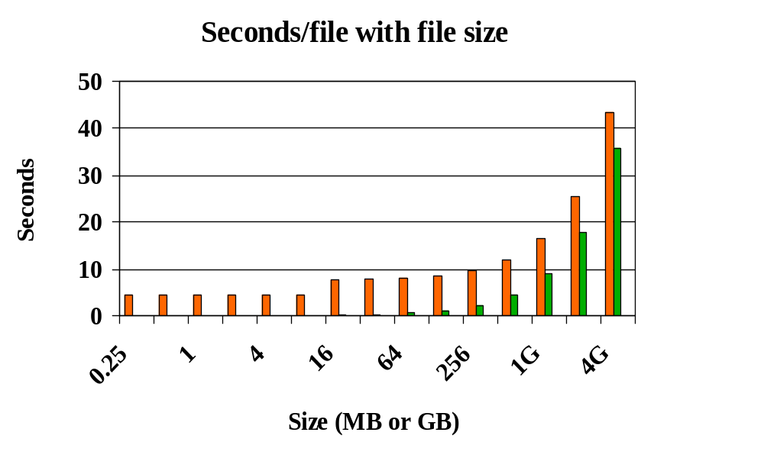
File process rate (ANSI file write/read)
Penalty of ~4.5 s per file on write!
No compression, 1k block=1024 bytes, 1MByte/s=10⁶ bytes/s. For a 2 MB file:
dd if=/dev/null ibs=80 of=/dev/nst0 obs=80 count=3
dd if=/dev/null ibs=252144 of=/dev/nst0 obs=262144 count=8
dd if=/dev/null ibs=80 of=/dev/nst0 obs=80 count=3

Slide 14
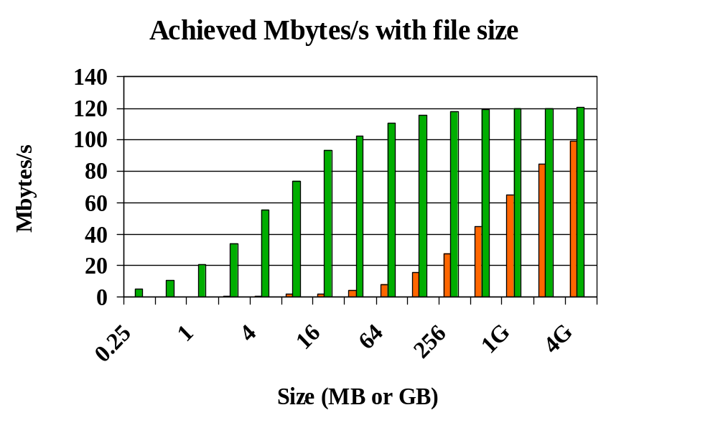
File process rate (ANSI file write/read)
Need to write files of ~1GB to reach ~50% of drive performance limit
No compression, 1k block=1024 bytes, 1MByte/s=10⁶ bytes/s. For a 2 MB file:
dd if=/dev/null ibs=80 of=/dev/nst0 obs=80 count=3
dd if=/dev/null ibs=252144 of=/dev/nst0 obs=262144 count=8
dd if=/dev/null ibs=80 of=/dev/nst0 obs=80 count=3

