Slide 1
CTA: CERN (CASTOR) Tape Archive Rationale and Status
Germán Cancio, Daniele Kruse, Eric Cano, Steven Murray

Slide 2
A talk in two parts
What is CTA - Presented by Eric Cano
Requirements of a tape storage system
Architecture of CTA (CERN/CASTOR Tape Archive)
Rationale and status - Presented by Steven Murray
Rationale
The prototype / proof of concept
What’s next

Slide 3
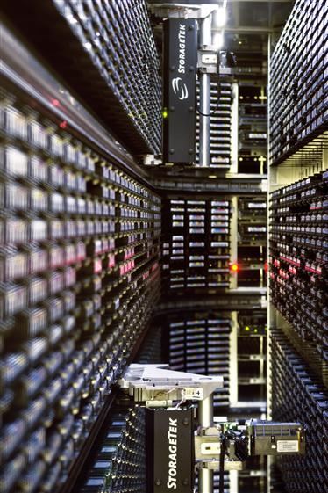
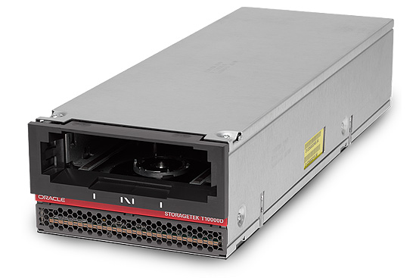
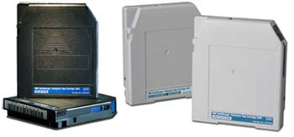
Main characteristics of tape
It’s cheap, safe, power efficient
Media is the biggest cost driver
Tapes can be reformatted to higher density when newer drives come out
High throughput
360MB/s per drive today, 1GB/s already in the roadmaps
High capacity
7-10TB per tape, 220TB demonstrated in labs
About 8 hours to fill or read a complete tape
High latency
Tape mount and unmount take ~30s/1min+ each
Full tape seek ~30s
This does not improve with new equipment
Sequential access
Low concurrency
Limited number of tape drives in the library
Locality and format constraints
Drive only mount tapes from their own library and right format

Slide 4
Our infrastructure and forecast
2 vendors
7 libraries (~70k slots)
~30k tape (7-10TB each)
80 drives (250-360MB/s)
Expected load for the coming years
2016 last cool year (40PB to write, as much to verify, plus user reads)
From 2017 on write 120-140PB/year (multiply by 2-3 for reads)
Repack and verification are high volume, low priority tasks
Should yield drives to user activity

Slide 5
Requirements for tape efficiency
Mounts should be made worthwhile
1 mount operation ⬄ 20GB of bandwidth
Queue file transfers until we have enough data to transfer
Single step mount decision for tape-drive couple
Drives should run full speed
Buffering in memory (12-64GB/drive) absorbs glitches
Disk system should achieve proper average
Drives should run all the time
Repack and verification should fill all idle drive time
… but also yield to experiment activity
Data has to be repacked regularly
Allowing re formatting of media
Data needs to be verified
Detection of problem tapes

Slide 6
Jobs queues
Retrieve jobs queued via front ends
Archive jobs queued via front ends
Tapepools
Tape pool is chosen through archive routes
Tapes
Queue sizes (file sizes and count) are used for mount decision
Tape is bound late to drive: no tape stuck with no compatible drive available
Tape servers pulls retrieve jobs from
the queue in shared storage
Tape servers pulls archive jobs from
the queue in shared storage
tapeserverd
tapeserverd
tapeserverd
tapeserverd
Tapeserverd
Tapeserverd

Slide 7
Global architecture
Archive
namespace
All of the CTA business logic and data management code is in the client interface to metadata
Commands/control
Evolved from CASTOR
CTA meta data store
CTA
tape server
CTA
front-end
CTA
tape server
CTA
front-end
Tape catalogue
Hardware layout
CTA
tape server
Drive status
Drive capabilities
Tape pools
Routing
Tape
Tape
Tape
Tape
Tape
Queues
Mount policies
Tape
CTA
command-line
tools
Two prototypes
Ceph
Local file system
CTA
command-line
tools
Data
CTA
Client commands
Disk
Remote
storage
Disk
Disk
EOS
Disk

Slide 8
Rationale for CTA
Less daemons
CASTOR
5 types of daemon
stagerd + tapegatewayd + vmgrd + vdqmd + tapeserverd
CTA
2 types of daemon
xrootd (front end) + tapeserverd
Tapes and drives can be scheduled simultaneously

Slide 9
Scheduling a CASTOR archival
3. Locks the tape for write access
5. Sends the job to the drive
vmgrd
vdqmd
tapeserverd
2. Requests a free tape from the destination tape pool
4. Queues a request for drive compatible with the chosen tape
Tape
tapegatewayd
Organic/legacy system resulting in 5 types of daemon
Partial decisions made by different daemons results in tape being chosen independently of drive
Generates needless queues on busy drives whilst other eligible drives are idle
Organic/legacy system resulting in 5 types of daemon
Partial decisions made by different daemons results in tape being chosen independently of drive
Generates needless queues on busy drives whilst other eligible drives are idle
stagerd
1. Schedules a archival mount based because:
There are enough files OR
There is enough data OR
A pending file is too old

Slide 10
Scheduling a CTA archival
Pull the next eligible tape to be mounted
Scheduler object store
tapeserverd
Tape
Single step “pull” scheduling using only a single type of daemon
Tape and drive scheduled simultaneously
Workload is naturally load balanced across eligible drives

Slide 11
Rationale for CTA
Simpler solution for a simpler problem
No need to support random access
Tape access has evolved from random access to bulk archival and retrieval
Centralized disk scheduling no longer needed
Distributed striped file systems now exist
Only really need to prioritize tape streams
Can concentrate on scheduling tape

Slide 12
Rationale for CTA
Less wire protocols
Will follow the EOS approach of using XrootD
All scheduling information in one place
(hardware catalogues, queues, policies)
Global view
Easier to understand
Easier to improve
Easier to maintain
Support preemptive scheduling
Throttle repack and tape verification
Use drives 100% of the time with little operator effort

Slide 13
Rationale for CTA
Avoid duplication of disk management between CASTOR and EOS
Preserve the knowledge and code driving the tape hardware from CASTOR
System boundary between EOS and CTA
Clean separation of concerns
Independent EOS and CTA releases
Simpler system to operate
Less daemons
Tape operators responsible for stager disks

Slide 14
CTA prototype
What was in the prototype
End user and admin command-line tools
Frontend server – A CTA plugin for xrootd
Ported tapeserverd from CASTOR to CTA
Central object store for scheduling
Hardware catalogues
Policies
Queues

Slide 15
CTA prototype
What was shown by a demo of the prototype
Archived files from EOS to tape
2 tape drives were used in parallel
Each EOS file had two tape replicas
Retrieved the file back from tape to EOS
Provided a user interface targeted at end users and at administrators

Slide 16
CTA prototype
CTA commands used during the demo
cta logicallibrary add -n IBM1JB -m "the test lib"
cta tapepool add -n cms -p 15 -m "CMS raw"
cta tape add -v I21748 -l IBM1JB -t cms -c 1000000000000 -m "A cta tape"
cta tape add -v I21805 -l IBM1JB -t cms -c 1000000000000 -m "A cta tape"
cta tape add -v I21902 -l IBM1JB -t cms -c 1000000000000 -m "A cta tape"
cta storageclass add -n single -i 2 -c 1 -m "A single copy class"
cta archiveroute add -s single -c 1 -t cms -m "Route to cms"
cta mkdir /cms
cta setstorageclass /cms single
cta archive "eos://eos/cms/smallfile" /cms/smallfile
cta ls /cms
cta listpendingarchives
sleep 60
cta ls /cms
cta retrieve /cms/smallfile "eos://eos/cms/smallfile_retrieve"
cta listpendingretrieves
Admin commands
File commands

Slide 17
What’s next
Conclusions from architecture meetings
Several models and approaches were discussed within the section and group
Models ranged from
Putting CTA on the back of EOS
Through to
A new orchestrator in front of EOS and CTA
Similar systems were studied and in particular the IBM Spectrum Archive Solution (GPFS)
Will now concentrate on putting CTA on the back of EOS

Slide 18
What’s next
EOS at the front – CTA hidden from end users
Critical information about tape files and tapes
Scheduler queues and policies
Scheduler object store
One EOS instance for each LHC experiment plus one for public users
Each EOS instance is responsible for the namespace of its users
Archive file and tape catalogue
EOS
Workflow engine
EOS
Workflow engine
EOS
Workflow engine
tapeserverd
tapeserverd
Tape
CTA frontend
tapeserverd
Tape
Tape

Slide 19
What’s next
Modules to be developed
Archive file and tape catalogue
Production version of scheduler object store
Functionalities to be developed
EOS workflow engine to CTA glue
Repack
Tape verification
EOS to CTA reconciliation engine
Operations scripts and procedures

Slide 20
What’s next
Migration strategy from CASTOR to CTA
CTA uses the same tape format at CASTOR
No need to transfer data
Only need to transfer metadata
Many possibilities still under discussion
Transfer one experiment at a time
Transfer one tape pool at a time
Transfer one tape at a time
Transfer based on the namespace

