Slide 1
Current status of tape storage at CERN
Speaker Steven Murray
Authors
Vladimir Bahyl, Cedric Caffy, German Cancio, Eric Cano, Michael Davis, David Fernandez Alvarez, Julien Leduc, Steven Murray

Slide 2
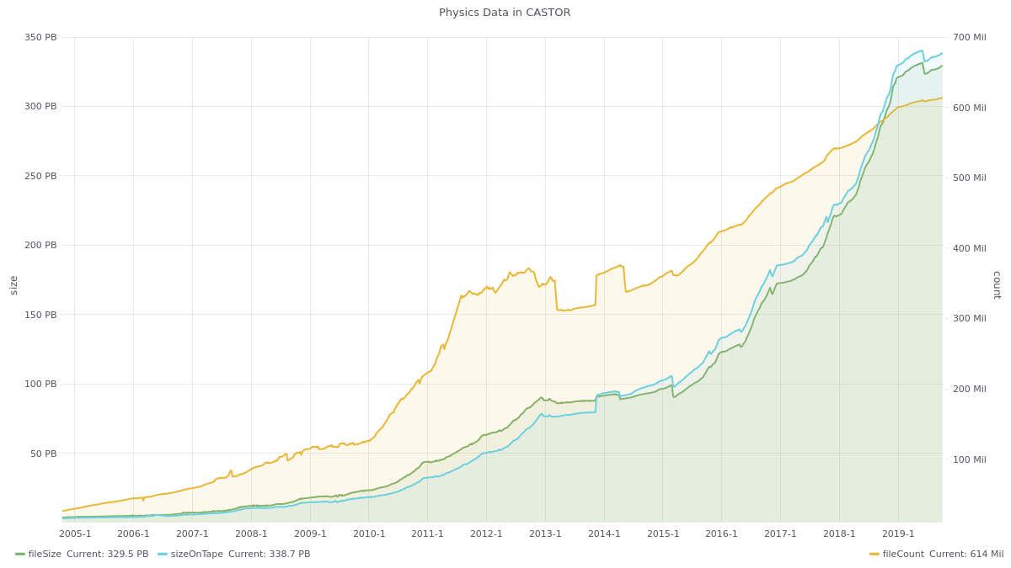
Total amount of archived data up to 2019
Data:
~335 PB physics
data (stored ad eternum)
~12 PB backup
Tape libraries:
IBM TS3500 (3+2)
Oracle SL8500 (2)
Tape drives:
~100 archive
~35 backup
Capacity:
~70 000 slots
~36 000 tapes
Equipment lifetime:
Media ~4-6 years
Drives ~4 years
Libraries >10 years
With regular upgrades

Slide 3
CERN tape infrastructure 2019
Repacked out of Oracle
  80 PB of data were repacked
  Some “bottom of the barrel” files still to be processed
Removed two Oracle SL8500 libraries
Two Oracle SL8500 libraries remain but about to go
  We are looking for a potential buyer
  Please contact Vladimir.Bahyl@cern.ch if you are interested
Converted one IBM library from TS3500 to TS4500
Extended another IBM library to full size
  From 5000 to 20000 slots
Successful test of replacing FC links to tape drives with RoCE (RDMA over Converged Ethernet)
  For enterprise drives only
  Uses RDMA over Ethernet

Slide 4
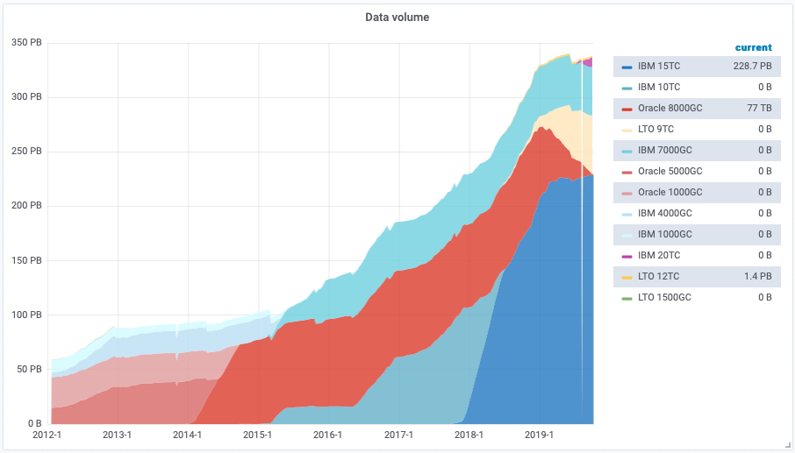
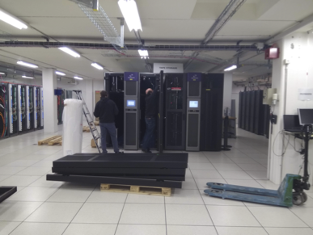
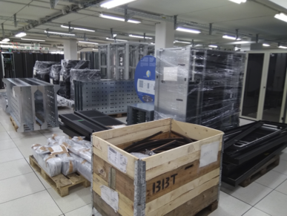
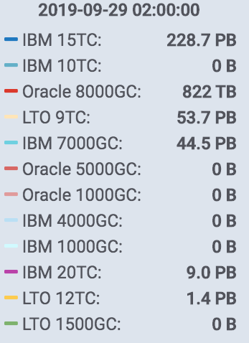
Moving away from Oracle and moving towards LTO

Slide 5
CERN tape infrastructure 2020 plans
Prepare for run 3
  Write > 150 PB in one year at > 40GB/s
  Increase number of tape drives from 100 to ~160
  Install LTO-9 drives if available in Q4
  Install TS1160 drives if available in Q4
Install new LTO tape library in Q1
  Following open tender

Slide 6
EOS CERN Tape Archive (EOSCTA)
EOSCTA is tape on the back of EOS
EOSCTA will replace CASTOR
EOS is the disk storage solution for LHC physics at CERN
Natural evolution from CASTOR
  Reused existing high performance CASTOR tape server
  Same tape format – only need to migrate metadata
Removed duplication between CASTOR disk and EOS
New scheduler
  Single step with complete global view
  Preemptive - Use tape drives at full speed all of the time
Single relational database with no PL/SQL business logic
  Supports multiple database backends
  CASTOR had 5 different databases
Less networked components than CASTOR

Slide 7
EOSCTA solutions
Ideal software bundle/solution for tape
  FTS + EOSCTA
Tailored solutions to match each LHC experiment
  Alice with AliEn → EOSCTA + HSM like
  ATLAS with Rucio → FTS + EOSCTA
  CMS with Rucio → FTS + EOSCTA
  LHCb with Dirac → FTS + EOSCTA (Drop SRM)

Slide 8
The SSD buffer of EOSCTA
Strict producer/consumer buffer
Client
Tape server
SSD buffer
File lifetime within buffer is short
EOSCTA is bandwidth driven
SSD buffer solves the thrashing problem of spinners
Scaling spinners to meet bandwidth requirements is too expensive
The life time of a file in the buffer is short lived

Slide 9
EOSCTA shared vs dedicated storage
Each VO has its own dedicated SSD buffer
Alice
SSD buffer for Alice
ATLAS
Tape drives are shared
SSD buffer for ATLAS
Tape library
CMS
Tape drive
SSD buffer for CMS
Tape drive
Tape drive
LHCb
Tape drive
SSD buffer for LHCb
Each VO has its own dedicated tapes
Public
SSD buffer for Public

Slide 10
EOSCTA operations 2019
Moved from spinners to SSDs
Deployed “retrieve only” instance for ATLAS
  5 hyper-converged servers
  20 TB of SSDs
  10 tape drives
Migrated ATLAS metadata from CASTOR to EOSCTA
  See Giuseppe Lo Presti’s “CERN Storage Evolution” presentation
Successful ATLAS 2018 recall campaign
  All ATLAS data in CASTOR was available via CTA
  "From ATLAS side, the recall campaign went smoothly and we managed to recall all the files (326k files, 741 TB) in a timely manner (CERN was the first site to achieve the full recall of all the files).This gave us additional confidence in CTA performance and in the migration strategy”
Developed EOSCTA operations tools, dashboards and workflows
ATLAS deployment of EOSCTA is possible from November

Slide 11
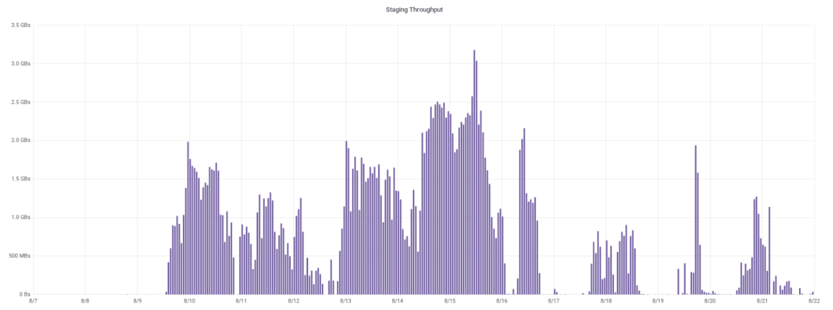
EOSCTA performance during ATLAS recall campaign

Slide 12
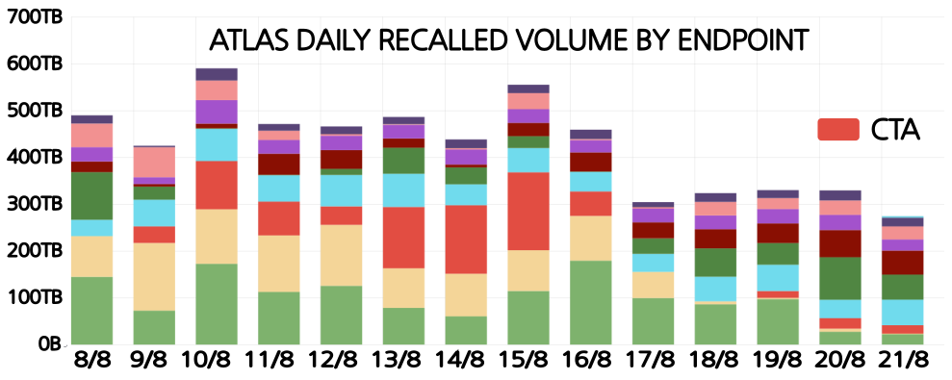
Relative EOSCTA performance during ATLAS recall campaign

Slide 13
EOSCTA operations 2020 plans
Deploy LHC instances
  Alice
  ATLAS
  CMS
  LHCb
Deploy non-LHC “public” instance after LHC instances
  Users and VOs will be consulted accordingly
  Need to understand public specific workflows
  CASTOR will not be turned off without agreement with users and VOs

Slide 14
EOSCTA software developments 2019
Repack
Full integration with FTS and XRootD
Support for multiple database backends
“Activities” and priorities for retrieves
  ATLAS requested support for “activities”
  Integrated with FTS

Slide 15
EOSCTA database backends
Oracle
  The current production solution at CERN
PostgreSQL
  The future production solution at CERN
  Recommended for Tier 1 sites
MySQL
  Contributed by IHEP, China

Slide 16
EOSCTA service improvements 2020
CERN LTO RAO
  Travelling salesman optimization for read positioning
  Mass recalls are ~2.5x-3x faster than linear
  Please see
    LTO performance, Make Tape Reading Great Again, HEPiX Fall 2018, Barcelona
    https://indico.cern.ch/event/730908/contributions/3153156/attachments/1732268/2800425/LTO-CERN-HEPiX-Oct-2018-germancancio.pdf
Pre-emption of tape drives
  Use tape drives at full speed all of the time
Tools and modifications to facilitate operations
  Tape and drive dedications
Migrate to XRootD 5 (extended attributes)
Collocation hints in collaboration with ATLAS

