Slide 1
Rendell Jay S. Eyas
WEB DEVELOPER

Slide 2
Who I am
Has more then 3 years of experience in the IT industry and is still eager to learn more and explore new things that will help me improve my abilities and mindset as a professional. With this, I would gladly extend my efforts in order to contribute to the company's success.

Slide 3
projects
List here are the project I've work on as Web developer.

Slide 4
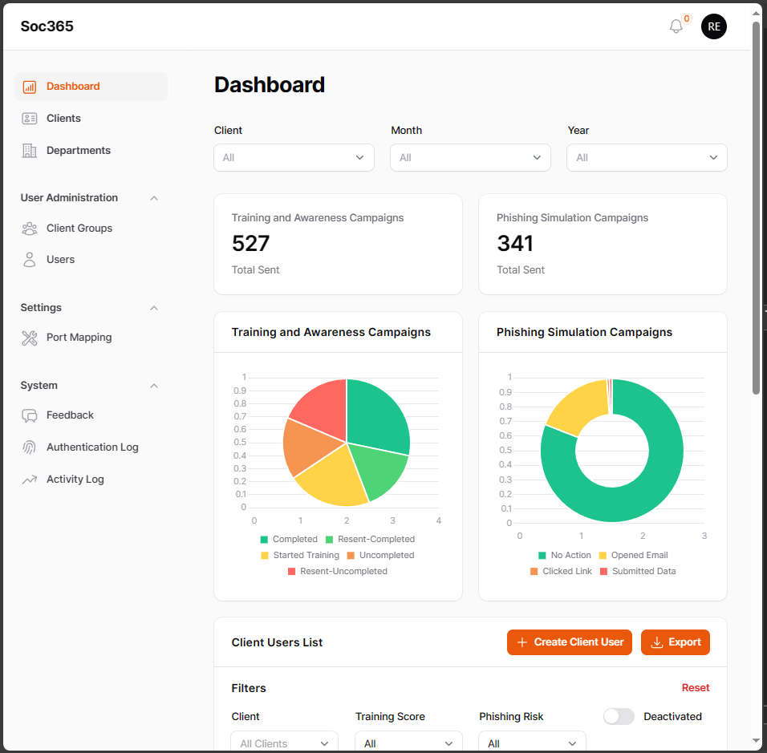
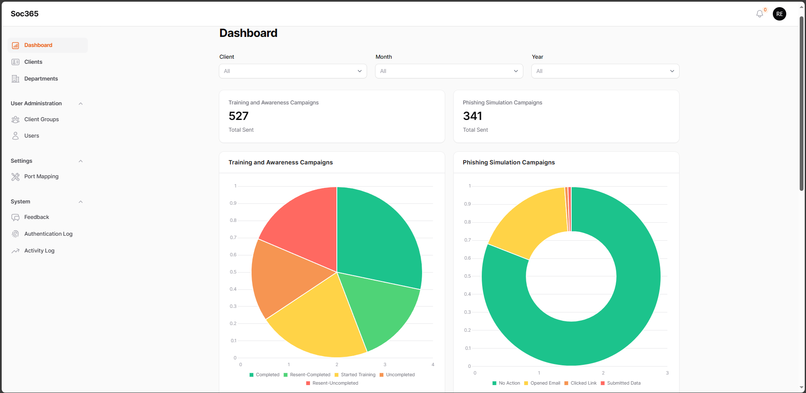
Software : Soc365 (Company: NetlinkVoice)
Details
Web application used to track clients' employee's security awareness and training initiatives, analyze data, and summarize staff development to help clients identify areas for improvement.
Stack Used
Laravel and Filament, Aws s3 bucket, Javascript
Responsibility
Update the current system into Laravel 10 and Filament v3.
Add functions based on client request
Improves system perfomance

Slide 5
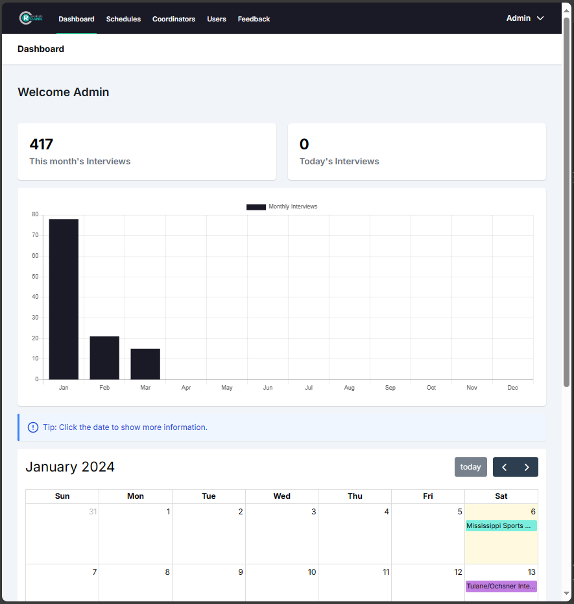
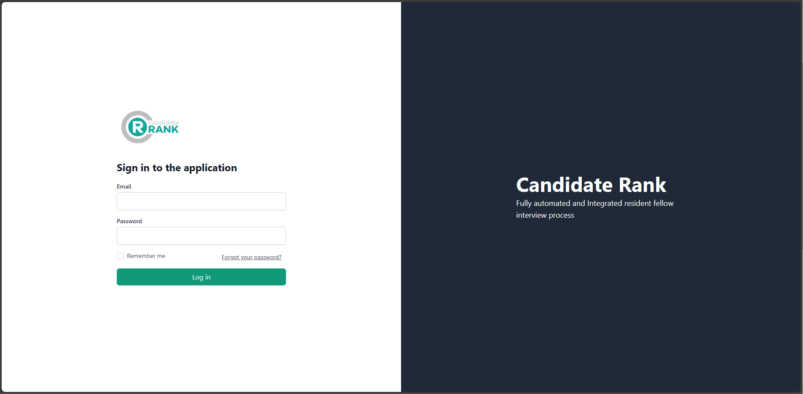
Software : CandidateRank (Company: NetlinkVoice)
Details
Fully automated and Integrated resident fellow interview process. A web platform that helps human resources track, classify, and process candidates.
Stack Used
Laravel and Inertia VueJs, Ant Design, GhostScriptt
Responsibility
Update the current system into Laravel 9 and Inertia-VueJS v3
Add functions based on client request
Fix bugs encountered by the clients

Slide 6
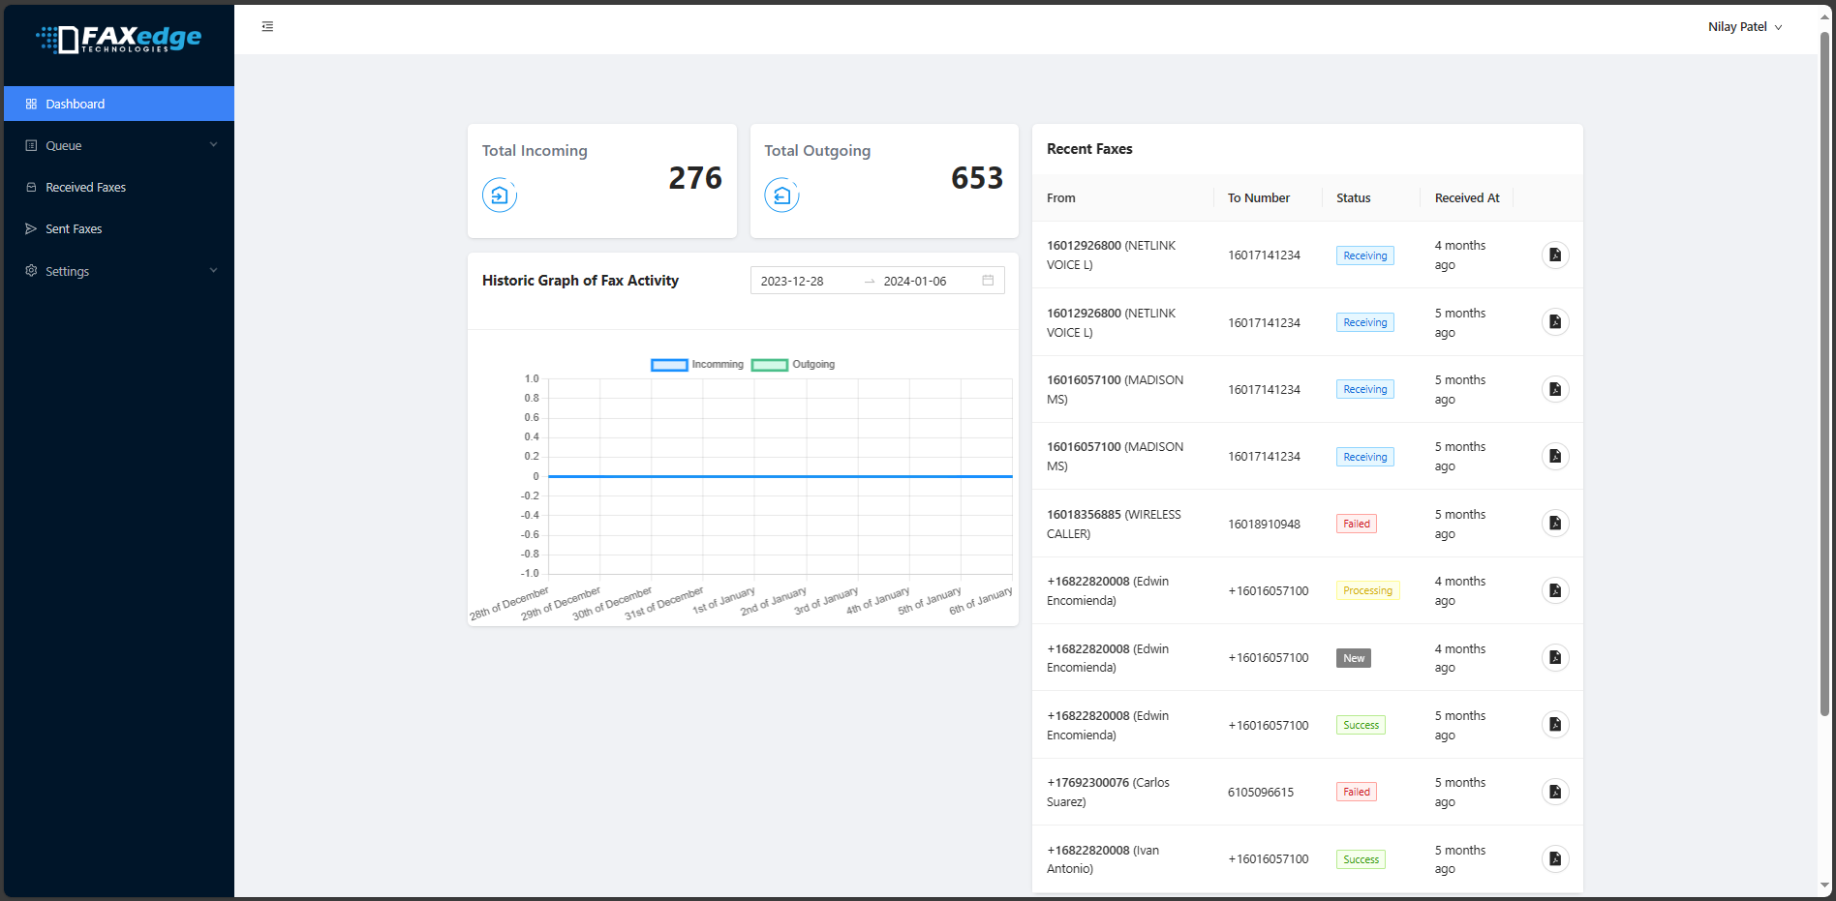
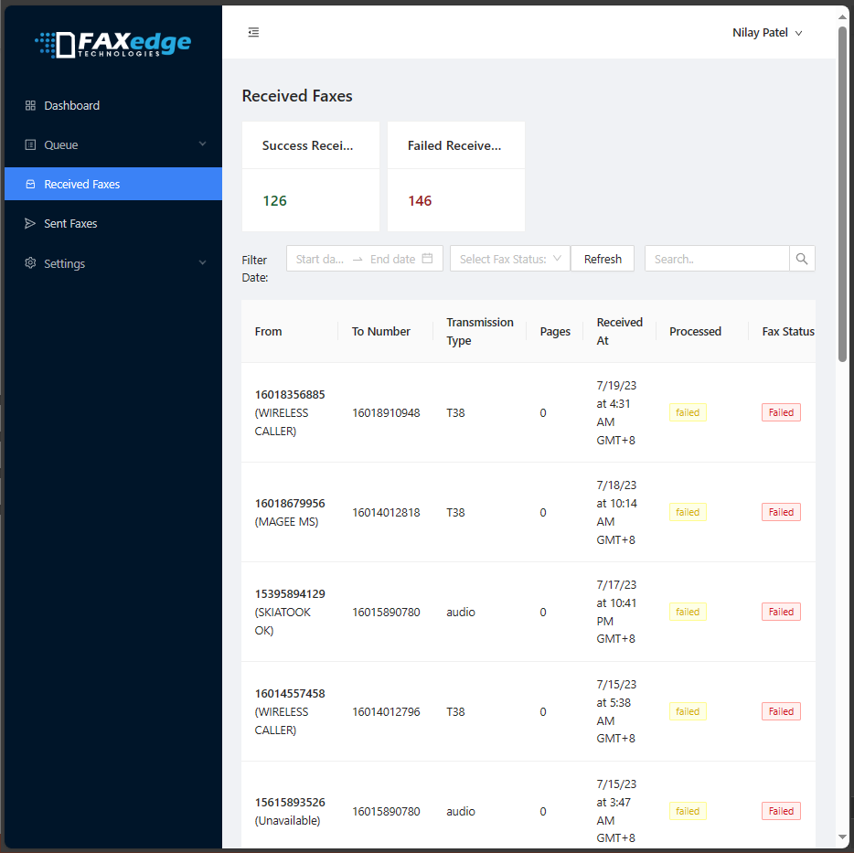
Software : Fax Edge Dispatcher (Company: NetlinkVoice)
Details
Used to monitor faxes transactions. Incoming and outgoing faxes either successful or failed transactions.
Stack Used
Laravel and Inertia VueJs, and Ant Design
Responsibility
Update the current system into Laravel 9 and Inertia VueJs v3.
Fix encountered bugs

Slide 7
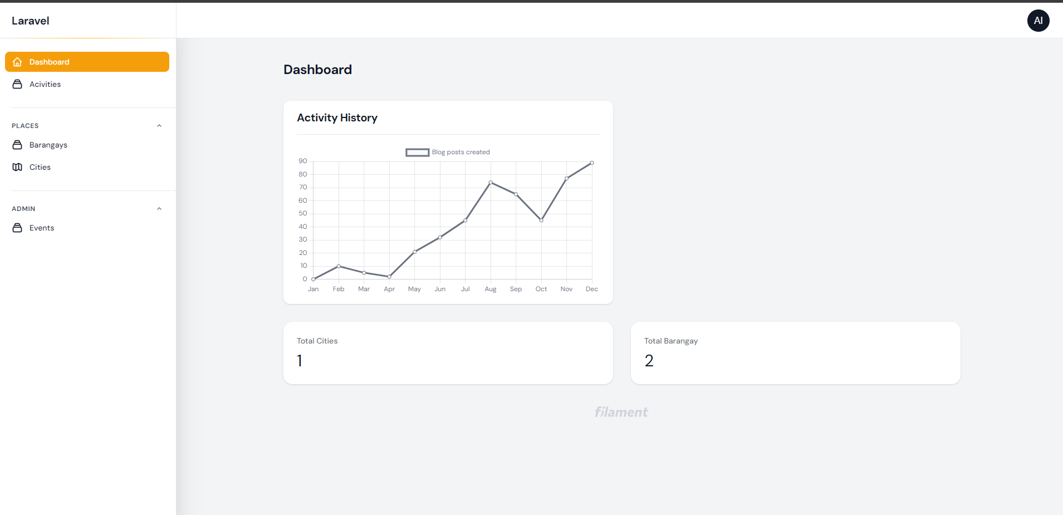
Software : WebhookMonitoring (Company: NetlinkVoice)
Details
An apps that monitor the event transacted in an apps using apis.
Stack Used
Laravel 9 and Filament v3
Responsibility
Setup and create the project from Scratch
Add features based on Senior Dev orders

Slide 8
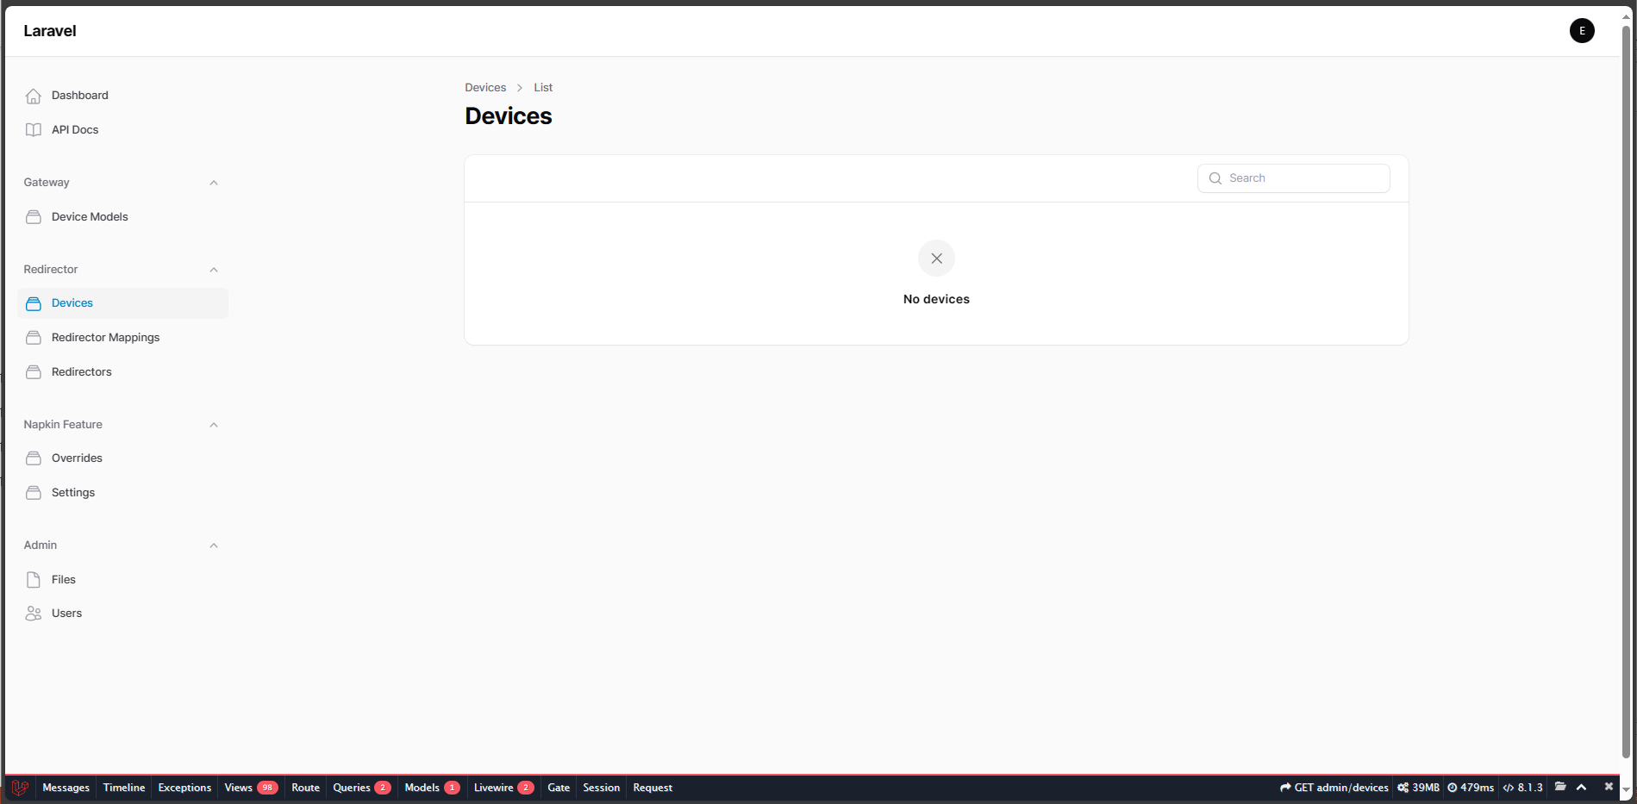
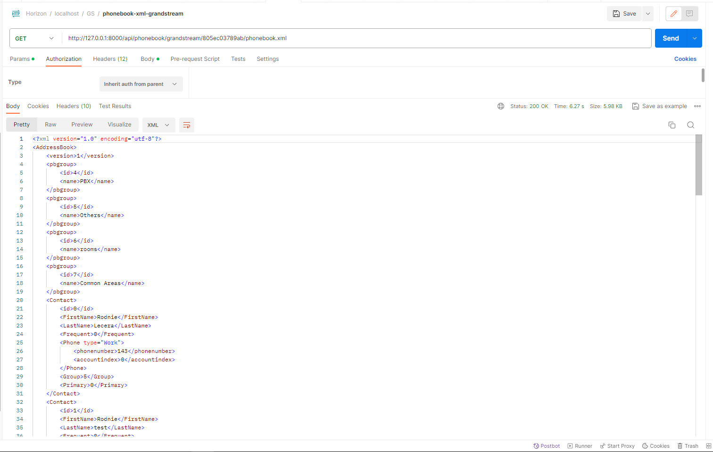
Software : Horizon (Company: NetlinkVoice)
Details
Web app that that manage and keeps track of the devices utilized by the company.
Stack Used
Laravel, Filament, and Pest PHP
Responsibility
Created an XML phonebook api endpoint to be utilized on clients' devices
Add feature and unit testing using pest php

Slide 9
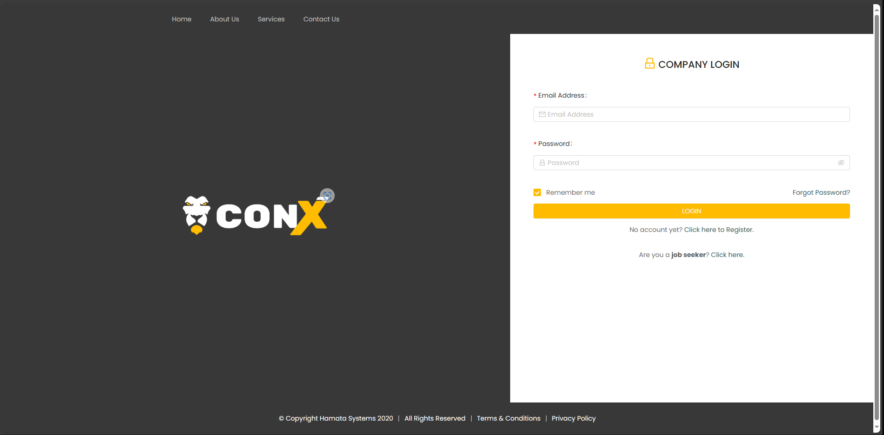
Software : ConX (Company: ESPC)
Details
Web and app-based platform that assists contractors of all kinds that are dealing with labor issues, primarily over and understaffing.
Stack Used
Laravel 9, NuxtJs, TailwindCss
Responsibility
Develop and proposed ERD designs
Create features based on client's request
Oversee and update the website
Assign task and monitor task to each co-devs
Maintenance (Ubuntu server management)

Slide 10
Software : StrangeDomains (Company: NetlinkVoice)
Details
A web hosting website. That helps a user manage their domains
Stack Used
Laravel, Inertie-VueJs, Tailwind and Java SpringBoot
Responsibility
Create and proposed UI design
Develop and proposed ERD designs
Setup and develop the app from scratch
Maintenance (Ubuntu server management)
Using Java (spring boot) creates an authorization server who create authentication token to access resource server

Slide 11
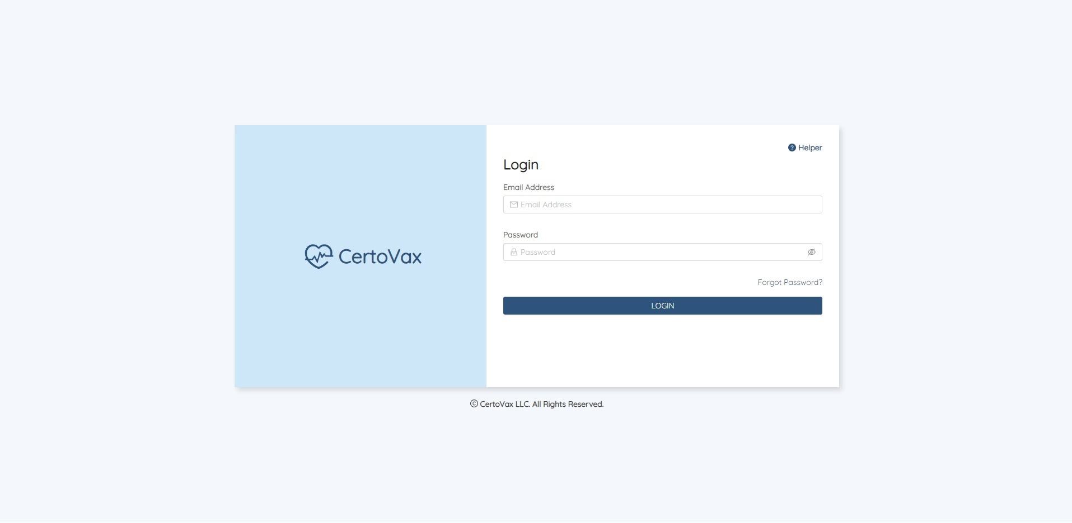
Software : CertoVax (Company: ESPC)
Details
A vaccine verification web app. It is used to verify if the vaccine certificate of an individual if it is valid using google cloud vision.
Stack Used
Laravel, Nuxt, PWA
Responsibility
Develop and proposed ERD designs
Setup and develop the site from scratch
Create features based on client's request
Maintenance (Ubuntu server management)

Slide 12
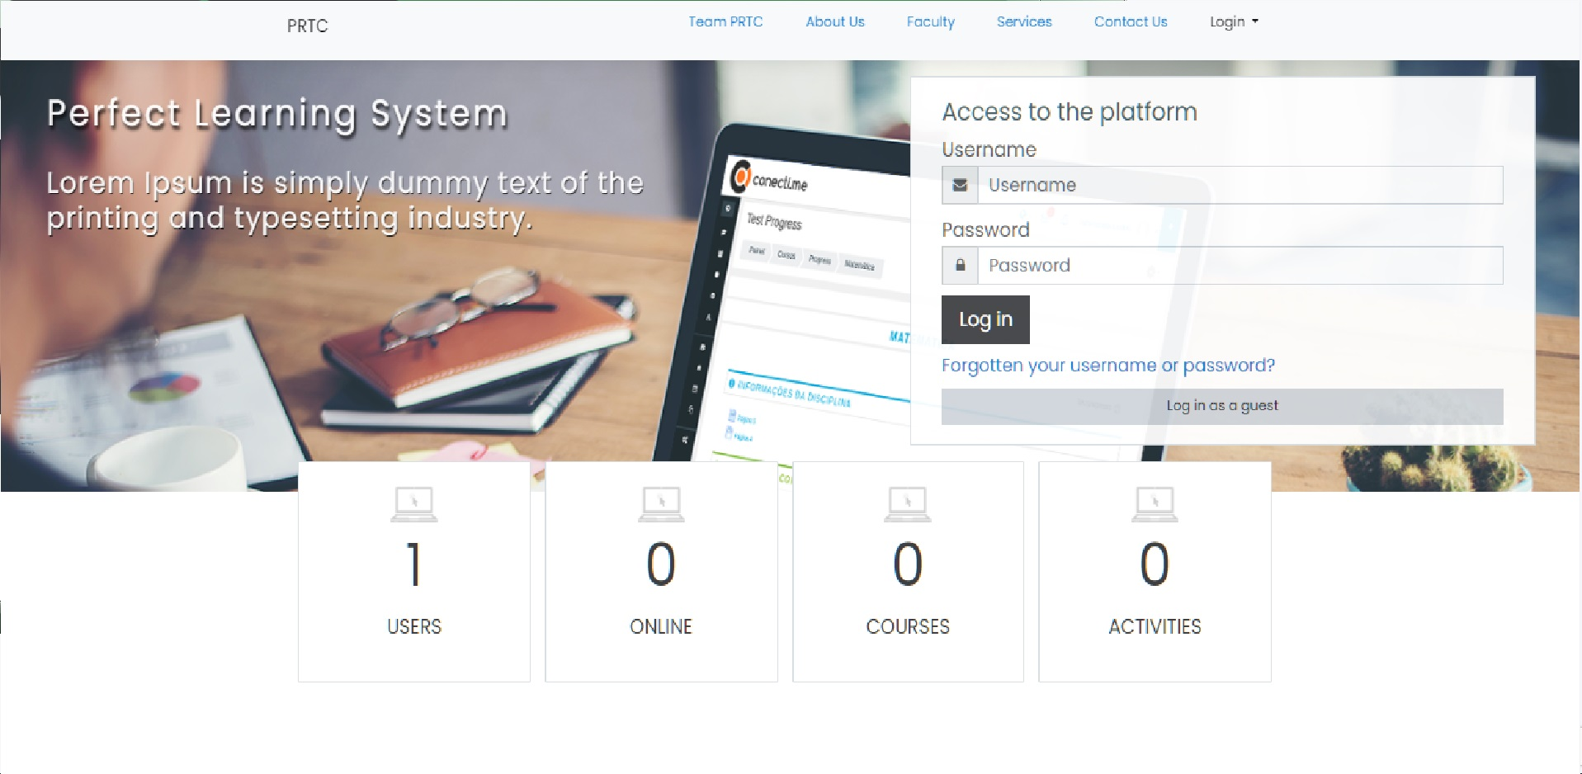
Software : PRTC-SMAH CPA Review System (Company: ESPC)
Details
An e-learning management system used specifically for CPA Review
Stack Used
Moddle (PHP framework)
Responsibility
Create and maintain the website
Create functionality in response to client requests
Ubuntu server management (deployment and maintenance)

Slide 13
THANK YOU
Rendell Jay S. Eyas
rendell.eyas@gmail.com

