Slide 1

Music to notes conversion
A Machine learning Approach
Team:
P Jayakrishna Sahit (16110104)
R Aditya (16110137)
Sai Praneeth M (16110145)

Slide 2
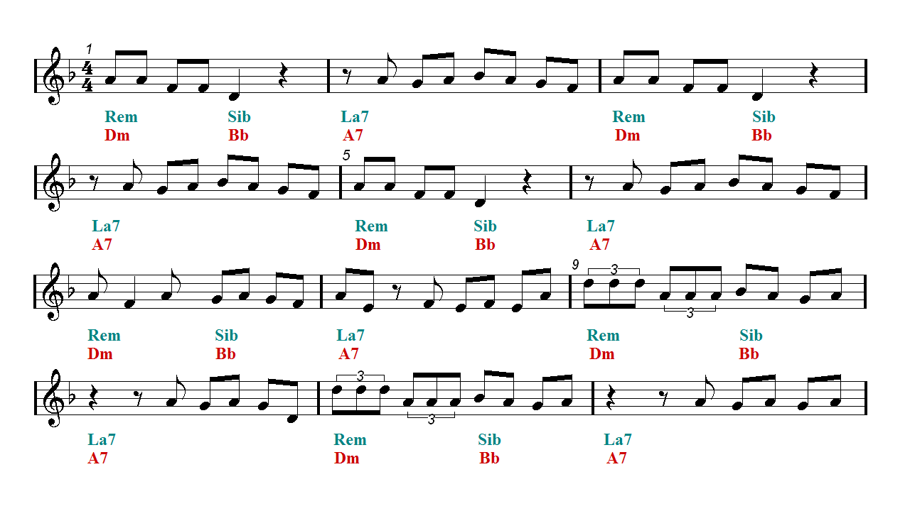


Aim of the project
…………………………………………………………….
Given the music file our aim is to generate the guitar sheet notes for it

Slide 3
Why is it important to solve?
…………………………………………………….....
We come across lot of music daily
To learn it using acoustic instruments we require notes for it
Solving this would give better insight for understanding sound from non-electrical devices
Helps people interested in acoustic instruments(in particular guitar)
Notes:
Music identification from acoustic instruments is an added advantage for people interested in acoustic instruments, because they now have an easier way of learning songs using such instruments. On a broader note, understanding such instruments, can give us better insight on understanding sound from non-electrical devices, such as the human voice box, etc

Slide 4
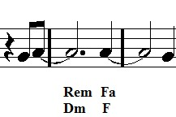

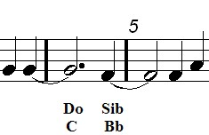


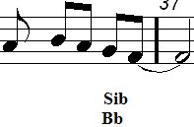
Need for CS
……………………………………………………..
Goal is to identify notes corresponding to a piece of music
We can’t store all the notes corresponding to each music bit
There is a need for automating this process
We can bring ML models in, to do this task
.
.
.
.
.

Slide 5
Previous work and chance for extension/ improvement
…………….……………………………………
Previous work on music transcription was done for keyboard music
We wanted to extend that work to guitar
Check whether the same architecture works for music transcription of guitar music
Current state of the art method in music transcription is done for any instrument by ScoreCloud

Slide 6
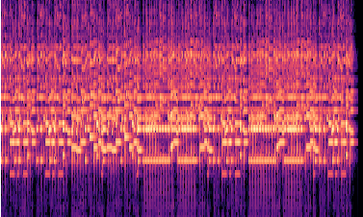
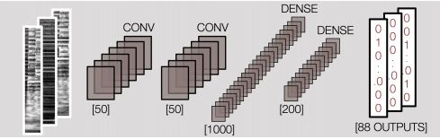
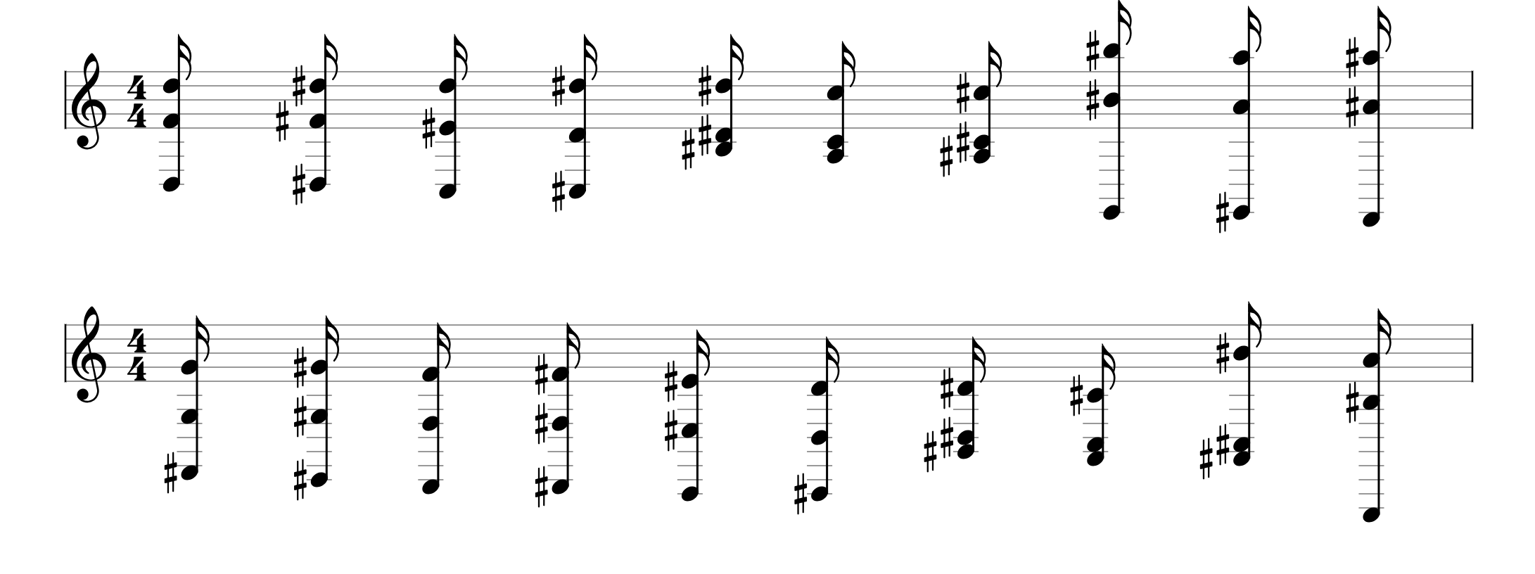
Brief sketch of our model
Our model is divided into four steps, they are
converting audio signal into its CQT image
giving that CQT image to trained CNN model for detecting the notes
rewriting the notes into sheet music

Slide 7
Results
……………………………………………………….
We have used precision score, recall score, f1-score, and accuracy to evaluate our model.
Values of the above mentioned metrics are:
precision score - 0.16
recall score - 0.36
f1 score - 0.24
accuracy - 0.973

Slide 8
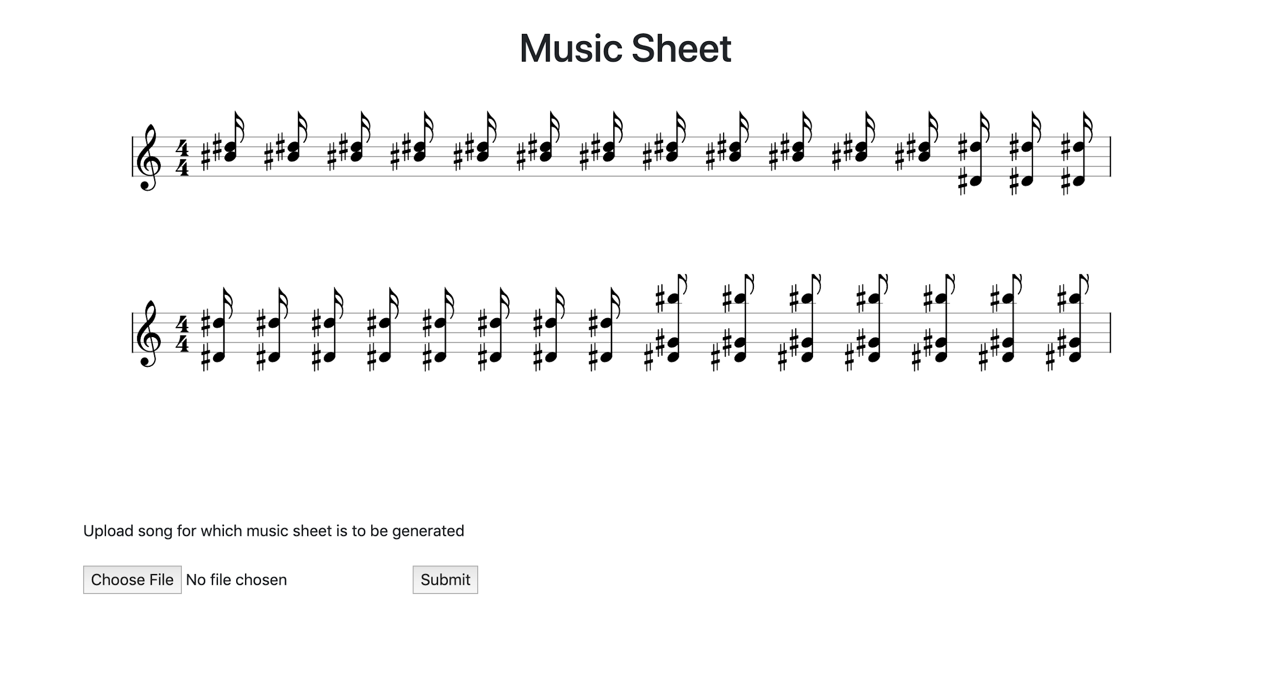
Results
……………………………..

Slide 9
Conclusion
………………………………………..
Architectures used for keyboard music did provide good scores for guitar music, however different ones were necessary.
In a way it proves our hypothesis (not conclusively though) that guitar music is different from keyboard music

Slide 10


