Slide 1
Feature-based 3D Reassembly
Devi Parikh
Mentor: Rahul Sukthankar
September 14, 2006

Slide 2
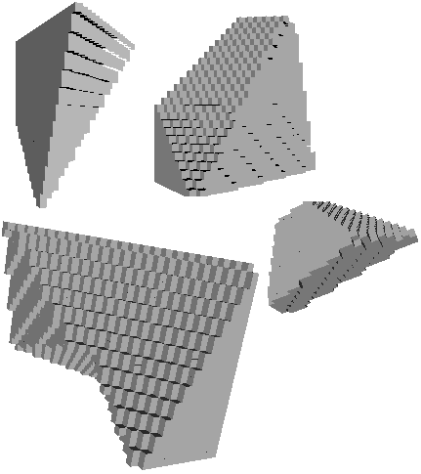
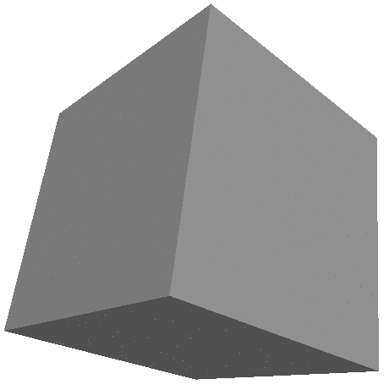
What is 3D Reassembly?
3D Reassembly
Potentially a mixture of several broken objects

Slide 3
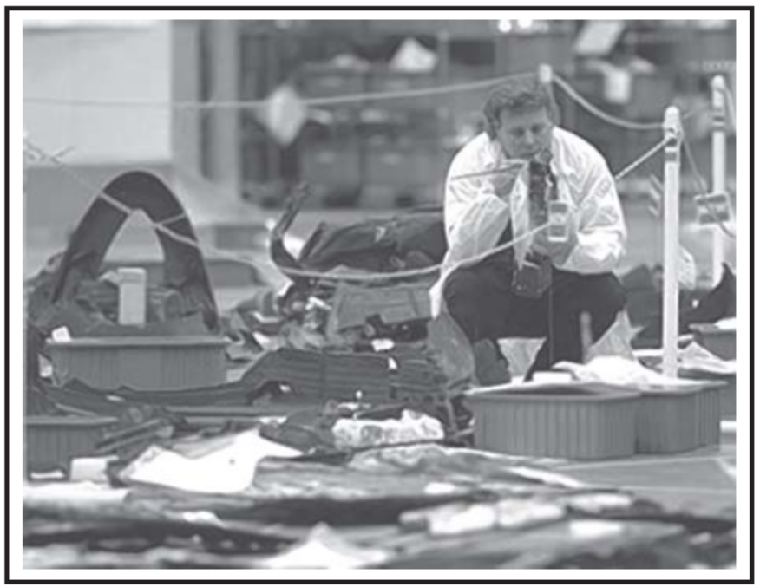
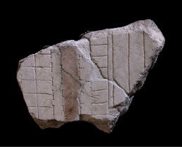
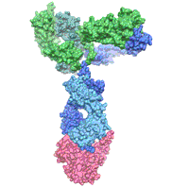
Why is it important?
  Aircrafts or space shuttles post-crash failure analysis [McDanels, et.al., 2006]
  Protein docking
  Archeology [Koller, et.al., 2005]
  Forensics
  Industrial applications

Slide 4
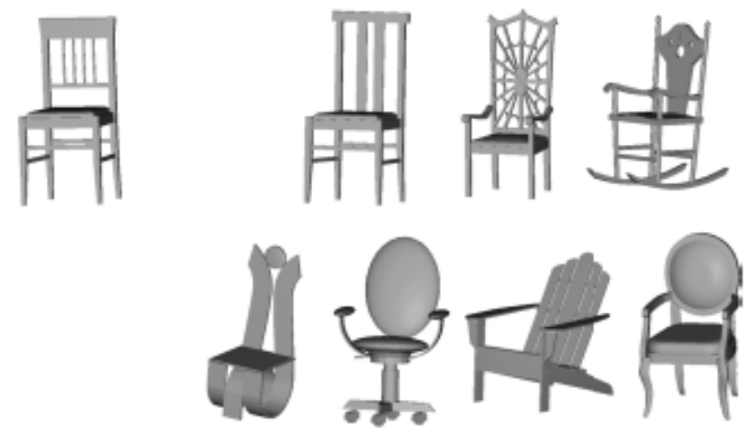

Why it is interesting?
[Bustos, et.al., 2005]
  Different from conventional 3D similarity matching
    Global vs. local
  Local phenomenon but entails non-local agreement
    Partial fitting
  Infinitely many possible configurations can be hypothesized
    Generate-and-test not feasible

Slide 5
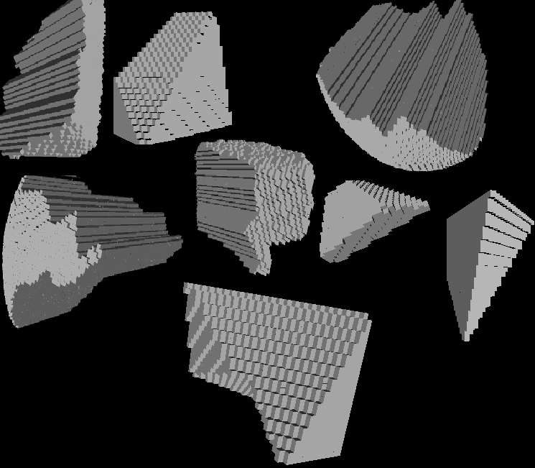
Goal

Slide 6
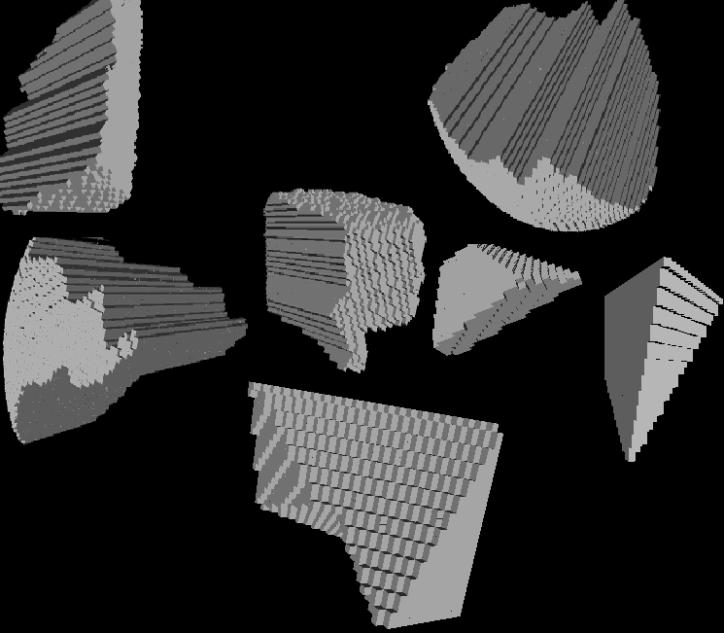
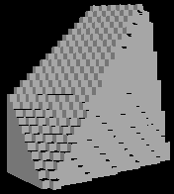
Goal

Slide 7
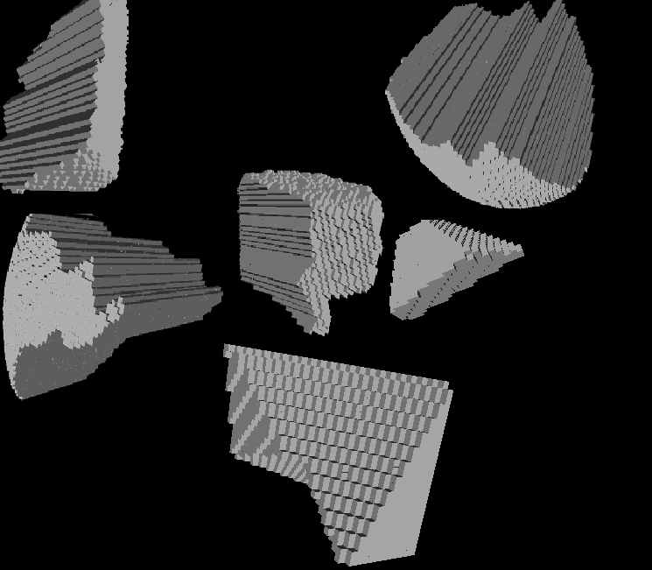
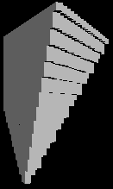
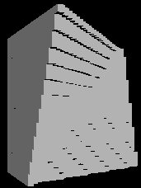
Goal

Slide 8
Goal

Slide 9
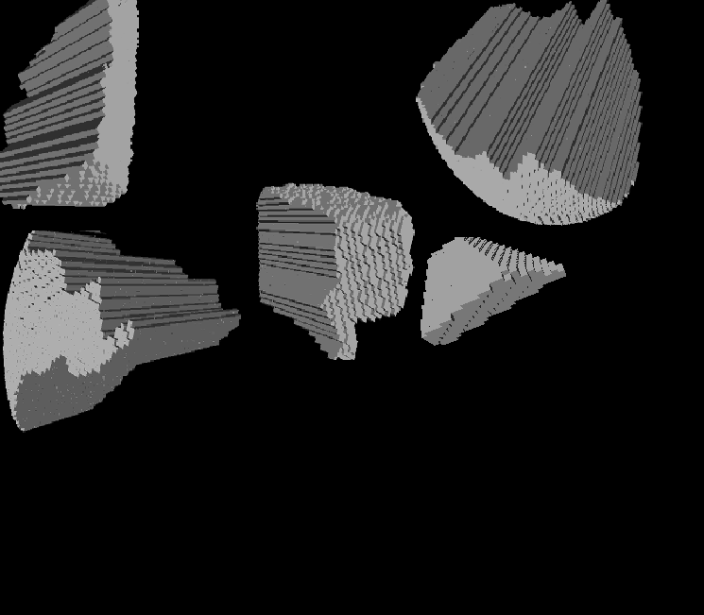
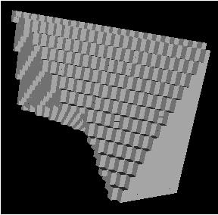
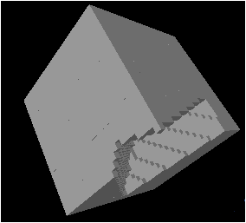
Goal

Slide 10
Goal

Slide 11
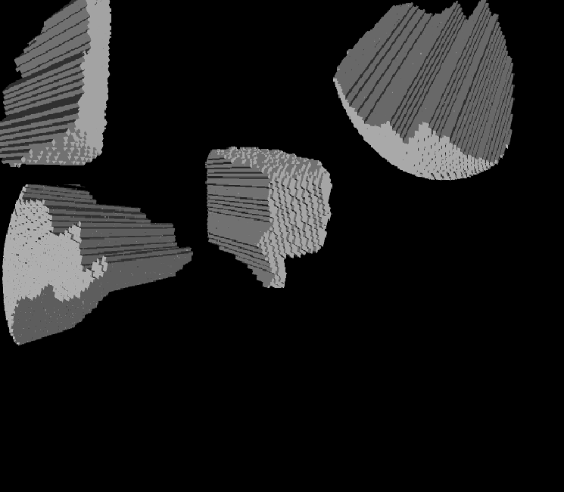
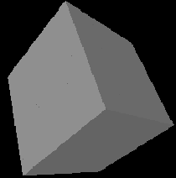
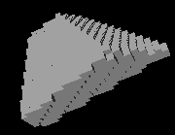
Goal

Slide 12
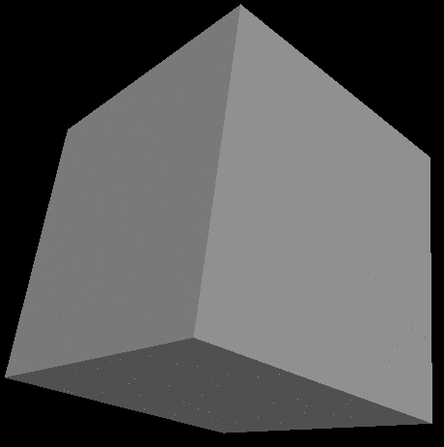
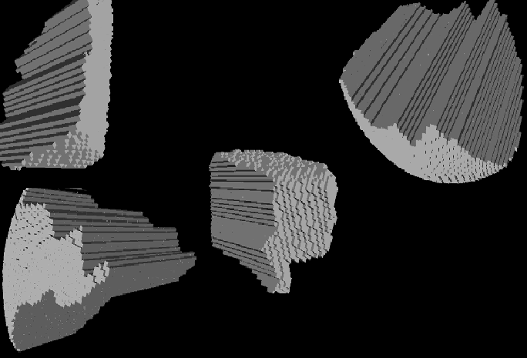
Goal

Slide 13
Outline
  Related work
  Proposed algorithm
  Experiments and Results
  Summary
  Questions

Slide 14
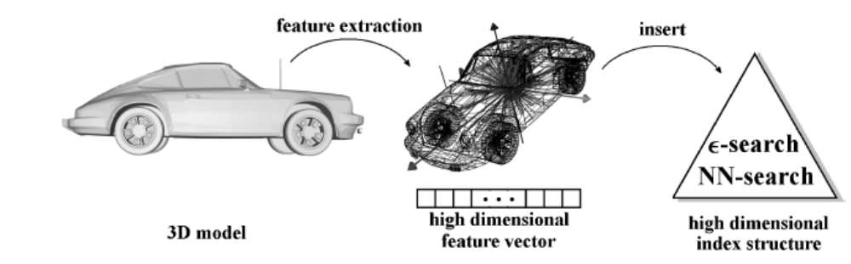
Related Work
3D Similarity Matching
  Exact search
  Annotation
  Content based
    Feature based:
      Project objects onto a point in feature space
      Similarity measured by a distance metric in space
      Captures global similarity
      Mostly not applicable to 3D reassembly
[Bustos, et.al., 2005]
X
X
[Bustos, et.al., 2005]

Slide 15
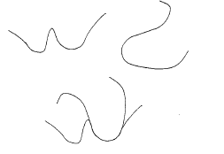
Related Work
[Wolfson, 1990]
Reassembly
  Curve fitting based: [Kong, et.al., 2001],[Papeioannou, et.al., 2002]
    Mostly to 2D
    Not applied to 3D data or to very small database (~10)
    Cannot fit curves to (robustly) to 3D surfaces
    Involves generate-and-test approach at a certain level
  Bayesian framework: [Willis, et.al., 2004]
    Assumes reassembling axially symmetric objects (pots)
  Most works concentrate on automatic reassembly search algorithm
    Compatibility score between pieces are not robust

Slide 16
We propose…
  Feature-based
    Efficient
    Not a generate-and-test approach
  Does not require knowledge of the shape of the entire object
  Can handle mixture of multiple broken objects
  Can handle larger databases
  Very few false matches
    Alleviates the need for sophisticated search algorithms to accomplish automatic reassembly
  Focus on scores between two pieces
    Can later be used for automatic reassembly
    Can be used for interactive reassembly e.g. Diamond

Slide 17




The idea…
query

Slide 18
The idea…
query

Slide 19
The idea…
query

Slide 20
The idea…
query

Slide 21
Framework
To find a compatibility score between two pieces
Interest region detection
Local description of interest regions
Near-neighbor based correspondence
Geometric agreement
Spectral technique based score

Slide 22



Framework
Interest region detection
Interest region detection
Interest region detection
Interest region detection
Local description of interest regions
Local description of interest regions
Local description of interest regions
Local description of interest regions
Near-neighbor based correspondence
Near-neighbor based correspondence
Near-neighbor based correspondence
Near-neighbor based correspondence
Geometric agreement
Geometric agreement
Geometric agreement
Geometric agreement
Spectral technique based score
Spectral technique based score
Spectral technique based score
Spectral technique based score

Slide 23
Framework
Interest region detection
Interest region detection
Local description of interest regions
Local description of interest regions
Near-neighbor based correspondence
Near-neighbor based correspondence
Geometric agreement
Geometric agreement
Spectral technique based score
Spectral technique based score

Slide 24
Framework
Interest region detection
Local description of interest regions
‘Goodness’ of match
Near-neighbor based correspondence
Geometric agreement
Geometric agreement
Spectral technique based score
Adjacency Matrix
Eigen vector
Graph
…
…
…
…
1
0
1
0
binarize
[Leordeanu, et.al., 2005]

Slide 25
Framework
Interest region detection
Local description of interest regions
Near-neighbor based correspondence
Geometric agreement
Eigen vector
Spectral technique based score
0
1
0.70
0.11
0.60
0.36
1
0.11
0.60
0.36
1
0
0.60
0.36
0.95
0.6
0
0.99
0.2
0
1
0.2
0.91
0
0.6
0
0
0.92
max →1
conflicts → 0
[including geometrical disagreements]
…till binarized

Slide 26
Framework
Interest region detection
Local description of interest regions
Near-neighbor based correspondence
Geometric agreement
Eigen vector
Spectral technique based score
0
1
0.70
0.11
0.60
0.36
1
0
1
0.36
1
0
1
0
1
0
1
0
0.95
0.6
0
0.99
0.2
0
1
0.2
0.91
0
0.6
0
0
0.92
max →1
conflicts → 0
[including geometrical disagreements]
…till binarized

Slide 27
Framework
Interest region detection
Local description of interest regions
Near-neighbor based correspondence
Geometric agreement
Spectral technique based score
1
0
1
0
1 0 1 0
Score =

Slide 28
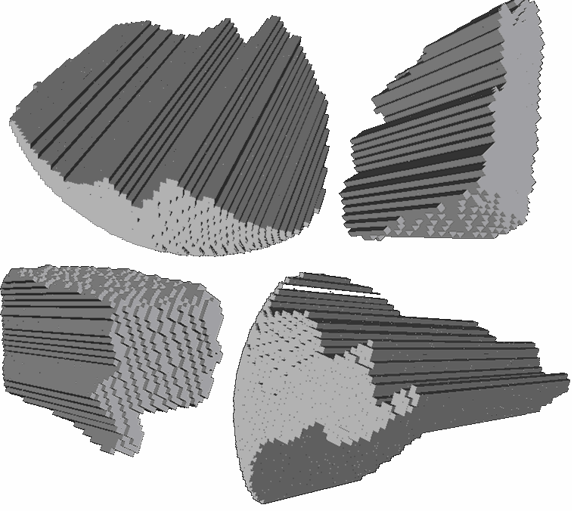
Experiments
Mixture of synthetic broken cubes and spheres

Slide 29
Experiments
  Interest region detector: Sphere
    Could use 3D extension of Harris corner detector, or spatio-temporal interest point detectors [Laptev, et.al., 2003], etc.
  Key-edges from key-points
  Local descriptor: Occupancy of sphere
    Could use spin images [Jhonson, et.al., 1997], etc.
  Compatibility metric: Summation of descriptors should be 1
  Geometric agreement: Shortest distance between lines parameterizing key-edges
    Tolerate up to 10% inconsistency, linearly decreasing

Slide 30
Experiment 1
500 piece database
Present a piece as a query
Compute score with every piece in database
Top score is picked as a match
Every piece is presented as a query
100% retrieval accuracy

Slide 31
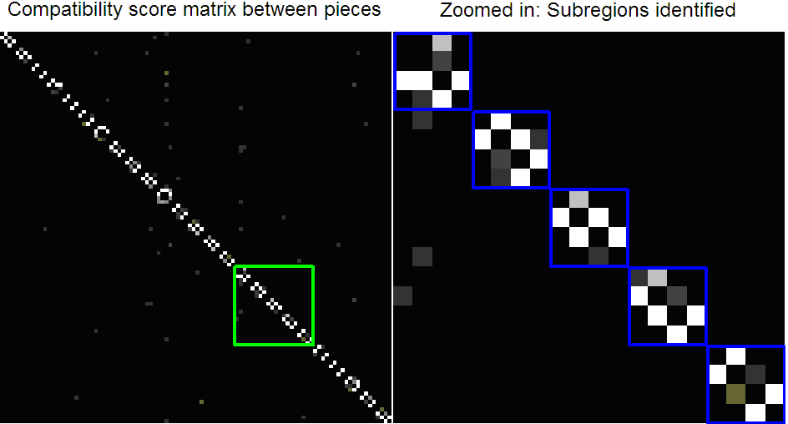
Experiment 1: Noise free
Query
pieces
Query
pieces
Database pieces
Database pieces

Slide 32

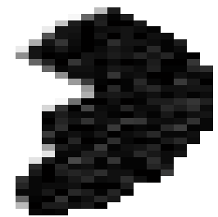
Experiment 2
  Add noise to pieces
    Gaussian noise, zero mean, 3% standard deviation
  100 piece database
  Every piece presented as a query, score computed with every other piece in database
  Retrieval accuracy recorded at different ranks retrieved
Adding 10% noise

Slide 33
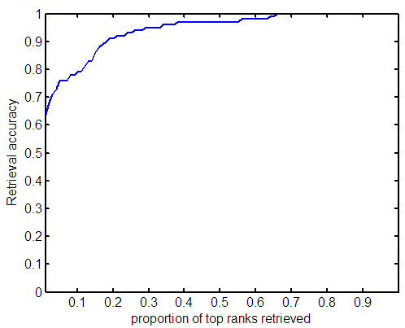
Experiment 2: With 3% noise
Area under the curve: 0.94

Slide 34
Experiment 3
  Different levels of noise
    No noise, 3%, 6% and 9%
  Baseline:
    Nearest neighbor based
    No geometric agreement enforced
  Compare area under the CMC curves of proposed framework
    For different noise levels
    With baseline

Slide 35
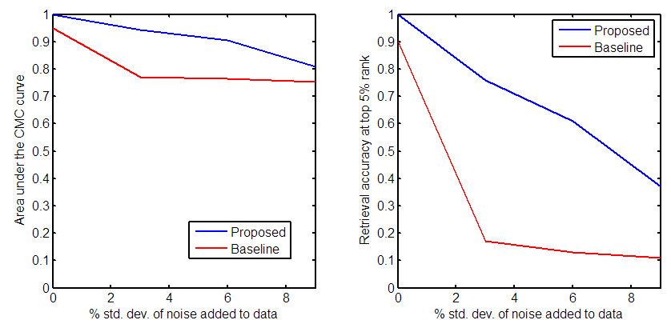
Experiment 3:

Slide 36
Summary
  3D reassembly
  Related work
  We concentrate on scores between two pieces
  We propose a feature based approach for computing a compatibility score between two pieces
  Proposed a framework – independent of specific components
  Promising results
  Submitting paper in Workshop on Applications in Computer Vision (WACV) 2007
  Next: Submission of paper, Demo for open house

Slide 37


