Slide 1
Bringing Diverse Classifiers to Common Grounds: dtransform
Devi Parikh and Tsuhan Chen
Carnegie Mellon University
April 3, ICASSP 2008

Slide 2
Outline
Motivation
Related work
dtransform
Results
Conclusion
Motivation
Related work
dtransform
Results
Conclusion

Slide 3
Motivation
Consider a three-class classification problem
Multi-layer perceptron (MLP) neural network classifier
Normalized outputs for a test instance
  class 1: 0.5
  class 2: 0.4
  class 3: 0.1
Which class do we pick?
If we looked deeper…
Motivation
Related work
dtransform
Results
Conclusion
class 1
Adaptability
class 2
- examples
+ examples
~ c₁
c₁
~ c₂
c₂
~ c₃
c₃
0
0.6
1
0
0.3
1
0
0.7
1
Notes:
Score before output

Slide 4
Motivation
Diversity among classifiers due to different
  Classifier types
  Feature types
  Training data subset
  Randomness in learning algorithm
  Etc.
Bring to common grounds for
  Comparing classifiers
  Combining classifiers
  Cost considerations
Goal: A transformation that
  Estimates posterior probabilities from classifier outputs
  Incorporates statistical properties of trained classifier
  Is independent of classifier type, etc.
Motivation
Related work
dtransform
Results
Conclusion

Slide 5
Related work
Parameter tweaking
In two-class problems (biometric recognition), ROC curves are prevalent
  Straightforward multi-class generalizations are not known
Different approaches for estimating posterior probabilities for different classifier types
  Classifier type dependent
  Do not adapt to statistical properties of classifiers post-training
Commonly used transforms:
  Normalization
  Softmax
  Do not adapt
Motivation
Related work
dtransform
Results
Conclusion

Slide 6
dtransform
Set-up: “Multiple classifiers system”
Multiple classifiers
One classifier with multiple outputs
Any multi-class classification scenario where classification system gives a score for each class
Motivation
Related work
dtransform
Results
Conclusion

Slide 7
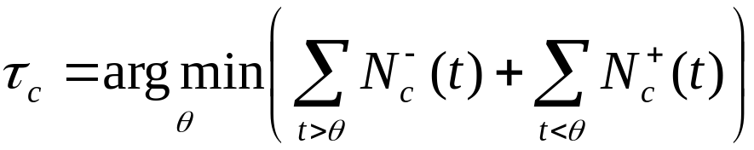
dtransform
For each output μ_{c}
  Raw output τ_{c} maps to transformed output 0.5
  Raw output 0 maps to transformed output 0
  Raw output 1 maps to transformed output 1
  Monotonically increasing
- examples
+ examples
Motivation
Related work
dtransform
Results
Conclusion
~ c
c
μ_{c}
0
1
τ_{c}

Slide 8
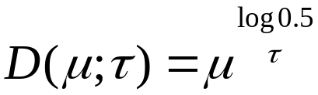
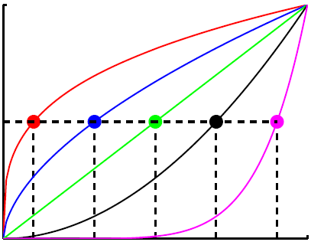
dtransform
Motivation
Related work
dtransform
Results
Conclusion
1
τ = 0.1
τ = 0.5
transformed output: D
τ = 0.9
0
raw output: μ
1

Slide 9
dtransform
Logistic regression
  Two (not so intuitive) parameters to be set
Histogram itself
  Non-parameteric: subject to overfitting
  dtransform: just one intuitive parameter
Affine transform
Motivation
Related work
dtransform
Results
Conclusion

Slide 10
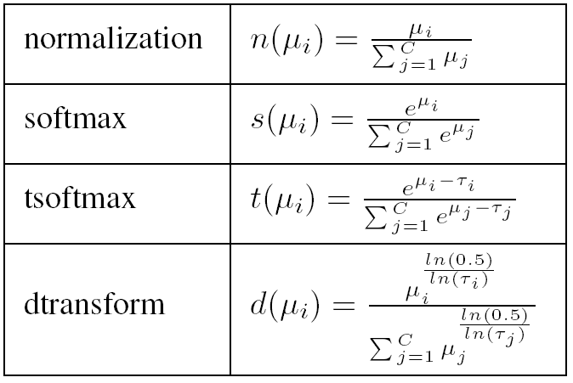
Experiment 1
Comparison with other transforms
Same ordering, different values
  Normalization and softmax → not adaptive
  tsoftmax and dtransform → adaptive
Similar values, different ordering
  softmax and tsoftmax
Motivation
Related work
dtransform
Results
Conclusion

Slide 11
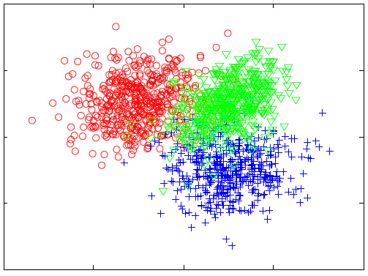
Experiment 1
Synthetic data
  True posterior probabilities known
  3 class problem
  MLP neural network with 3 outputs
Motivation
Related work
dtransform
Results
Conclusion

Slide 12
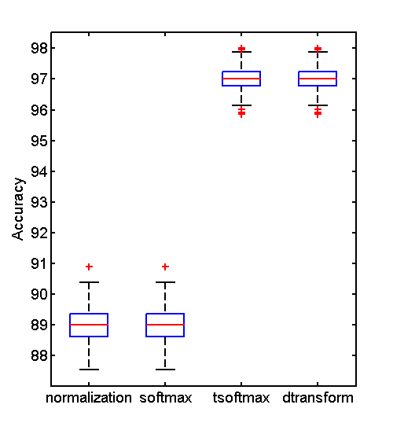
Experiment 1
Comparing classification accuracies
Motivation
Related work
dtransform
Results
Conclusion

Slide 13
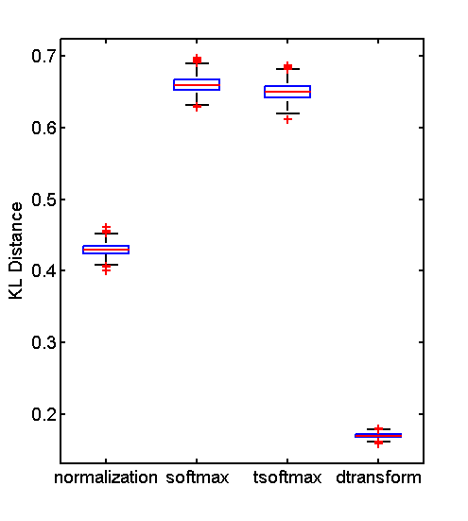
Experiment 1
Comparing KL distance
Motivation
Related work
dtransform
Results
Conclusion

Slide 14
Experiment 2
Real intrusion detection dataset
  KDD 1999
  5 classes
  41 features
  ~ 5 million data points
  Learn++ with MLP as base classifier
  Classifier combination rules:
    Weighted sum rule
    Weighted product rule
  Cost matrix involved
Motivation
Related work
dtransform
Results
Conclusion

Slide 15
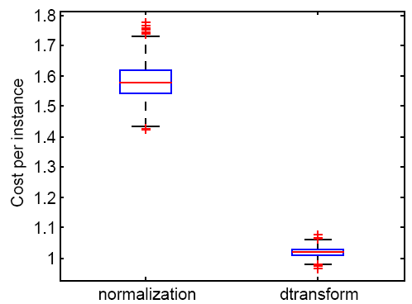
Experiment 2
Motivation
Related work
dtransform
Results
Conclusion

Slide 16
Conclusion
Parametric transformation to estimate posterior probabilities from classifier outputs
Straightforward to implement and gives significant classification performance boost
Independent of classifier type
Post-training
Incorporates statistical properties of trained classifier
Brings diverse classifiers to common grounds for meaningful comparisons and combinations
Motivation
Related work
dtransform
Results
Conclusion

Slide 17
Thank you!
Questions?
Motivation
Related work
dtransform
Results
Conclusion

