Slide 1
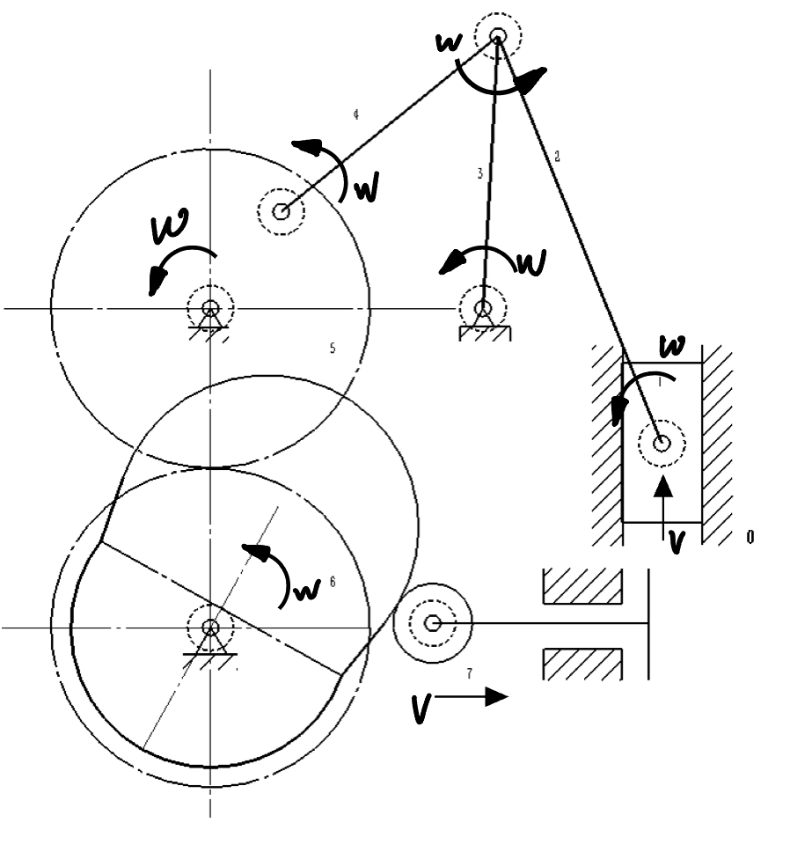

Slide 3
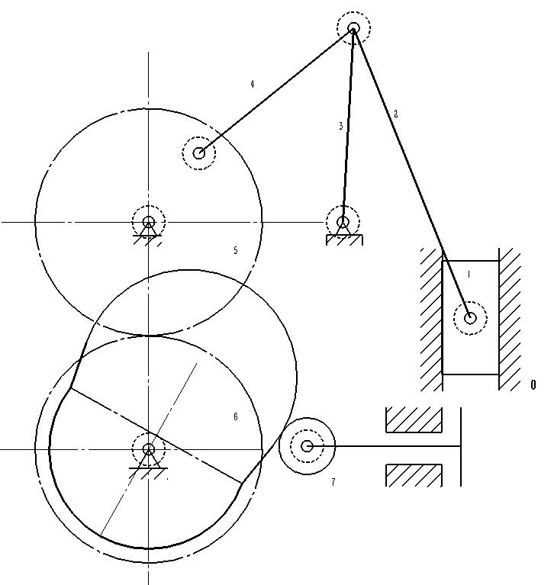














$$F_{R342}$$
$$F_{R243}$$
$$F_{R324}$$
M
$$F_{R54}$$
$$F_{R05}$$
$$F_{R03}$$
$$F_{R65}$$
$$F_{R56}$$
$$F_{R12}$$
$$F_{R76}$$
$$F_{R01}$$
$$F_{R06}$$
$$F_{R07}$$
$$F_{R67}$$

Slide 4




$$F_{R324y}$$
C
$$F_{R324x}$$
$$F_{R54x}$$
A
$$F_{R54y}$$

Slide 5




$$F_{R243x}$$
C
$$F_{R243y}$$
$$F_{R03y}$$
$$F_{R03x}$$
D

Slide 6



$$F_{R342y}$$
$$F_{R342x}$$
C
E
$$F_{R12x}$$
$$F_{R12y}$$

Slide 7



$$F_{R21y}$$
$$F_{R21x}$$
E
$$F_{R01}$$

