Slide 1
Introduction to RAGs

Slide 2
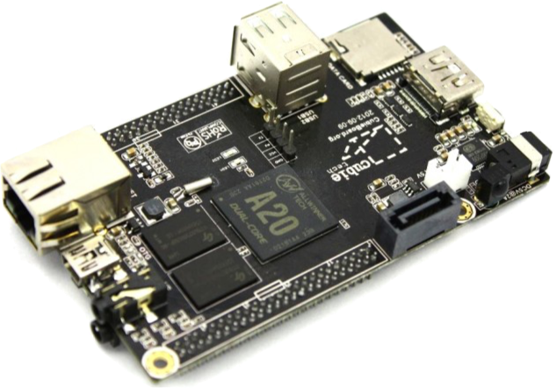
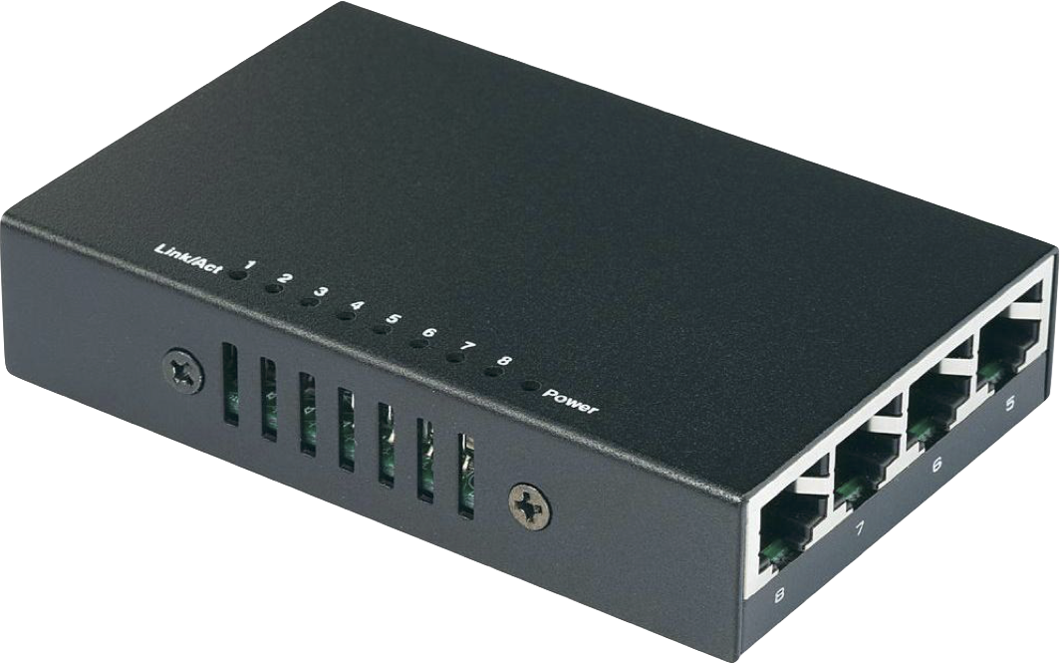
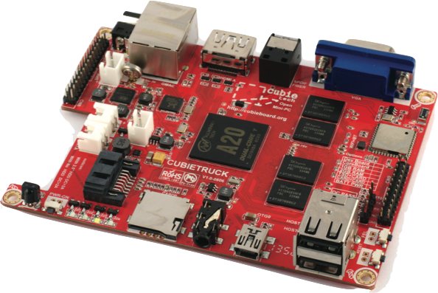
Real world

Slide 3
World-Model
Tree-based / hierarchical
Properties:
name, current load, type of device
Structural attributes (references)
parent, siblings in hierarchy
Handled requests

Slide 4
Abstract Syntax Tree (AST)
Specification of structure (possible node types and relationships)
Root
scheduler
backupworkers
AbstractWorker
id, state
timestamp
Request
id, size, deadline
dispatchtime
*
*
CompositeWorker
Worker
devicetype
Config
Switch

Slide 5
Abstract Syntax Tree (AST)
(ast-rule 'Root->scheduler-backupworkers-Config)
(ast-rule 'AbstractWorker->id-state-timestamp)
(ast-rule 'CompositeWorker:AbstractWorker->AbstractWorker*)
(ast-rule 'Config:CompositeWorker->)
(ast-rule 'Switch:CompositeWorker->)
(ast-rule 'Worker:AbstractWorker->devicetype-Request*<Queue)
(ast-rule 'Request->id-size-deadline-dispatchtime)

Slide 6
Attribute Grammar (AG)
Nodes in Abstract Syntax Tree can have attributes (some kind of computation)
Example:
(ag-rule
running?
(AbstractWorker
(lambda (n) (eq? (ast-child 'state n) 'RUNNING))))
Name of attribute
Node for which attribute is defined
Equation of the attribute

Slide 7
Reference Attribute Grammar (RAG)
Attributes can evaluate to nodes of the tree
(ag-rule
lookup-worker
(Worker
(lambda (n id) (if (= id (ast-child 'id n)) n #f)))
(CompositeWorker
(lambda (n id)
(if (= id (ast-child 'id n)) n
(ast-find-child*
(lambda (i worker)
(att-value 'lookup-worker worker id))
(ast-child 'Workers n))))))
Node for which
attribute is defined
Find first node satisfying condition

Slide 8
Reference Attribute Grammar Controlled Rewriting (RACR)
Builds depedency-graph of each attribute for used terminals
Enables rewrites of ASG
If rewrite changes terminal, attribute cache gets flushed
If attribute is called afterwards, it is reevaluated
If attribute is called without changes on dependent terminals, the cached value is used

Slide 9
RACR by example
Root
=total
AST Grammar
Attribute total
(ast-rule 'Root->A-B*)
(ast-rule 'A->id-state)
(ast-rule 'B->id-stock-B*)
*
A
->id, ->state
B
=total
->id, ->stock
*
(define (=total n id) (att-value 'total n id)
(ag-rule total
(Root (lambda (n id) (sum (->B* n))))
(B (lambda (n id)
(+ (->stock n) (sum (->B* n)))))

Slide 10
RACR by example (2)
Attribute findB
ASG
Evaluate total with given ASG
(define (=total n id) (att-value 'total n id)
(ag-rule total
(Root (lambda (n id) (sum (->B* n))))
(B (lambda (n id)
(+ (->stock n) (sum (->B* n)))))
Root
B (“b-1”,1)
B (“b-4”,5)
A (“a003”, running)
B (“b-1-2”,3)
B (“b-1-3”,6)
B (“b-4-3”,8)

Slide 11
RACR by example (3)
Attribute findB
ASG
Evaluate total with given ASG
(define (=total n id) (att-value 'total n id)
(ag-rule total
(Root (lambda (n id) (sum (->B* n))))
(B (lambda (n id)
(+ (->stock n) (sum (->B* n)))))
Cache for attribute total
Root =
B1 =
B12 =
B13 =
B4 =
B43 =
10
6
23
13
8
3
Root
B (“b-1”,1)
B (“b-4”,5)
A (“a003”, running)
B (“b-1-2”,3)
B (“b-1-3”,6)
B (“b-4-3”,8)

Slide 12
RACR by example (4)
Attribute findB
ASG
Evaluate total with same ASG
(define (=total n id) (att-value 'total n id)
(ag-rule total
(Root (lambda (n id) (sum (->B* n))))
(B (lambda (n id)
(+ (->stock n) (sum (->B* n)))))
Cache for attribute total
Root = 23
B1 = 10
B12 = 3
B13 = 6
B4 = 13
B43 = 8
Root
B (“b-1”,1)
B (“b-4”,5)
A (“a003”, running)
B (“b-1-2”,3)
B (“b-1-3”,6)
B (“b-4-3”,8)

Slide 13
RACR by example (5)
Attribute findB
ASG
Evaluate total with updated ASG
(define (=total n id) (att-value 'total n id)
(ag-rule total
(Root (lambda (n id) (sum (->B* n))))
(B (lambda (n id)
(+ (->stock n) (sum (->B* n)))))
Cache for attribute total
Root = ??
B1 = 10
B12 = 3
B13 = 6
B4 = ??
B43 = 8
B46 =
3
Root
B (“b-1”,1)
B (“b-4”,5)
A (“a003”, running)
B (“b-1-2”,3)
B (“b-1-3”,6)
B (“b-4-3”,8)
B (“b-4-6”,3)

Slide 14
RACR by example (5)
Attribute findB
ASG
Evaluate total with updated ASG
(define (=total n id) (att-value 'total n id)
(ag-rule total
(Root (lambda (n id) (sum (->B* n))))
(B (lambda (n id)
(+ (->stock n) (sum (->B* n)))))
Cache for attribute total
Root = 26
B1 = 10
B12 = 3
B13 = 6
B4 = 16
B43 = 8
B46 = 3
Root
B (“b-1”,1)
B (“b-4”,5)
A (“a003”, running)
B (“b-1-2”,3)
B (“b-1-3”,6)
B (“b-4-3”,8)
B (“b-4-6”,3)

