Slide 1
Preclass preparation
Sign in all clients with teacherX accounts
Use Epoptes to share the screen with everyone before the class starts

Slide 2
Welcome to Computer Training!!!
Reneal International Education Outreach, Inc.
Rene Bierbaum
Neal Bierbaum
David Nyangaka
Robert Nyangaka
Erick Mneney

Slide 3
This System
This computer system has office programs, like a word processor and spreadsheet
It also has educational programs for different subject areas
It has educational materials and books stored in it
With this system, you can teach students how to use the computer, but you can also use the computer to teach them about different subject areas!

Slide 4
Today
I will show you some of the educational material on the system that you can use
Today we will learn how to “log on” to the system with your username and password
I will show you how to create and save a document or spreadsheet

Slide 5
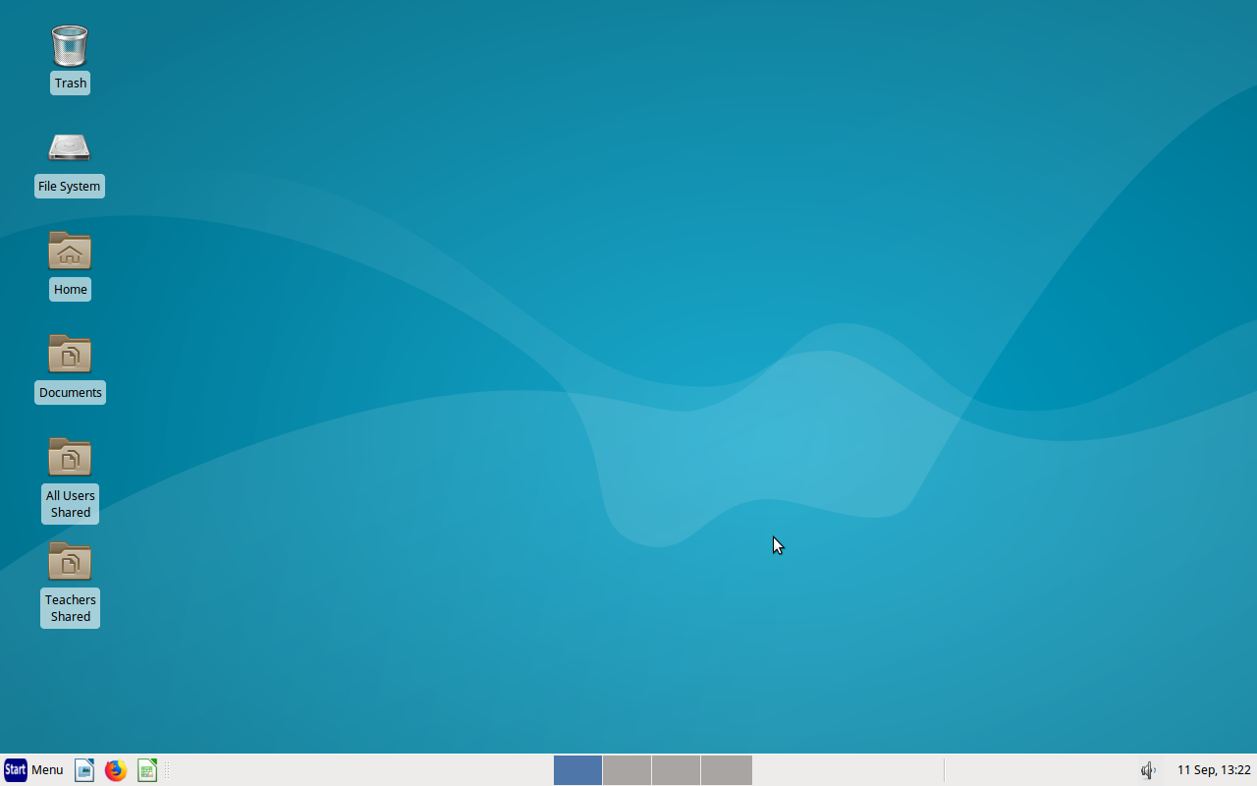
Your Desktop

Slide 6

Finding Programs
We find programs in two ways:
  Single-click on the icons in the task bar at the bottom of the screen
  Go to “Start Menu” and then find the program that we want

Slide 7
Educational Resources
There are many educational resources that have already been saved on the computer system for you
  Some are found in Firefox:
    Khan Academy videos
    RACHEL
    PhET
  Educational programs
  Teachers Shared

Slide 8
Khan Academy Videos
There are thousands of educational videos stored on the server
Open “Firefox” and look for the Khan Academy videos
  Both English and Kiswahili
Click through and find the topic you want
You can download them too – start the video and right-click to save

Slide 9
RACHEL Educational Resources
RACHEL is a free collection of educational materials saved on the main server (no internet required to use)
Material for many different subject areas
How to get to it...
  Start Firefox
  Choose “Rachel Educational Materials”

Slide 10
RACHEL Educational Resources
Off-line Wikipedia with search capability
Typing program
English, math, and science resources
ICT teaching material and videos

Slide 11
PhET
PhET science and math simulations are also found in Firefox
There are simulations for earth science, chemistry, physics, biology, probability, etc.

Slide 12
Educational Programs
“Start Menu” button
“Education”
Now pick an option...

Slide 13
Kalzium
Periodic Table of the elements

Slide 14
Marble
Type in the place you want to go
Do some exploring!

Slide 15
Educational Programs
Even more!
Just experiment to see what is there...

Slide 16
Computer Trainings
You will also find some computer trainings videos when you click on Firefox
They talk about this system and how it is used
There are also short videos for some of the applications, like Marble, Lybniz, and Kalzium

Slide 17

Your Username and Password
Each teacher will have a user name that is the first letter of the given name and “_” and the family name
  Example: John Massawe
  So his user name is j_massawe
The password is birthdate (ddmmyyyy)
  Example: John Massawe's birthdate is April 23, 1960
  So his password is 23041960

Slide 18
Teachers Shared
Many times, we want to share files with other teachers
This is what “Teachers Shared” is for!
You can click on the “Teachers Shared” icon on the desktop or on the “Teachers Shared” icon in the File Manager

Slide 19
Teachers Shared
This folder has material organized by topic area
This information was collected for high school teachers
Science and Math might be the most useful

Slide 20
Teachers Shared
We would encourage you to save things that you create yourself or find on the internet in the “Teachers Shared” folder
That way, you can use them year after year and share them with your other teachers
Try to save things in folders and use meaningful file names so you can find them again easily

Slide 21
AllUsersShared
Teachers can save files in the AllUsersShared folder for access by all students
  Assignments, tests, readings, games, etc.
AllUsersShared folder
  ClientHome / AllUsersShared

Slide 22
Creating and Saving a File

Slide 23
My Files
When you log in with a teacher user name, you have a “Documents” folder
Click on “Documents”
This is where you will save your personal files!
You can also click on “Home” and then on “Documents”

Slide 24

LibreOffice
LibreOffice (LO) is a set of “applications”
  Applications are programs that help us do work, such as a word processor and a spreadsheet program
LibreOffice is like Microsoft Office
  Microsoft Word ↔ LO Writer
  Microsoft Excel ↔ LO Calc
  Microsoft PowerPoint ↔ LO Impress
LibreOffice can run on either Microsoft Windows or Linux!

Slide 25
Saving LibreOffice Files
When you save a file, Open Office gives you several different options for saving it: LibreOffice format or Microsoft Office format
Documents: .odt .doc .docx
Presentations: .odp .ppt .pptx
Spreadsheets: .ods .xls .xlsx
You can also save documents and presentations as Adobe Acrobat (.pdf) files

Slide 26
Saving LibreOffice Files
To save a file so you can open in Microsoft office…
Choose “Save as”
At the top, type the file name
In the middle, choose where you want to save the file (it will automatically assume your Documents folder)
Near the bottom right, choose the file type for Microsoft Office format (.docx, .xlsx, .pptx)

Slide 27
USB Flash Drive
Put in your flash drive
You will see your flash drive show up in the file manager
Click on it to see the contents of your flash drive

Slide 28
USB Flash Drive
To remove the flash drive, double-click on the green triangle on the desktop
The name of the flash drive will disappear from the file manager, and then you can remove it

Slide 29
Epoptes Lab Monitor
The program Epoptes (under the “Internet” category) allows you to see the screen of each student
You can…
  share your screen to all students
  send a message to one or students
  lock one or more screens
  log out or shut down all computers
It is a very powerful lab management tool for you

Slide 30
Video Streamer
You can’t use Epoptes to share videos
You can use the Video Streamer program to share a video to all other computers (must use Teacher account)
  Students: choose “Multimedia”, “Video Viewer”
  Teacher: choose “Multimedia”, “Video Streamer”, then select the movie you want to share

Slide 31
Student Accounts
There are also student accounts
  User name: student1 through student30
  Password: student
These accounts cannot access the teacher files
There is a special folder where student files are saved

Slide 32
Using Student Accounts
Students will select their Form, Stream, and Name using the arrow keys (don’t type)
When they first log in, a folder will automatically be created for them to store their work
Students can also log in as “Guest” but their work will not be saved automatically in their own folder
IMPORTANT: Please do not log into more than one computer at a time with the same user name!!!

Slide 33
Checking Student Outputs
There is a program called “Manage Classes” on the teacher account
It allows you to define assignments for students and then consolidates their outputs for easy checking

Slide 34
Logging Off
Click once on the “Start Menu” button and select “Log out”
Select Log Out
It will ask you if you are sure...

