Slide 1
Angular 4
Developer Rene Cardozo

Slide 2
What Is Angular CLI?
Angular CLI is a Command Line Interface (CLI) to automate your development workflow. It allows you to:
create a new Angular application
run a development server with LiveReload support to preview your application during development
add features to your existing Angular application
run your application’s unit tests
run your application’s end-to-end (E2E) tests
build your application for deployment to production

Slide 3


Installing Angular CLI
Before you can use Angular CLI, you must have Node.js 6.9.0 and npm 3.0.0 or higher installed on your system.
To verify whether your installation completed successfully, you can run:

Slide 4

Creating a New Angular Application
For creating a new angular cli Project type type the following commands.
Behind the scenes, the following happens:

Slide 5
Creating a New Angular Application
A new directory PROJECT-NAME is created
All source files and directories for your new Angular application are created based on the name you specified.
Npm dependencies are installed
TypeScript is configured for you
The karma unit test runner is configured for you
The protactor end-to-end test framework is configured for you
Environment files with default settings are created.

Slide 6
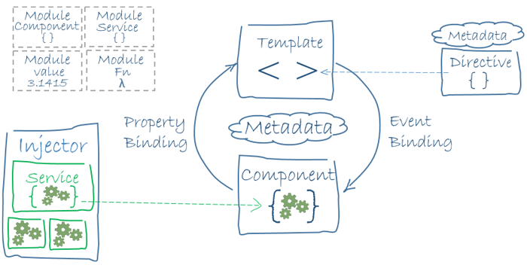
Angular 4
Angular is a framework for building client applications in HTML and either JavaScript or a language like TypeScript that compiles to JavaScript.

Slide 7
Components
Components are the most basic building block of an UI in an Angular application
When building applications with Angular 2, we will be using the @ decorator all the time to create. The main objective of these decorators is to allow us to add meta-data to our application that will tell Angular 2 how to process a class.
An Angular application is a tree of Angular components.
Components can control their runtime behavior by implementing various Life-Cycle hooks.

Slide 8
Directives and Structural directives
Directive decorator allows you to mark a class as an Angular directive and provide additional metadata that determines how the directive should be processed, instantiated and used at runtime.
Directives allow you to attach behavior to elements in the DOM.
An Attribute directive changes the appearance or behavior of a DOM element.

Slide 9
Lifecycle Hooks
A component has a lifecycle managed by Angular.
Angular creates it, renders it, creates and renders its children, checks it when its data-bound properties change, and destroys it before removing it from the DOM.
Angular offers lifecycle hooks that provide visibility into these key life moments and the ability to act when they occur.
A directive has the same set of lifecycle hooks, minus the hooks that are specific to component content and views.

