Slide 1
Hong Kong Workshop Lecture 4
Antigenicity of MICA epitopes

Slide 2
The Major Histocompatibility Complex class I-related chain A (MICA) antigens
Highly polymorphic, stress-inducible cell-surface proteins encoded by genes on chromosome 6 mapping close to HLA-B and HLA-C
Similar to class I HLA but no β2-microglobulin and no peptide binding
Ligand for NKG2D also expressed on CD8αβ T-cells and γδ T-cells
Increased MICA expression on endothelial cells and following transplantation
MICA mismatches can trigger alloantibody responses that are associated graft rejection and transplant failure
Pre-transplant MICA antibodies represent significant risk factors for allograft rejection and lower graft survival
References: Bahram et al. Res. Immunol. 147:328, 1996. Steinle et al. Immunogenetics 53:279, 2001. Zwirner et al. Hum Immunol. 61:917, 2000. Zou et al. NEJM 357:1293, 2007. Mizutani et al. Amer. J Transplantation 5:2265, 2005

Slide 3
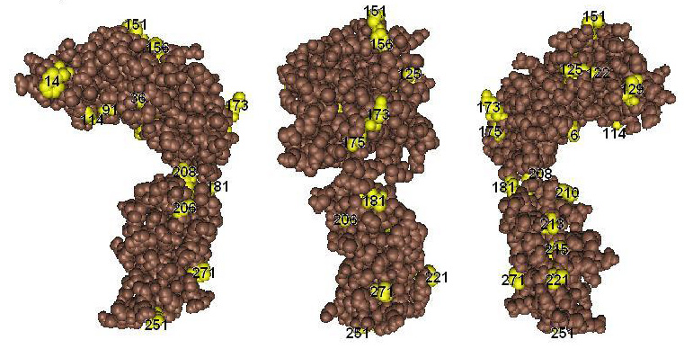
Topography of Polymorphic Residues on MICA
Duquesnoy, Mostecki, Hariharan and Balazs: Structurally based epitope analysis of MICA antibody specificity patterns, Human Immunology 69: 826-832, 2008

Slide 4
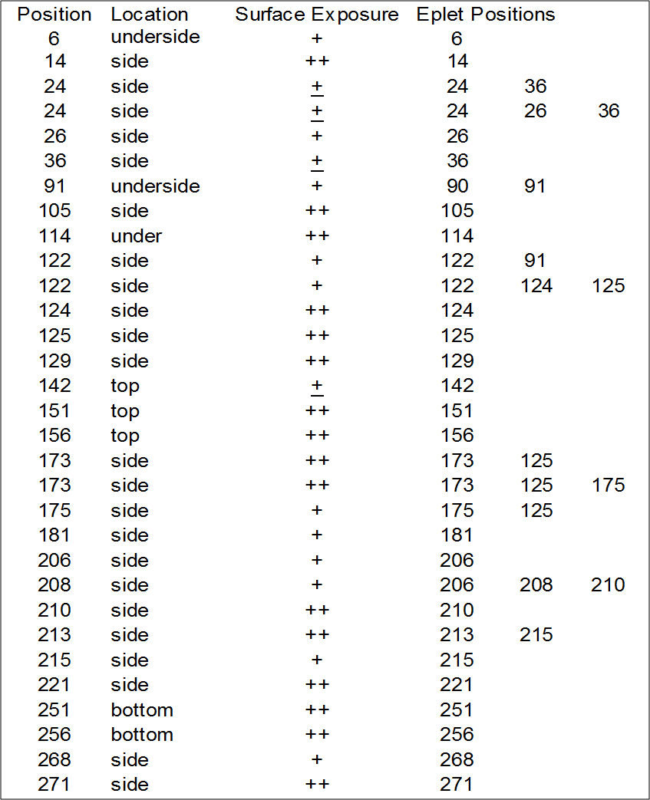
Eplet Positions on MICA

Slide 5
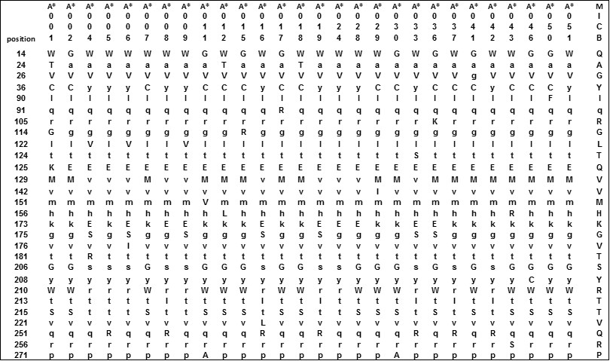
Comparisons between residue differences between MICA and MICB

Slide 6
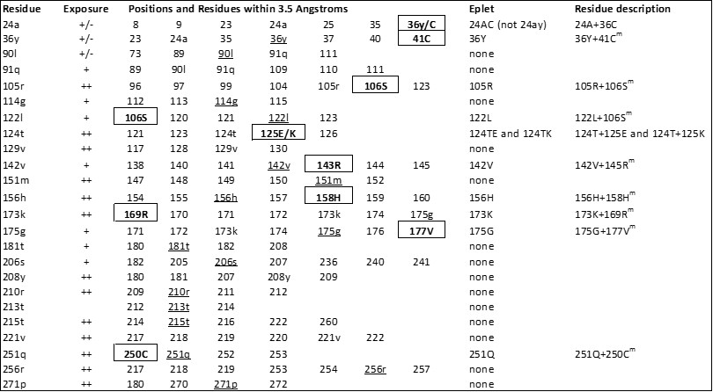
MICA eplets defined by residues that are monomorphic for MICB but share residues distinct for MICA

Slide 7
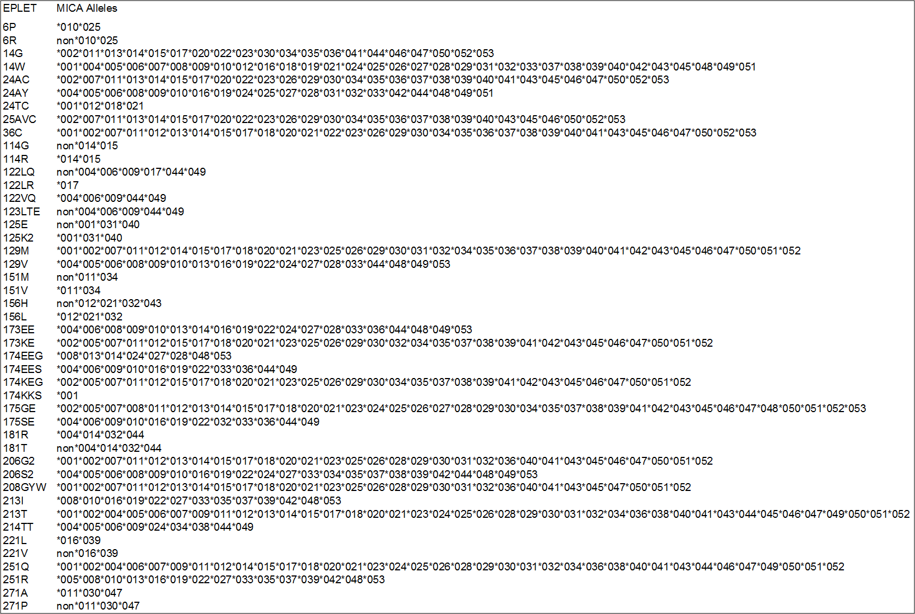
Common Eplet Repertoire of MICA

Slide 8
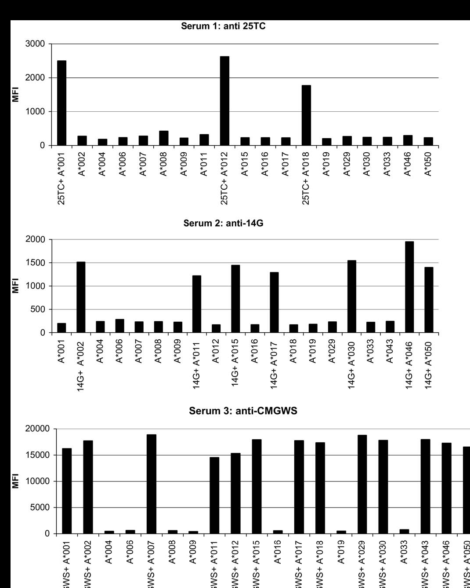
Three patients with antibodies against MICA epitopes
Duquesnoy, Mostecki, Hariharan and Balazs
Human Immunology 69:826-832, 2008

Slide 9
Antibody Verification of HLA Epitopes
Duquesnoy RJ, Marrari M, Mulder A, da M. Sousa LCD, Da Silva AS, do Monte SJH. ‘First Report on the Antibody Verification of HLA-ABC Epitopes Recorded in the HLA Epitope Registry’. Tissue Antigens 83:391-400, 2014
  97 HLA-ABC antibody-verified epitopes have been recorded, 62 correspond to eplets and 35 are defined by eplets paired with other residue configurations
Duquesnoy RJ, Marrari M, Tambur A, da Mata Sousa LCD, Da Silva AS, do Monte SJH. ‘First Report on the Antibody Verification of HLA-DR, HLA-DQ and HLA-DP Epitopes Recorded in the HLA Epitope Registry’ Human Immunology 75:1097-1103, 2014
  24 HLA-DRB1/3/4/5, 15 DQB, 3 DQA and 8 DPB antibody-verified epitopes
Duquesnoy RJ, Marrari M, Mostecki J, Da Silva AS, da Mata Sousa LCD, do Monte SJH. ‘First Report on the Antibody Verification of MICA Epitopes Recorded in the HLA Epitope Registry ‘ Int J Immunogenetics 41: 370-377, 2014
  MICA eplets were defined in comparison with MICB polymorphisms
  22 MICA epitopes verified with antibodies which have primarily been tested in Luminex assays with single alleles

Slide 10
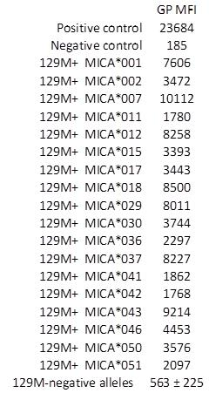
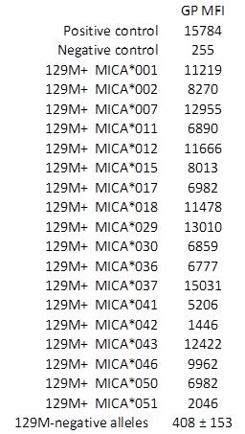
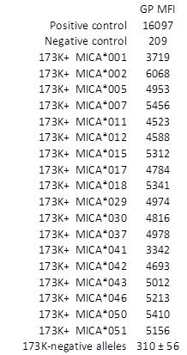
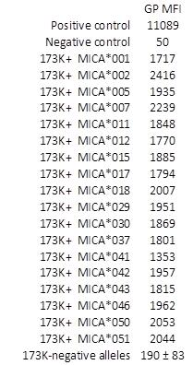
Allosera specific for MICA epitopes defined by 129M and 173K

Slide 11

Antibody-Verified MICA Epitopes in HLA Epitope Registry
* Provisional assignment

