Slide 1
Lecture 4
Registry of HLA epitopes and HLAMatchmaker analysis for antibody-verified epitopes

Slide 2
16th Workshop Project:
International HLA Epitope Registry
GOALS:
Develop a notation system for epitopes encoded by HLA-ABC, DRB1/3/4/5, DQAB, DPAB and MICA
Establish a database of antibody-verified HLA epitopes
Offer clinically relevant search functions
The registry does not address so-called cellular HLA epitopes defined by alloreactive T-cells

Slide 3
The Website-Based International Registry of Antibody-Verified HLA Epitopes
Int J. Immunogenetics, 40: 54-59 http://www.epregistry.com
Developed and managed by
Marilyn Marrari and Rene Duquesnoy
University of Pittsburgh School of Medicine, Pittsburgh PA
and
Luiz Claudio Sousa, Adalberto da Silva, Keylla Maria Aita, Jose Renato Barroso, Mário Sérgio Marroquim and Semiramis do Monte
Federal University of Piaui, Teresina, PI, Brazil

Slide 4
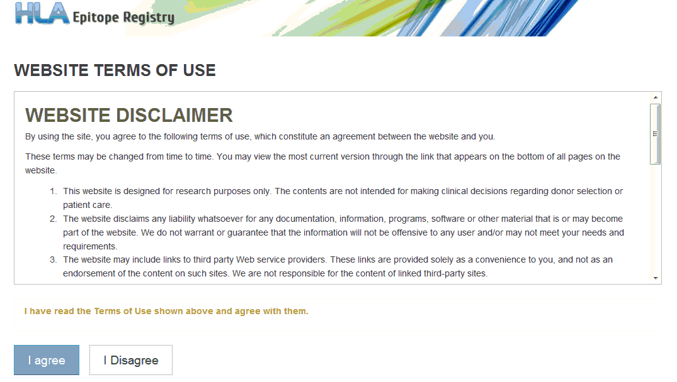
HLA Epitope Registry: www.epregistry.ufpi.br
(can be viewed in Microsoft Internet Explorer,
Google Chrome or Mozilla Firefox browsers)
Website information is for research use only. Users must agree to terms of use before using website:

Slide 5
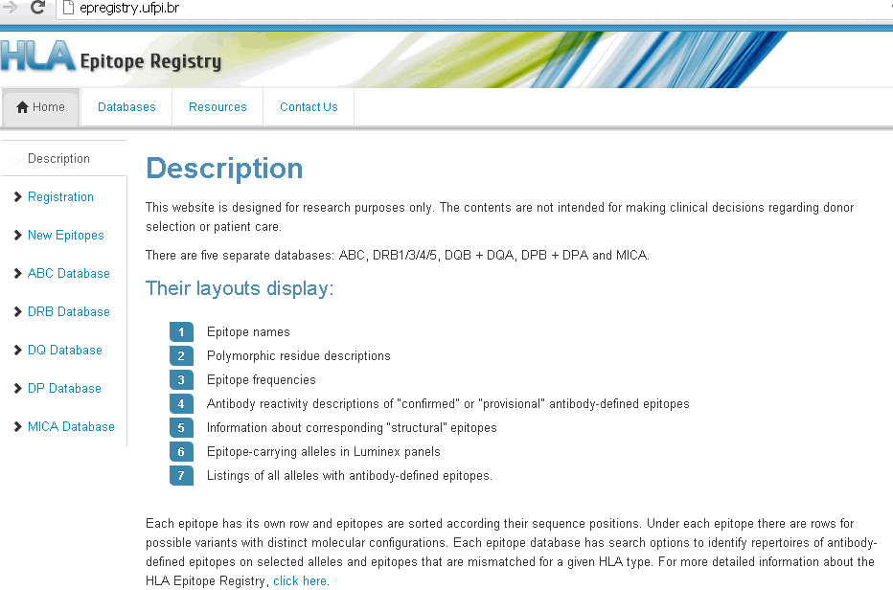
Registry Home Page

Slide 6
Class I Eplet Examples
Eplet | Description | Eplet-Carrying Alleles in Luminex Panel
62GE | 62G,63E,65R | A*02:01/02/03/05/06,B*57:01/03,*58:01
166DG | 166D,167G | A*01:01,*23:01,*24:02,*80:01,B*15:12
163EW | 162G163E166E167W | A*66:02,B*07:02*13:01/02,*27:05/08,*40:01/02/06,*47:01,*48:01,*73:01,*81:01,C*02:02,*17:01
44KM₃ | 43Q44K45M46E / 149A150V151H152A / 158V | A*01:01, A*36:01
Locus | Eplet | Description | Eplet-Carrying Alleles in Luminex Panel
MICA | 24T | 24T, 26V,36C | A*001,*012,*018
MICA | 175S | 173E,175S | A*004,*006,*009,*016,*019,*033,*036

Slide 7
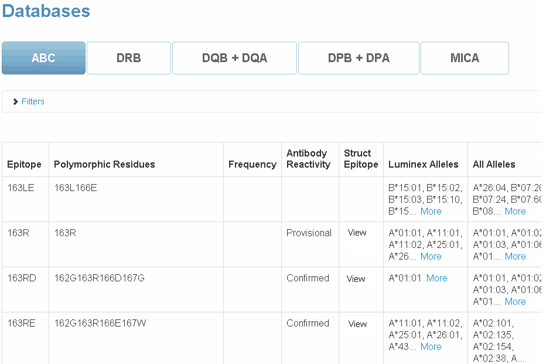
Class I ABC Database

Slide 8
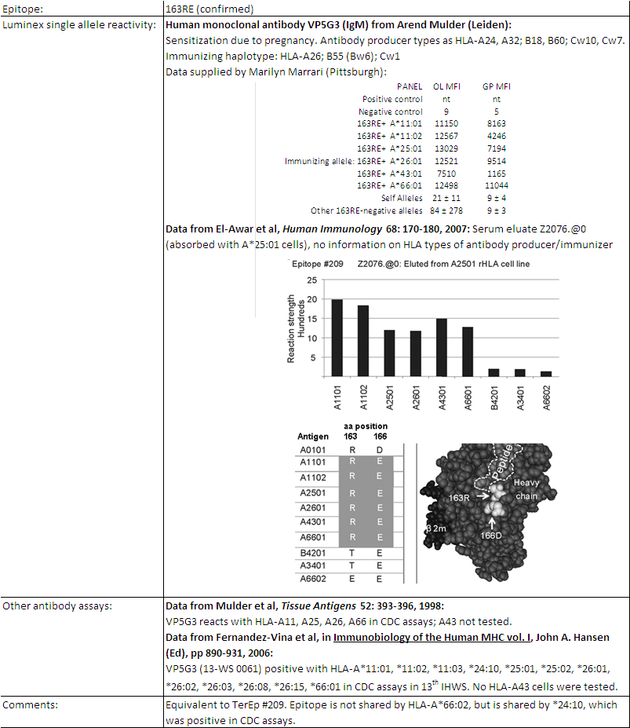
Antibody Reactivity Report for 163RE

Slide 9
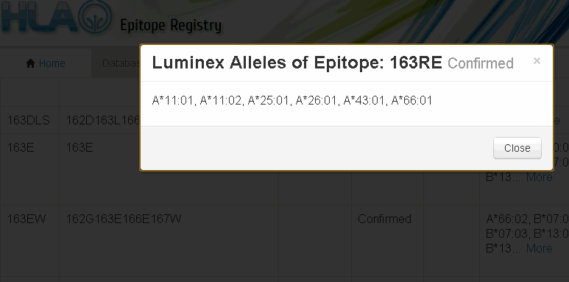
Epitope-sharing Luminex alleles
1414

Slide 10
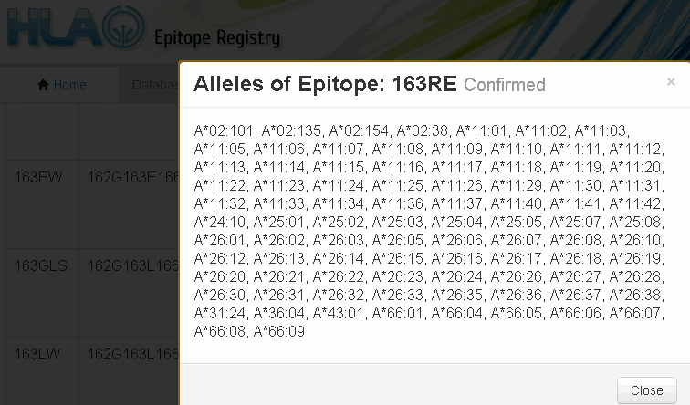
All Alleles that Share Epitope

Slide 11
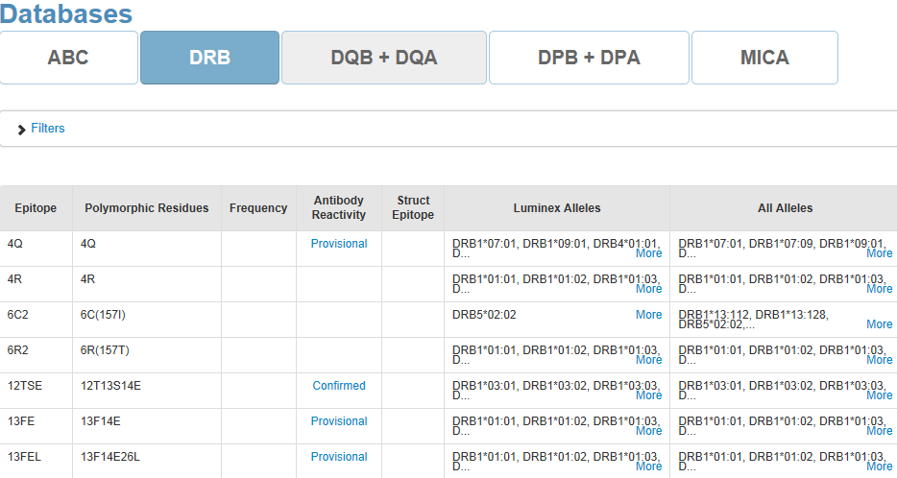
Select a Database to View - DRB

Slide 12
Epitope Database Search Options
Identify the epitope repertoire of any selected allele (Luminex or non-Luminex)
  Choose antibody-verified or all epitopes
Identify all mismatched epitopes for a given HLA phenotype
  Choose antibody-verified or all epitopes
These options can be combined to identify a donor allele’s repertoire of epitopes that are mismatched for a recipient’s HLA type

Slide 13
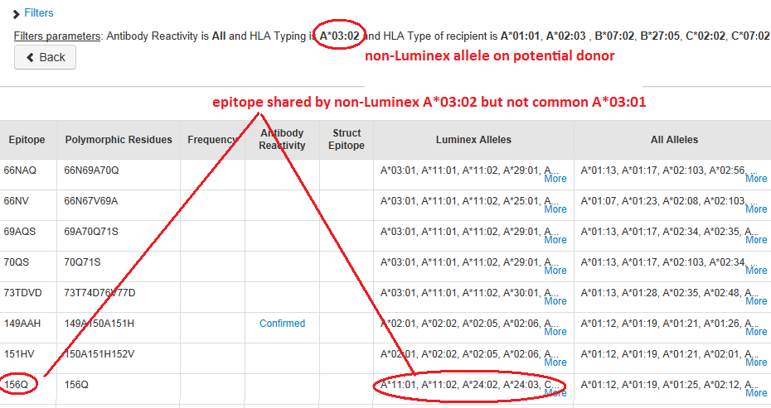
Identifying epitopes on non-Luminex alleles mismatched for a patient
Enter the non-Luminex allele of interest (e.g., donor) in the “Search by allele” field and the patient HLA type in the “HLA type of recipient” field; results show one epitope on non-Luminex A*03:02 that is not shared by the common A*03:01 found in the Luminex panels.
If screening results show antibody reactivity towards epitope 156Q, A*03:02
is likely an unacceptable allele!

Slide 14
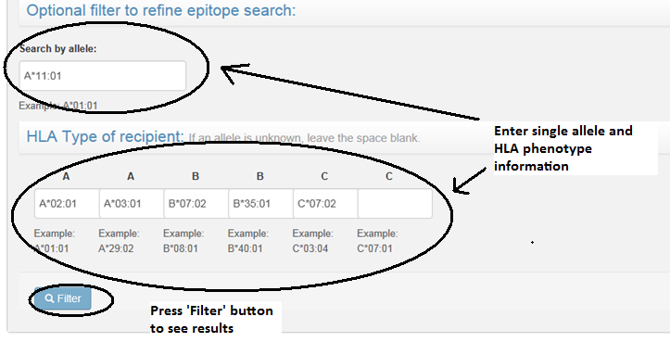
Combining Options
Use Filters 2 and 3 in combination to display epitopes on an allele that are mismatched for a given HLA type, e.g., to identify epitope mismatches for a patient’s HLA phenotype that are found on a specific donor allele.

Slide 15
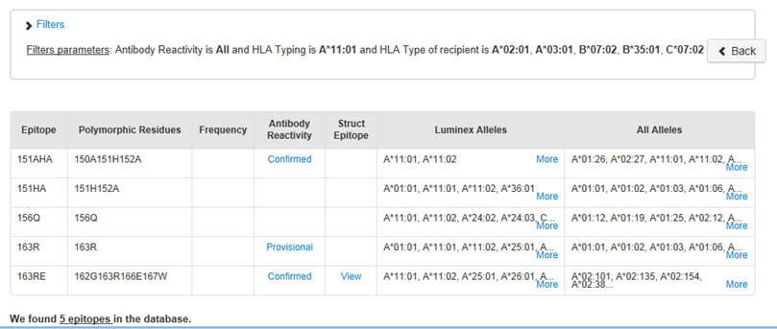
Results of combined options

Slide 16
Recording Antibody-Defined Epitopes in Registry
Each database in the HLA Epitope Registry comprises a list of potential epitopes that can be predicted to serve as recognition sites for specific antibodies
The intention is to document epitopes that have been verified experimentally with informative specific antibodies

Slide 17
Recording Antibody-Defined Epitopes in Registry
Each database in the HLA Epitope Registry comprises a list of potential epitopes that can be predicted to serve as recognition sites for specific antibodies
The intention is to document epitopes that have been verified experimentally with informative specific antibodies
Depending on the completeness of antibody reactivity information, there are two categories of antibody-defined epitopes: “confirmed” or “provisional”
Analogous to the original serological assignments of HLA antigens during the early international workshops, the provisional status will be upgraded to confirmed if sufficient additional verification becomes available

Slide 18
Recording Antibody-Defined Epitopes in Registry
Each database in the HLA Epitope Registry comprises a list of potential epitopes that can be predicted to serve as recognition sites for specific antibodies
The intention is to document epitopes that have been verified experimentally with informative specific antibodies
Depending on the completeness of antibody reactivity information, there are two categories of antibody-defined epitopes: “confirmed” or “provisional”
Analogous to the original serological assignments of HLA antigens during the early international workshops, the provisional status will be upgraded to confirmed if sufficient additional verification becomes available
For each antibody-defined epitope a link on the webpage leads to detailed information about antibody reactivity patterns

Slide 19
Antibody Verification of HLA Epitopes
Duquesnoy RJ, Marrari M, Mulder A, da M. Sousa LCD, Da Silva AS, do Monte SJH. ‘First Report on the Antibody Verification of HLA-ABC Epitopes Recorded in the HLA Epitope Registry’. Tissue Antigens 83:391-400, 2014
  97 HLA-ABC antibody-verified epitopes have been recorded, 62 correspond to eplets and 35 are defined by eplets paired with other residue configurations
Duquesnoy RJ, Marrari M, Tambur A, da Mata Sousa LCD, Da Silva AS, do Monte SJH. ‘First Report on the Antibody Verification of HLA-DR, HLA-DQ and HLA-DP Epitopes Recorded in the HLA Epitope Registry’ Human Immunology 75:1097-1103, 2014
  24 HLA-DRB1/3/4/5, 15 DQB, 3 DQA and 8 DPB antibody-verified epitopes
Duquesnoy RJ, Marrari M, Mostecki J, Da Silva AS, da Mata Sousa LCD, do Monte SJH. ‘First Report on the Antibody Verification of MICA Epitopes Recorded in the HLA Epitope Registry ‘ Int J Immunogenetics 41: 370-377, 2014
  21 MICA epitopes verified with antibodies which have primarily been tested in Luminex assays with single alleles

Slide 20
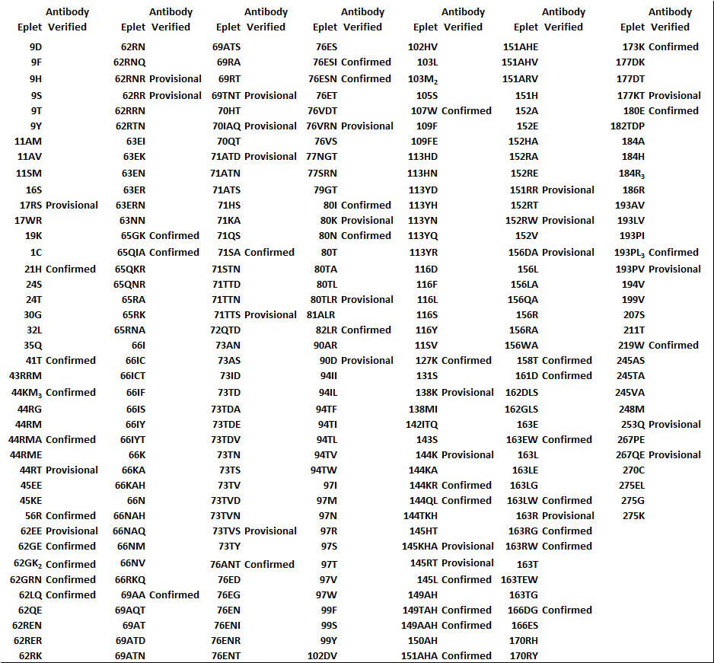
Antibody-verified HLA-ABC Epitopes corresponding to Eplets and Recorded in the Registry ( October 2014)

Slide 21
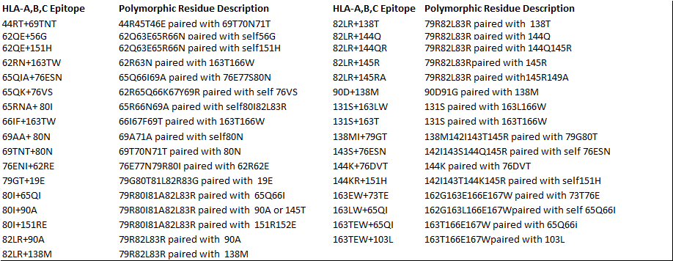
Antibody-verified HLA-ABC Epitopes corresponding to Eplet Pairs and Recorded in the Registry ( October 2014)
All have provisional status

Slide 22
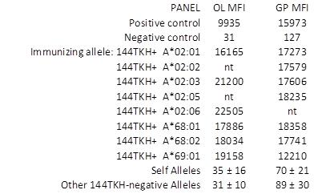
Example of a record of an antibody-verified HLA-A epitope

Slide 23
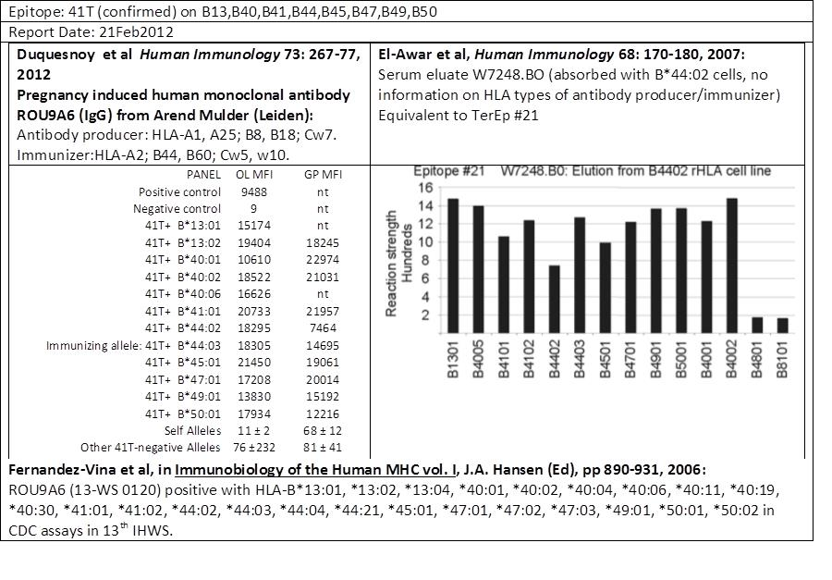
Example of a record of an antibody-verifiedHLA-B epitope

Slide 24
New Antibody-Verified Epitopes
An important aspect is the participation by HLA professionals who have identified antibodies specific for new and not-so-well described epitopes
From the website one can download instructions for how to submit information about epitope-specific antibody reactivity

