Slide 1
Hong Kong Workshop Lecture 7
HLA Epitope Based Donor Selection for Platelet Transfusions

Slide 2
Alloimmunization-Induced Refractoriness to Random Donor Platelet Transfusions
Antibody reactivity with
  HLA Class I antigens
  Platelet-specific antigens
  Other antigens (MICA?, HLA class II?, blood groups)
Refractory patients
  Hematological defects (e.g. aplastic anemia)
  Malignancies (e.g. leukemia)
  Intra-operative transfusion support of highly sensitized patients undergoing liver transplantation (Weber et al. Transplantation 45:797, 1989)

Slide 3
Treatment of HLA Alloimmunization-Induced Refractoriness
Platelet transfusions from HLA matched donors (Yankee et al. N Eng J Med 281:1208, 1969)
Platelet transfusions from donors mismatched for cross-reacting HLA antigens (Duquesnoy et al. Amer J Hematol 2: 219, 1977)

Slide 4
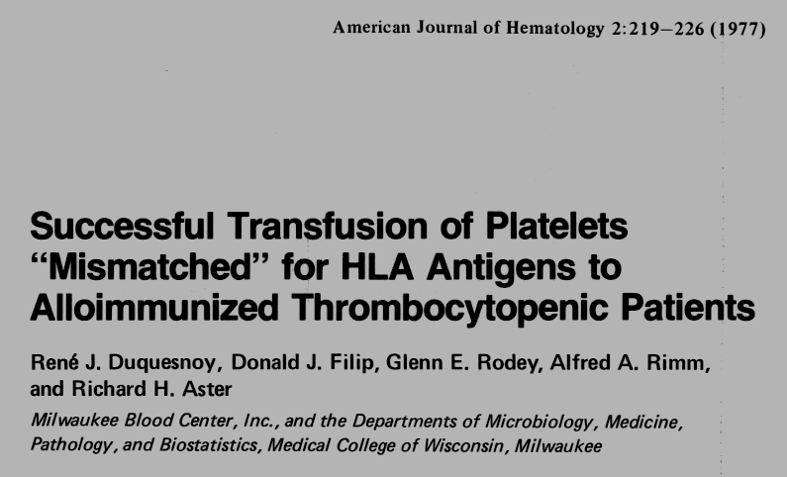

Slide 5
Serological Cross-Reactivity Between HLA Antigens
HLA antigens carry “private” and “public” epitopes
Cross-Reacting Groups (CREGs) of HLA antigens share the same public epitope
Rodey and Fuller: Crit Rev Immunol 7:229, 1987

Slide 6
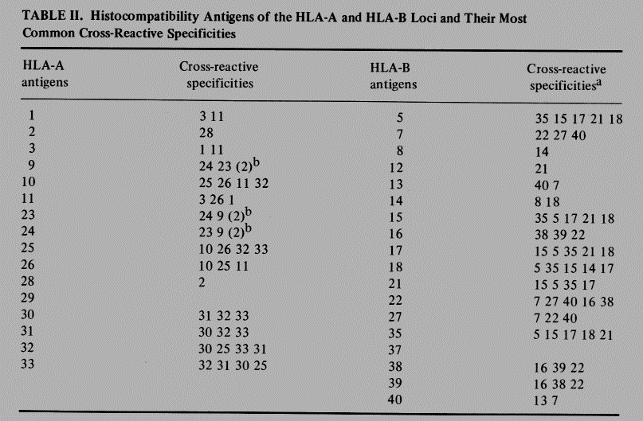
Duquesnoy et al. American Journal of Hematology. 2:219-226, 1977

Slide 7
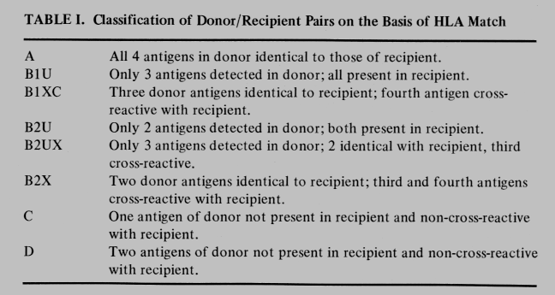
Duquesnoy et al. American Journal of Hematology. 2:219-226, 1977

Slide 8
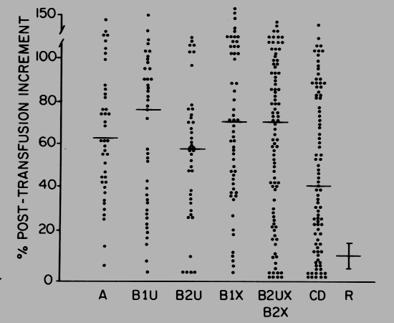
Responses to Platelet Transfusions with Different HLA Match Grades
Duquesnoy et al. American Journal of Hematology. 2:219-226, 1977

Slide 9
Limitations of the Cross-Reactivity Based HLA Match Grade System
Many BX matches are unacceptable epitope mismatches
A and BU match groups may have incompatible epitopes revealed by 4-digit DNA typing
CREG matching considers only HLA-A and HLA-B; how important is HLA-C?

Slide 10
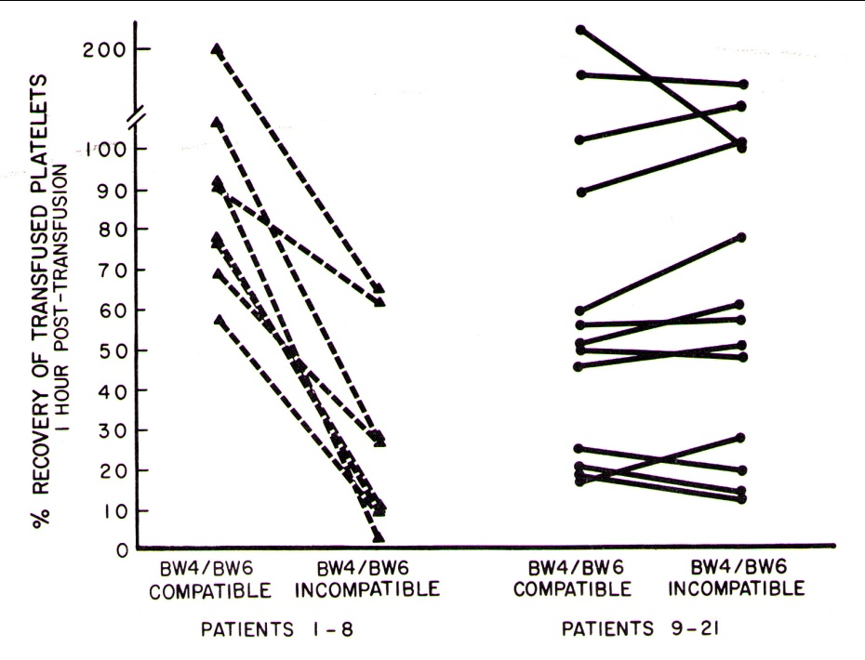
Many BX Matches Have Incompatible Epitopes
Cross-Reacting Matches and Bw4/Bw6 mismatches
B
Bw4/Bw6 epitopes are defined by residues in 79-83 sequence
Effect of BW4/6 incompatibility on responses to BX matched platelet transfusions
Patients 1-8: lower increments
Patients 9-21: comparable increments
McElligott et al Blood 59: 971, 1982

Slide 11
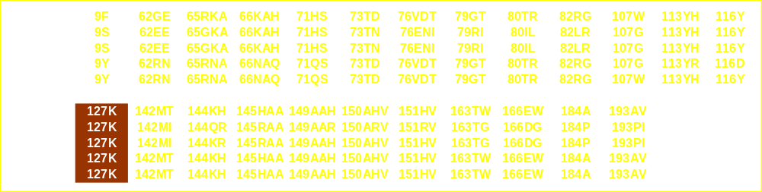
Eplet Differences Between Cross-Reacting Antigens
Example: A2 CREG

Slide 12
Limitations of the Cross-Reactivity Based HLA Match Grade System
Many BX matches are unacceptable epitope mismatches
A and BU match groups may have incompatible epitopes revealed by 4-digit DNA typing
CREG matching considers only HLA-A and HLA-B; how important is HLA-C?

Slide 13
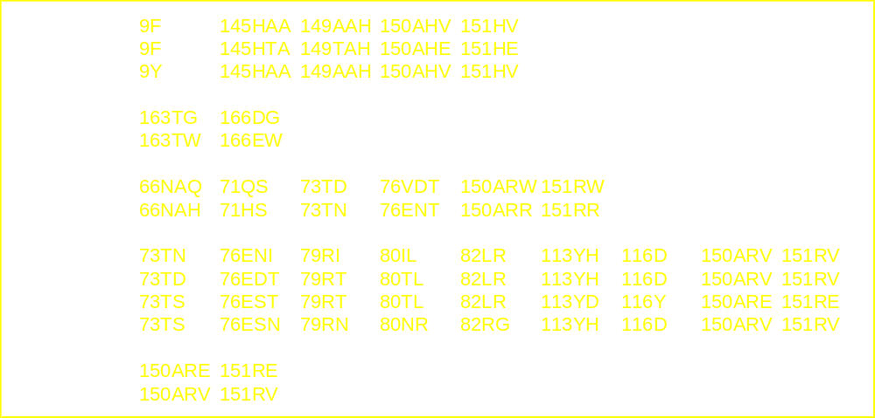
Eplet Differences Between 4-Digit Alleles

Slide 14
Limitations of the Cross-Reactivity Based HLA Match Grade System
Many BX matches are unacceptable epitope mismatches
A and BU match groups may have incompatible epitopes revealed by 4-digit DNA typing
CREG matching considers only HLA-A and HLA-B. How important is HLA-C?
  Not Important (Duquesnoy et al Transplant. Proc. 9: 1827, 1977)
  Low expression on platelets (Mueller-Eckhart et al Tissue Antigens 16: 91, 1980)
  Important for some patients (Saito et al Transfusion 42: 302, 2002)

Slide 15
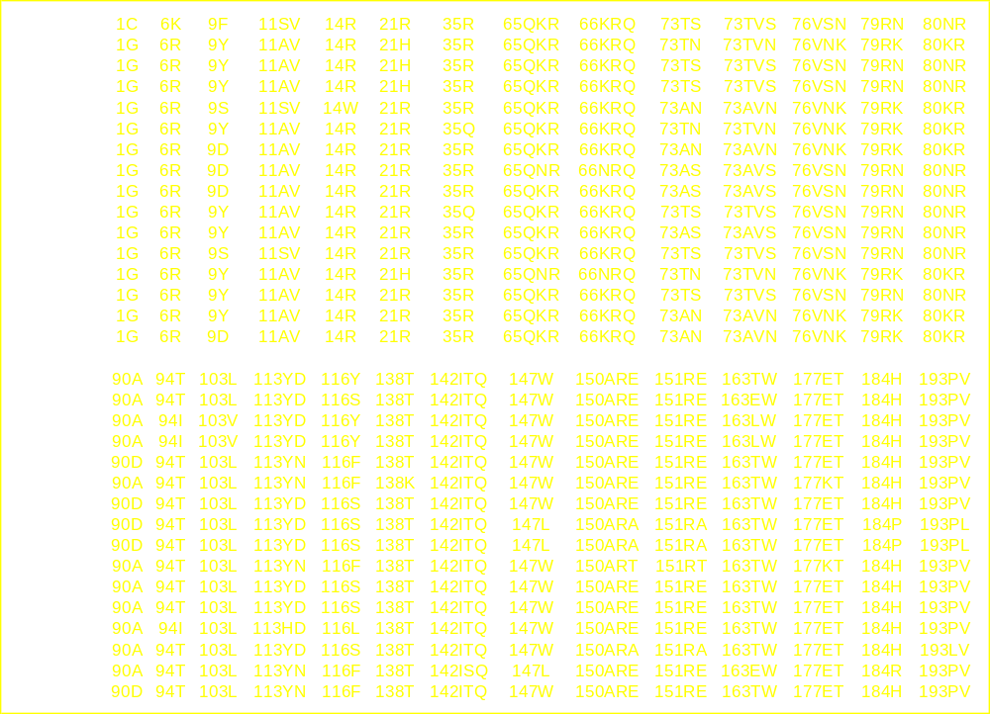
HLA-C Eplets in Positions 1-193

Slide 16
Conclusions
The serological cross-reacting antigen matching system introduced in 1977 should be replaced by a system that incorporates modern concepts of epitope reactivity with antibody.
The proposed HLA epitope matching protocol is expected to benefit platelet transfusion outcome and increase the number of compatible donors for refractory patients.

Slide 17

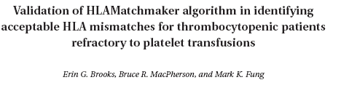
HLAMatchmaker and Platelet Transfusions
TRANSFUSION 2008;48:2159-2166
A RETROSPECTIVE REVIEW OF THE EFFICACY OF HLA MATCHED PLATELETS TRANSFUSION USING HLAMATCHMAKER DEFINED TRIPLET AND EPLET EPITOPES FOR APLASTIC ANAEMIA PATIENTS
D. M. Kallon, C. J. Brown, J. Marsh, C. V. Navarrete (Abstract 2007 EFI meeting)

Slide 18
Epitope-based matching for HLA-alloimmunized platelet refractoriness in patients with hematologic diseases
Shun-Chung Pai, Shyh-Chyi Lo, Su-Jen Lin Tsai, Ji-Sheng Chang, Dong-Tsamn Lin, Kuo-Sin Lin and Liang-In Lin
National Taiwan University Hospital, Taipei Blood Center, Taiwan Blood Services Foundation
TRANSFUSION 50: 2318-2327, 2010

Slide 19
Transfusions grouped by different HLA matching criteria
Pai et al. TRANSFUSION 50: 2318-2327, 2010
 | A/BU matches | CREG Matches | Epitope-Based Matches | P value
N=142 | 61 | 38 | 43
Median CCI | 14.55 (10.38-22.17) | 10.12 (2.11-26.32) | 22.03 (9.85-30.87) | 0.034*
Successful Transfusions | 52 (85.2%) | 24 (63.2%) | 36 (83.7%) | 0.021 **
Kruskal-Wallis test; ** Chi-square test
EBM versus CREG p=0.004 (proportion test)
In follow-up studies, no emerging HLA-specific antibodies were detected after receiving HLAMatchmaker-based eplet-matched platelets

Slide 20
T R A N S F U S I O N P R A C T I C E
Structural epitope matching for HLA-alloimmunized
thrombocytopenic patients: a new strategy to provide more
effective platelet transfusion support?
Transfusion, 48: 221-227, 2008

Slide 21
Platelet Transfusion Management of Refractory Patients (steps 1 and 2)
Perform HLA-A, B, C typing of patients and donors by DNA methods at the high-resolution (4-digit allele) level.
Screen patient sera with HLA typed panel
  Complement-dependent methods: direct and/or antiglobulin-augmented lymphocytotoxicity
  Antigen-binding assays such as Luminex, Flow Cytometry and ELISA preferably with single HLA class I alleles
  HLAMatchmaker-based analysis of serum reactivity pattern to identify acceptable mismatches

Slide 22
Platelet Transfusion Management of Refractory Patients (step 3)
3. Conduct a platelet donor search
  Establish a computerized platelet donor registry that incorporates an HLAMatchmaker-based search engine
  Enter the HLA type of the patient and the non-reactive mismatched alleles in this database and the computer will generate a list of donors with matches and acceptable mismatches at the eplet level
  No need for platelet cross-match testing for HLA incompatibility

Slide 23
Platelet Transfusion Management of Refractory Patients (step 4)
4. Evaluate the outcome of the platelet transfusion, if increment is low then:
  Determine whether serum reactivity patterns have improperly been interpreted in terms of HLA mismatch acceptability
  Look for antibodies against platelet-specific antigens and blood groups, or autoimmune phenomena and drug reactions
  Consider clinical conditions such as coagulopathy, infection and hepatosplenomegaly

Slide 24
Prevention or Delay of HLA Alloimmunization
HLAMatchmaker-based selection of apheresis platelets with minimal numbers of mismatched eplets
  From existing inventories of stored platelets
  Do a computer search for compatible platelet donor
  Avoid immunogenic eplets
Leukoreduction of platelet preparations prior to transfusion

Slide 25
Class I HLA Epitope Matching in Stem Cell Transplantation

Slide 26
HLAMatchmaker-Defined Triplet Matching for Patients with Class I HLA Allele Mismatched Hematopoietic Cell Transplants from Unrelated Donors
National Marrow Donor Program (NMDP) Study
2431 cases including ALL (N=581), AML (N=676), CML (N=954) and MDS (N=223)
Compare 10/10 allele matches with 9/10 allele matches with different numbers of mismatched triplets
Analyze engraftment, GVHD incidence and patient survival
Duquesnoy et al. Biol. Blood Marrow Transplant. 14: 1064-1071, 2008

Slide 27
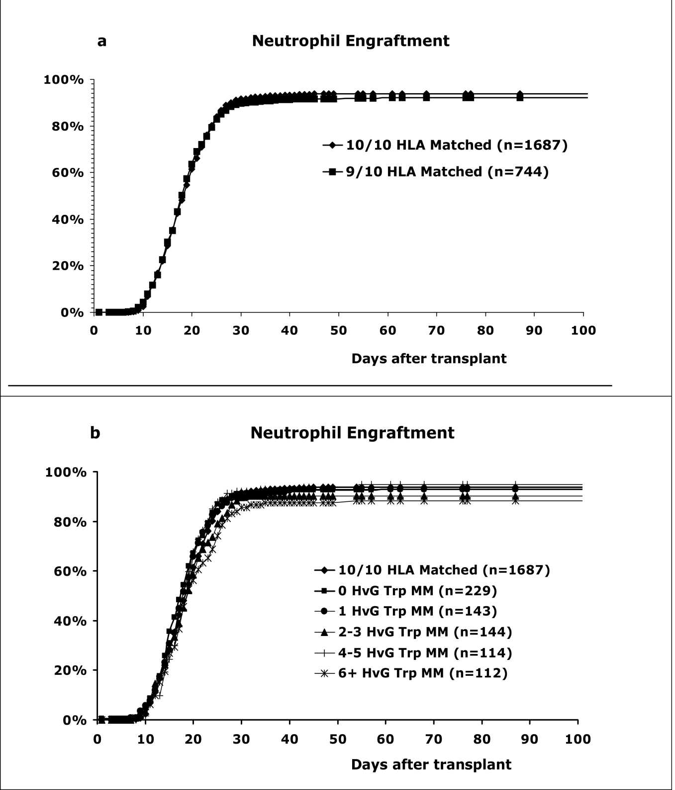

Slide 28
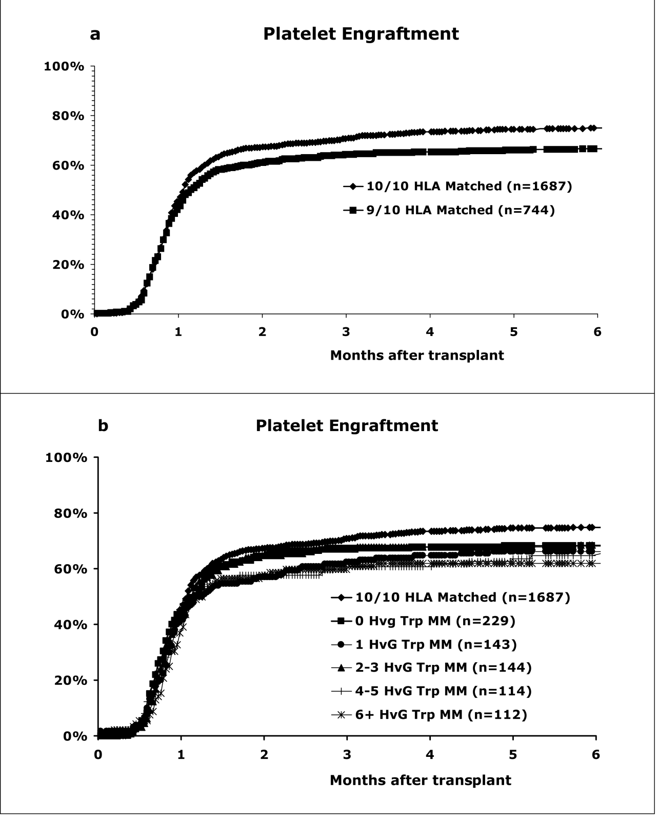

Slide 29
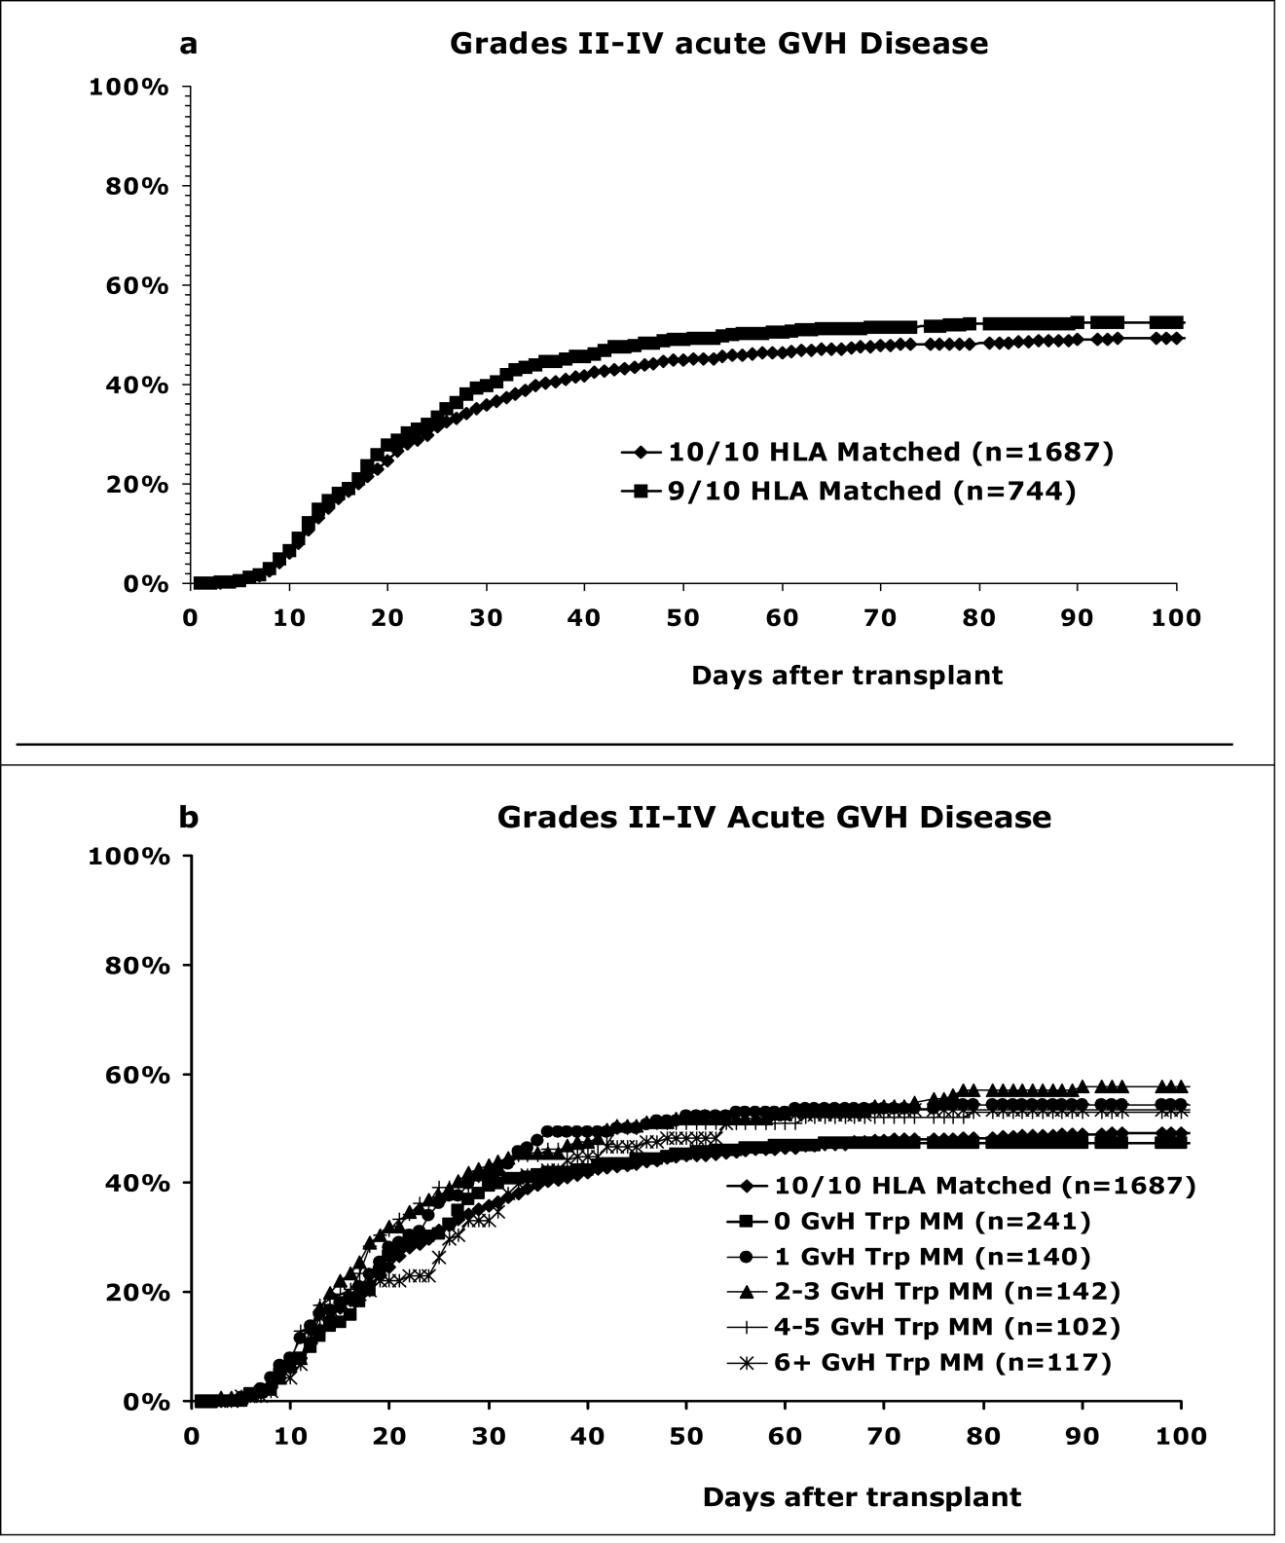

Slide 30
Multivariate analysis comparing acute GVH disease for 10/10 matches with the 9/10 match groups with triplet mismatches
Match Group | N | Relative risk (95% Confidence Interval) | P - value
 |  | Grade II-IV GVH disease
(1) 10/10 matches | 1687 | 1.00 | p_{overall} = 0.008
(2) 0 Triplet mismatches | 241 | 1.04 (0.85 - 1.26) | p₁₂ = 0.72
(3) 1 Triplet mismatches | 140 | 1.16 (0.92 - 1.46) | p₁₃ = 0.22
(4) 2-3 Triplet mismatches | 142 | 1.46 (1.16 - 1.84) | p₁₄ = 0.001
(5) 4-5 Triplet mismatches | 102 | 1.36 (1.03 - 1.79) | p₁₅ = 0.031
(6) ≥ 6 Triplet mismatches | 117 | 1.17 (0.91 - 1.50) | p₁₆ = 0.23
Adjusted factors: disease, GVH disease prophylaxis, graft type, Karnofsky score, year of transplant, gender

Slide 31
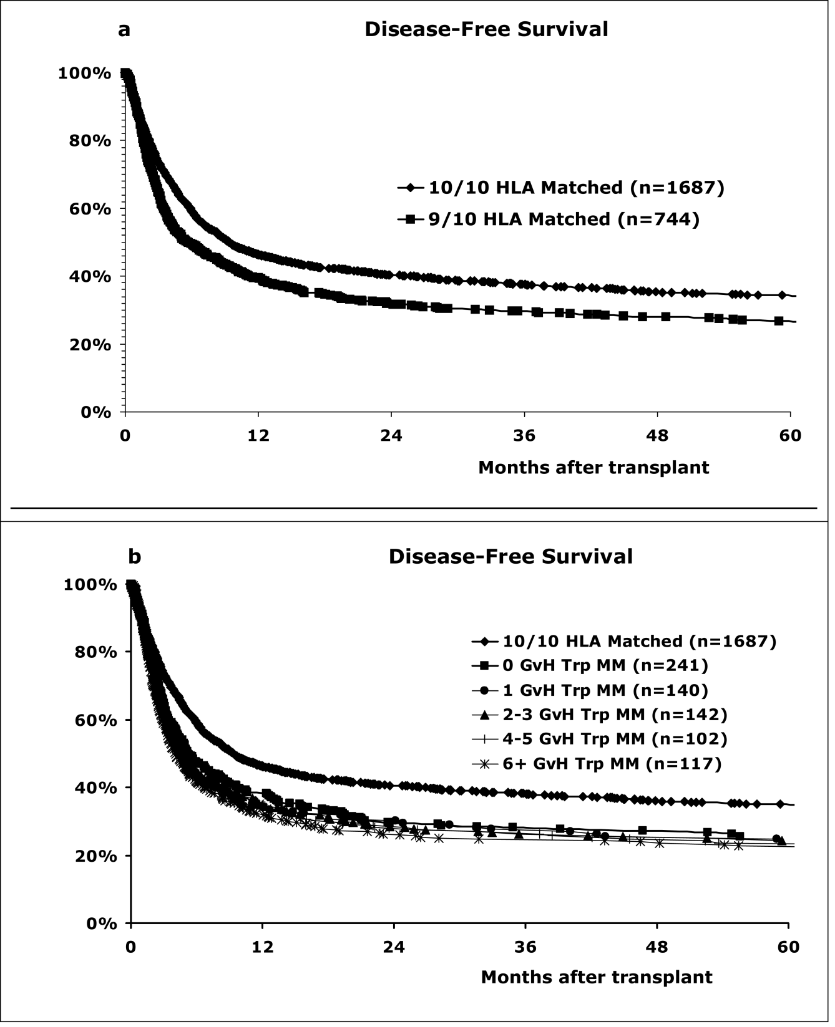

Slide 32
Conclusion
Class I HLA Triplet Matching Does Not Significantly Affect Stem Cell Transplant Survival

