Slide 1
Hong Kong Workshop Lecture 8
HLA Epitopes and Acceptable Mismatches for Sensitized Transplant Patients

Slide 2
HLA Matching for Transplantation: The Traditional Way
Count the A, B, DR antigen mismatches of the donor (range: from 0 to 6)
  Why do so many zero-antigen mismatches fail?
  Why are many mismatches successful?
Avoid unacceptable mismatches for highly sensitized patients
  Why do we see so many graft failures?
  Many patients are never transplanted
  Desensitization with IVIG / plasmapheresis

Slide 3
HLA Antibodies Are Major Risk Factors for Graft Failure

Slide 4
Dealing with the HLA Antibody Problem
Pre-transplant testing
  Serum screening and cross-matching
  Finding an acceptable mismatch
Post-transplant monitoring
  Donor-specific HLA antibodies
  Biopsy pathology, C4d
Desensitization
  Plasmapheresis
  IV-IgG
  Bortezomib

Slide 5
Conventionally we talk about antibody specificities against HLA antigens
Examples: anti-HLA-A1
anti-HLA-B7
anti-HLA-DR1
But what do antibodies see?

Slide 6
HLA Antibodies Are Important in Transplantation
HLA antibodies cause allograft rejection and transplant failure
HLA antibodies recognize epitopes
Therefore
HLA epitopes are important in transplantation

Slide 7
Epitope Specificity Analysis with HLAMatchmaker
HLA-ABC epitopes
HLA-DRB1/3/4/5 epitopes
DQA1-DQB1 epitopes
DPA1-DPB1 epitopes
MICA epitopes

Slide 8
Purpose of Serum Screening
Identify unacceptable HLA antigens (UNOS)
Identify acceptable mismatches
  Represents a direct approach of finding compatible donors for a transplant candidate
  Eurotransplant uses the Acceptable Mismatch program in conjunction with HLAMatchmaker
(Claas et al. Transplantation 78:190-193, 2004
Doxiadis et al. Curr. Opin. Immunol. 17:536-540, 2005)

Slide 9
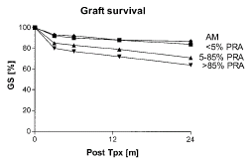
Eurotransplant’s Acceptable Mismatch Program Now Includes HLAMatchmaker
Validation of HLAMatchmaker by direct cross-matches
HLA-A mismatch
Expected Observed
negative negative
0 triplet 18 18
1 triplet 25 25
HLA-B mismatch
Expected Observed
negative negative
0 triplet 54 54
1 triplet 133 131
AM are Acceptable Mismatches
5-85% and >85% PRA are conventional ET-KAS cases
Claas et al.: The Acceptable Mismatch Program as a Fast Tool to Transplant Highly Sensitized Patients Awaiting a Post-Mortal Kidney: Short Waiting Time and Excellent Graft Outcome. Transplantation 78:190-193, 2004

Slide 10
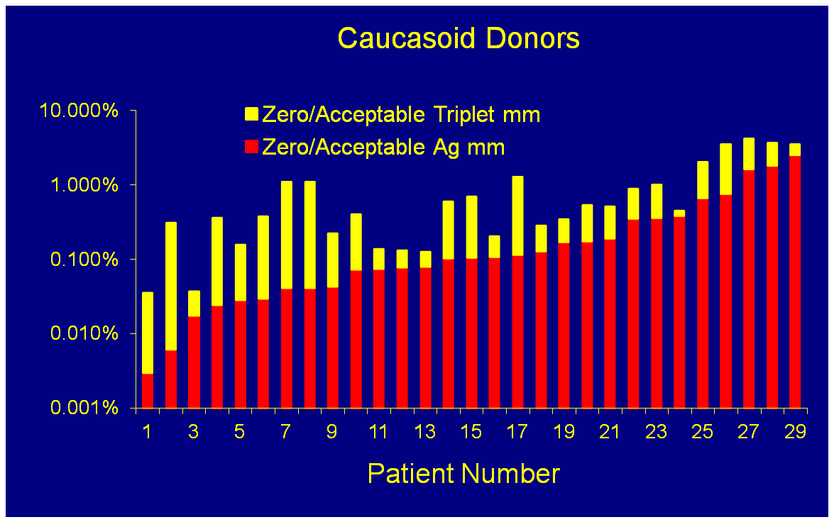
Chances of Finding a Zero or Acceptable HLA-A,B Mismatch for a High PRA Patient (30 patients)
Eurotransplant Patients, Leiden, The Netherlands

Slide 11
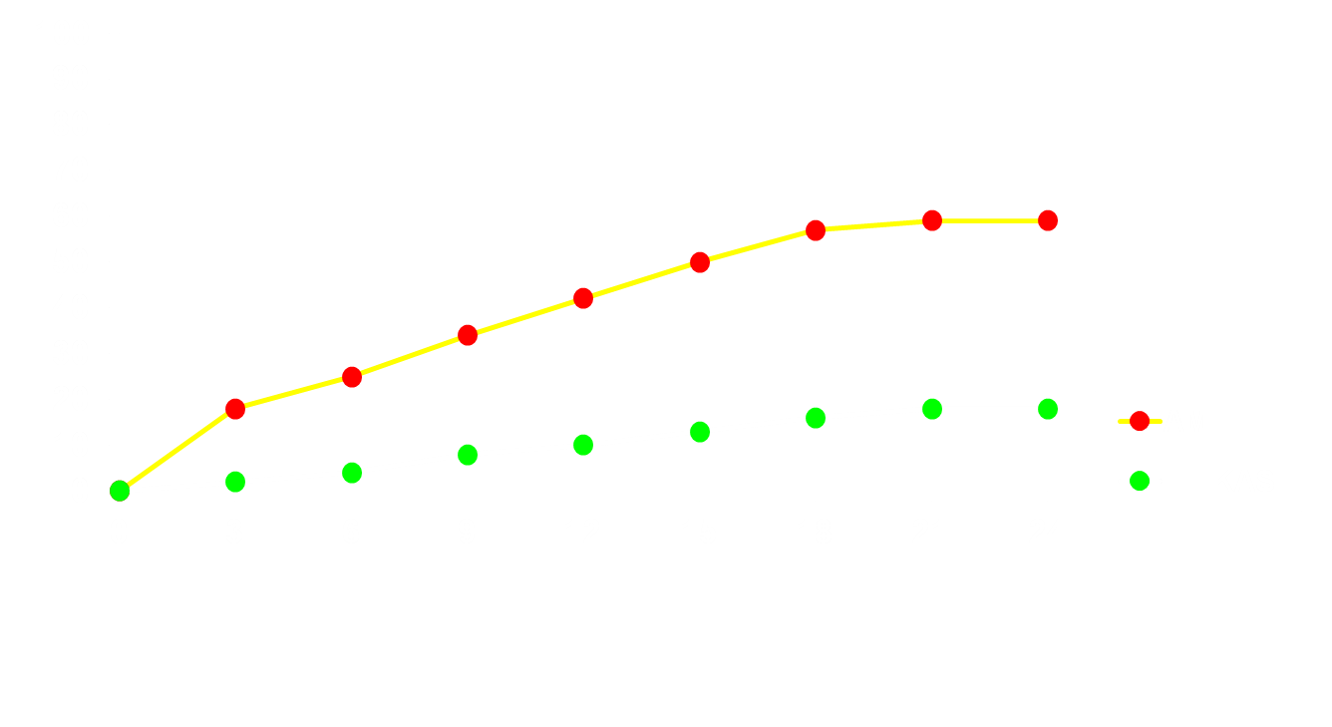
Chance to Receive a Suitable Crossmatch Negative Organ
% patients transplanted
Waiting time (months)
ET-KAS and UNOS strategies are similar
Slide provided by Frans Claas (Leiden University Medical Center, The Netherlands)

Slide 12
Post-transplant monitoring for epitope-specific antibodies
Diagnostic tool for humoral rejection
Does the transplant affect antibody detection?

Slide 13
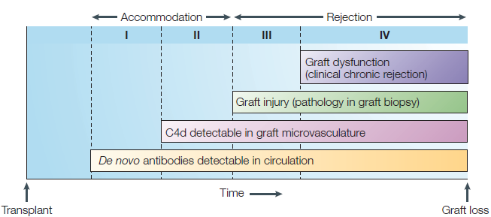
Stages of Antibody-Mediated Rejection
Takemoto et al NIH Consensus Report, 2004
Colvin and Smith, 2005

Slide 14
Effect of Allograft Nephrectomy on HLA Antibody Detection in Serum

Slide 15
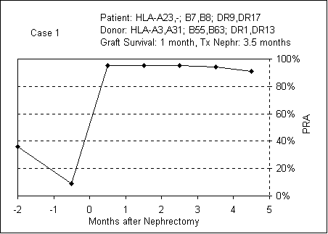
Allograft Nephrectomy Case
Donor Epitopes:
A3: 62QE,66RNV,70AQS,76VD,80GTL,144TKR,149AAH,151AHE,163DT
A31: 56R,62QE,66RNV,74ID,76VD,80GTL,193AvV
B55: 131S
B63: 45MA,66RNM,70ASA,74Y,131S
Adeyi et al. Transplant Immunology, 14: 53-62, 2005

Slide 16
Donor Epitopes (CDC-reactive epitopes are shown in underlined bold font)
A3: 62QE,66RNV,70AQS,76VD,80GTL,144TKR,149AAH,151AHE,163DT
A31: 56R,62QE,66RNV,74ID,76VD,80GTL,193AV
B55: 131S
B63: 45MA,66RNM,70ASA,74Y,131S
Adeyi et al. Transplant Immunology, 14: 53-62, 2005

Slide 17
Donor Epitopes (CDC-reactive epitopes are shown in underlined bold font)
A3: 62QE,66RNV,70AQS,76VD,80GTL,144TKR,149AAH,151AHE,163DT
A31: 56R,62QE,66RNV,74ID,76VD,80GTL,193AV
B55: 131S
B63: 45MA,66RNM,70ASA,74Y,131S
HLAMatchmaker predicts unacceptable mismatches
e.g. 45MA is present on B13, B46, B57,B62, B63. B75, B76, B77
Adeyi et al. Transplant Immunology, 14: 53-62, 2005

Slide 18
Donor Epitopes (CDC-reactive epitopes are shown in underlined bold font)
A3: 62QE,66RNV,70AQS,76VD,80GTL,144TKR,149AAH,151AHE,163DT
A31: 56R,62QE,66RNV,74ID,76VD,80GTL,193AV
B55: 131S
B63: 45MA,66RNM,70ASA,74Y,131S
Challenging Question:
What about the non-immunogenic epitopes?
Did they induce specific B-cell tolerance?
Adeyi et al. Transplant Immunology, 14: 53-62, 2005

Slide 19
15th workshop project: 65 allograft nephrectomy cases contributed by 16 laboratories worldwide
Antibody testing done with single allele panels on a Luminex platform
DSA | Pre-allonx | Post-allonx | Significance
HLA-AB | 64% | 87% | P=0.0033
DRB1 | 57% | 86% | P=0.001
DRB3/4/5 | 65% | 78% | P=0.22
DQB | 76% | 87% | P=0.18
Conclusion: although the Luminex antibody assay can detect anti-donor antibodies in the presence of a rejected transplant, it is apparent that the antibody specificity pattern is often incomplete especially against the HLA-A, -B and DR mismatches.
Marrari M and Duquesnoy RJ: Transplant Immunology, 22:105-109, 2010

