Slide 1
Hong Kong Workshop Lecture 9
HLA Matching from Antigens to Epitopes in the Clinical Setting

Slide 2
Important for Sensitized Patients
Antibody specificity analysis for HLA epitopes to determine mismatch acceptability
Perform high-resolution (4-digit) typing of patients and donors

Slide 3
Personal Viewpoint: Should HLA Mismatch
Acceptability for Sensitized Transplant Candidates Be
Determined at the High-Resolution Rather than the
Antigen Level?
R. J. Duquesnoy, M. Kamoun,
L. A. Baxter-Lowe, E. S. Woodle,
R. A. Bray, F. H. J. Claas, D. D. Eckels,
J. J. Friedewald, S. V. Fuggle, H. M. Gebel,
J. A. Gerlach, J. J. Fung, D. Middleton,
P. Nickerson, R. Shapiro, A. R. Tambur,
C. J. Taylor, K. Tinckam and A. Zeevi
American Journal of Transplantation, 15: 923-930, 2015

Slide 4
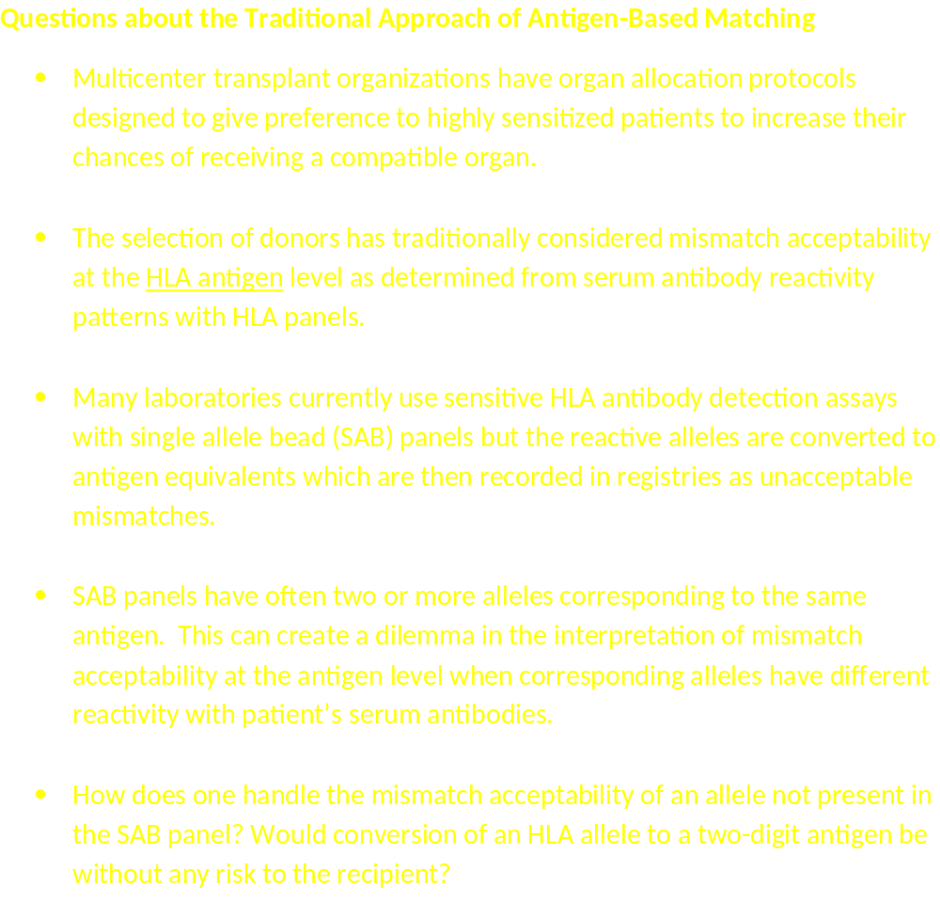

Slide 5
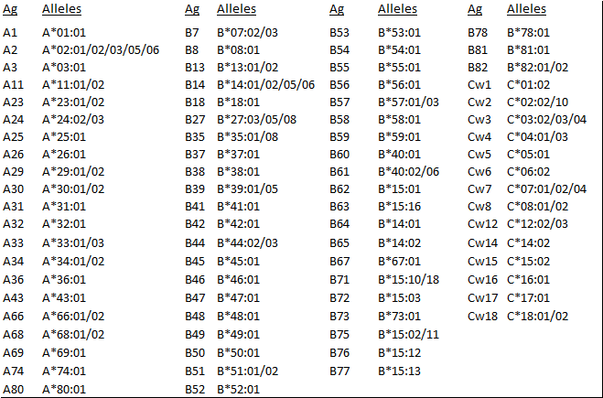
Alleles in SAB Panels

Slide 6
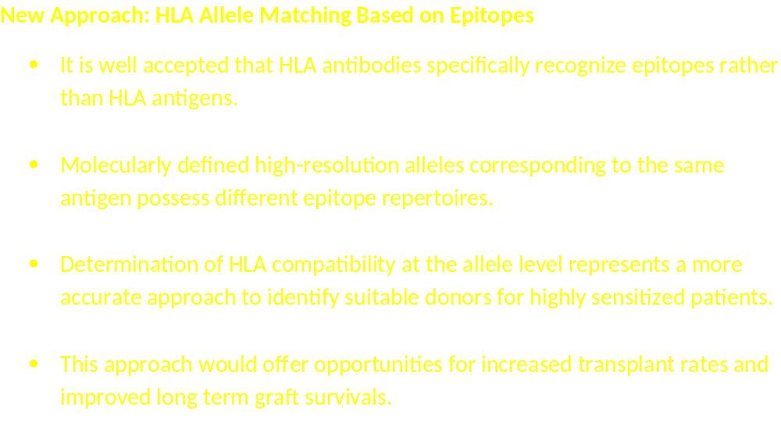

Slide 7
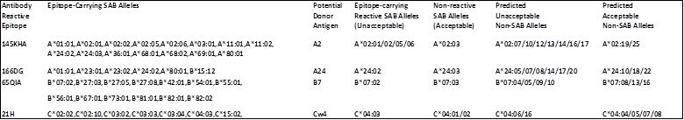
Table 1 Examples of antibody-reactive epitope expression on SAB alleles corresponding to the same antigen and predictions of unacceptable and acceptable non-SAB alleles

Slide 8
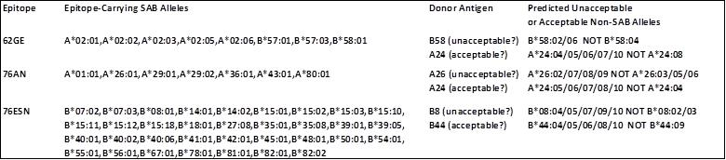
Table 2 Prediction of mismatch acceptability of non-SAB alleles corresponding to selected donor HLA antigens for patients with antibodies specific for the 62GE, 76AN and 76ESN defined epitopes

Slide 9
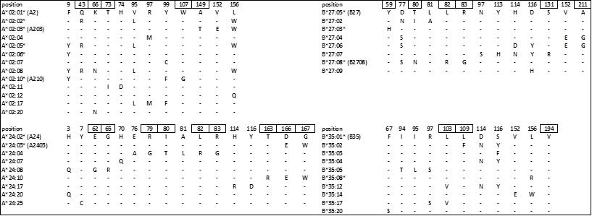
Table 3 Amino acid residue differences between HLA-A2, -A24, -B27 and -B35 alleles with greater than 0.5% frequencies in one or more common population groups of potential transplant donors
* Alleles in single allele bead (SAB) panels are annotated with an asterisk; the equivalent serological antigen is also listed. Antibody-accessible sequence positions on the molecular surface are in boxes

Slide 10
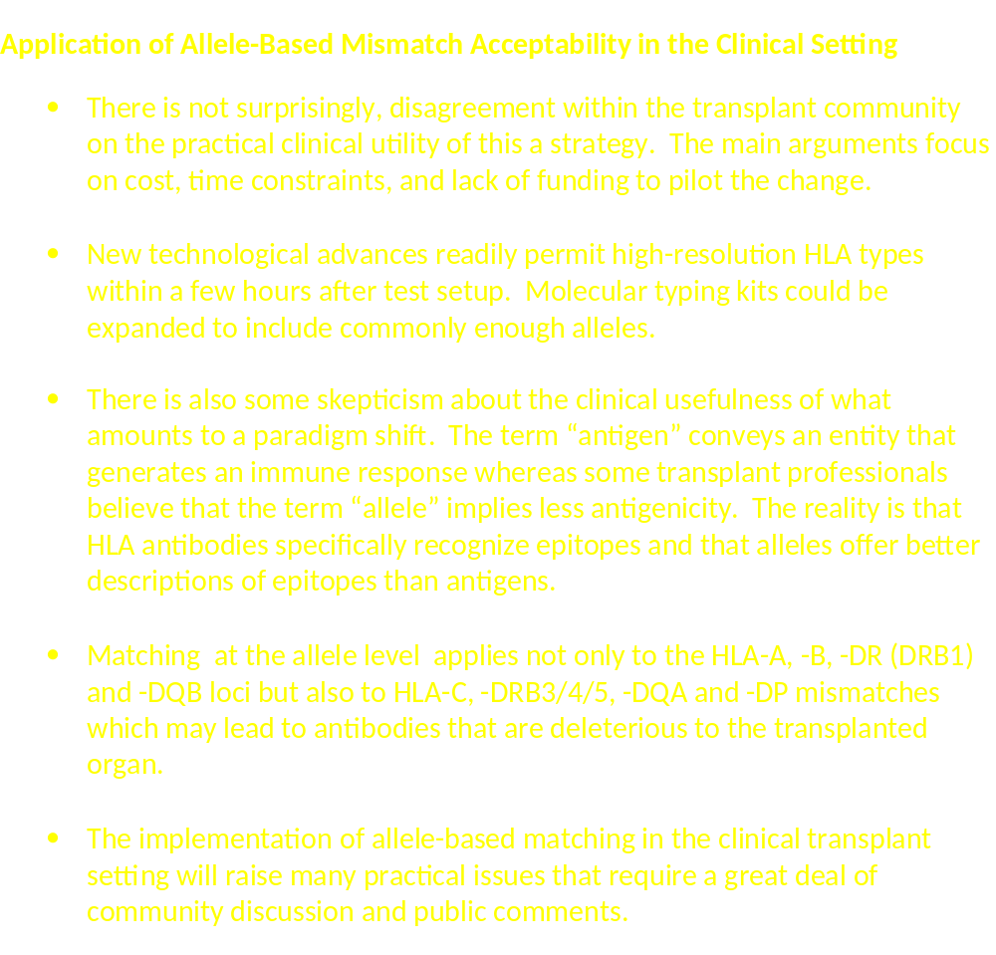

Slide 11
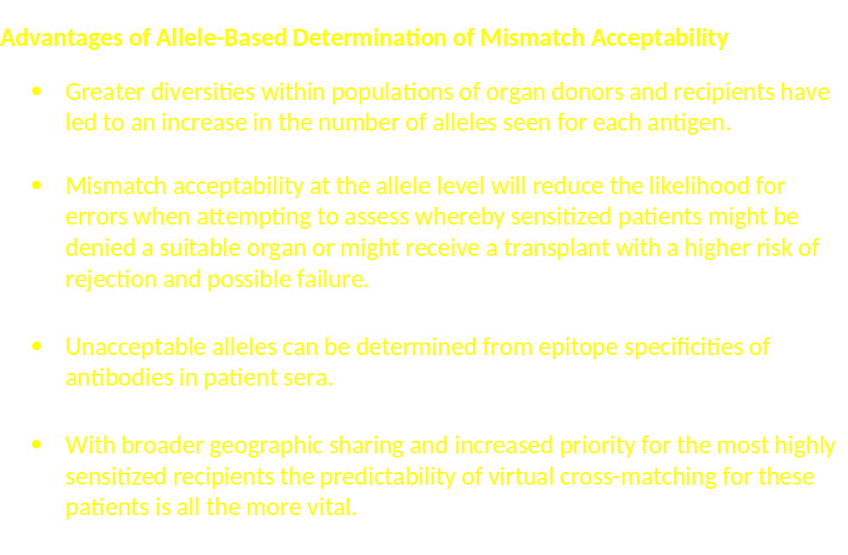

Slide 12
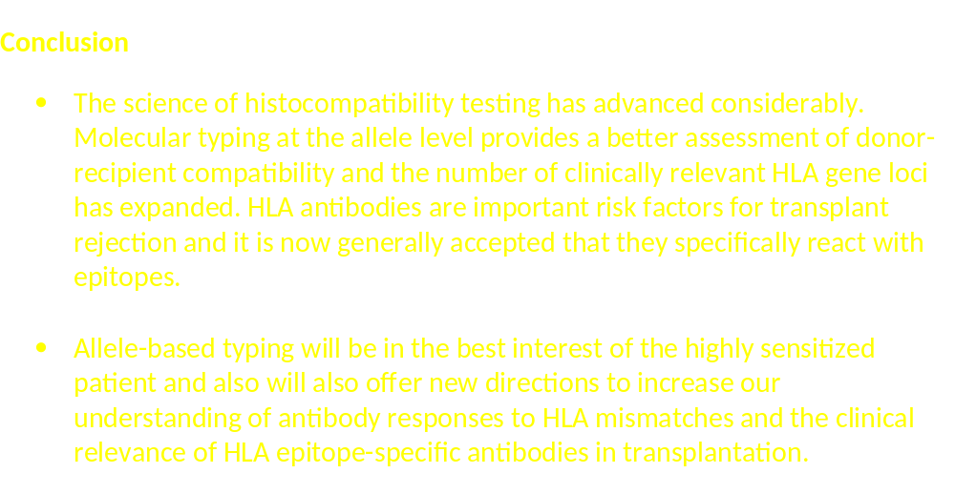

Slide 13
Three Related Publications
Personal Viewpoint: Should HLA Mismatch Acceptability for Sensitized Transplant Candidates Be Determined at the High-Resolution Rather than the Antigen Level? Amer. J Transplant 15: 923-930, 2015
Editorial by Cecka, Reed, and Zachary: HLA High-Resolution Typing for Sensitized Patients: A Solution in Search of a Problem? Amer. J Transplant 20:1, 2015
Our Letter to the Editor: High-Resolution HLA Typing for Sensitized Patients: Advances in Medicine and Science Require Us to Challenge Existing Paradigms Amer. J Transplant, 2015

Slide 14
Should We Try to Prevent or Minimize HLA Sensitization?

Slide 15
Causes of Sensitization
Pregnancy (acts of nature)
Transfusion (human procedure)
Transplantation (human procedure)
How to prevent or minimize sensitization?

Slide 16
Reduce HLA Sensitization
Transplants and blood transfusions from HLA matched donors
Permissible HLA mismatching
  Consider low epitope loads
  Minimize exposure to immunogenic epitopes

Slide 17
HLA Mismatches and Epitope Loads

Slide 18
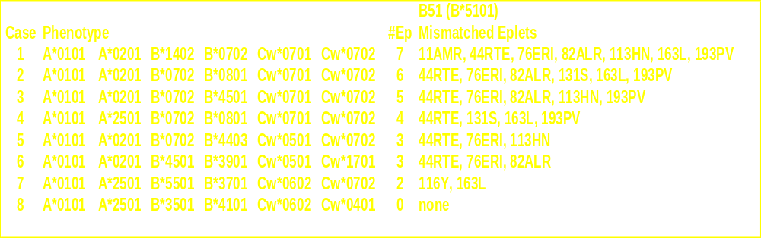
The Epitope Load of a HLA Mismatch Depends on HLA Type of Recipient
Example: a single B51 mismatch

Slide 19

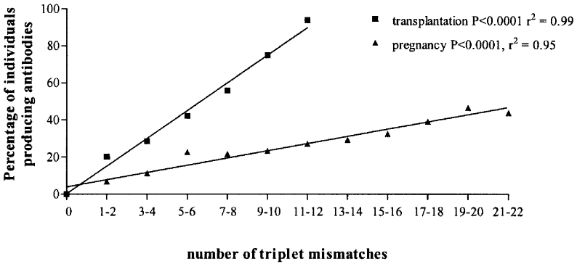
Volume 77(8) 27 April 2004 pp 1236-1239
THE NUMBER OF AMINO ACID TRIPLET DIFFERENCES BETWEEN PATIENT AND DONOR IS PREDICTIVE FOR THE ANTIBODY REACTIVITY AGAINST MISMATCHED HUMAN LEUKOCYTE ANTIGENS
Dankers, Witvliet, Roelen, De Lange, Korfage, Persijn, Duquesnoy, Doxiadis, and Claas
Department of Immunohematology and Blood Transfusion, Leiden University Medical Center

Slide 20
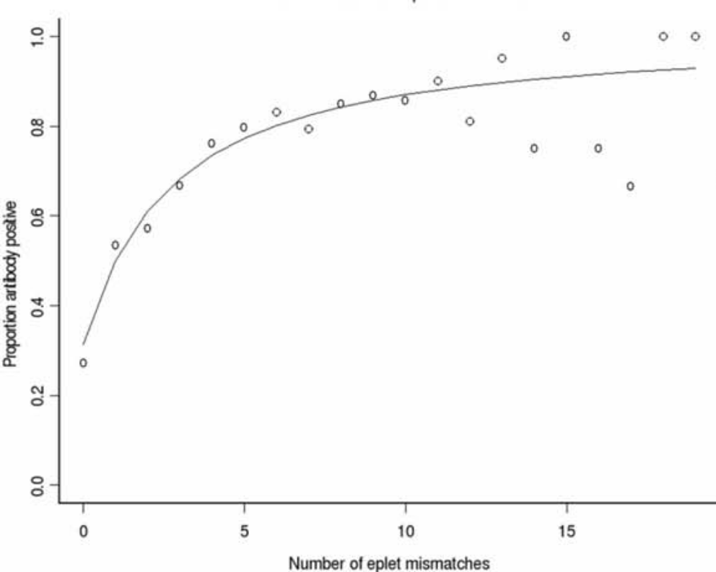
Donor HLA-A,B Specific Antibody Responses and Mismatched Eplet Loads
Kosmoliaptsis, Bradley, Sharples, Chaudhry, Goodman and Taylor. (Cambridge University Hospitals, UK) Transplantation 85: 1817–1825, 2008

Slide 21
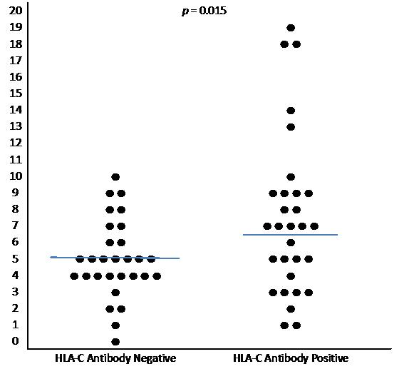
Correlation between Eplet Load and Antibody Responses to HLA-C Mismatches
Marrari and Duquesnoy: Detection of Antibodies against HLA-C Epitopes in Patients with Rejected Kidney Transplants, Transplant Immunology. 24:164-171, 2011

Slide 22
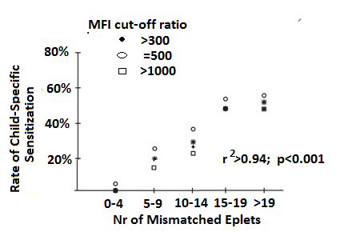
Correlation between mismatched eplet numbers and frequency of child-specific HLA-ABC sensitization during pregnancy
Honger, Fornaro, Granado,Tiercy, Hosli and Stefan Schaub: (Basel, Switzerland) Frequency and Determinants of Pregnancy-Induced Child-Specific Sensitization, American Journal of Transplantation, Nov 2012

Slide 23
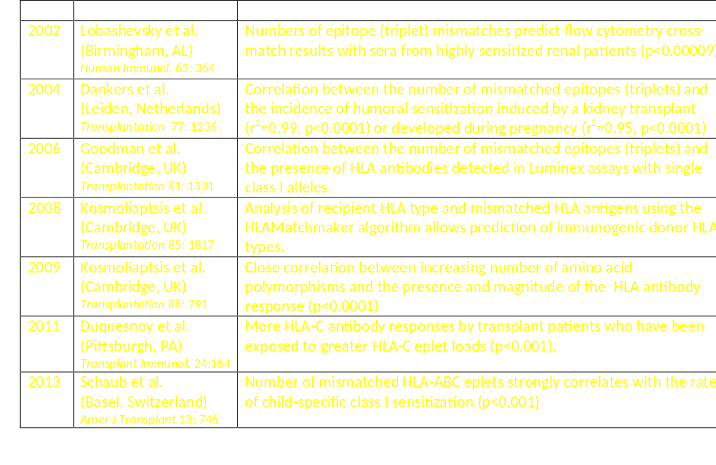
Epitope Loads and HLA Antibody Development

Slide 24
Mismatched Epitope Loads and Transplant Outcome
61

Slide 25
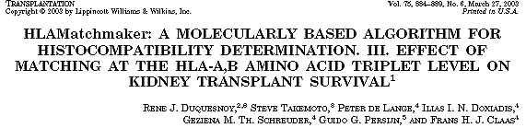
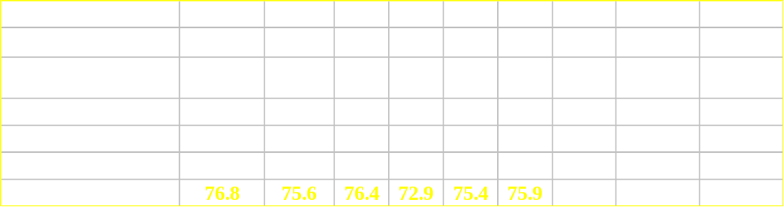
62
Effect of HLA-A,B Mismatched Epitope Load on Graft Survival
of Zero-HLA-DR Mismatched Kidneys in Eurotransplant

Slide 26
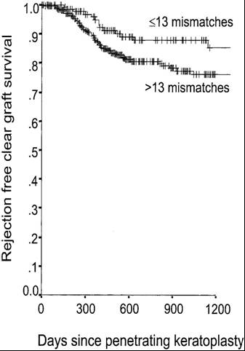
Mismatched Epitope (Triplet) Loads and Corneal Graft Survival
63
147 cases with up to 13 mismatched triplets 398 cases with more mismatched triplets
Kaplan-Meier estimation: 85% vs. 76% rejection-free clear graft survival
log-rank test, p=0.047
Daniel Boehringer et al.
(University Hospital, Freiburg, Germany), Transplantation 77, 417–421, 2004

Slide 27
Class II HLA Antibodies Decrease Transplant Success
DRB1 is “standard” for donor-recipient matching
DRB3/4/5
  Antibodies to DR51, DR52 and DR53
DQB1 and DQA1
  Relevance of DQB matching in transplantation
  Patients make antibodies to DQB and DQA epitopes
DPA1 and DPB1
  Relevance of DP matching
  Anti-DP antibodies in transplantation

Slide 28
Conventional DR Compatibility:
“One Antigen Mismatch”
Patient
DR15
DR18
Donor
DR mismatch
DR1
DR4
DR7
DR8
DR9
DR10
DR11
DR12
DR13
DR14
DR15 (self)
DR16
DR17
DR18 (self)

Slide 29
A DR Antigen Mismatch Has an Extra Class II Epitope Load
DRB1+ DRB3/4/5+ DQB+DQA+DPB+DPA

Slide 30
Conventional DR Compatibility:
“One Antigen Mismatch”
Patient
DR15
DR18
Donor
DR mismatch
DR1
DR4
DR7
DR8
DR9
DR10
DR11
DR12
DR13
DR14
DR15 (self)
DR16
DR17
DR18 (self)

Slide 31
Common High-Resolution DR-DQ Haplotypes
Patient | DRB1 | DRB3/4/5 | DQB1 | DQA1
DR15 | DRB1*15:01 | DRB5*01:01 | DQB1*05:02 | DQA1*01:02
DR18 | DRB1*03:02 | DRB3*01:01 | DQB1*04:02 | DQA1*04:01
Donor
DR mismatch | DRB1 | DRB3/4/5 | DQB1 | DQA1
DR1 | DRB1*01:01 | - | DQB1*05:01 | DQA1*01:01
DR4 | DRB1*04:01 | DRB4*01:01 | DQB1*03:01 | DQA1*03:02
DR7 | DRB1*07:01 | DRB4*01:01 | DQB1*02:02 | DQA1*02:01
DR8 | DRB1*08:01 | - | DQB1*04:02 | DQA1*04:01
DR9 | DRB1*09:01 | DRB4*01:01 | DQB1*03:03 | DQA1*03:02
DR10 | DRB1*10:01 | - | DQB1*05:01 | DQA1*01:01
DR11 | DRB1*11:01 | DRB3*02:02 | DQB1*03:01 | DQA1*05:01
DR12 | DRB1*12:01 | DRB3*02:02 | DQB1*03:01 | DQA1*05:01
DR13 | DRB1*13:01 | DRB3*01:01 | DQB1*06:03 | DQA1*01:03
DR14 | DRB1*14:01 | DRB3*02:02 | DQB1*05:03 | DQA1*01:04
DR15 (self) | DRB1*15:01 | DRB5*01:01 | DQB1*06:02 | DQA1*01:02
DR16 | DRB1*16:01 | DRB5*02:02 | DQB1*05:03 | DQA1*01:02
DR17 | DRB1*03:01 | DRB3*01:01 | DQB1*02:01 | DQA1*05:01
DR18 (self) | DRB1*03:02 | DRB3*01:01 | DQB1*04:02 | DQA1*04:01

Slide 32
Epitope-Based DR Compatibility
Patient | DRB1 | DRB3/4/5 | DQB1 | DQA1
DR15 | DRB1*15:01 | DRB5*01:01 | DQB1*05:02 | DQA1*01:02
DR18 | DRB1*03:02 | DRB3*01:01 | DQB1*04:02 | DQA1*04:01
Donor
DR mismatch | DRB1 | DRB3/4/5 | DQB1 | DQA1 | Epitope Total | DRB1 | DRB3/4/5 | DQB1 | DQA1
DR1 | DRB1*01:01 | - | DQB1*05:01 | DQA1*01:01 | 9 | 5 | 0 | 2 | 2
DR4 | DRB1*04:01 | DRB4*01:01 | DQB1*03:01 | DQA1*03:02 | 42 | 8 | 14 | 9 | 11
DR7 | DRB1*07:01 | DRB4*01:01 | DQB1*02:02 | DQA1*02:01 | 41 | 10 | 14 | 10 | 7
DR8 | DRB1*08:01 | - | DQB1*04:02 | DQA1*04:01 | 4 | 4 | 0 | 0 | 0
DR9 | DRB1*09:01 | DRB4*01:01 | DQB1*03:03 | DQA1*03:02 | 36 | 6 | 14 | 5 | 11
DR10 | DRB1*10:01 | - | DQB1*05:01 | DQA1*01:01 | 12 | 8 | 0 | 2 | 2
DR11 | DRB1*11:01 | DRB3*02:02 | DQB1*03:01 | DQA1*05:01 | 22 | 3 | 2 | 9 | 8
DR12 | DRB1*12:01 | DRB3*02:02 | DQB1*03:01 | DQA1*05:01 | 26 | 7 | 2 | 9 | 8
DR13 | DRB1*13:01 | DRB3*01:01 | DQB1*06:03 | DQA1*01:03 | 12 | 2 | 0 | 7 | 3
DR14 | DRB1*14:01 | DRB3*02:02 | DQB1*05:03 | DQA1*01:04 | 11 | 4 | 2 | 2 | 3
DR15 (self) | DRB1*15:01 | DRB5*01:01 | DQB1*06:02 | DQA1*01:02 | 6 | 0 | 0 | 6 | 0
DR16 | DRB1*16:01 | DRB5*02:02 | DQB1*05:03 | DQA1*01:02 | 2 | 0 | 2 | 0 | 0
DR17 | DRB1*03:01 | DRB3*01:01 | DQB1*02:01 | DQA1*05:01 | 17 | 0 | 0 | 9 | 8
DR18 (self) | DRB1*03:02 | DRB3*01:01 | DQB1*04:02 | DQA1*04:01 | 0 | 0 | 0 | 0 | 0

Slide 33
Each DR Antigen Mismatch Has an Extra Class II Epitope Load
DRB1+ DRB3/4/5+ DQB+DQA+DPB+DPA
Donor mismatch for patient who types as DR13, DR18 | Number of mismatched eplets
DR8 DR-DQ haplotype | 4
DR1 DR-DQ haplotype | 9
DR17 DR-DQ haplotype | 17
DR7 DR-DQ haplotype | 41
DR4 DR-DQ haplotype | 42

Slide 34
Class II Epitope Loads and Antibody Responses

Slide 35
Epitope Loads and Anti-DRB1 and Anti-DRB3/4/5 Antibody Responses after Kidney Transplantation
Mismatch | Donor-Specific Antibody Frequency | Nr of Mismatched Eplets
DRB1 | 23/96 (24%) | 6.8 + 3.6*
DR51 (DRB*05) | 4/8 (50%) | 9.8 + 2.5
DR52 (DRB*03) | 6/13 (46%) | 11.2 + 1.0
DR53 (DRB*04) | 15/18 (83%) | 13.2 + 2.3
*p< 0.01
Duquesnoy et al. Transplant Immunology 18: 352–360, 2008
61

Slide 36
Epitope Loads and Anti-DQ and anti-DRB1 Antibodies after Kidney Transplantation
Mismatch | Donor-Specific Antibody Frequency | Nr of Mismatched Eplets
DRB1 (N=96) | 24% | 6.8 + 3.6*
DQB (N=62) | 87% | 10.2 + 3.3
DQA (N=74) | 64% | 11.4 + 4.9
*p< 0.01
Duquesnoy et al. Transplant Immunology 18: 352–360, 2008

Slide 37
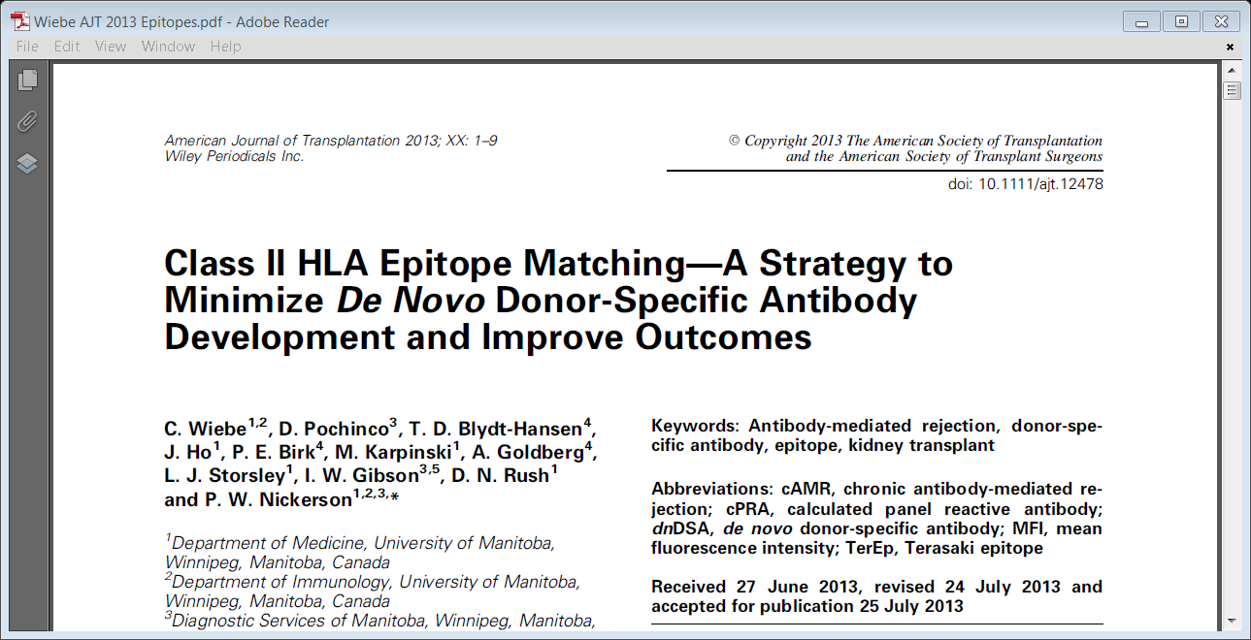
HLA-DR
Conclusion: DR and DQ epitope mismatching outperforms traditional low-resolution antigen mismatching and high-resolution allele mismatching as a predictor of de novo Class II DSA development thereby improving long-term graft outcome

Slide 38
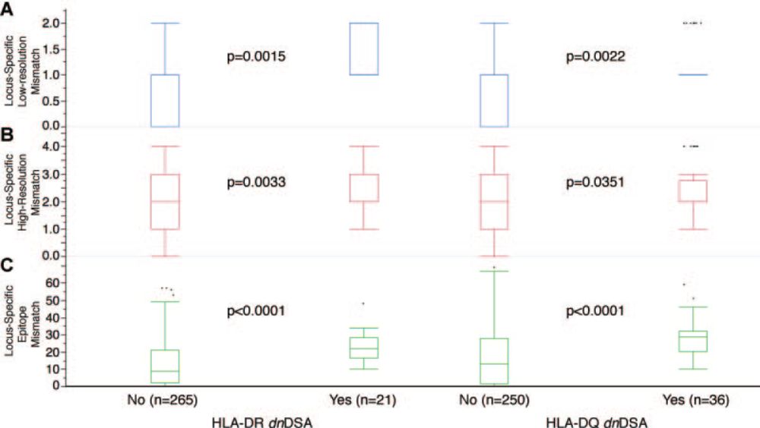
Prediction of de novo DSA post-transplant. A: how-resolution DRB,DQB mismatches, B: high-resolution DRB1/3/4/5, DQA,B mismatches; C: eplet-derived epitope mismatches
Wiebe et al. Amer. J Transplantation 20:1-9, 2013

Slide 39
HLA Class II Matching at the Epitope Level (Conclusions)
Type for HLA-DRDQDP at the 4-digit allele level
Determine mismatched epitopes on donor alleles
Consider the epitope load of a donor mismatch and epitope immunogenicity as risk factors for antibody-formation in non-sensitized transplant patients

Slide 40
Practical Usefulness of HLA Epitope Load Determinations

Slide 41
Mismatched Epitope (Triplet) Loads and Corneal Graft Survival
63
147 cases with up to 13 mismatched triplets 398 cases with more mismatched triplets
Kaplan-Meier estimation: 85% vs. 76% rejection-free clear graft survival
log-rank test, p=0.047
Daniel Boehringer et al.
(University Hospital, Freiburg, Germany), Transplantation 77, 417–421, 2004

Slide 42
Molecular Vision 2010; 16:2362-2367
Operational post- keratoplasty graft tolerance due to differential HLAMatchmaker matching
Daniel Böhringer, Frieder Daub, Johannes Schwartzkopff, Philip Maier, Florian Birnbaum,Rainer Sundmacher, Thomas Reinhard
University Eye Hospital Freiburg, Germany

Slide 43
Daniel Böhringer et al. Molecular Vision 2010; 16:2362-2367
Their hypothesis: Matching at the HLA-DR locus more closely than at loci HLA-A and -B would induce graft tolerance in keratoplasty.
Conventional HLA-allele-based matching might be inappropriate for detecting this effect
The standard matching approach does not reflect structural or functional similarities between HLA alleles
HLAMatchmaker quantitatively assesses donor-recipient histocompatibility on the basis of polymorphic amino acid configurations (eplets) that represent structurally defined elements of the HLA epitopes

Slide 44
Computation of Tolerance and Histocompatibility
Formula for tolerogenicity prediction
f_{tolerogenic}(MI, MII) = (MII)² − (MI)²
MI and MII are the numbers of mismatched class I and class II eplets
Examples |  | Recipient | Donor | # Mm Eplets | Tolerance factor
Example 1 (tolerogenic situation) |  | A*0301, A*2402 B*4402, B*5601 DRB1*1101,DRB1*0401 | A*0301,A*2402 B*3501 DRB1*1101,DRB1*1501 | 4 7 | 7²–4² = 33
Example 2 (immunogenic situation) |  | A*0201, A*2902 B*0702,B*4402 DRB1*0101,DRB1*1101 | A*0201 A*0301 B*4402 DRB1*0401,DRB1*1201 | 4 21 | 21²–4² = 425
Daniel Böhringer et al Molecular Vision 2010; 16:2362-2367

Slide 45
Study Design (Daniel Böhringer, Molecular Vision 2010;16:2362-2367)
First cohort (N=586) Only keratoplasties without specific risk factors
Empirically determine the respective thresholds for two binomial factors with the highest predictive power on graft rejection.
Optimal Thresholds | Cox Proportional Hazards ratio | p-value
Tolerance factor >220 eplets² | 2.22 | 0.04
>10 mismatched HLA-A,B eplets | 3.63 | <0.01

Slide 46
Study Design (Daniel Böhringer, Molecular Vision 2010;16:2362-2367)
First cohort (N=586) Only keratoplasties without specific risk factors
Empirically determine the respective thresholds for two binomial factors with the highest predictive power on graft rejection.
Optimal Thresholds | Cox Proportional Hazards ratio | p-value
Tolerance factor >220 eplets² | 2.22 | 0.04
>10 mismatched HLA-A,B eplets | 3.63 | <0.01
Second cohort (N=975) Both low-risk and high-risk patients (repeat keratoplasties, vascularized corneas and surface disorders)
Verify the effect of these binomial factors on immune rejection (endothelial precipitates, stromal edema or stromal infiltrates, and epithelial rejection lines) Routine visits after 6 weeks, 4 and 12 months and annually thereafter

Slide 47
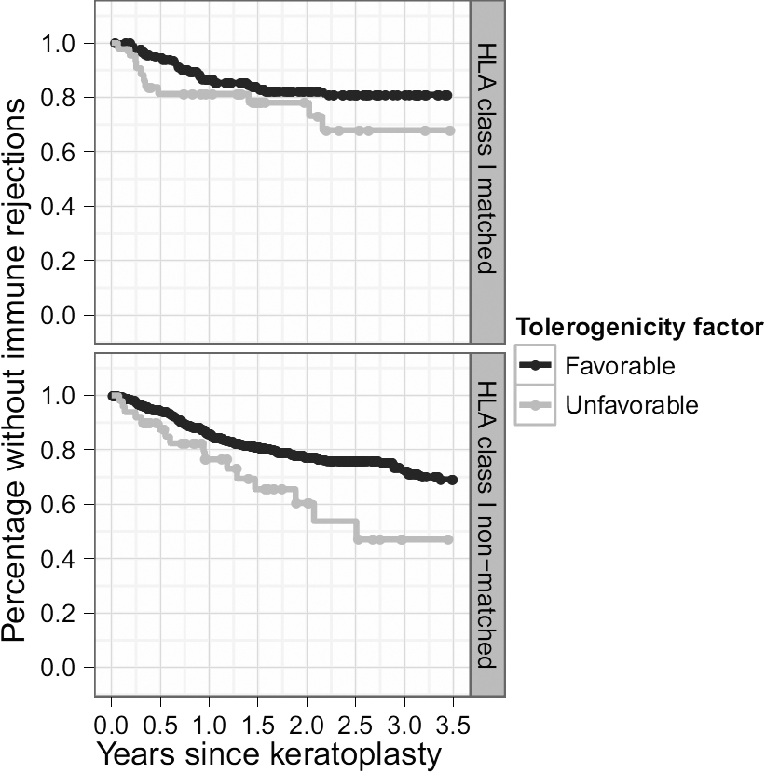
Kaplan–Meier estimations of rejection free survival for the 975 consecutive patients in Cohort 2
HLA-class I matched (<10 mismatched eplets) and nonmatched (>10 mismatched eplets )
More immune reactions with unfavorable tolerance factors (>220 eplets²) (light gray) than with favorable tolerance factors (<220
eplets²) (dark gray).
This difference seems to be even more pronounced for the non-HLA-class I matches
Daniel Böhringer et al Molecular Vision 2010; 16:2362-2367

Slide 48
Kaplan–Meier estimations of rejection free survival for the 975 consecutive patients in Cohort 2
HLA-class I matched (<10 mismatched eplets) and nonmatched (>10 mismatched eplets )
More immune reactions with unfavorable tolerance factors (>220 eplets²) (light gray) than with favorable tolerance factors (<220
eplets²) (dark gray).
This difference seems to be even more pronounced for the non-HLA-class I matches
The Cox model is adjusted for low- versus high-risk keratoplasties
Factor | Hazards ratio | p-value
TF >220 eplets² | 2.00 | <0.01
>10 A,B eplets | 1.50 | 0.02
Daniel Böhringer et al Molecular Vision 2010; 16:2362-2367

Slide 49
Clinical Usefulness of HLA Epitope Load Determinations
Risk prediction for de novo HLA antibody formation and humoral rejection of mismatched transplants
May identify better mismatches for non-sensitized patients

Slide 50
Manuscript in preparation:
Application of an Epitope Based Allocation System Pediatric Transplant Recipients
Joshua Kausman
Melbourne Children’s Hospital
Selection of donors for non-sensitized patients is based on epitope loads
Post-transplant follow-up: excellent

Slide 51
Possible Relevance of Mismatched Epitope Numbers in Desensitization Protocols
Duquesnoy RJ (Letter to the Editor) : HLA epitopes and tolerance induction protocols, Amer. J Transplant, 14:2667, 2014

Slide 52
Clinical Relevance of HLA Epitope-Based Matching for Transplantation (Conclusions)
Epitope antigenicity
  Analyses of epitope specificities of antibodies enhance the determination of HLA mismatch acceptability for sensitized transplant candidates
  Consider the antigen-antibody binding energy concept
Epitope loads of HLA antigen mismatches
  Clinically useful in the post-transplant management of patients at risk for antibody-mediated rejection
  May lead to permissible mismatch strategies for non-sensitized patients to reduce humoral rejection and increase transplant success

Slide 53
HLA Epitope Immunogenicity
How often do mismatched eplets induce specific antibodies?
This issue will be addressed in the lecture 10

