Slide 1
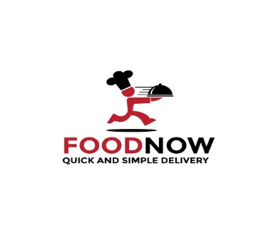
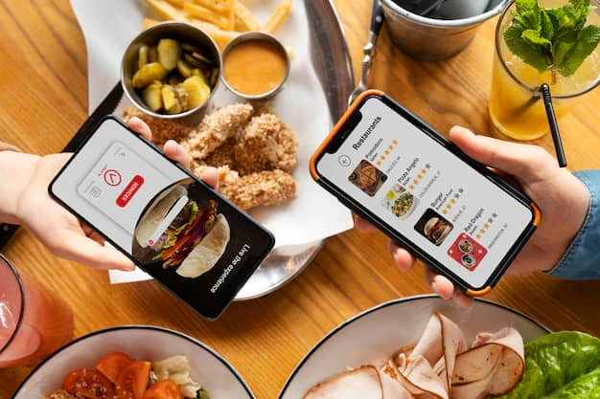

Slide 2
MEMBERS OF THE GROUP
WINSLEY JOHN MAGOMBEKA
DEOGRATIUS PHILIPO
ESTER JACOB MDEE
STEPHEN PHILEMONI MJEMA
YASIN NASSORO SALUM
IBRAHIM HAJI MUSTAFA
SWEDI HUSSEIN JABIR

Slide 3
Introduction | Project Abstract for Food Ordering System Application:
The rapid advancement of technology and the increasing demand for convenient dining solutions have transformed the food industry. A modern food ordering system serves as a vital tool that bridges the gap between customers and restaurants, allowing users to place orders effortlessly from the comfort of their homes.
This project aims to develop an intuitive food ordering system that simplifies the ordering process, offers a diverse selection of cuisines, and provides real-time tracking of orders. By enhancing user experience through customizable menus and efficient order management, our goal is to elevate customer satisfaction and streamline restaurant operations, ultimately contributing to a more dynamic and responsive food service ecosystem.

Slide 4
Problem Statement for Food Ordering System Application:
As consumer preferences continue to shift toward convenience and speed, traditional methods of ordering food—whether by phone or in person—prove to be inefficient and increasingly inadequate. Customers experience frustration due to long wait times, difficulty in accessing diverse menu options, and challenges in articulating specific preferences or dietary restrictions. Furthermore, many existing food ordering systems lack real-time tracking capabilities, leaving customers uncertain about their order status and delivery times.
Restaurants, on the other hand, face challenges such as order inaccuracies, inefficient inventory management, and the inability to gather valuable insights into customer preferences and behaviors. This often results in suboptimal service, wasted resources, and missed opportunities for customer engagement and loyalty.

Slide 5
Main Objective:
This project aims to address these issues by developing a comprehensive food ordering system that provides an intuitive interface for users to place and customize their orders easily. Key features will include real-time order tracking, efficient inventory management, and an analytics dashboard to help restaurants better understand their customers.
By solving these problems, the food ordering system seeks to enhance the overall dining experience for customers and improve operational efficiency for restaurants.

Slide 6
Specific objectives:
Allow Restaurant Staff to Update Menu and Food Prices: This feature empowers restaurant staff to directly manage the menu by adding new dishes, removing outdated items, and adjusting prices in real-time. This flexibility ensures that customers have access to the latest offerings and accurate pricing, improving transparency and customer trust.
Allow Users to Order Food on the System: This objective enables customers to browse the menu, select their desired items, and place orders through an intuitive interface. Users can customize their orders based on preferences or dietary restrictions, making the ordering process more accessible and convenient.
Streamline the Food Ordering Process: By optimizing the workflow from order placement to delivery, this objective focuses on reducing bottlenecks and inefficiencies. Features like quick order reordering, real-time tracking, and simple payment processes minimize friction for both customers and restaurant staff, enhancing the overall efficiency and speed of service.

Slide 7
Functional Requirements of Food Ordering System:
User Authentication: The system must allow users to create accounts, log in, and manage their profiles, including password recovery.
Menu Management: Restaurant staff should be able to add, edit, or remove food items from the menu, including descriptions, images, and prices.
Order Placement: Users must be able to browse the menu, customize their orders (e.g., ingredients, portion sizes), and place orders seamlessly
Order Tracking: Users should have access to real-time updates on the status of their orders, from preparation to delivery.
Customer Feedback: Users must be able to leave reviews or ratings for their orders, helping restaurants improve their service.

Slide 8
Non-Functional Requirements of Food Ordering System:
Performance: The system handle multiple orders simultaneously without significant delays, ensuring quick response times especially during peak hours.
Usability: The interface should be intuitive and user-friendly, allowing customers of all tech proficiency levels to navigate the system easily.
Reliability: The system should have high availability, ensuring it is operational and accessible to users without frequent downtimes.
Scalability: The platform should be designed to handle an increasing number of users and orders without a drop in performance.
Maintainability: The code and system architecture should support easy updates and maintenance, allowing for quick fixes and new feature implementations.
Compatibility: The system have the compatible with various devices (desktop, mobile, tablet) and browsers, providing a consistent user experience

Slide 9
Features of Food Ordering System:
User Registration and Login: Allow users to create accounts and log in securely, facilitating personalized experiences and order history tracking.
Menu Browsing and Search: Provide an easy-to-navigate menu structure with category filters and a search function to help users find specific dishes quickly.
Customizable Orders: Enable users to customize their food orders (e.g., choosing toppings, portion sizes, or special instructions) to meet individual preferences.
Admin Dashboard: Provide restaurant staff and administrators with an interface to manage orders, update menus, view sales reports, and monitor customer feedback.
User Profile Management: Enable users to manage their profiles, including saved addresses, and order history for a more personalized experience.

