Slide 1
Topics in Quantitative Finance: Machine Learning for Finance Hotel Review Sentiment Analysis
Wang Yu
1601213621

Slide 2
Contents
Project Introduction
Data
Process
Chinese text segmentation
Stop-word removal
Bag-of-words model, Transforming words into feature vectors
TFIDF (term frequency-inverse document frequency)
Data split
Classify methods: SVM, Decision tree, Logistics regression, Naive bayes
Prediction results
Improvement
Conclusion

Slide 3
Project Introduction
Contents
Project Introduction
Data
Process
Chinese text segmentation
Stop-word removal
Bag-of-words model
TFIDF
Data split
Classify methods
Prediction results
Improvement
Conclusion
This project will use a data set consisting of Chinese hotel reviews from www. ctrip.com（携程） to build sentiment classifiers that classifies a review as positive or negative.

Slide 4
Data
Contents
http://www.datatang.com/data/11936
ChnSentiCorp-Htl-ba-6000: balanced corpus，
positive(3000 reviews) /negative（3000 reviews）
Project Introduction
Data
Process
Chinese text segmentation
Stop-word removal
Bag-of-words model
TFIDF
Data split
Classify methods
Prediction results
Improvement
Conclusion

Slide 5
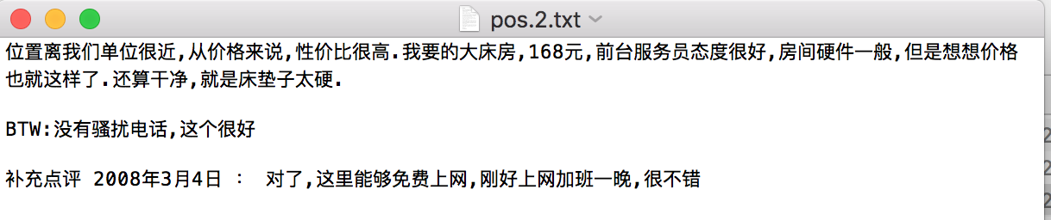
Data Example - positive

Slide 6
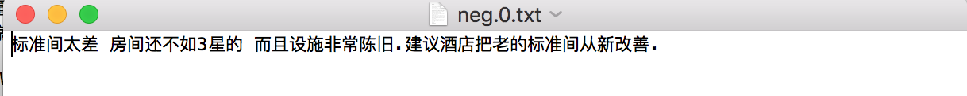
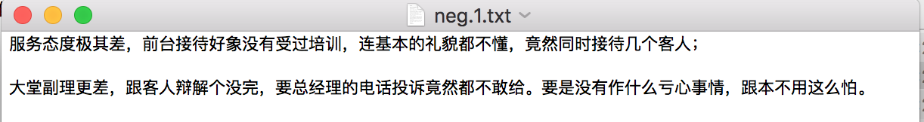
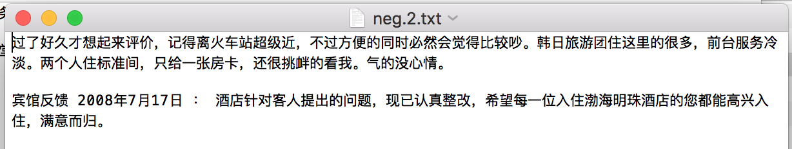
Data Example - negative

Slide 7
Process: Chinese text segmentation
Contents
The biggest difference between English and Chinese.
There is a space between word and word in English.
Chinese text segmentation（divide text into words) is an important question of Chinese information processing.
Using Jieba: https://github.com/fxsjy/jieba
("Jieba" (Chinese for "to stutter") Chinese text segmentation: built to be the best Python Chinese word segmentation module.)
Example:
seg_list = jieba.cut(”我来到深圳北京大学")
print(", ".join(seg_list))
output: 我/ 来到/ 深圳/ 北京大学
Project Introduction
Data
Process
Chinese text segmentation
Stop-word removal
Bag-of-words model
TFIDF
Data split
Classify methods
Prediction results
Improvement
Conclusion

Slide 8
Process: Chinese text segmentation
Contents
Algorithm of Jieba for Chinese text segmentation:
1. Matching dictionary
1.1 maximum matching method: from the first character, matching each character with dictionary, recording words.
1.2 reverse maximum matching method: from the last character in text.
2. Use dynamic programming to find the most probable combination based on the word frequency:
A Hidden Markov Model (HMM)-based model is used with the Viterbi algorithm.
Input: a Chinese sentence, e.g. 我/硕士/毕业于/北大/汇丰/商学院
Output: a sequence string with four states “BEMS”, e.g. S/BE/BME/BE/BE/BME
B: the beginning character of a word, E: the ending character of a word,
M: the medium character of a word, S: a single character as a word.
transition probability B→B, B→E, B→S, B→M, S→S, S→E, S→S, S→M……
E.g ABC， segmentation approaches: A/BC, AB/C, ABC, A/B/C
Maximum probability
Project Introduction
Data
Process
Chinese text segmentation
Stop-word removal
Bag-of-words model
TFIDF
Data split
Classify methods
Prediction results
Improvement
Conclusion

Slide 9
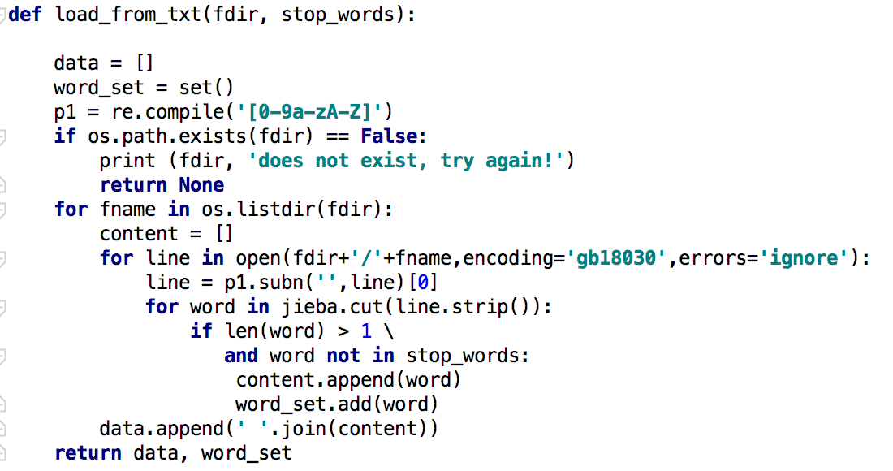
Process: Chinese text segmentation
Contents
Project Introduction
Data
Process
Chinese text segmentation
Stop-word removal
Bag-of-words model
TFIDF
Data split
Classify methods
Prediction results
Improvement
Conclusion
Text segmentation using jieba

Slide 10
Process: Stop-word removal
Contents
Project Introduction
Data
Process
Chinese text segmentation
Stop-word removal
Bag-of-words model
TFIDF
Data split
Classify methods
Prediction results
Improvement
Conclusion
Data Processing:
1. remove individual character after segmentation
2.stop-word removal

Slide 11
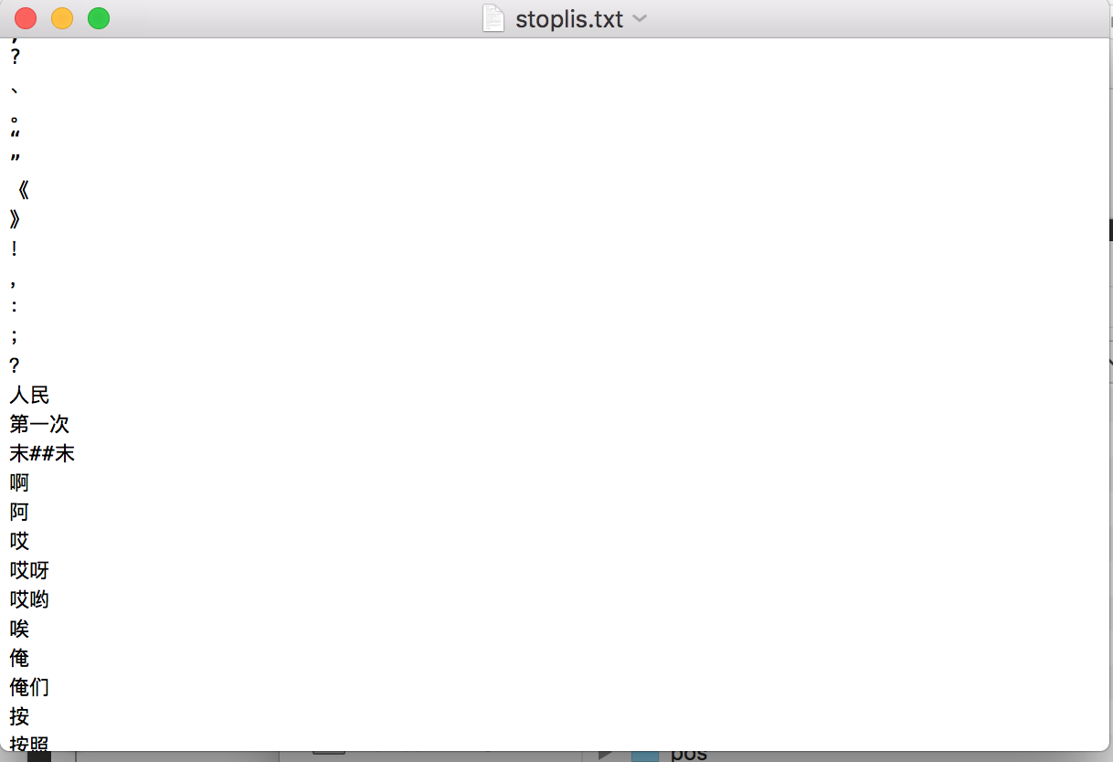
Process: Stop-word removal
Contents
Stop-words are simply those words that are extremely common in all sorts of texts and likely bear no (or only little) useful information that can be used to distinguish between different classes of reviews.
stoplis.txt
（From Internet)
Example:
modal particle
（啊Ah，哦Oh）
adversative
（但是but）
personal pronoun
（我I，我们We）
Number
(1,2,3……)
……
Project Introduction
Data
Process
Chinese text segmentation
Stop-word removal
Bag-of-words model
TFIDF
Data split
Classify methods
Prediction results
Improvement
Conclusion

Slide 12
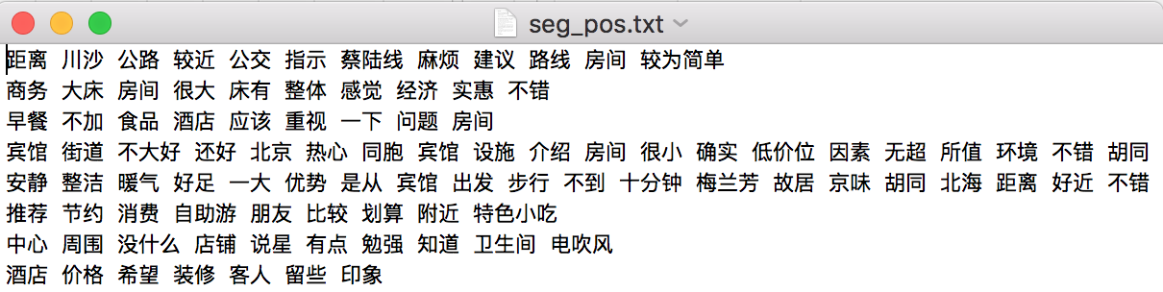
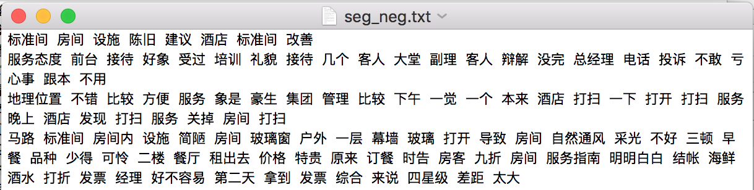
Process: segmentation and removal results

Slide 13
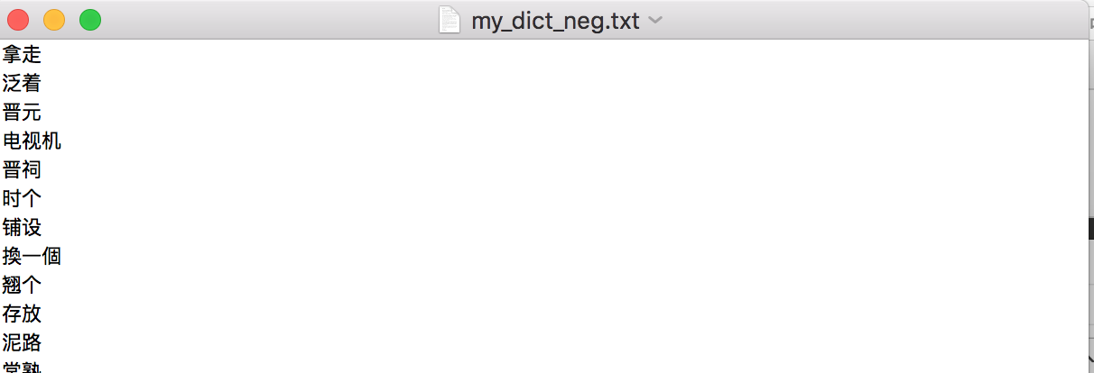
Process: Bag-of words model
Contents
Using bag-of-words (BOW) model to represent text as numerical feature vectors.
1. Create a vocabulary of unique words—from the entire set of reviews dataset.
Project Introduction
Data
Process
Chinese text segmentation
Stop-word removal
Bag-of-words model
TFIDF
Data split
Classify methods
Prediction results
Improvement
Conclusion

Slide 14
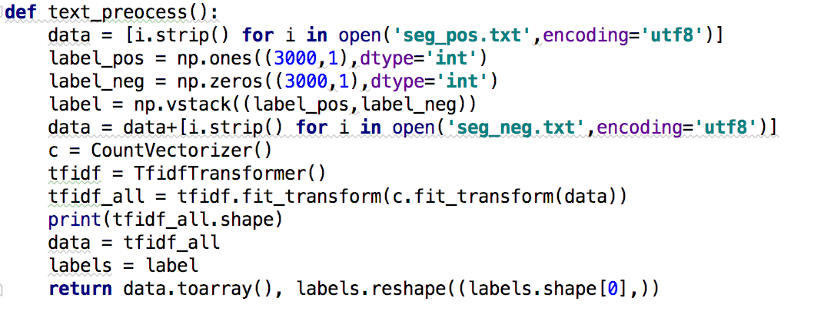
Process: Bag-of words model
Contents
Using bag-of-words (BOW) model to represent text as numerical feature vectors.
2. construct a feature vector from each review that contains the counts of how often each word occurs in the particular review.
use the CountVectorizer class implemented in scikit-learn.
Project Introduction
Data
Process
Chinese text segmentation
Stop-word removal
Bag-of-words model
TFIDF
Data split
Classify methods
Prediction results
Improvement
Conclusion
takes an array of text data, constructs the BOW

Slide 15
Process: TFIDF
Contents
term frequency-inverse document frequency (tf-idf) that can be used to downweight those frequently occurring words in the feature vectors.
Assessing word relevancy: tf-idf(t,d)=tf(t,d)×idf(t,d）
use the TfidfTransformer class implemented in scikit-learn.
Project Introduction
Data
Process
Chinese text segmentation
Stop-word removal
Bag-of-words model
TFIDF
Data split
Classify methods
Prediction results
Improvement
Conclusion
TFIDF

Slide 16
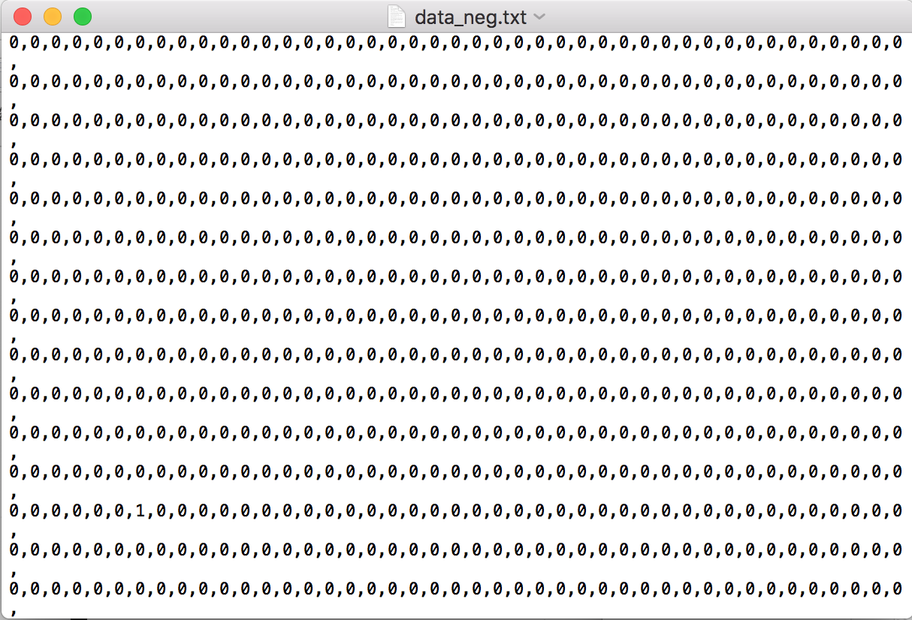

Process: Transforming words into feature vectors
the feature vectors consist of mostly zeros, sparse

Slide 17
Process: Data split
Contents
Get train/test split
Project Introduction
Data
Process
Chinese text segmentation
Stop-word removal
Bag-of-words model
TFIDF
Data split
Classify methods
Prediction results
Improvement
Conclusion

Slide 18
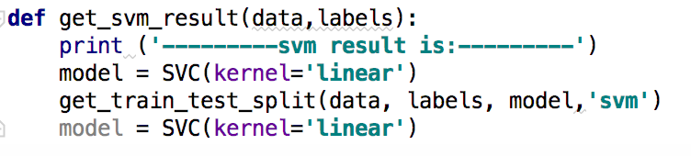
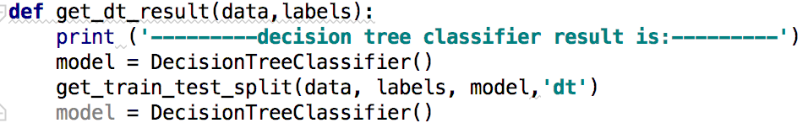
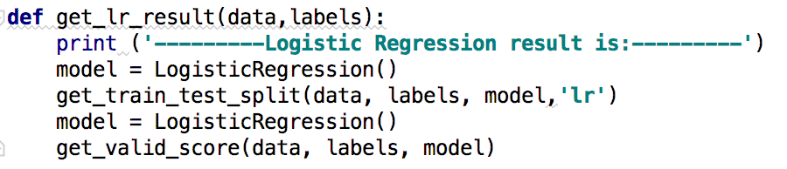
Process: Classify methods
Contents
Methods:
SVM, Decision tree, Logistics regression
Project Introduction
Data
Process
Chinese text segmentation
Stop-word removal
Bag-of-words model
TFIDF
Data split
Classify methods
Prediction results
Improvement
Conclusion

Slide 19
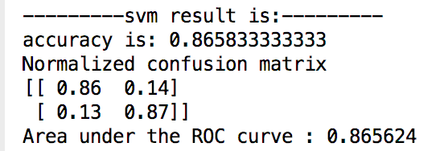
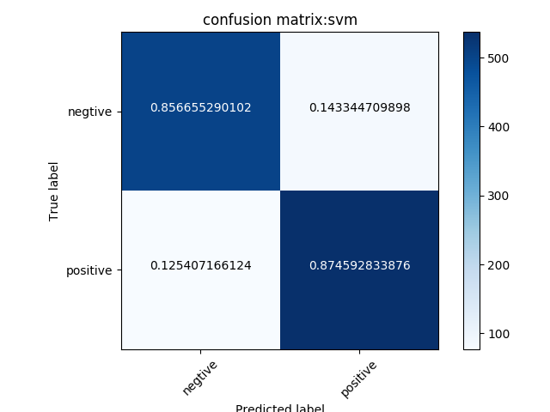
Process: Prediction results
Contents
SVM
Project Introduction
Data
Process
Chinese text segmentation
Stop-word removal
Bag-of-words model
TFIDF
Data split
Classify methods
Prediction results
Improvement
Conclusion

Slide 20
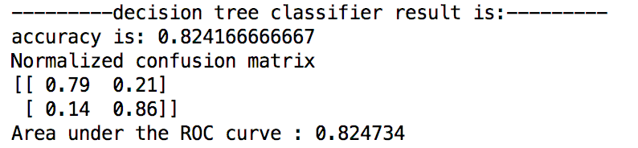
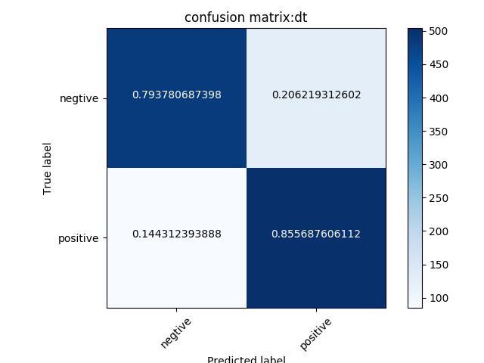
Process: Prediction results
Contents
Decision tree
Project Introduction
Data
Process
Chinese text segmentation
Stop-word removal
Bag-of-words model
TFIDF
Data split
Classify methods
Prediction results
Improvement
Conclusion

Slide 21
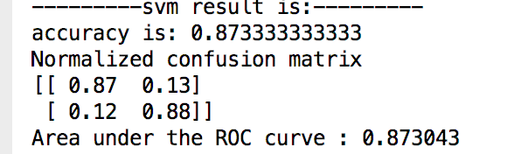
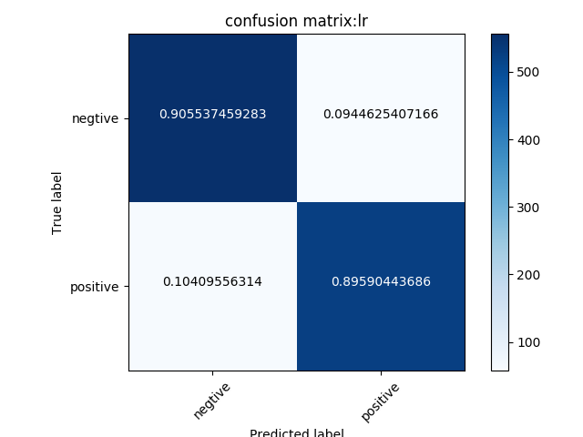
Process: Prediction results
Contents
Logistics regression
Project Introduction
Data
Process
Chinese text segmentation
Stop-word removal
Bag-of-words model
TFIDF
Data split
Classify methods
Prediction results
Improvement
Conclusion

Slide 22
Improvement
Contents
Documentary frequency
If a word only shows in 1 or 2 reviews of all 6000 reviews, I think the word is not important and remove it.
(documentary frequency ≥ 3)
Context: A triple model
Combine words in sequence and consider the context information
A/B/C/D/E 5 features
(A/B/C/D/E)(AB/BC/CD/DE)(ABC/BCD/CDE) 5+4+3=12 features
use the CountVectorizer class implemented in scikit-learn.
Project Introduction
Data
Process
Chinese text segmentation
Stop-word removal
Bag-of-words model
TFIDF
Data split
Classify methods
Prediction results
Improvement
Conclusion

Slide 23
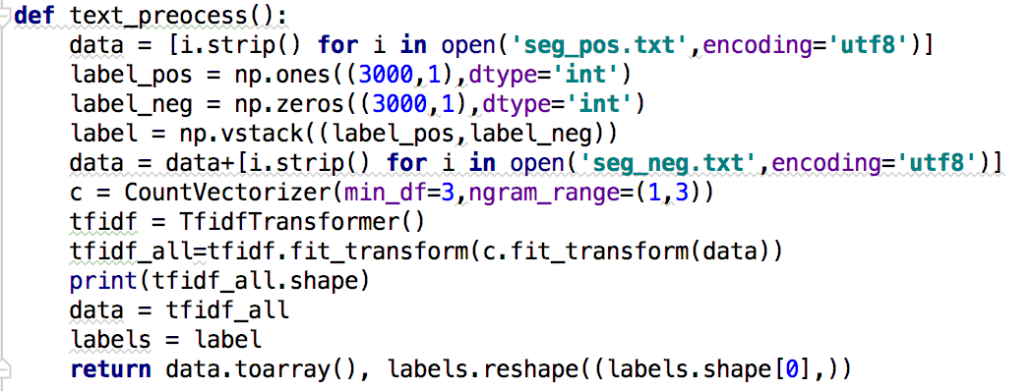

Improvement
Contents
Project Introduction
Data
Process
Chinese text segmentation
Stop-word removal
Bag-of-words model
TFIDF
Data split
Classify methods
Prediction results
Improvement
Conclusion
Document frequency, context (triple)

Slide 24
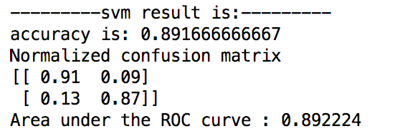
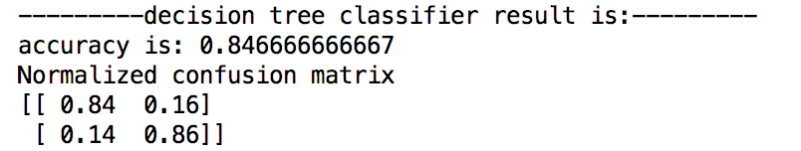
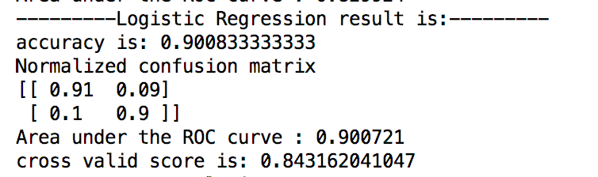
Improvement
Contents
Project Introduction
Data
Process
Chinese text segmentation
Stop-word removal
Bag-of-words model
TFIDF
Data split
Classify methods
Prediction results
Improvement
Conclusion
SVM Original accuracy: 0.86
DT Original accuracy: 0.82
LR Original accuracy: 0.87

Slide 25
Conclusion
Contents
There is no significant difference between different methods, the possible reason is that the dataset is not large enough.
Data processing/feature engineering is more important.
To improve the accuracy, we should have larger dataset.
Project Introduction
Data
Process
Chinese text segmentation
Stop-word removal
Bag-of-words model
TFIDF
Data split
Classify methods
Prediction results
Improvement
Conclusion

Slide 26
Thank you
Q&A

