Slide 1
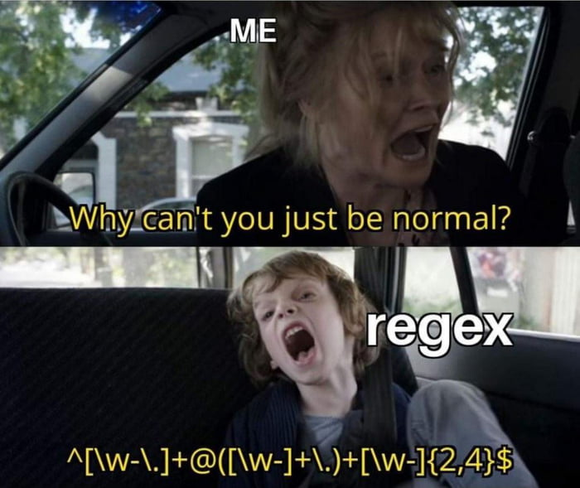
Regular Expressions
Regular Expression

Slide 2


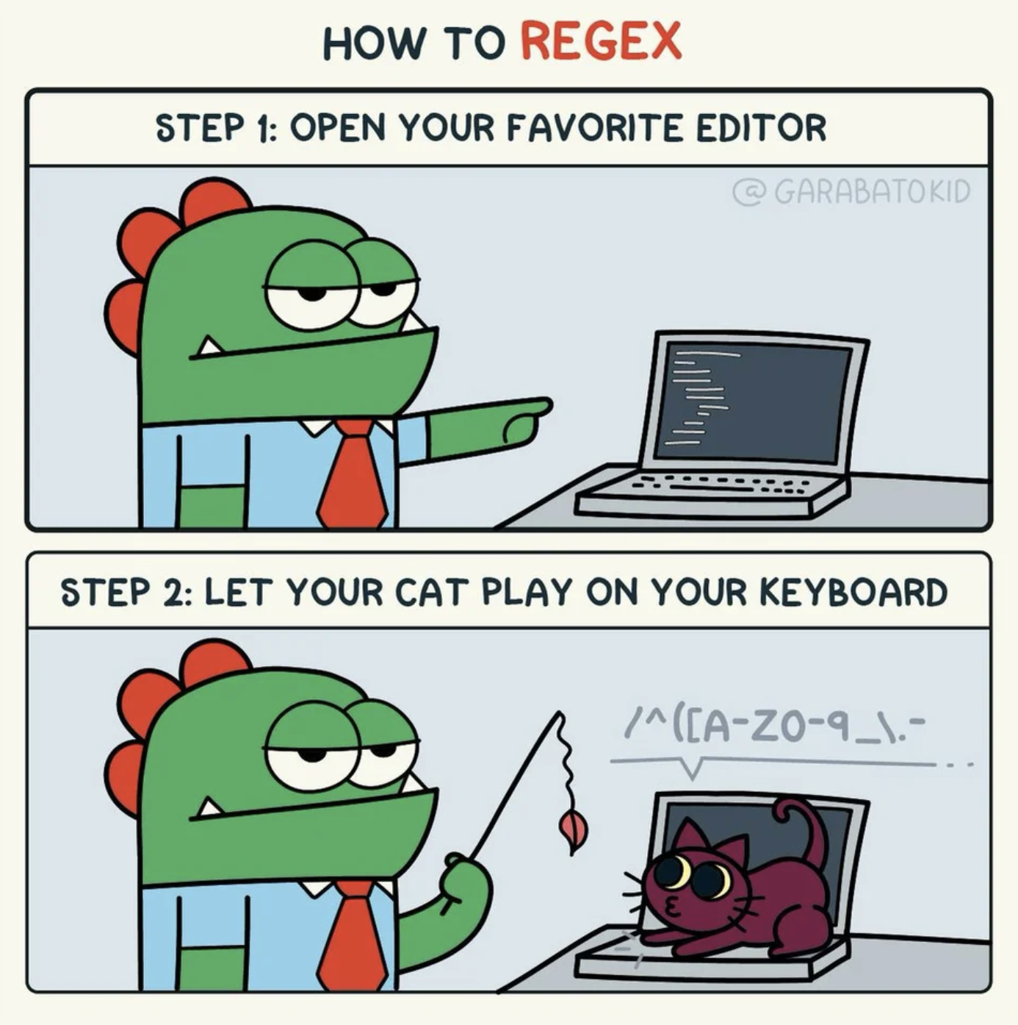
Start with regex101.com

Slide 3




Tips and Advice
THINK OF ALL POSSIBLE ITERATIONS OF YOUR ‘TARGET’.
TEST THEM! (UNIT TESTS SEEM MIGHTILY IMPORTANT)
WEBSITE TO HELP DEBUG IT (REGEX101.COM IS SUPER USEFUL).
USE GROUPS! (?: … )

Slide 4
Regex.py
Find all days the dates format in the text are MM/DD/YYYY.
Find all web address domains from the list of strings the domains of a website are after https://www.
Find all the words that contain a three-digit number in the middle
Pass the tests.

Slide 5



Challenge your partner!
Come up with wacky things to look for in tests (e.g., words that have more c’s than b’s).
See if there’s a possible regular expression for it.
Give it to your neighbors. See if they can solve it.

