Slide 1
SI 206 Discussion 4
Writing test cases

Slide 2
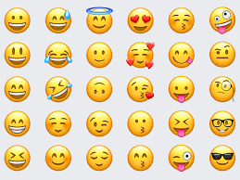
Ice breaker
Pull out your phone; what are your top 5 most used emojis?
What do you think this says about you?

Slide 3
Testing tips
Remember to first enumerate what are the different scenarios you are testing. It will help you better test your programs!
It is often useful to FIRST write tests, THEN write the program. Tests will help you think of how your program will behave in edge cases.
Now, go to github and clone the repository for today’s discussion section.

Slide 4
Warehouse and Items
Item class contains information about an item (name and price)
Warehouse class stores items.
Now you will implement (and test!) methods for the Warehouse class.
(We have created some items in setUp for you to use – feel free to use them if you wish!)

Slide 5
add_item in the Warehouse class
add_item: add_item is a method for the Warehouse class that adds an item to the warehouse.
Write tests to determine if it will work.

Slide 6
get_max_price in the Warehouse class
get_max_stock: get_max_stock is a method for the Warehouse class that finds and returns the item with the most stock
Write tests to determine if it will work.
There is an error in get_max_price, use tests to figure out what the issue is and fix it!

Slide 7
check_warehouse_for_item in the Warehouse class
Checks if item is in items list. It prints "Item already in warehouse" if the item is in itms and if item isn't in the items then print "Adding item" and adds item to the items.
There are two scenarios you need to test here, write a test for each case.

