Slide 1

Bhi-bsn 2018 big data challenge
Jiaqi Gong, Ridwan Alam, Ben Ghaemaghammi,
Renee Mitchell
University of Maryland, Baltimore County
University of Virginia
3/7/2018

Slide 2
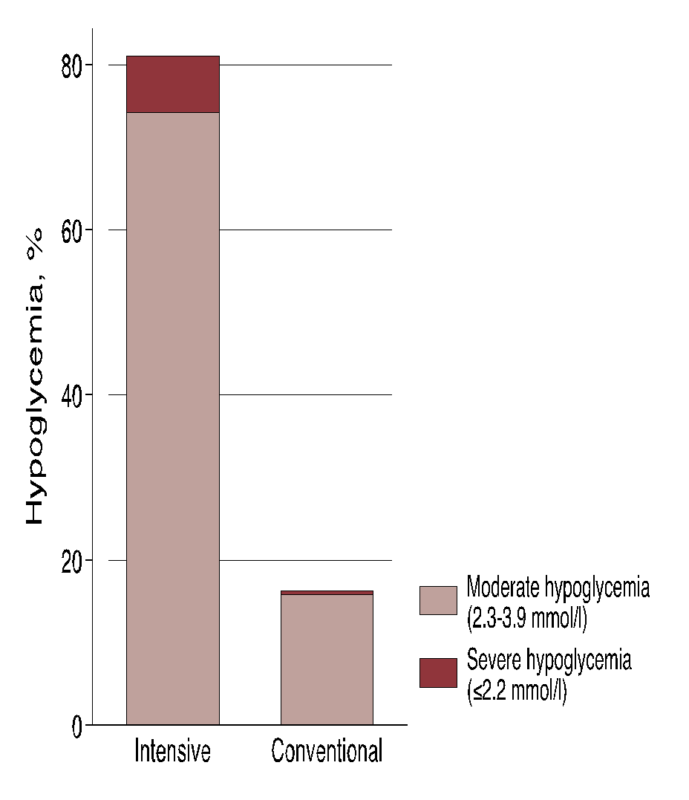
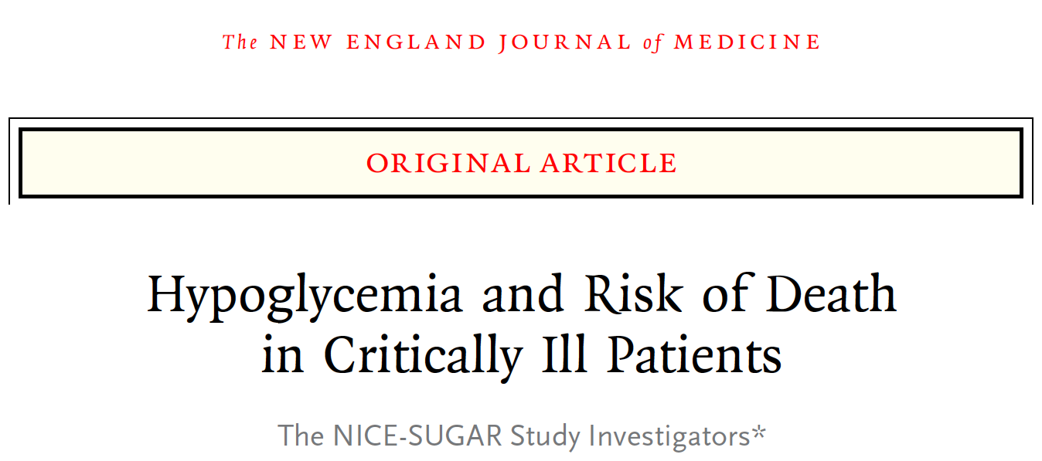
background
Brief literature review and motivation
We have limited understanding of X
We can study it in MIMIC-III

Slide 3
Study aim
A detailed and testable hypothesis
e.g. Patients with one or more episodes of hypoglycemia (≤70 mg/dL) have a higher in-hospital mortality than patients with no episodes.

Slide 4
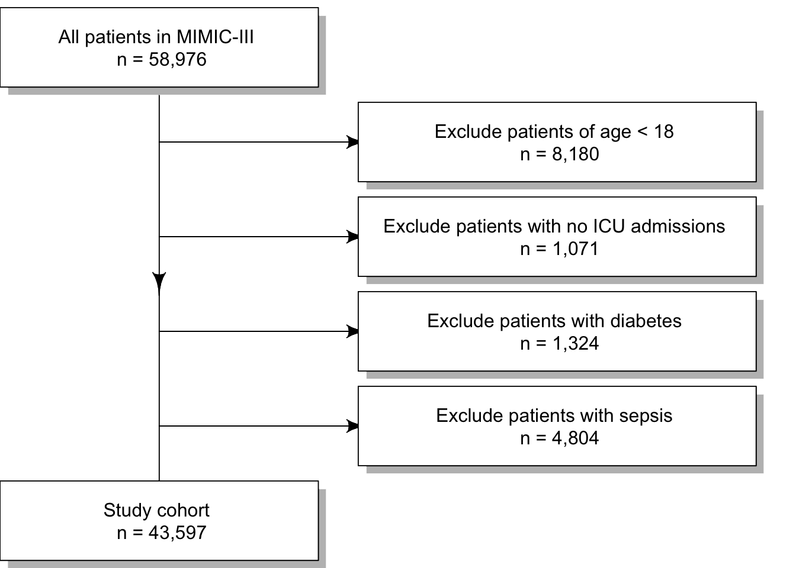
Cohort selection

Slide 5
Methods
Logistic regression on in-hospital mortality
Covariates included:
age, gender, number of events, etc…
Code for reproducing the analysis is available at: http://{your-favorite-code-repository}.com

Slide 6
Results (table)
 | Hypoglycemia (n = xxx) | No hypoglycemia (n = xxx) | P value
Age, years
Male sex, n (%)
APACHE III score
Diabetes, n (%)
Type 1
Type 2
Unknown
Liver disease
Admission diagnosis
Operative
Non-operative

Slide 7

Results (figure)

Slide 8
Discussion
Promising results?
Limitations?

Slide 9
Future aims
Plan to:
Adjust for A, B, C.
Try in subgroup D and E.

Slide 10
Acknowledgements
We would like to thank…
Colleagues?
Funders?
etc…

