Slide 1



Understanding the Relationship between Healthcare Processes and in-Hospital Mortality using MIMIC III
Team Members: Jiaqi Gong, Benjamin Ghaemmaghami, Renee MitChell
University of Maryland, Baltimore County
University of Virginia
03/06/2018

Slide 2
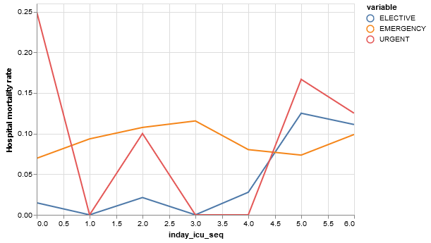
Background
Disparities in resources, expertise, and healthcare providers working during weekends may explain the observed differences in weekend mortality. [1]
Further work to understand the relationship between weekend processes of care and mortality, especially in the elective setting, is required. [2]
[1] Mohammed, Mohammed A., Khesh S. Sidhu, Gavin Rudge, and Andrew J. Stevens. "Weekend admission to hospital has a higher risk of death in the elective setting than in the emergency setting: a retrospective database study of national health service hospitals in England." BMC health services research 12, no. 1 (2012): 87.
[2] Saposnik, Gustavo, Akerke Baibergenova, Neville Bayer, and Vladimir Hachinski. "Weekends: a dangerous time for having a stroke?." Stroke 38, no. 4 (2007): 1211-1215.

Slide 3
Study Aims
Explore answers for the question: Are patients admitted to the intensive care unit (ICU) on a weekend more likely to die in the hospital than those admitted on a weekday?
Further understand the relationship between healthcare processes and mortality towards identifying factors that might be causing the weekend effect
Hypothesis: Disparities in resources, expertise, and healthcare providers working during weekends may explain the observed differences in weekend mortality.

Slide 4
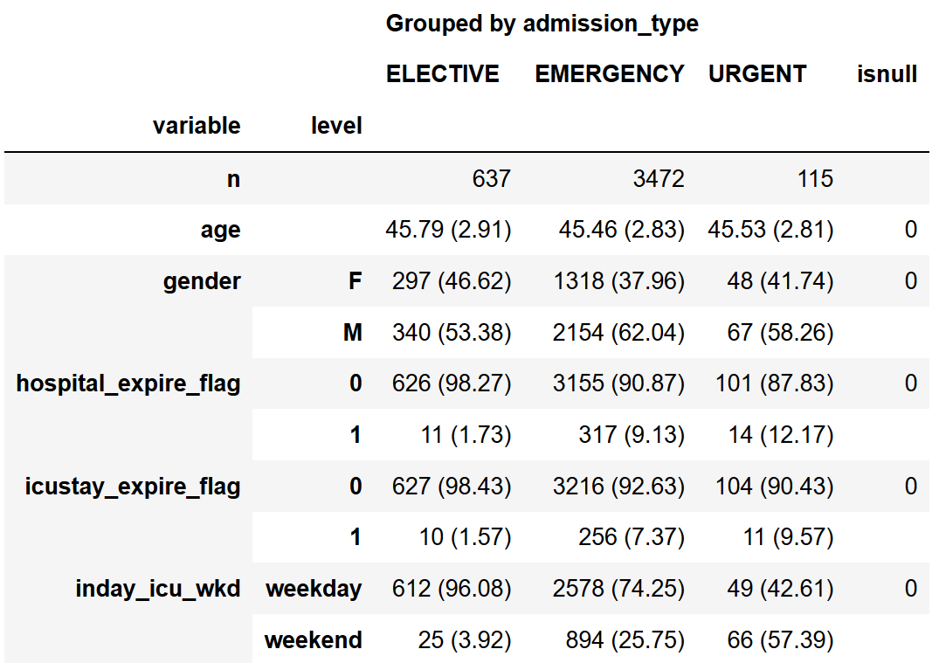
Cohort Selection
Age Category: 40-50years, 4224 patients

Slide 5
Methods
Covariates included:
Healthcare processes: number of chart measures, number of caregivers, caregiver average efficacy, number of lab tests
Severity of illness score: OASIS, OASIS probe
Duration: Length of hospital stay, length of the most recent ICU stay
Models
Correlation studies
Logistic regression model on in-hospital mortality
Decision tree to identify potential factors
Code for reproducing the analysis is available at:
https://github.com/reneelinmitchell/inertia-sail

Slide 6
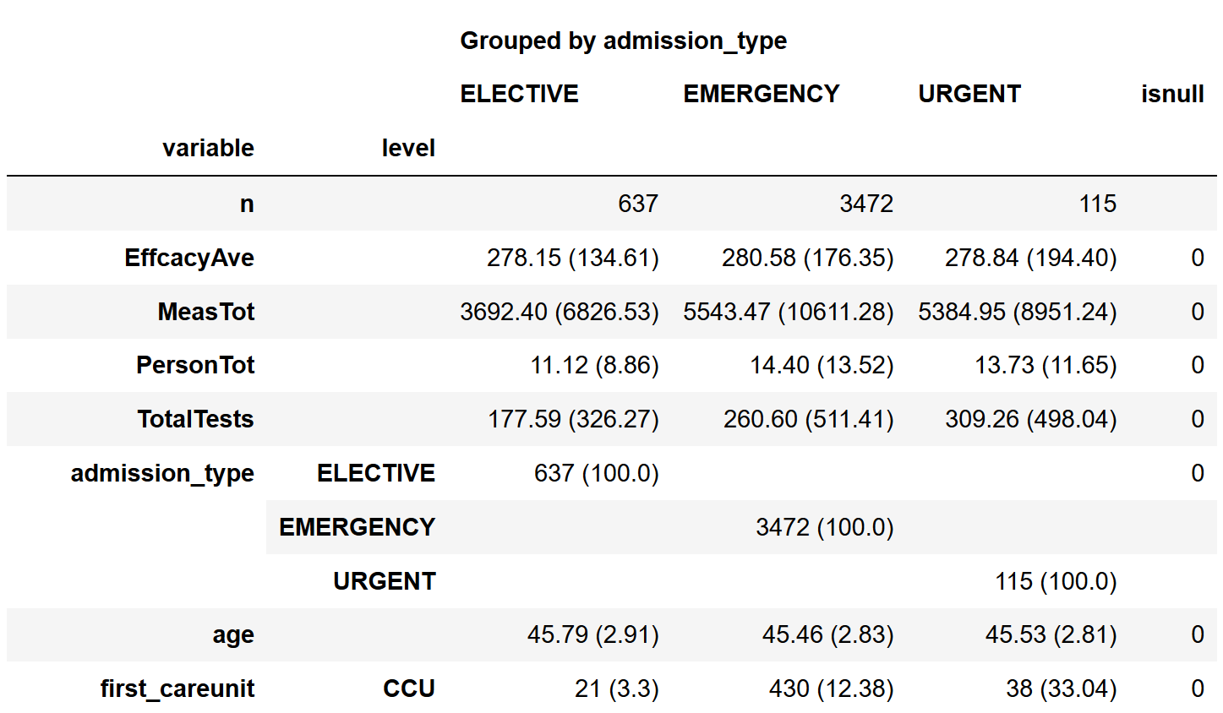
Results
Existing disparities in healthcare processes

Slide 7
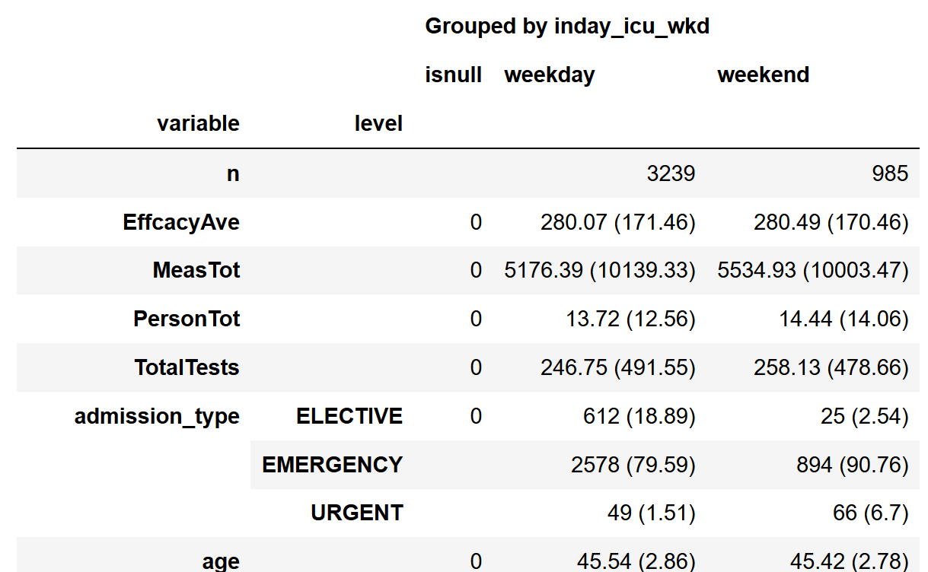
Results
No disparities between weekend and weekday

Slide 8
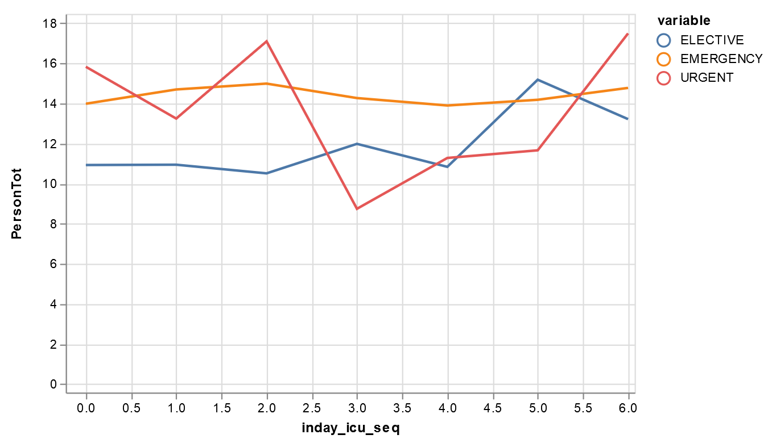
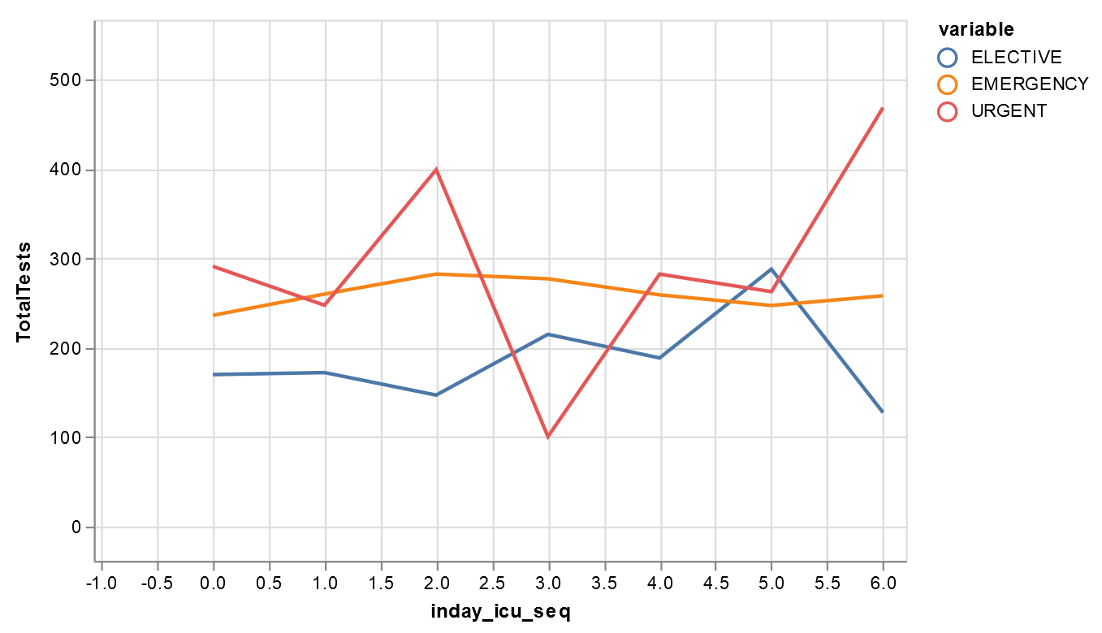
Correlation studies
in-hospital mortality
 | Elective | Emergency | Urgent
Number of Caregivers | 0.88 | 0.64 | 0.55
Number of Chart Measures | 0.46 | 0.76 | 0.40
Caregiver Average Efficacy | -0.26 | -0.30 | 0.48
Number of Lab Tests | 0.30 | 0.90 | 0.40
Number of Caregivers
Number of Lab Tests

Slide 9
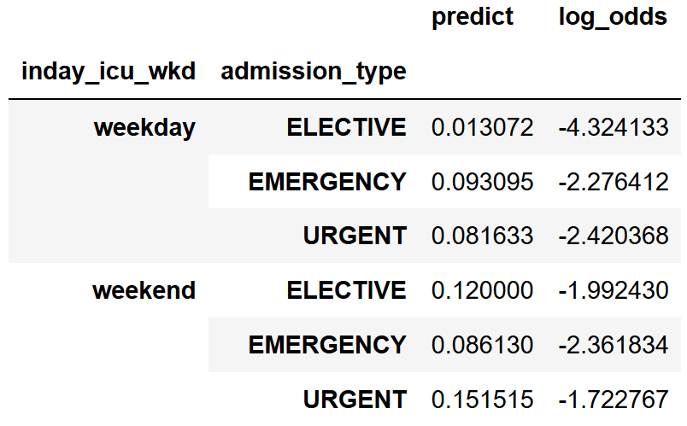
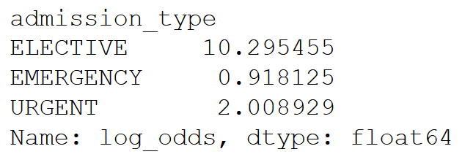
Logistic regression model
Elective admission group demonstrated significant weekend effect.

Slide 10
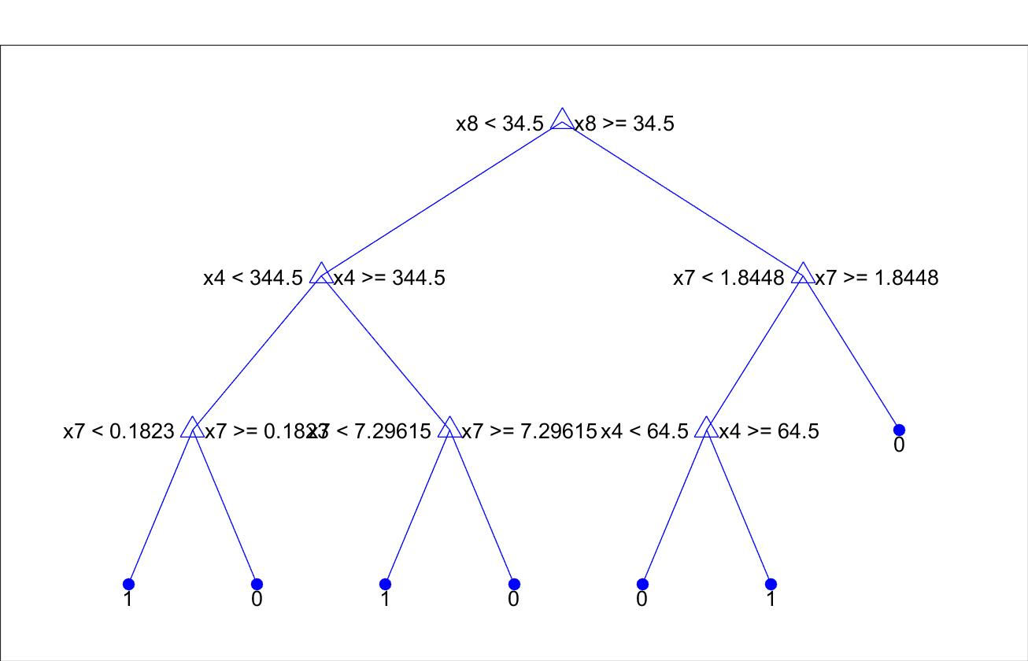
Decision Tree
Factors
x8: oasis
x4: Number of Lab Tests
x7: length of stay in hospital
hospital_expire_flag
0
1

Slide 11
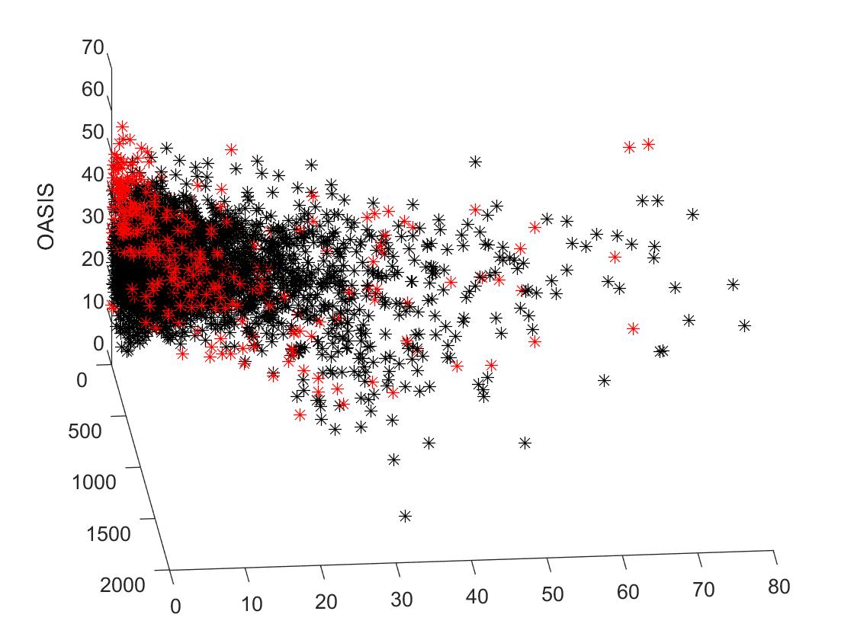
Decision Tree
Visualization
z: oasis
y: Number of Lab Tests
x: length of stay in hospital
hospital_expire_flag
0(black)
1(red)
Number of lab tests
Length of hospital stay
Notes:
Number of lab tests

Slide 12
Discussion
Developed a promising method to understand the relationship between healthcare processes and mortality
Revealed the existing disparities in healthcare processes;
Elective admission group demonstrated significant weekend effect;
Identified several factors of in-hospital mortality.
But current results cannot prove the hypothesis. It needs more work in other data analysis such as caregiver rotation and scheduling.

Slide 13
Future Work
Plan to:
Analyze other age categories
50-60
60-70
70-80
Explore caregiver information
Rotation
Scheduling
Work load
Explore other information: lab test, services (e.g., surgery)
Develop teaching materials for a course in health informatics.

Slide 14

Acknowledgments
Groups
SAIL Lab at UMBC
Sensor Accelerated Intelligent Learning
INERTIA Lab at UVA
Integrated Networked Embedded Real-time Technologies In Applications

