Slide 1
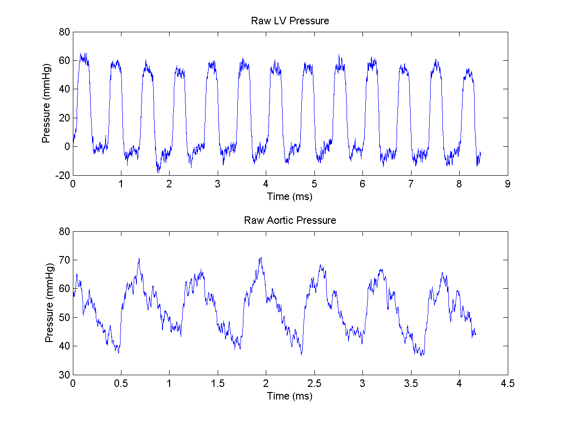
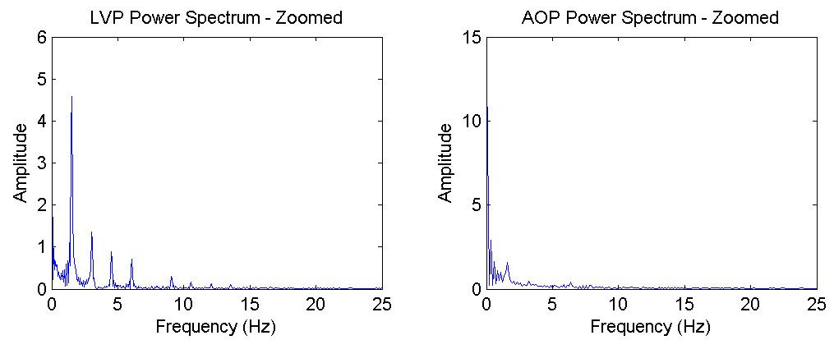
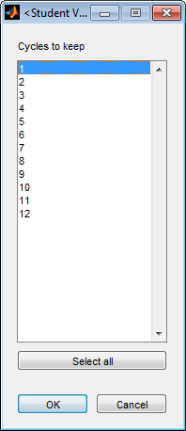
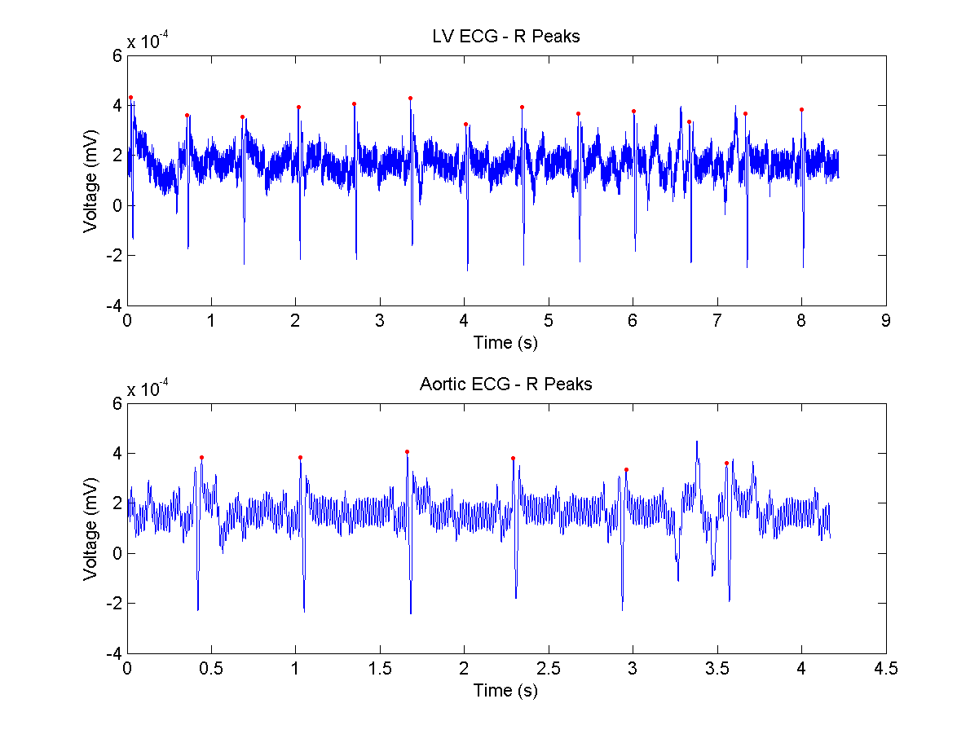

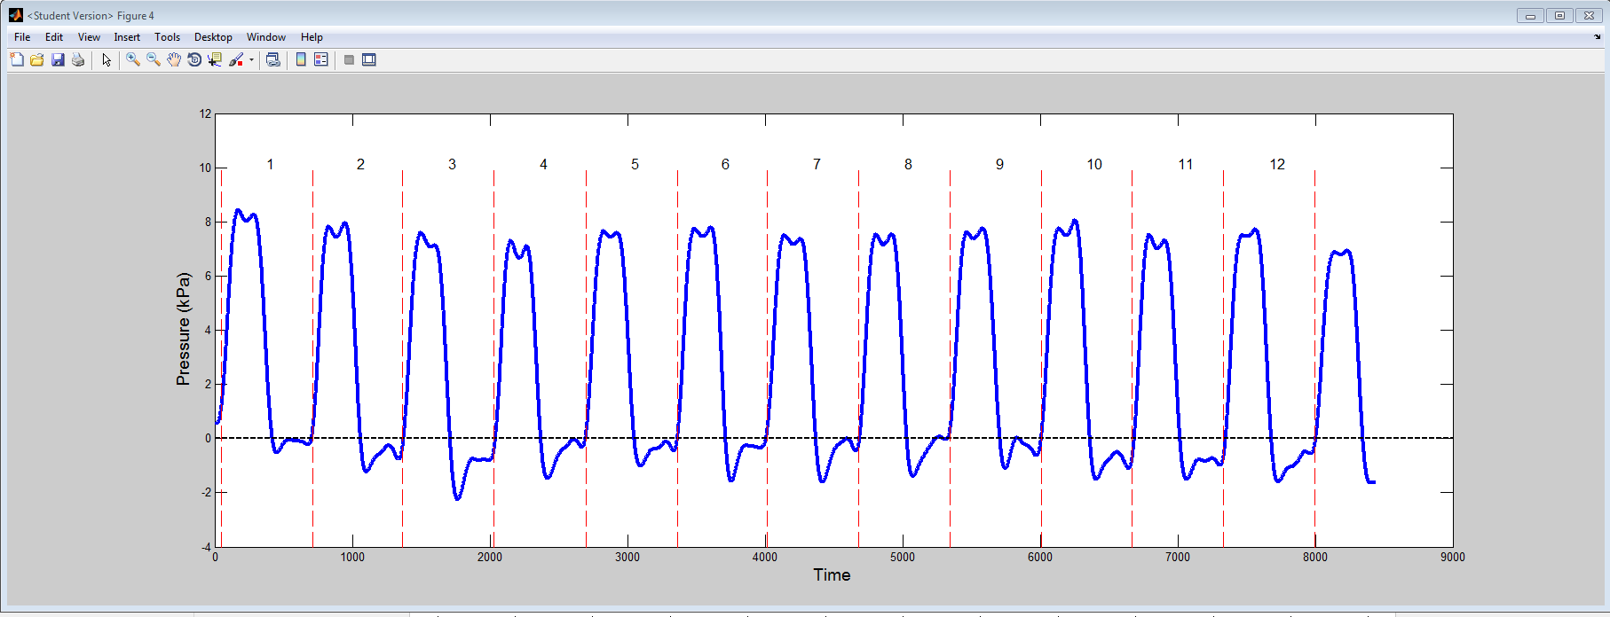
Read in LV and aortic pressure files
Calculate power spectrum to set low-pass cut off frequencies for filtering pressure signals
UI: Click on cut off frequency
Low-pass filter pressure signal
No
UI: Satisfied?
Yes
Detect R-peaks in ECG
UI: Choose which cycles in LVP and AOP to use
Detect cardiac events:
1) ED (a)
2) DS (a)
3) ES (ui)
4) eIVC (a)
5) eIVR (a)

Slide 2
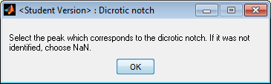
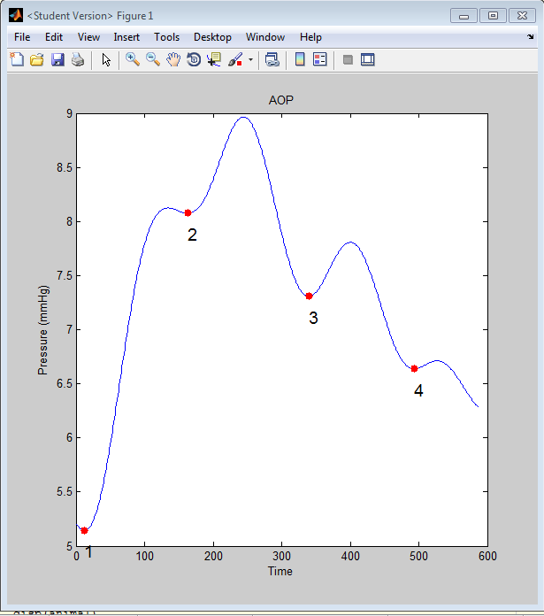
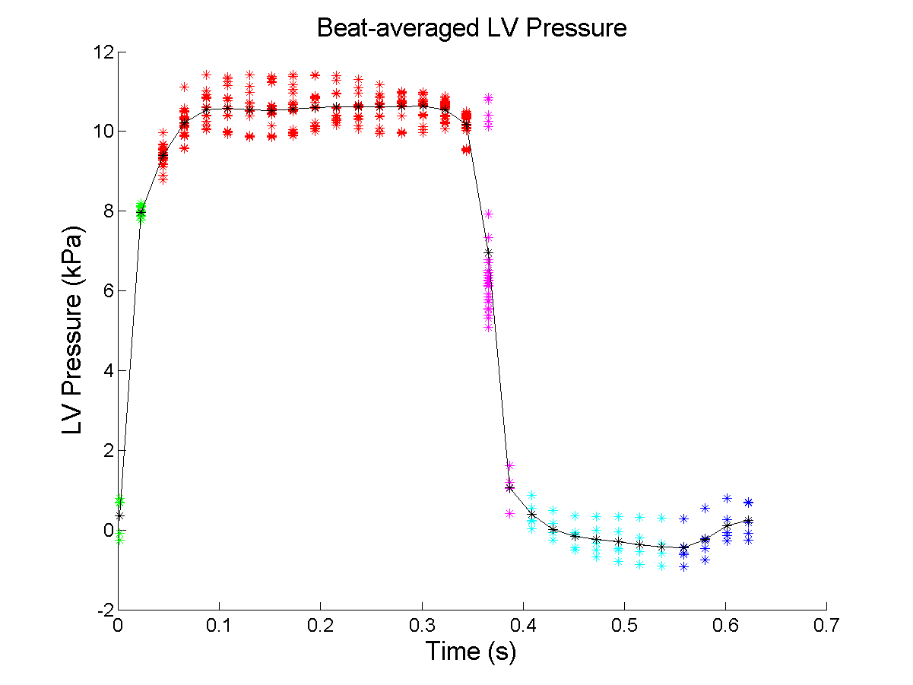
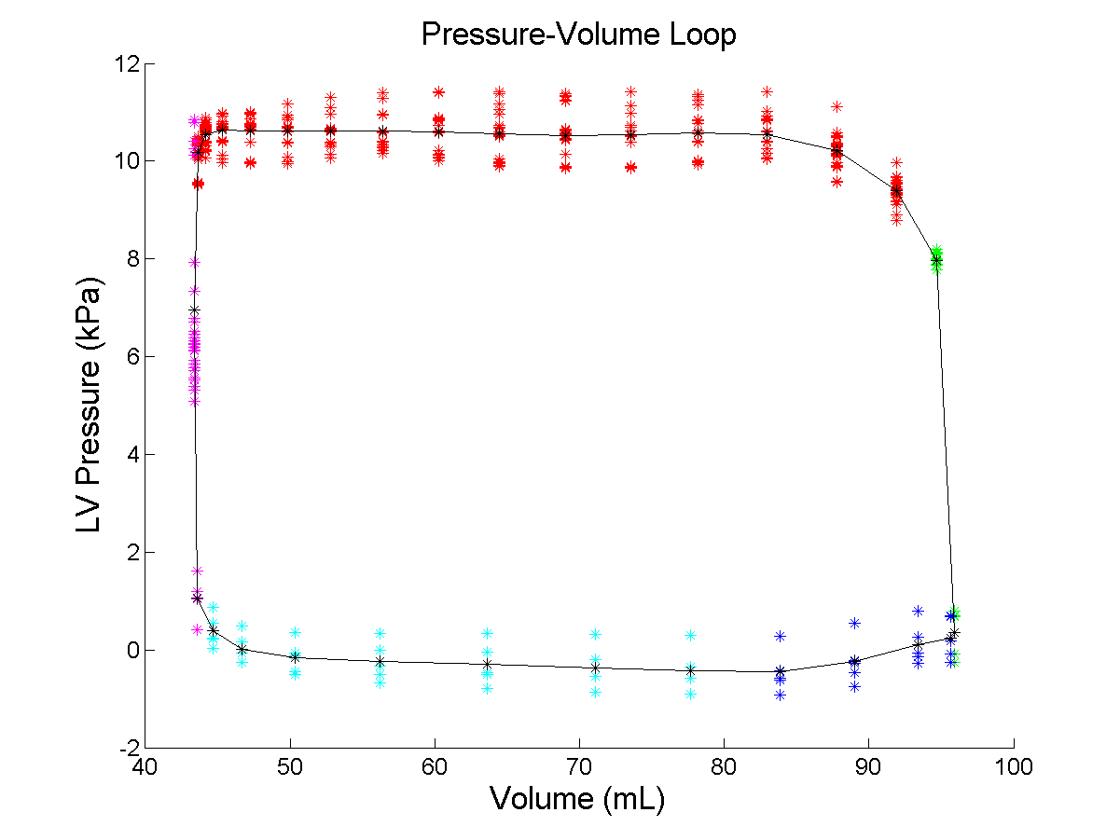
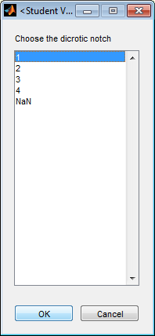
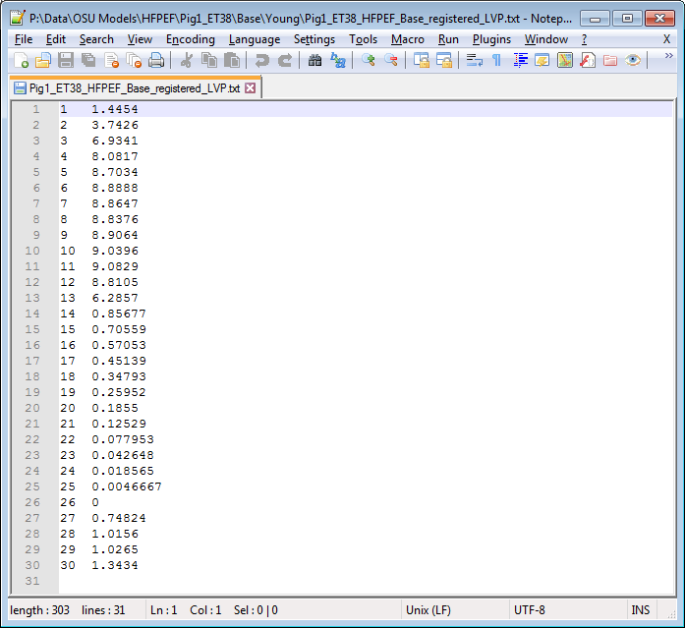
*Detect cardiac events:
1) ED (a)
2) DS (a)
3) ES (ui)
4) eIVC (a)
5) eIVR (a)
Linearly interpolate LVP segments between cardiac time points
Plot final LVP trace and PV loop
Write out final text file with image number and LV pressures

Slide 3
*
Detect cardiac events:
1) ED (a)
2) DS (a)
3) ES (ui)
4) eIVC (a)
5) eIVR (a)
i = 0
i = 0
i <= num AOP cycles?
No
i <= num LVP cycles?
No
Yes
Yes
Identify eIVC
Identify ED
Identify ES →
UI: Identify dicrotic notch in AOP
Identify DS
Identify eIVR
Identify maxLVP

