Slide 1
Steps of Haemodynamic Fitting Code
Contributors: Renee Miller, Jenny Wang, Angus Cheng
Extract Data from Pressure Files
Low pass filter data using cutoff frequency chosen from power spectrum of pressure signals
Get R peaks of ECG trace
User chooses which cycles to use in LVP and AOP traces
Get eIVC and ES from AOP traces
Get ED, DS and eIVR from LVP traces
Get RR interval and number of MRI frames
Interpolate LV pressures at MRI frames
Plot traces, PV Loops, etc.
Green = user input
Purple = automated

Slide 2
Things to improve upon:
Better dicrotic notch detection – fully automated
Scroll bar for smoothing – need enough smoothing not to find minima everywhere but not so much smoothing that the dicrotic notch disappears
Allow user to input how many points to use for scaling

Slide 3
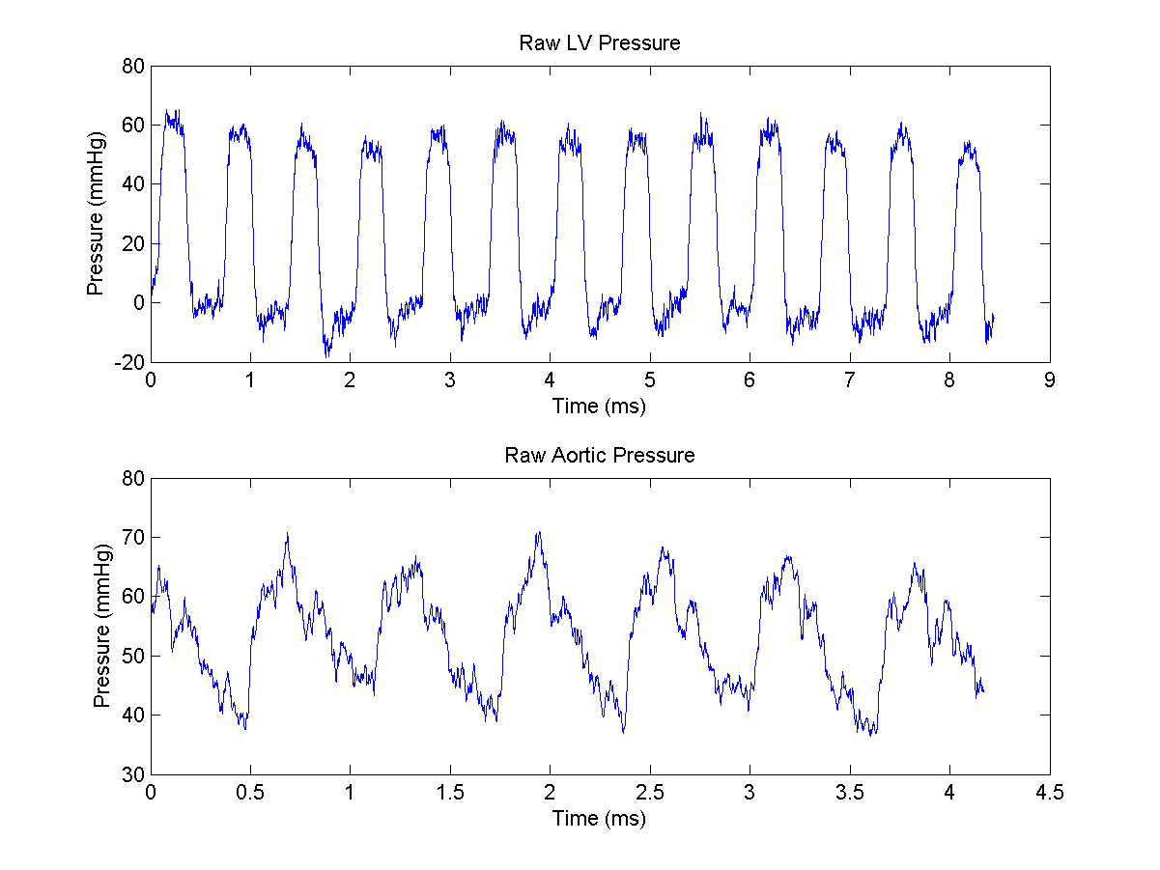

Slide 4
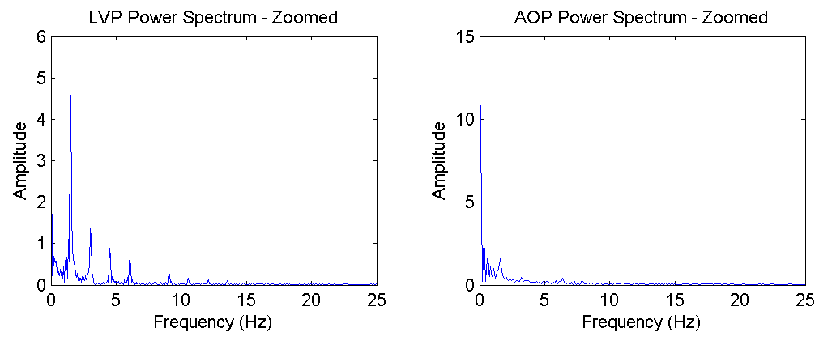
User chooses where to place the cutoff frequencies

Slide 5
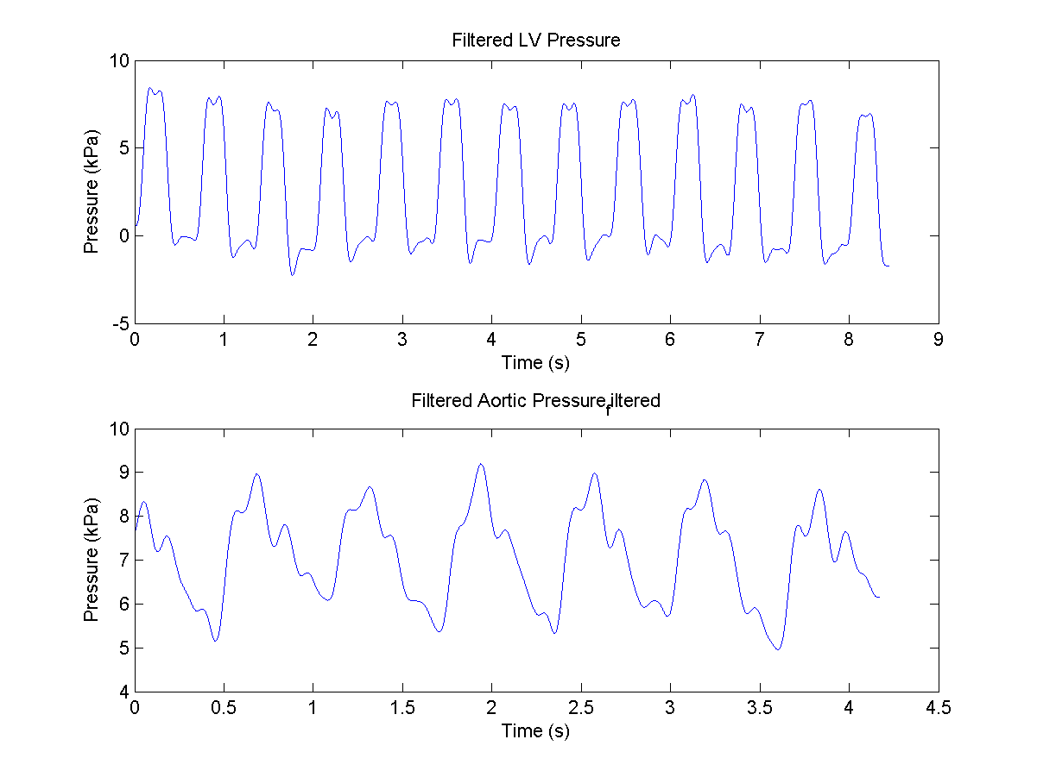

Slide 6
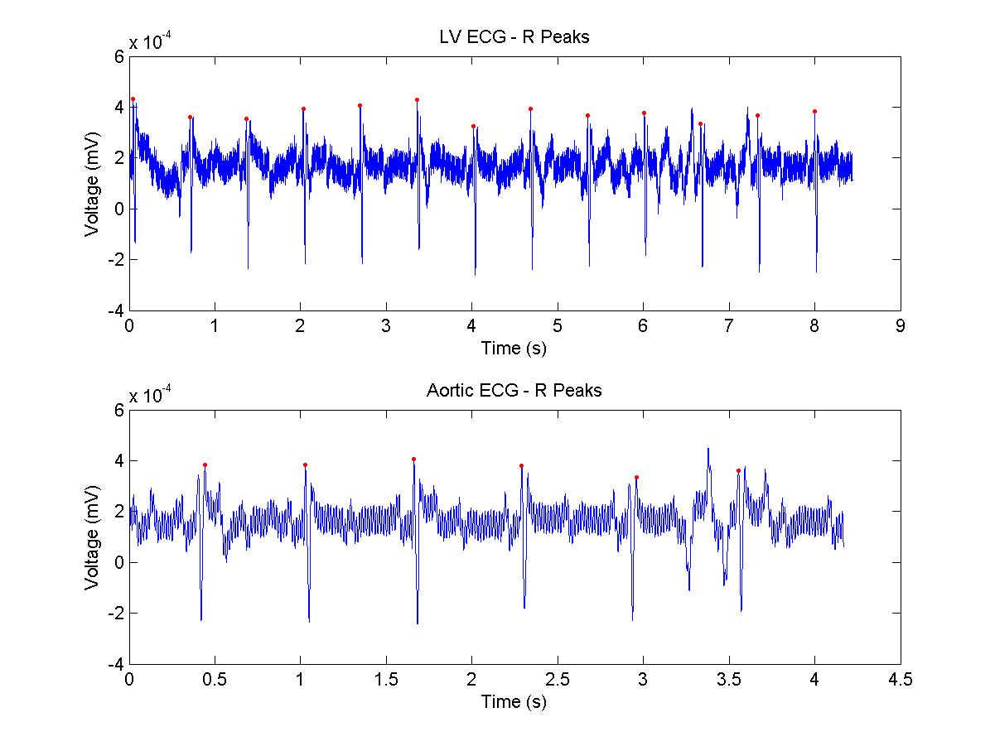

Slide 7
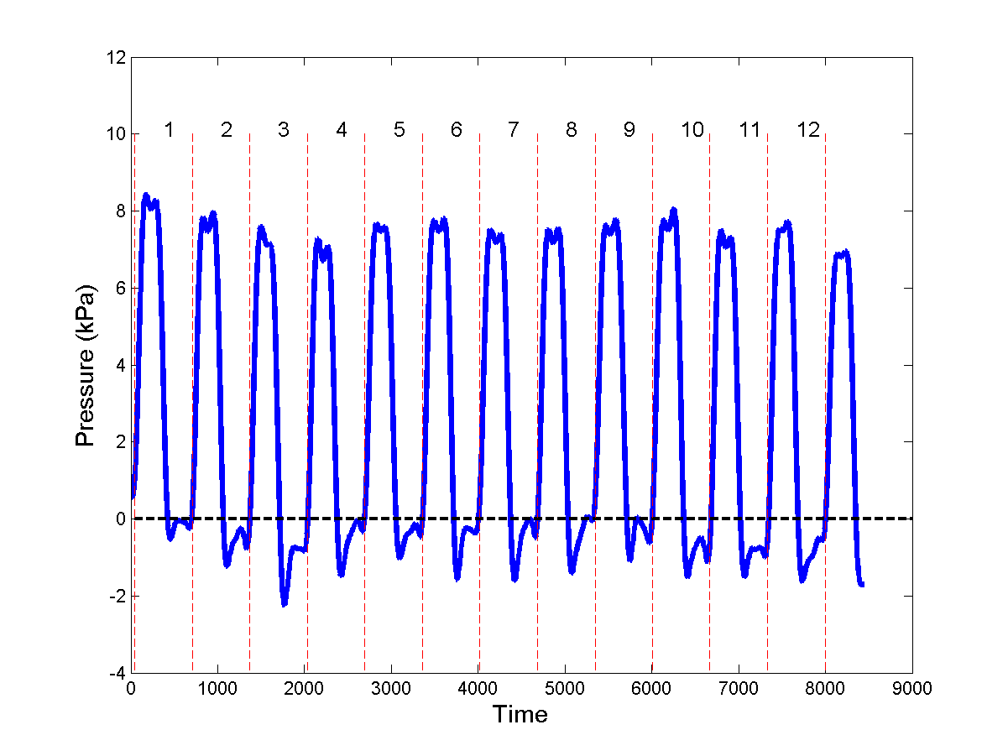
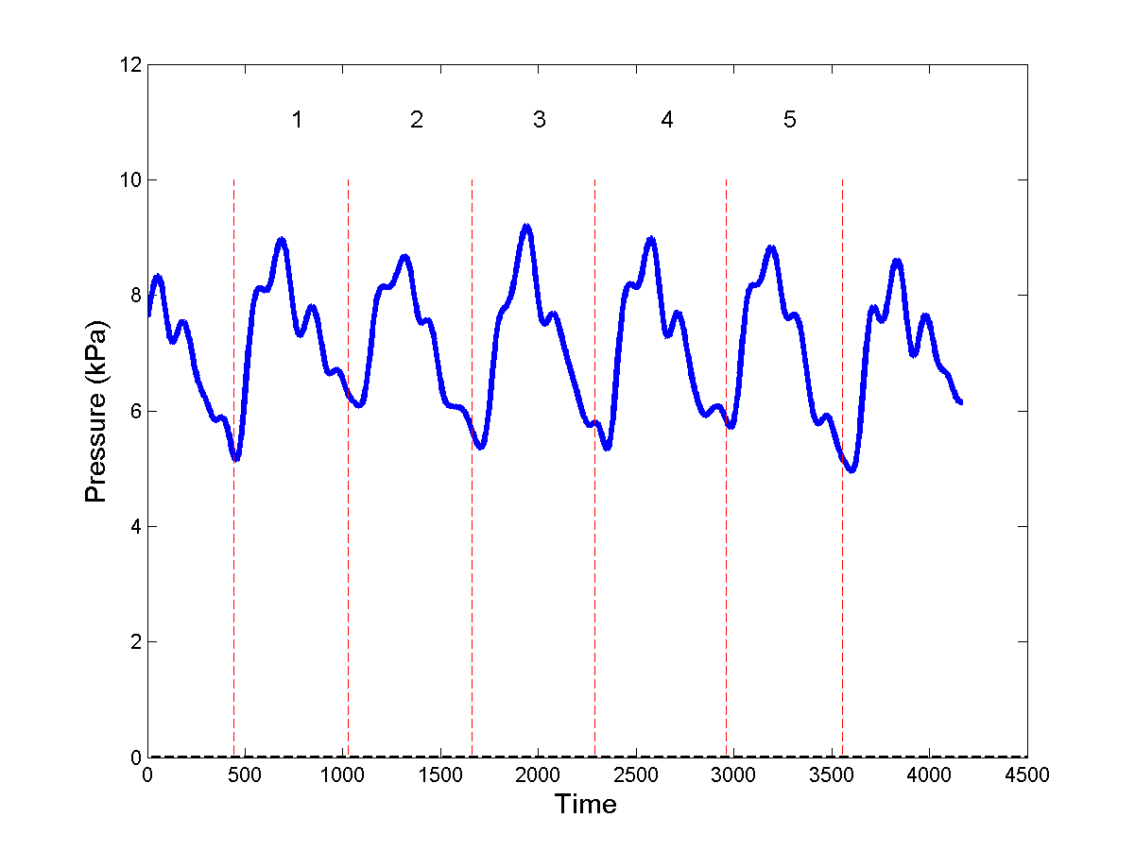
User chooses which cycles to use for analysis

Slide 8
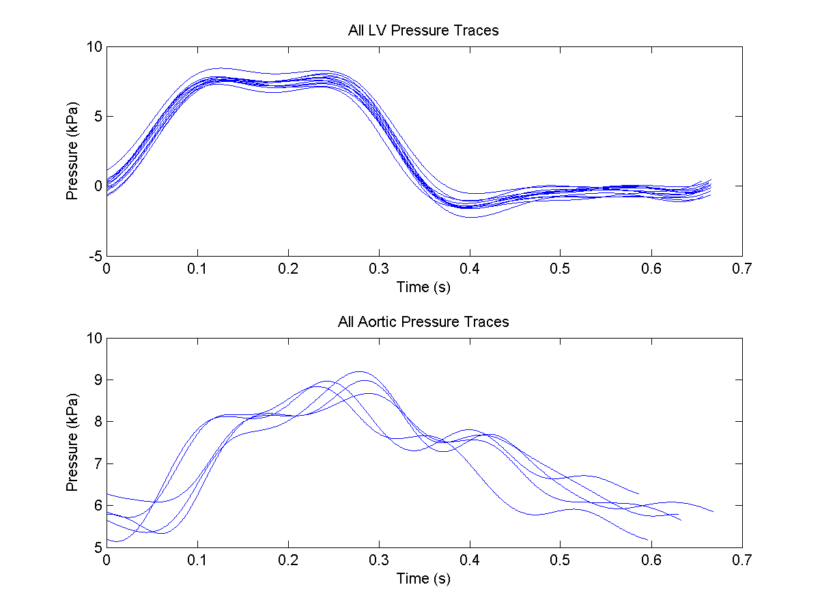

Slide 9
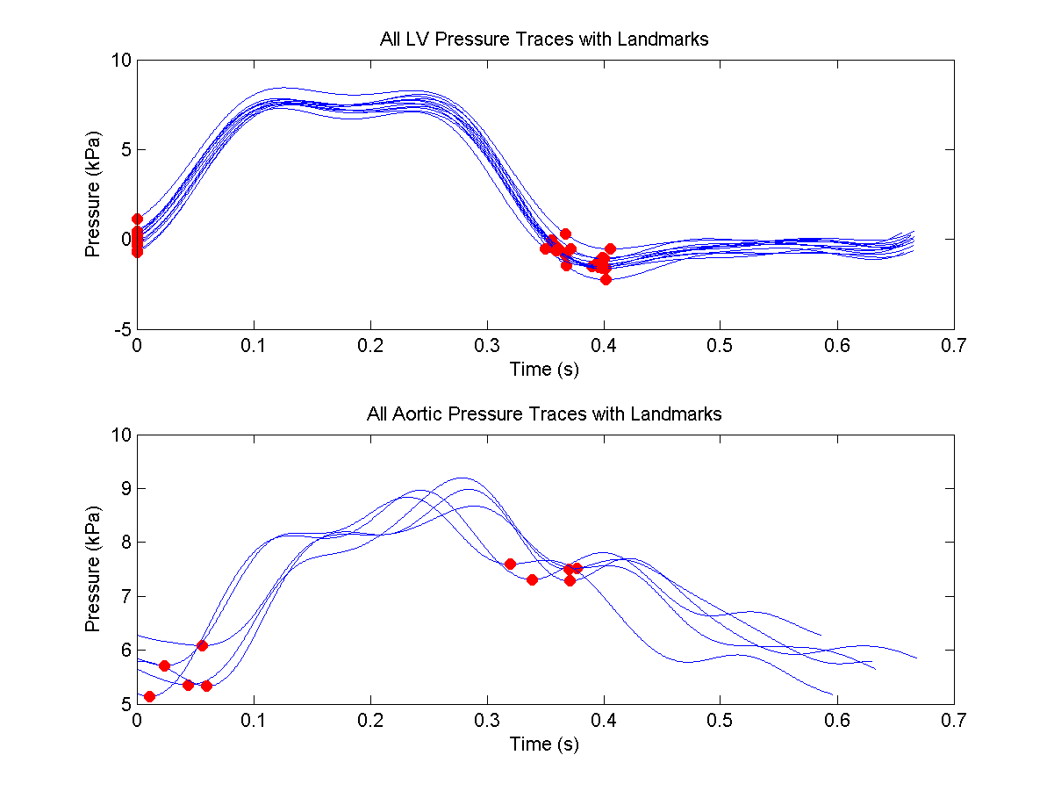

Slide 10
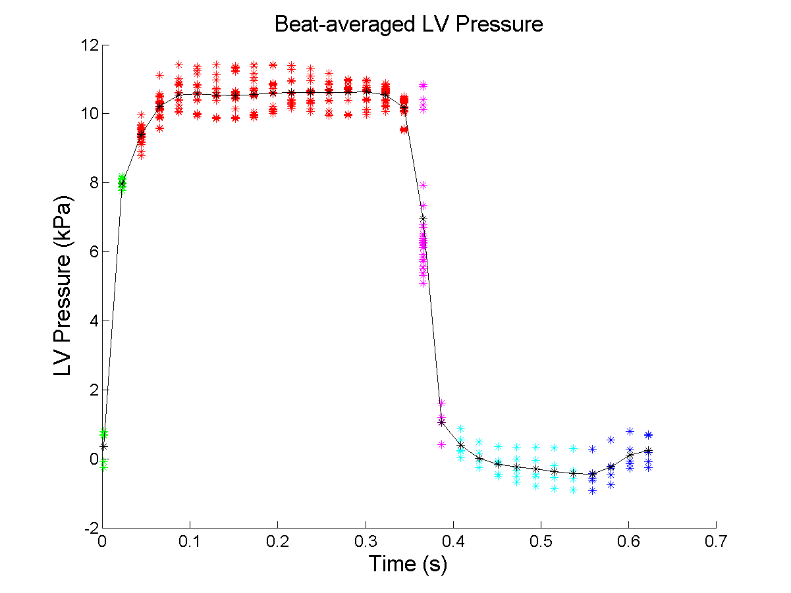

Slide 11
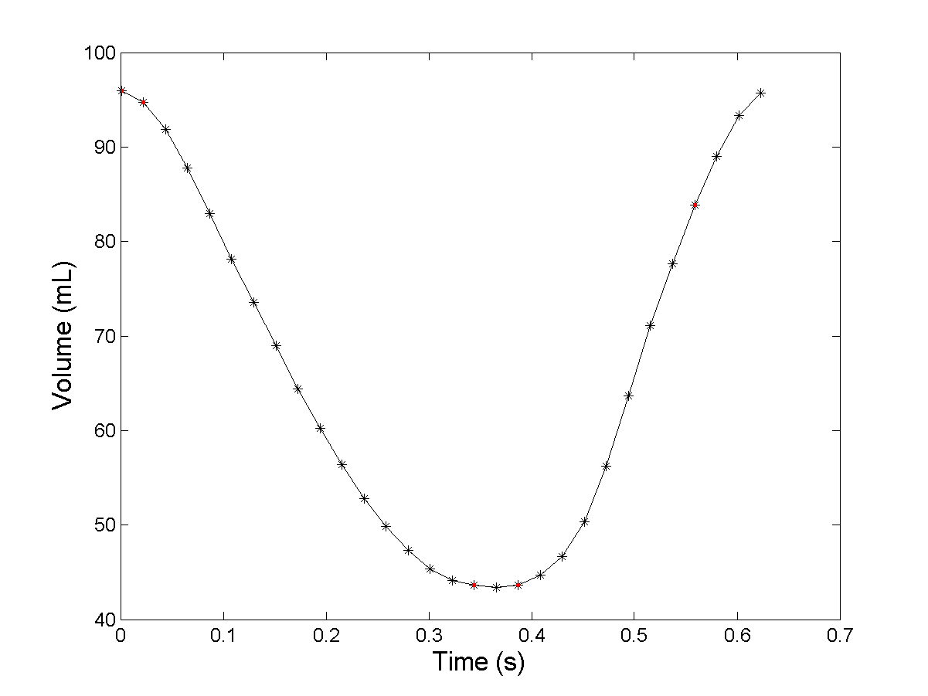

Slide 12
