Slide 1

Welcome to Live Lecture
Moderator: Gina Cooper
Agenda
Opening Remarks
Best Practices for this Course
Basics of Visual Studio
Basics of C++
Questions

Slide 2
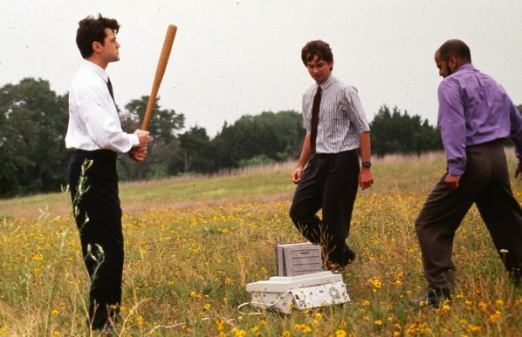
Introduction to Programming

Slide 3
Programming Envirornment
Visual Studio.NET IDE
Visual C++ Express
Citrix Environment
Save on the correct drive
Mac users
Need something like parallels, boot camp

Slide 4
Visual Studio
Solution explorer window = shows the physical components of the program in a hierarchical list
IDE = Integrated Development Environment
Visual Studio.NET is an IDE
SAVE often
RAM is volatile and everything is lost when the power is turned off
Solution = all the resources that are required to solve a programming problem

Slide 5
What is structured programming?
A systematic, disciplined approach to programming that applies three standard control structures:
Sequence
Selection (decision-making)
Repetition (iteration or looping)
Applies top-down development by outlining the problem to be solved, then functionally decomposing the problem into smaller “units”
Applies modular design by grouping similar tasks together into code modules

Slide 6
Variables
Variables are named locations in memory that hold data required by a program and may be changed repeatedly at runtime.
Each variable has a type (int, float, double, char) and a storage size based on its type.
Leftside = rightside
The left side is always a single variable

Slide 7
Summary of fundamental data types
The data types highlighted above are those we’ll mostly use in this course
Notes:
This is a brief list. We’ll go over them one by one.

Slide 8
Starting VS
File -> New Project
Choose Visual C++ and Win32 Console Application
Name the project CIS170LiveLecture
Pick Application Settings
Check the Empty Project box
Right click -> Add New item
.cpp file named myMain

Slide 9
Program to calculate the volume of Alderaan
#include <iostream>
#include <iomanip>
using namespace std;
const double PI= 3.14159;
//Constants can not be changed after initializing
int main() //Main function or module
{
double radius = 3884;
return 0; //return 0 indicates the program has terminated successfully
}
Note: C++ is case sensitive

Slide 10
Add calculations and print results
//Calculate volume
double volume =4/3*PI*radius*radius*radius;
//Print results
cout << "The volume is "<<volume<<endl;
Save, Build, and run
What happened?
Add:
cout<<fixed; //disables scientific notation
cout<<setprecision(2); //sets output precision
cin.ignore(2);
Now: add user input for the radius

Slide 11
Adding an input
double radius=0;
cout << "Please enter the radius between 0 and 4000: ";
cin>>radius;

Slide 12
Input and Output and =
cout
cout << "Number 1" << number1 << endl; //note: endl has a l as in love
<< is stream insertion operator
>> is stream extraction operator
Output manipulator setw(n)
cout << setw(8) << variable;
cin
cin >> number1;
The assignment = operator
Evaluate the expression on the right side
Assign value of right side to left side
Perfectly acceptable in C++ (but not math):
a = a * 2; // Double the value of a

Slide 13
Arithmetic Operators
Integer division truncates
Modulus operator a % b returns the remainder of a / b
a and b must be integers
Pre and post increment and decrement b++ or b--
Logical operators
&& → AND
|| → OR
! → Not
Escape sequence \ to display special characters:
cout<<"We like\'CIS170\'" displays: We like 'CIS170'

Slide 14
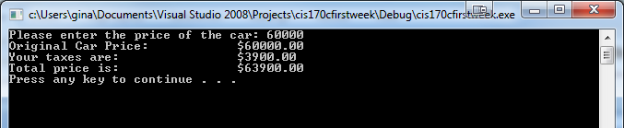
Scenario
Write a program that calculates and displays the sales tax for a new car. The User will enter the price of the car and will see the total price including the sales tax.
Input: Prompt the user for the price of the car. Process: Perform the calculations. The tax rate is 6.5% on the car. Calculate the sales tax on the car and the total price of the car.
Output: Display the results.

Slide 15
#include <iostream>
#include <iomanip>
using namespace std;
// Global constant - use a fixed tax rate of 6.5%
const double taxRate = 0.065;
int main()
{
double price, salesTax, totalPrice;
cout<<"Please enter the price of the car: ";
cin>>price;
salesTax = price * taxRate;
totalPrice = salesTax + price;
cout<<fixed<<showpoint<<setprecision(2); //Use this to show calculations with 2 decimal places
cout<<"Original Car Price: "<<setw(12)<<"$"<<price<<endl;
cout<<"Your taxes are: "<<setw(12)<<"$"<<salesTax<<endl;
cout<<"Total price is: "<<setw(12)<<"$"<<totalPrice<<endl;
system("pause");
}

Slide 16

Key concepts
C++ introduction
Creating a program in C++
Algorithm
Comments

