Slide 1
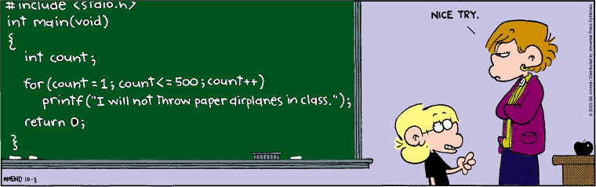
Welcome to Live Lecture
Week 3 Agenda
Moderator: Gina Cooper
Loops
For/While/Do loops
Some Hints for the Week 3 iLab
Questions

Slide 2
Why use a Loop?
Repetition or iteration structures = identify and block together one or more statements to be repeated based on a predetermined condition
Two general classes of loops:
Pretest (top-test) loops
Post-test (bottom-test) loops
Two general methods of controlling a loop
(to determine when the loop will cease or exit):
Counter-controlled loops
Condition-controlled loops

Slide 3
Looping Constructs
Looping Construct | When to Use
FOR | When you know how many times the procedure needs to be repeated
WHILE | When you don't know how many times the procedure needs to be repeated or if it even needs to execute one time
DO WHILE | When you know the procedure needs to execute at least once, but you don’t know how many times after that

Slide 4
3 Loops that do the same thing
While loop:
int x=0; //priming the loop
while(x<10)
{
cout<<"x is "<<x<<endl;
++x;
}
For loop
cout<<"\n\nThis is the for loop"<<endl;
for(x=0;x<10;x=x+2)
{
cout<<"x is "<<x<<endl;
}
Do… while loop
x=0;
cout<<"\n\nThis is the do while loop"<<endl;
do
{
cout<<"x is "<<x<<endl;
x++;
}while(x<10);

Slide 5
Countdown Timer – Backwards for loop
#include <iostream>
#include <windows.h>
using namespace std;
int main()
{
int seconds;
cout<<"Please enter the number of seconds to countdown: ";
cin>>seconds;
for (int i=seconds;i>0; i--)
{
cout<<"seconds remaining: "<<i<<endl;
Sleep(1000);
}
cout<<"Countdown completed!"<<endl;
Beep(750,300);
cin.ignore(2);
return 0;
}

Slide 6
Getting Strings
#include <string>
cout<<"Please enter your name: ";
getline(cin,name);
cout<<"Please enter the city: ";
getline(cin,city);
cout<<"Your name is "<<name<<" Your city is "<<city<<endl;

Slide 7
Nested loops
How many times will the following loop be executed (note this is a nested for loop)
int i=1, j=1;
for(i=1;i<4;i++){
for(j=1;j<4;j++)
{
cout<<"i is "<<i<<" and j is "<<j<<endl;
}
}

Slide 8
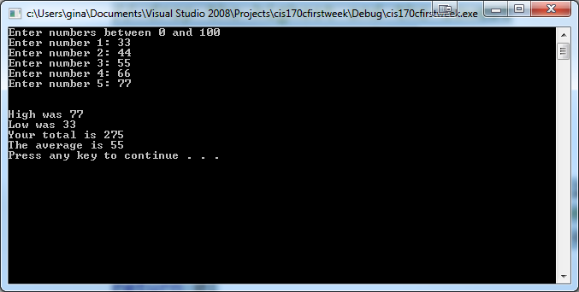
Scenario
Prompt the user for 5 numbers and test whether they are between 0 and 100. Then calculate the total, average, and find the high and low value.

Slide 9
#include <iostream>
#include <iomanip>
using namespace std;
const int TOTAL = 5;
int main()
{
// intialize variables
int num = 0;
int sum = 0;
int high = -1;
int low = 101;
cout << "Enter numbers between 0 and 100"<< endl;
for (int i = 0; i < TOTAL; i++)
{
cout << "Enter number " << i + 1 << ": ";
cin >> num;
while(num<0 || num>100)
{
cout<<"Please enter a number between 0 and 100"<<endl;
cout << "Enter number " << i + 1 << ": ";
cin >> num;
}
// test if num is the highest
if (num > high)
high = num;
// test if num is the lowest
if (num < low)
low = num;
sum += num;
}// end for
cout << endl << endl;
cout << setprecision(2) << fixed; //Display values 2 decimal places
cout << "High was " << high << endl;
cout << "Low was " << low << endl;
cout << "Your total is " << sum << endl;
//Show average value
cout << "The average is " << sum/TOTAL << endl;
system("pause");
return 0;
}

Slide 10
Counters, Accumulators and Sentinels
Accumulator = running total to accumulate values
Example: totalSales = totalSales+dailySales or totalSales+=dailySales
Counter = incremented to count number of values
Example: counter = counter+1 or counter++
Sentinel = A value used to terminate a loop
Example: Press Q to quit, Q is the sentinel
Note: do not use floating point values for counters

Slide 11
Compound Arithmetic Operators
Operator | Operation
+= | Addition
-= | Subtraction
*= | Multiplication
/= | Division
%= | Modules
total+=newValue is total = total + newValue
price*=discountPercent is price= price*discountPercent

Slide 12
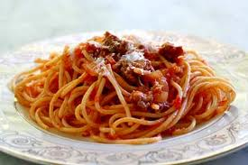
Transfer of Control
Jump statements:
Break = Causes execution to jump out of the loop and proceed with subsequent statements of the program
Continue = Causes execution to jump to the loop's conditional expression ignoring any subsequent statements in the block
Goto = transfer control out of a loop and proceed to a marked point in the program. Not recommended

Slide 13
Continue example
int total = 0;
for (int nval = 0; nval<10; nval++)
{
if (nval==5)
{
continue;
}
total +=nval;
cout<<nval <<"\t";
}
cout<<"The total is equal to "<<total<<endl;
Notes:
The total is equal to 10

Slide 14
Common error: an extra semicolon
In this case, the programmer probably did not want to insert the semicolon after the for expression:
int i; for (i = 1; i <= 10; i++); {
cout<<"hello world!";
}
this ; is going to be trouble

Slide 15
More common errors with loops
Infinite loops
for (i = 10; i > 0; i++) //bad!!
Off-by-one errors. How do these differ?
for (i = 0; i < 100; i++)
for (i = 1; i <= 100; i++)
for (i = 0; i <= 100; i++)

Slide 16
Best Programming Practice
Indent statements of the body of your control structure
Nesting multiple repetition structures can be helpful
Place vertical spacing above and below control structures
Always use descriptive method, variable, and program names

Slide 17
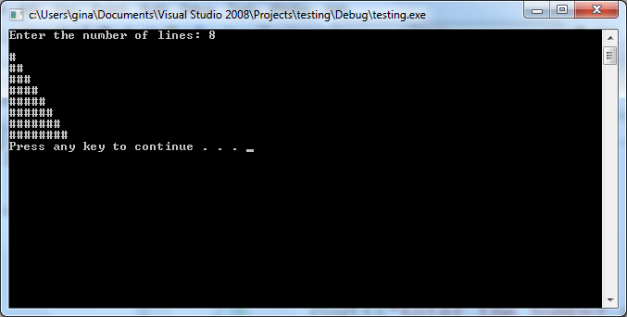
Problem 1
Allow the user to input a number. This number will be used as the maximum number of # symbols for a triangle. Below is an example of the output:
Notes:
cout<<"Enter the number of lines: ";
int num;
cin>>num;
int i = 0;
int x = 0;
while (i <= num)
{
x = 0;
while (x < i)
{
cout<<"#";
x++;
}
cout<<endl;
i++;
}
system("pause");

Slide 18
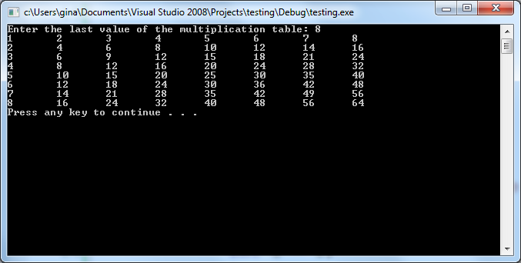
Problem 2
Write a program to produce a multiplication table. All the user to input the last value for the multiplication table. The first column and first row should display values 1 to the last value of the multiplication table. Use \t to place tabs between values
Notes:
cout<<"Enter the last value of the multiplication table: ";
int num;
cin>>num;
int i = 1;
int x = 0;
while (i <= num)
{
x = 1;
while (x <= num)
{
cout<<(x*i)<<"\t";
x++;
}
cout<<endl;
i++;
}
system("pause");

Slide 19
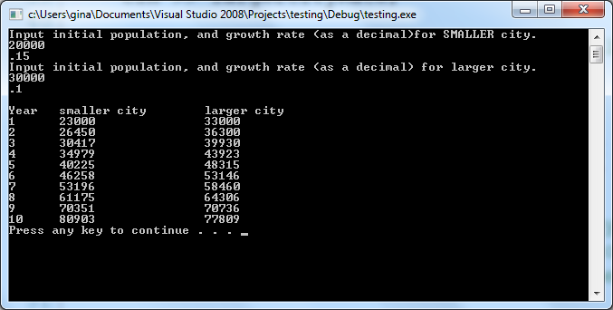
Problem 3
Write a program that accepts a city population and growth percentage from a smaller city and a larger city. The smaller city will have a larger growth percentage. Loop displaying the current population until the smaller city is larger than the larger city
Notes:
int smallerCityPopulation;
double smallerCityRate;
cout << "Input initial population, "
<< "and growth rate (as a decimal)"
<< "for SMALLER city." << endl;
cin >> smallerCityPopulation;
cin >> smallerCityRate;
int largerCityPopulation;
double largerCityRate;
cout << "Input initial population, "
<< "and growth rate (as a decimal) "
<< "for larger city." << endl;
cin >> largerCityPopulation;
cin >> largerCityRate;
// Process only if growth rate of smaller city is higher than larger city
if (smallerCityRate > largerCityRate)
{
// Output column headings
cout << endl << left << setw(7) << "Year"
<< setw(20) << "smaller city" << setw(20) << "larger city" << endl;
int year = 1; // Counter to display the year number
// Continue to output the populations until the population
// of the smaller cinty exceeds the initially larger one
// Output one row of data per iteration
while (smallerCityPopulation < largerCityPopulation)
{
// Truncate: Do not count fractional people
smallerCityPopulation +=
(int)(smallerCityPopulation * smallerCityRate);
largerCityPopulation +=
(int)(largerCityPopulation * largerCityRate);
cout << left << setw(7) << year << setw(20)
<< smallerCityPopulation << setw(20)
<< largerCityPopulation << endl;
year++;
}
}
else
{
cout << "Smaller city's growth rate "
<< "must be higher than larger city's!" << endl;
}
system("pause");

Slide 20

Key concepts
Loop types
Accumulator, counter, sentinel
Counter-controlled vs. condition controlled loops

