Slide 1
Composition
CIS247C – Week 4 Live Lecture
Instructor: Mike Velgersdyk
Email: mikev@neb.rr.com

Slide 2
Overview
Design Guidelines
What is Composition?
Interfaces
Program Example
Lab Assignment
Summary
Week’s Objectives

Slide 3
Design Guidelines

Slide 4
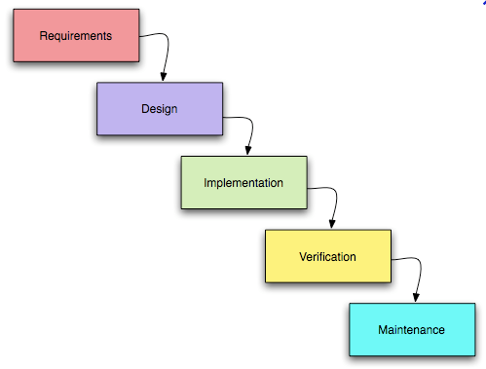
Design
Design model types
Waterfall model (proven unreliable because of strict boundaries)
Requirements, Design, Implementation, Testing, Maintenance
Iterative Design
Agile Methodologies
Extreme Programming
Scrum
Reasons to keep design changes to minimum:
Cost of requirement/design change in design phase is relatively small.
Cost of design change in the implementation phase is significantly higher.
Cost of design change after the deployment phase is astronomical when compared to the first item

Slide 5
Design Guidelines
There is no right or wrong way to create a design.
What’s important is to find a consistent, repeatable process.
OO design steps:
Doing the proper analysis
Determine feasibility, research system needs
Developing a statement of work that describes the system
The SOW needs to completely describe the system
Gathering the requirements from this statement of work (SOW)
Many times this is a list of things that must be completed
Developing a prototype for the user interface
Identifying the classes
Determining the responsibilities of each class
Determining how the various classes interact with each other
Creating a high-level model that describes the system to be built (UML)

Slide 6
What is composition?

Slide 7
Composition
Composition is the mechanism for creating a new class containing related classes.
The new class “has-a” object of a related class.
Through composition, a containment of related types can be created that share code and an interface.
Allows for code extension to create larger classes.

Slide 8
Composition²
Objects are often related to other objects
an oven has a timer
a book has an author
an alarm clock (often) has a radio
a car has an engine
a student has a schedule
Common characteristic? The “has a” relationship.

Slide 9
Composition Class Diagrams
DigitalVideoRecorder
Timer
videoTimer : Timer
minutes : int
startRecording() : void
startTimer () : void
setTimer(int) : void
getTimer() : int

Slide 10
Composition Class Diagrams
A DigitalVideoRecorder has a Timer
DigitalVideoRecorder
Timer
videoTimer : Timer
minutes : int
startRecording() : void
startTimer () : void
setTimer(int) : void
getTimer() : int

Slide 11
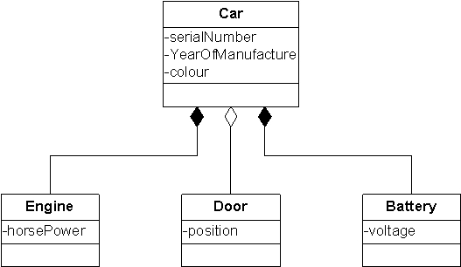
Composition Class Diagrams

Slide 12
Timer Class
class Timer
{
public:
Timer();
void startTimer();
void setMinutes(int);
int getMinutes();
private:
int minutes;
};
Timer
minutes : int
startTimer () : void
setTimer(int) : void
getTimer() : int
Build your “inner” classes first

Slide 13
DigitalVideoRecorder Class
class DigitalVideoRecorder
{
public:
DigitalVideoRecorder();
void startRecording(int);
private:
Timer videoTimer;
};
DigitalVideoRecorder
videoTimer : Timer
startRecording() : void
Programmer defined classes are just like any other class!

Slide 14
Chain of Events
Main()
DigitalVideoRecorder myDVR;
myDVR.startRecording(60);
DigitalVideoRecorder Class
void DigitalVideoRecorder::startRecording(int min)
{
videoTimer.setMinutes(min);
videoTimer.startTimer();
}
Timer Class
void Timer::setMinutes(int min) { }
void Timer::startTimer() { }

Slide 15
Interfaces
Notes:
const
cin.ignore()
header files
variable scope

Slide 16
Interfaces
C++ does not have an interface keyword like Java and C#
Uses the inheritance and pure virtual function mechanisms
Necessary to specify general behavior without specifying details of the behavior
Each subclass is responsible for its definition

Slide 17
Interface Example
class iController
{
virtual void MoveLeft()=0;
virtual void MoveRight()=0;
virtual void MoveForward()=0;
virtual void MoveBackward()=0;
virtual void Jump()=0;
virtual void Run()=0;
virtual void Drop()=0;
}
class Character : public iController
{
// class definition that defines above methods
}

Slide 18
Program example

Slide 19
Lab Assignment

Slide 20
Summary
Design guidelines for consistent process
Composition is characterized by a has-a relationship.
“Outer” class must contain an accessor/mutator methods to get/set the “inner” object.
The state of the “inner” object is accessed/modified using the methods described above.
Interfaces help specify general behavior

Slide 21
Week’s Objective
TCO 3: We looked at the concept of Composition
Given a set of specifications, design, code, and test a program that defines and uses a set of objects in which an instance of one object is a member of another object.

Slide 22
Questions ?
Next Week:
Inheritance “is-a” Relationship

