Slide 1
Inheritance and Polymorphism
CIS247C – Week 5 Live Lecture
Instructor: Mike Velgersdyk
Email: mikev@neb.rr.com

Slide 2
Overview
Composition Review
What is Inheritance?
Polymorphism
Program Example
Lab Assignment
Summary
Week’s Objectives

Slide 3
composition Review

Slide 4
Composition
Composition is the mechanism for creating a new class containing related classes.
Objects are often related to other objects
an oven has a timer
a book has an author
an alarm clock (often) has a radio
a car has an engine
a student has a schedule
Common characteristic? The “has a” relationship.
Allows for code extension to create larger classes.

Slide 5
DigitalVideoRecorder Class
class DigitalVideoRecorder
{
public:
DigitalVideoRecorder();
void startRecording(int);
private:
Timer videoTimer;
};
DigitalVideoRecorder
videoTimer : Timer
startRecording() : void

Slide 6
What is inheritance?

Slide 7
Inheritance
Inheritance is the mechanism for deriving a new class from an old one.
The new class “is-a” extended/altered version of the old.
Through inheritance, a hierarchy of related types can be created that share code and an interface.
Allows for code reuse and extension.

Slide 8
Inheritance²
A derived class inherits members from the base class.
derived AKA subclass or child
base AKA superclass or parent
A derived class can be a more specific example of a base class -- characterized by an “is a” relationship
a DVD player is an electronic appliance
a salaried employee is an employee
a car is a vehicle
a ball is a toy

Slide 9
Derived Classes
The derived class effectively becomes a new version of the base class by adding new members
In other words, it extends the base class such that the new derived class is a new and extended model of the base
It inherits attributes and methods
It may also customize or override a base classes’ member methods

Slide 10
Inheritance Hierarchies
There can be many levels of inheritance in a hierarchy
Often described as having a tree-structure
Class 1
Class 2a
Class 2b
Class 2c
Class 3a
Class 3b
Class 3c
Class 3d

Slide 11
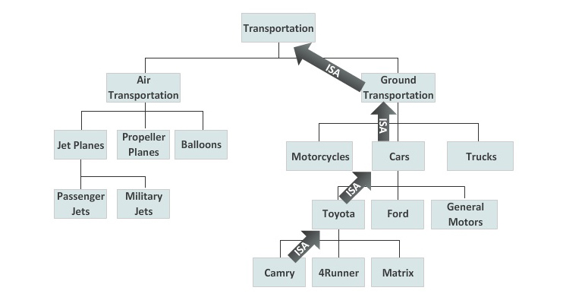
Inheritance

Slide 12
Recognizing Inheritance
A Toyota is a car
Same type of object
That means a Toyota shares characteristics with a car
The derived class is a more specific type of the parent object
Specific
General

Slide 13
Base Class
Toyota/Car have common attributes
Color
Year
Toyota/Car have common behaviors
Start/Stop engine
Brake
Lights On/Off

Slide 14
Derived Class
The derived Toyota class has some unique characteristics
Batteries
Hybrid Engine

Slide 15
Inheritance Syntax
General format:
class parentClass { … }; // Base class
class childClass : public parentClass { … }; // Derived class

Slide 16
Inheritance Semantics
A Derived class is a combination of the Base class and the Derived class
A Derived class inherits the members of the Base class
The Base class knows nothing about any derived classes
The Derived class, however, is aware of its Base class

Slide 17
Constructors and Inheritance
Constructors are not inherited
When constructors are present in the class inheritance hierarchy, the ancestor constructors are executed first, with the highest ancestor being the first to execute
All derived class constructors in the chain will execute in order from top to bottom

Slide 18
Polymorphism

Slide 19
Polymorphism
Polymorphism gives us the ability to assign a different usage or meaning to a method depending on the context of the containing class.
In C++, polymorphism is achieved through the overloading of functions and operators.
In inheritance hierarchies, objects have the same general behaviors but implement those behaviors in different ways.

Slide 20

Static/Dynamic Binding
Person
firstName : string
middleName : string
lastName : string
age : int
+ Person()
+ Person(firstName, middleName, lastName, age)
+ displayName() : string
Employee
hireYear : int
supervisor : string
salary : double
+ Employee()
+ Employee(hireYear, supervisor, salary, firstName, middleName, lastName, age)
+ displayName() : string

Slide 21
displayName() Method
class Person
{
public:
// rest of definition omitted
void displayName();
};
void Person::displayName()
{
string tmpString;
tmpString = firstName + “ “;
if (middleName != “”)
tmpString = tmpString + middleName + “ “;
tmpString = tmpString + lastName;
cout << endl << tmpString << endl;
}
class Employee : public Person
{
public:
// rest of definition omitted
void displayName();
};
void Employee::displayName()
{
string tmpString;
cout << “Employee: “;
Person::displayName();
}
Sample output:
Drew C. Brees
Sample output:
Employee: Drew C. Brees

Slide 22
Static Binding
class Person
{
public:
// rest of definition omitted
void displayName();
};
class Employee : public Person
{
public:
// rest of definition omitted
void displayName();
};
doTest(Person input)
{
cout << input.displayName();
}
Person p1; Employee e1;
doTest(p1); doTest(e1);

Slide 23
Static Binding²
class Person
{
public:
// rest of definition omitted
void displayName();
};
class Employee : public Person
{
public:
// rest of definition omitted
void displayName();
};
doTest(Employee input)
{
cout << input.displayName();
}
Person p1; Employee e1;
doTest(p1); doTest(e1);

Slide 24
Dynamic Binding
class Person
{
public:
// rest of definition omitted
virtual void displayName();
};
class Employee : public Person
{
public:
// rest of definition omitted
void displayName();
};
doTest(Person* input)
{
cout << input->displayName();
}
Person p1; Employee e1;
Person * ptr = &p1; Person* ptr = &e1;
doTest(p1); doTest(e1);

Slide 25
Dynamic Binding
class Person
{
public:
// rest of definition omitted
virtual void displayName();
};
class Employee : public Person
{
public:
// rest of definition omitted
void displayName();
};
doTest(Person* input)
{
cout << input->displayName();
}
Person p1; Employee e1;
Person * ptr = &p1; Person* ptr = &e1;
doTest(p1); doTest(e1);

Slide 26
Program example
Notes:
const
cin.ignore()
header files
variable scope

Slide 27
Lab Assignment

Slide 28
Summary
Inheritance is characterized by an “is-a” relationship
Base class contains common attributes and behaviors
Derived class contains unique attributes and behaviors not found in the base class object
Inheritance eliminates redundancy
The access modifier “protected” can be used in the base class to allow derived classes to directly get/set the state of derived class objects.
Inheritance hierarchies can have many levels.

Slide 29
Week’s Objective
TCO3: We reviewed Composition
Given a set of specifications, design, code, and test a program that defines and uses a set of objects in which an instance of one object is a member of another object.
TCO 4: We looked at Inheritance
Given a set of specifications, design, code, and test a program that defines and uses a set of objects in which one object is derived from another object.
TCO 6: We looked at static and dynamic binding
Given a set of objects related through inheritance, design, code, and test a program that contains statically and dynamically bound functions.

Slide 30
Questions ?

