Slide 1

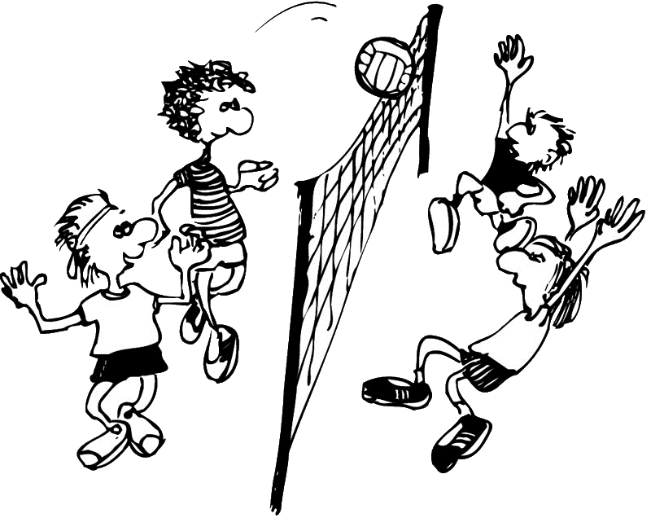
Beachvolley Assist
Group 36 – Rene Gau, Manuel Haid, Blaz Kolar
Image reference: www.cms.cvjm-ansbach.de/images/stories/Grafiken/10_volley2.jpg
Notes:
Welcome to the presentation
Group 36
Team mates: Manuel Haid and Blaz Kolar
Develop an android application

Slide 2
Beachvolley Assist
Group 36 – Rene Gau, Manuel Haid, Blaz Kolar
Mission
The idea is to have a mobile app for supporting beachvolleyball referees or scoring assistents.
The app should guide through administative tasks
like conducing the toss to decide upon the first service
and the sides of the court …
Support the game
current score line, service order, time-out‘s and so on
Notes:
Administrative tasks:
- set team names, set players names
- Guide the referee before starting the game. Choosing - beginning sides of the teams - team that has the first serve - the order of the players to serve
Support the game:
- shows the scorelines - signals when the teams have to change the sides (every 7 points) - signals technical time-outs (when the combined teams scores equals 21) - signals begin and end of technical/tactical time-outs (30 seconds) - informs which player should perform the next serve

Slide 3
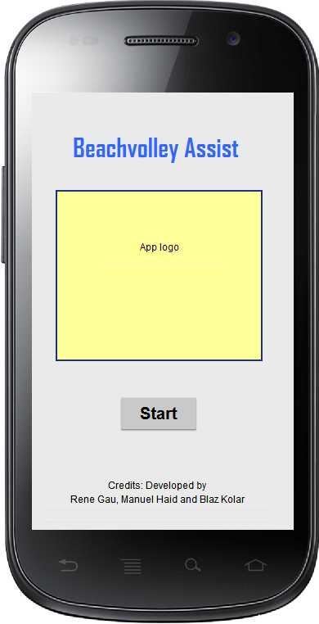
Beachvolley Assist
Group 36 – Rene Gau, Manuel Haid, Blaz Kolar
General requirements
The app should be intuitively and also usable for non experienced referees. Helping the users step by step with only minimal required input and using graphic and acoustic support.
By default the app should comply with the official regulations.
Notes:
Graphic support: using colours and usefull/functional design
Accoustic support: using ring tones
Official regulations: FIVB regulative (internation volleyball federation)
Opitonal: possibility of changing game parameters
Like no tactical and/or technical time-out

Slide 4
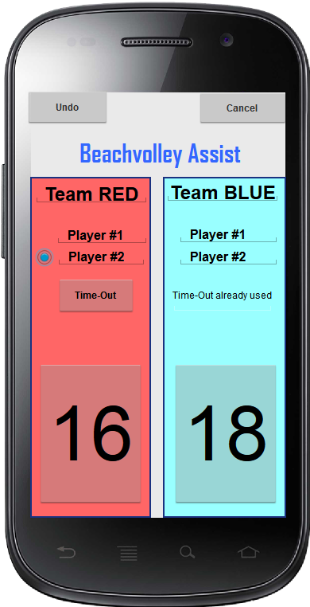
Beachvolley Assist
Group 36 – Rene Gau, Manuel Haid, Blaz Kolar
Main screen
Service
Tactical time-out
General infos
Teams names
Players names
Score line
General actions
Undo
Cancel the game
Notes:
One set up to 21 points
Graphical support:
Which player hould perform the serve
Which team can take a tactical time-out

Slide 5
Beachvolley Assist
Group 36 – Rene Gau, Manuel Haid, Blaz Kolar
Examples of supporting the game
Time-out`s
Change sides

Slide 6
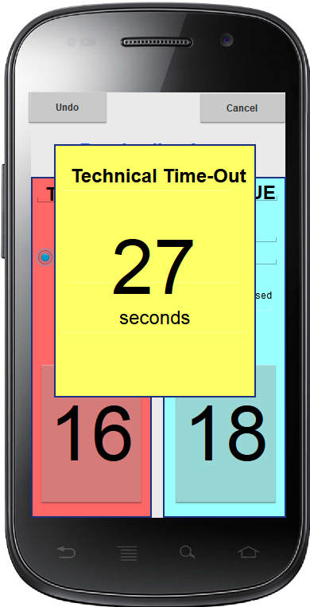
Beachvolley Assist
Group 36 – Rene Gau, Manuel Haid, Blaz Kolar
Time-out
Technical time-out
The combined teams scores equals 21
30 seconds
Signaling begin and end by a ring-tone
Count down
Tactical time-out
- One pro team and set
30 seconds
Signaling end by a ring-tone
Notes:
Graphic support: counter
Accoustic support: ring tones

Slide 7
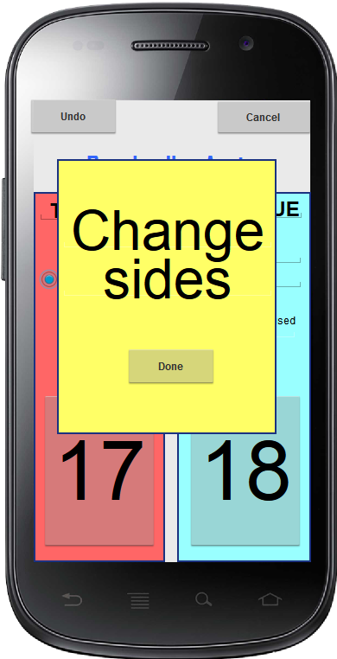
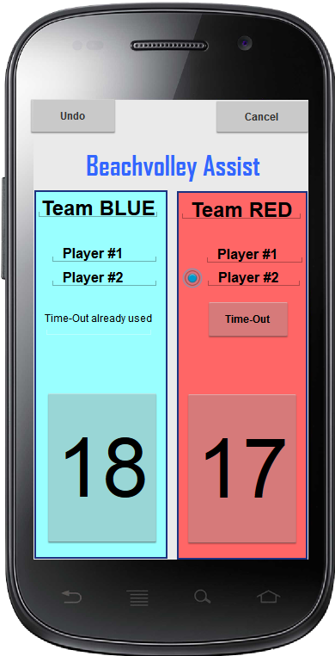
Beachvolley Assist
Group 36 – Rene Gau, Manuel Haid, Blaz Kolar
Change sides
the teams have to change the sides every 7 points
Notes:
Changing sides to eleminate weather-related influential (wind, sun light)
17 + 18 = 35
Graphic support: changing sides of team on the screen
Accoustic support: ring tone signals to change the sides

Slide 8
Beachvolley Assist
Group 36 – Rene Gau, Manuel Haid, Blaz Kolar
Questions
Notes:
More thinking on funtional design then technical things

