Slide 1

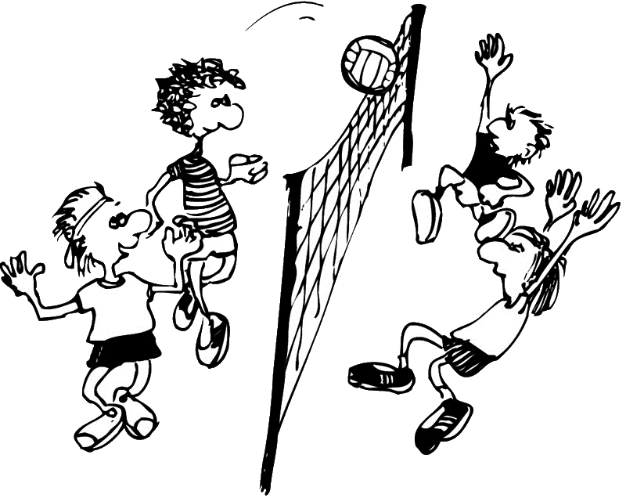
Beachvolley Assist
SW14_Free_36
Rene Gau, Manuel Haid, Blaz Kolar
Image reference: www.cms.cvjm-ansbach.de/images/stories/Grafiken/10_volley2.jpg
Notes:
Welcome to the presentation
Group 36
Team mates: Manuel Haid and Blaz Kolar
Develop an android application

Slide 2
Beachvolley Assist
SW14_Free_36
Links
Video
http://www.gau.at/download/BeachvolleyAssist_video.avi
Android apk-File
http://www.gau.at/download/BeachvolleyAssist.apk
Team page
http://www.ist.tugraz.at/software2014/bin/view/Main/TeamThirtySix
git Repository
github.com/renegau/sw14_free_36
Notes:
Administrative tasks:
- set team names, set players names
- Guide the referee before starting the game. Choosing - beginning sides of the teams - team that has the first serve - the order of the players to serve
Support the game:
- shows the scorelines - signals when the teams have to change the sides (every 7 points) - signals technical time-outs (when the combined teams scores equals 21) - signals begin and end of technical/tactical time-outs (30 seconds) - informs which player should perform the next serve

Slide 3
Beachvolley Assist
SW14_Free_36
Mission
The idea is to have a mobile app for supporting beachvolleyball referees or scoring assistents.
The app should guide through administative tasks like conducing the toss to decide upon the first service and the sides of the court …
Support the game current score line, service order, time-out‘s …
Notes:
Administrative tasks:
- set team names, set players names
- Guide the referee before starting the game. Choosing - beginning sides of the teams - team that has the first serve - the order of the players to serve
Support the game:
- shows the scorelines - signals when the teams have to change the sides (every 7 points) - signals technical time-outs (when the combined teams scores equals 21) - signals begin and end of technical/tactical time-outs (30 seconds) - informs which player should perform the next serve

Slide 4
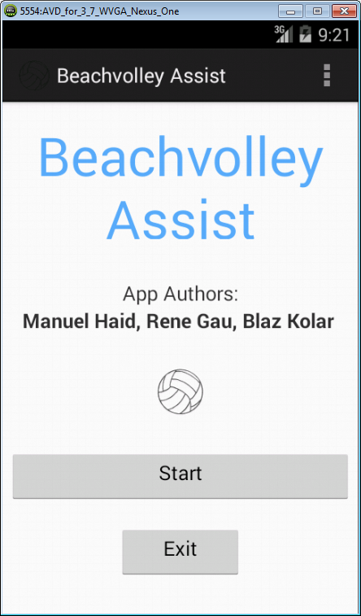
Beachvolley Assist
SW14_Free_36
Video presentation
Notes:
Graphic support: using colours and usefull/functional design
Accoustic support: using ring tones
Official regulations: FIVB regulative (internation volleyball federation)
Opitonal: possibility of changing game parameters
Like no tactical and/or technical time-out

Slide 5
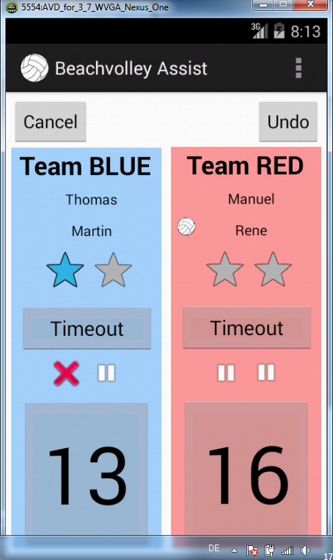
Beachvolley Assist
SW14_Free_36
Questions?
Notes:
More thinking on funtional design then technical things

