Slide 1
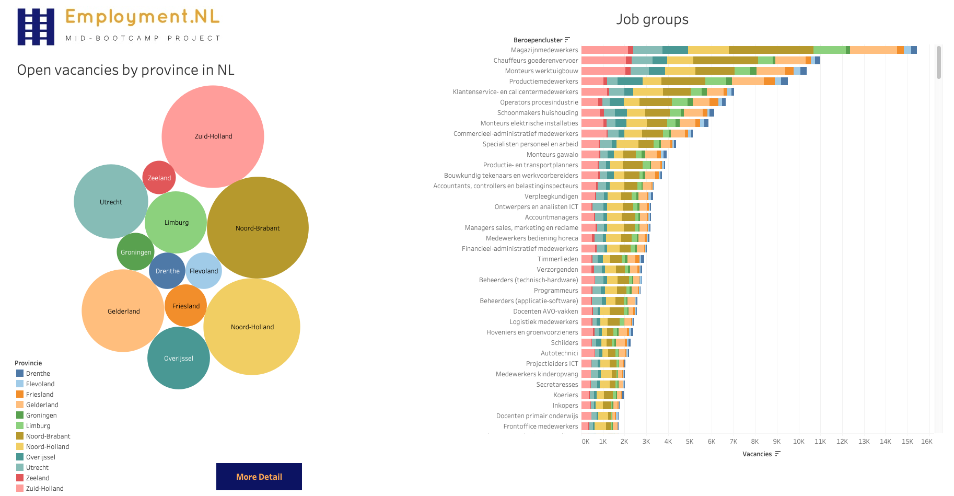

2. Open vacancies organized in Job GROUPS /categories
Each Province shows different insights
zuidholland ICT
overijssel: more traditional carpenters & painters
flevoland:
1. This dashboard gives a strategic overview on the potential workforce that is still there per provinde → Scrollen: verhouding jobs
4. Why helpful?
UWV works together with local partners
what’s happening locally? Local insights
share this information with local partners to work out employment programs
3. Normally I would work with a top-10 but this
time I left it all in there.
So you can see that groups of jobs turned into …
not really grouping. What’s the point of grouping jobs, when
the smallest groups are so detailed? 360+ Groups!
There is an improvement for UWV

Slide 2
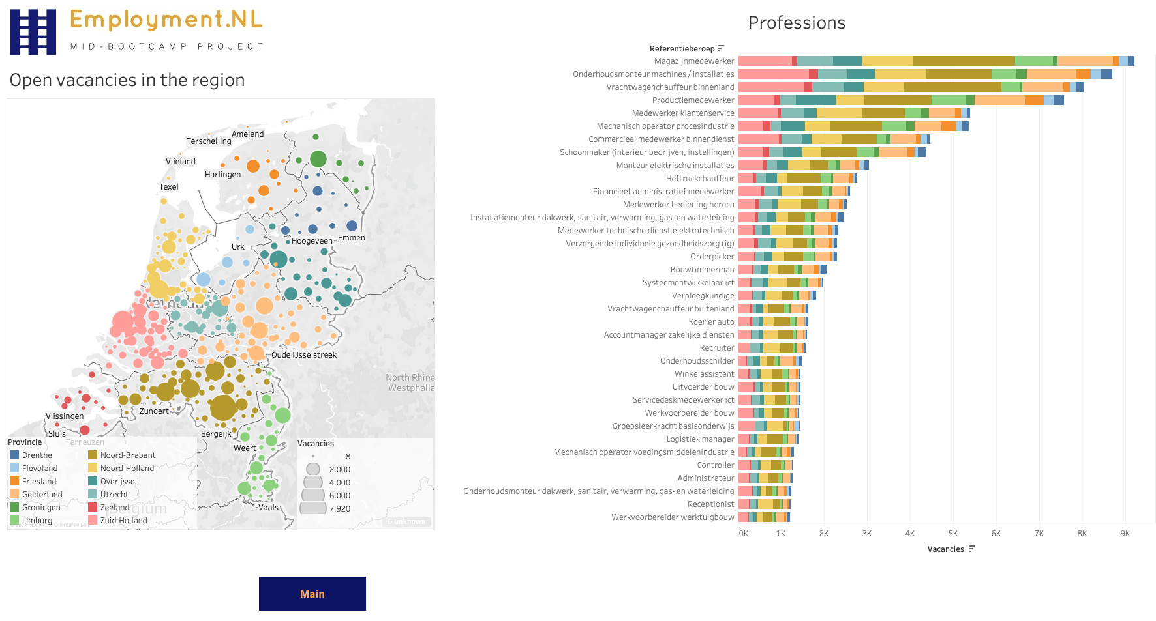

1. This dashboard has also a detailed page where you can zoom in more locally
2. Now you don’t see job groups but the actual job vacancies published on the market.
Here you can see the randstad, where most cities are versus the more rural areas in the north
CLICK on zwolle
3. Why helpful?
Gives insights on demand in the employment market
on provinces, cities, job groups and actual jobs

Slide 3
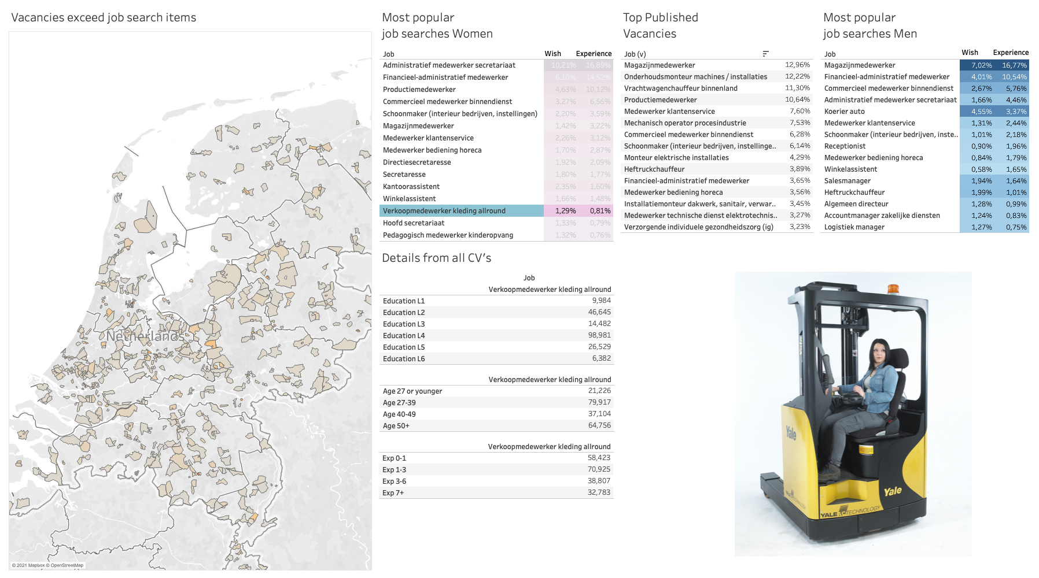
So how about putting the open vacancies next to employment potential? I thouight it would be interesting to create a dashboard for your program manager, so that they can work out matching programs with their local partners

