Slide 1
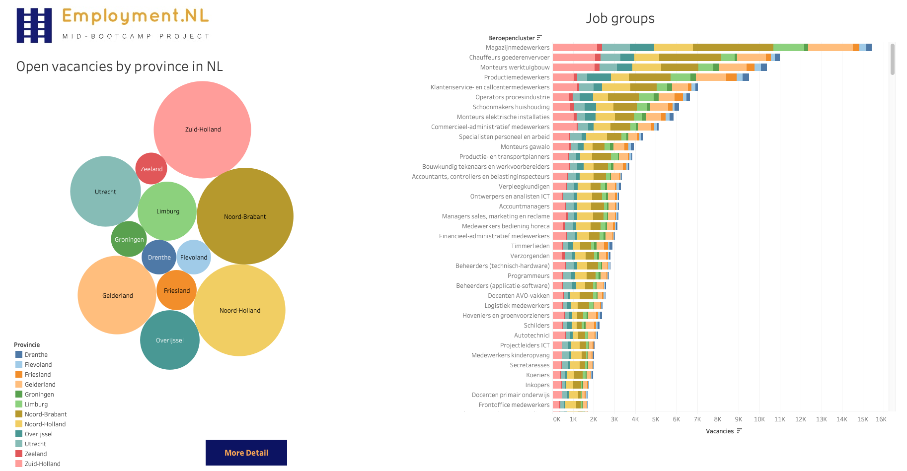

2. Open vacancies organized in Job GROUPS /categories
Each Province shows different insights
zuidholland ICT
overijssel: more traditional carpenters & painters
flevoland:
1. This dashboard gives a STRATEGIC overview on the potential workforce that exists per province
4. Why helpful?
UWV works together with local partners
what’s happening locally? Local insights
share this information with local partners to work out employment programs
3. Normally I would work with a top-10 but this
time I left it all in there.
So you can see that groups of jobs turned into …
not really grouping. What’s the point of grouping jobs, when
the smallest groups are so detailed? 360+ Groups!
There is an improvement for UWV

Slide 2
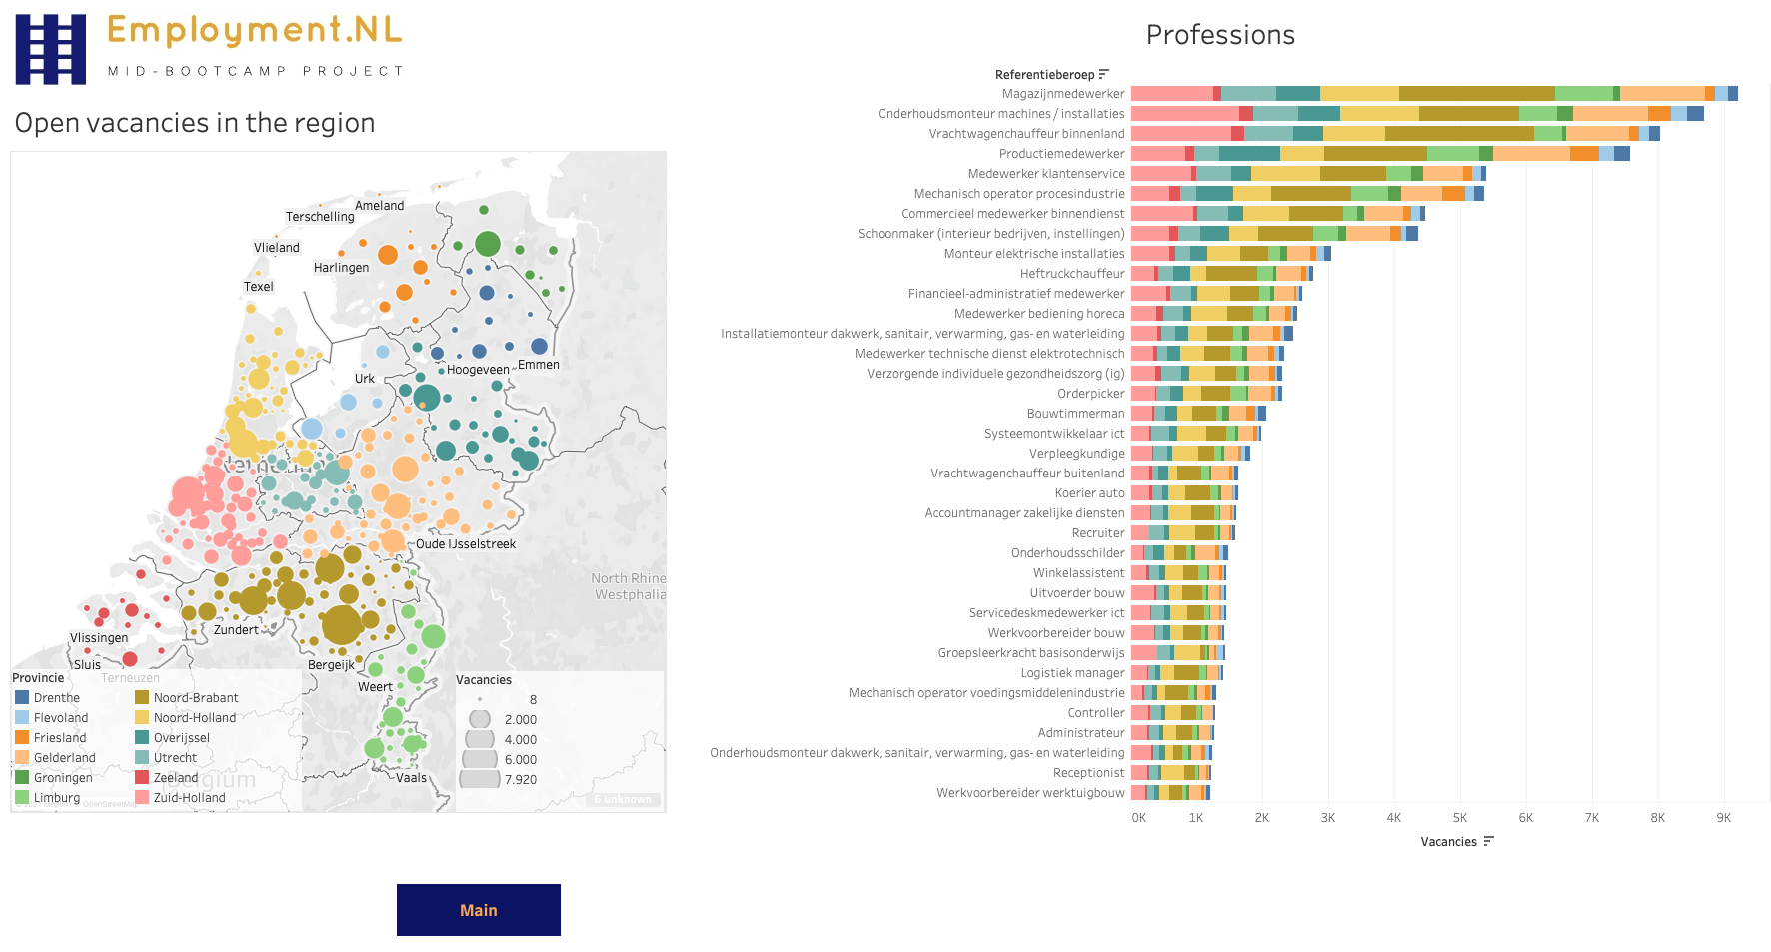

1. IS DETAIL
2. Now you don’t see job groups but the actual job vacancies published on the market.
Here you can see the randstad, where most cities are versus the more rural areas in the north
CLICK on zwolle
3. Why helpful?
Gives insights on demand in the employment market
on provinces, cities, job groups and actual jobs

Slide 3
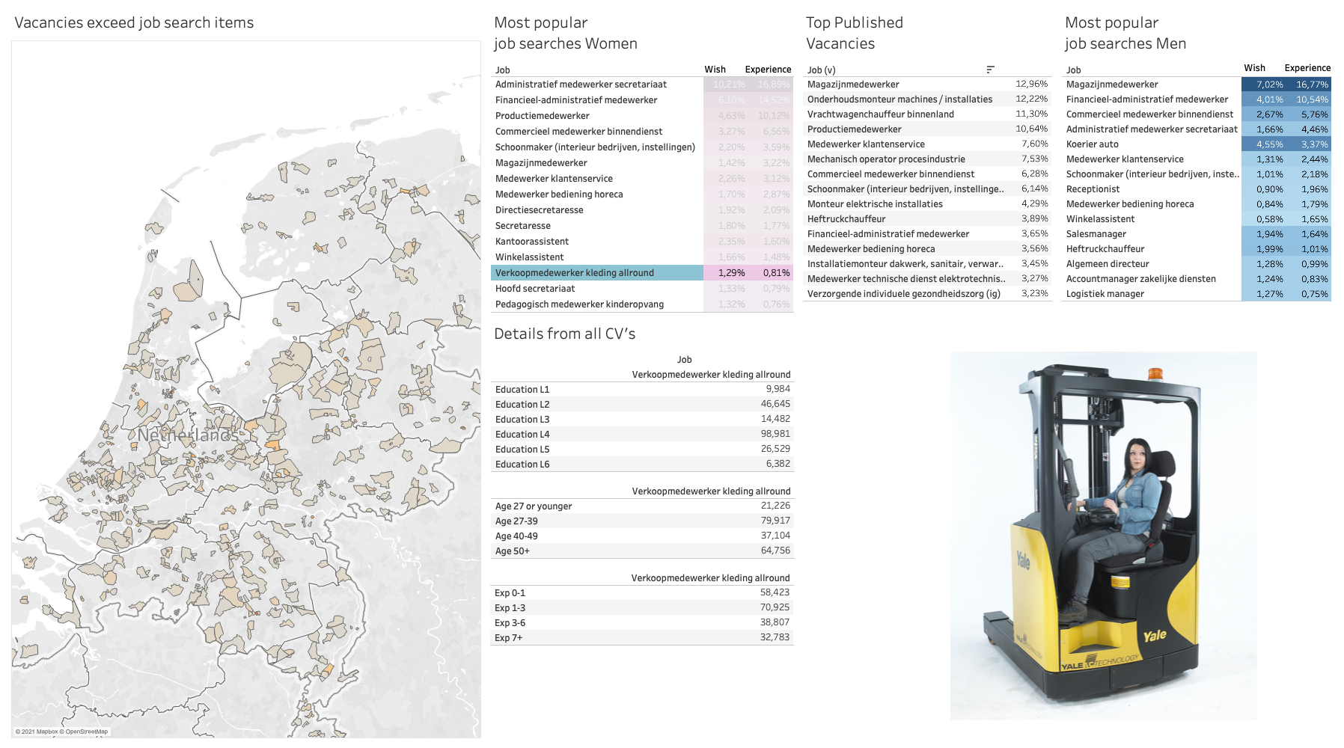
On tactical level I guess your program managers want to match open vacancies to job seekers
TECHNICALLY A MATCH WOULD BE POSSIBLE
So how about putting the open vacancies next to employment potential? I thouight it would be interesting to create a dashboard for your program manager, so that they can work out matching programs with their local partners
2. And drill down on certain areas or job groups
grens streek magazijn medewerker → inzoomen: local matching proposal
2. Midden: most published jobs. The program manager
match with popularity of the job amongst men and women
forklift driver

