Slide 1
Outside
Cam
Solar Cells
Box
Dispenser
Food Plate

Slide 2
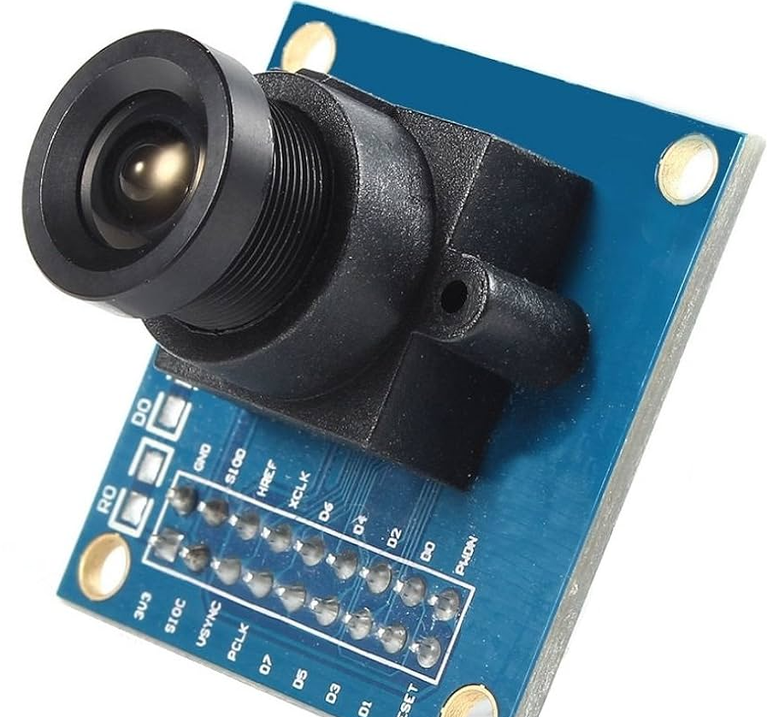
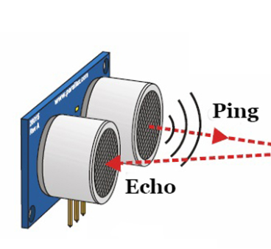
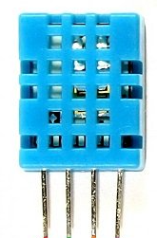
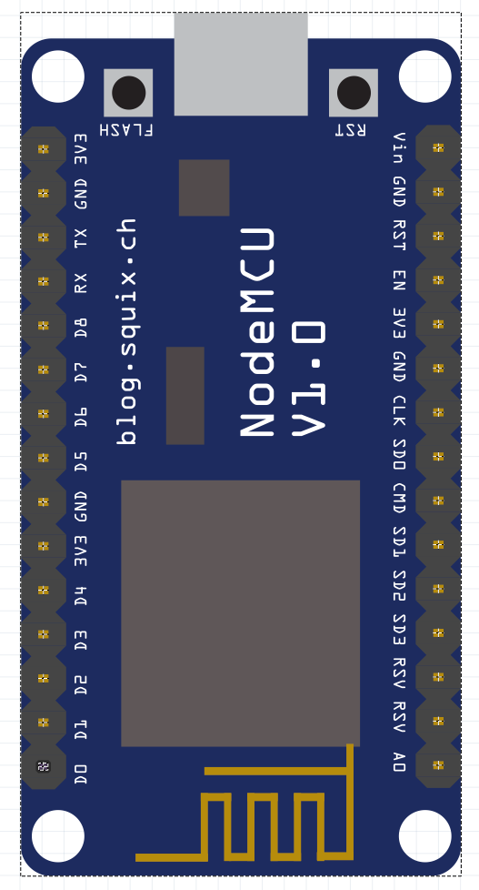
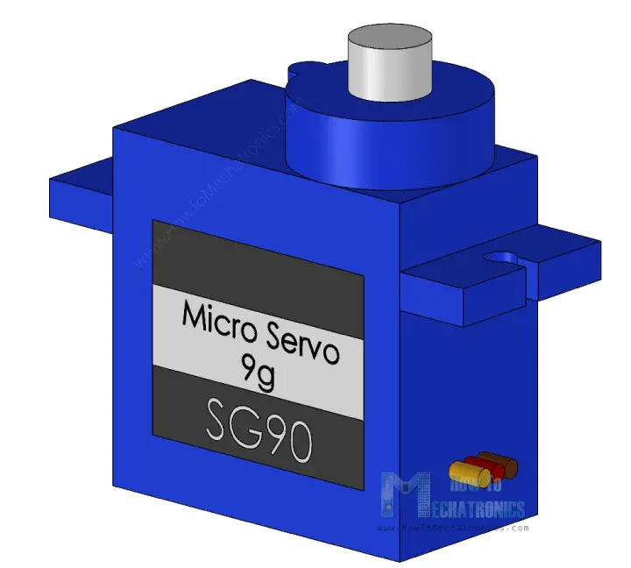
Cam
Rechargeable Battery
Ultrasonic Sensor
Temperature Sensor
NodeMcu SIM Card
Dispenser
Box
Mini Servo

