Slide 1

Internet of Things Pet Feeder Project
Masters degree in Computer Engineering
2022/2023

Slide 2
Summary
Introduction
Related works
System Architecture
Interoperability

Slide 3

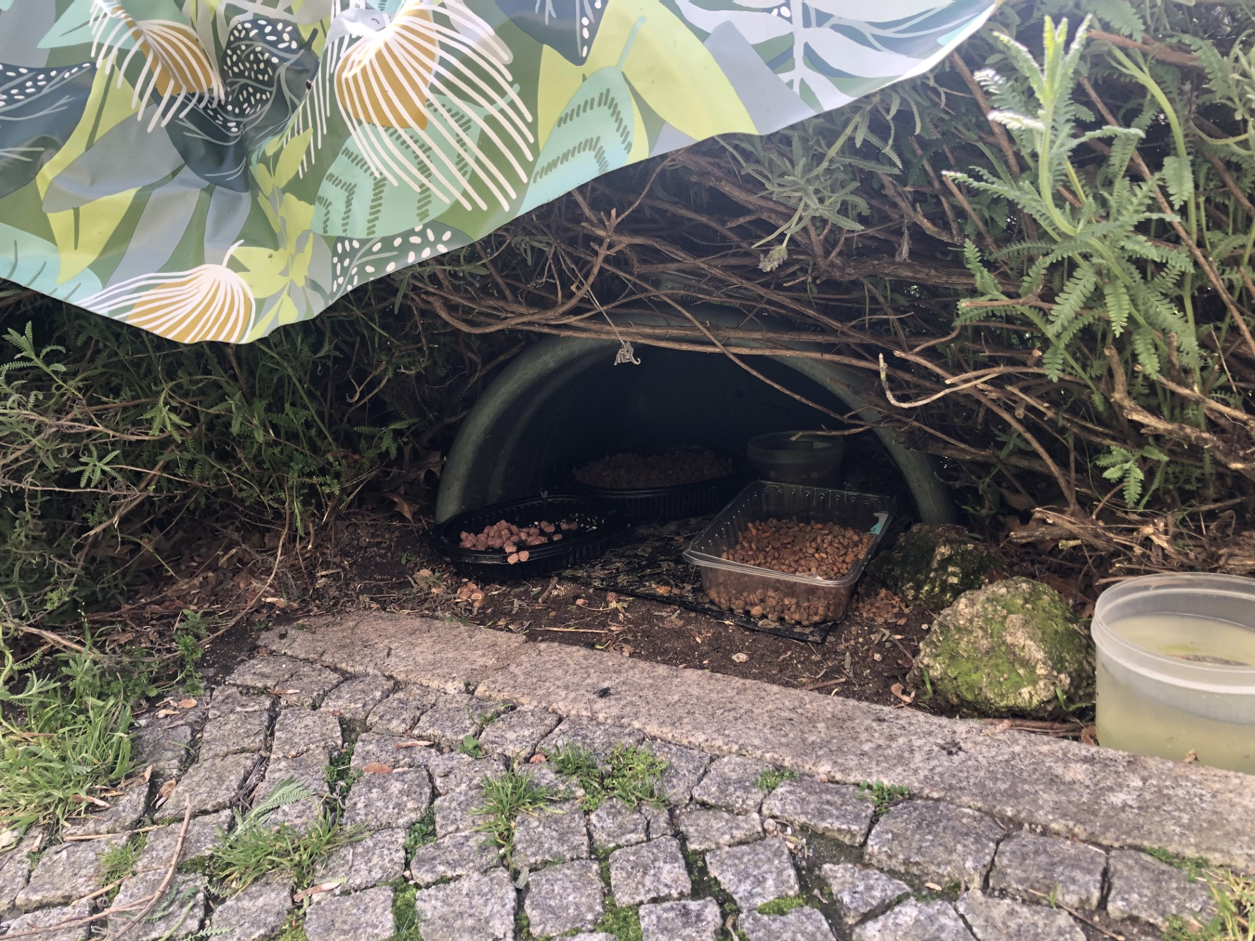
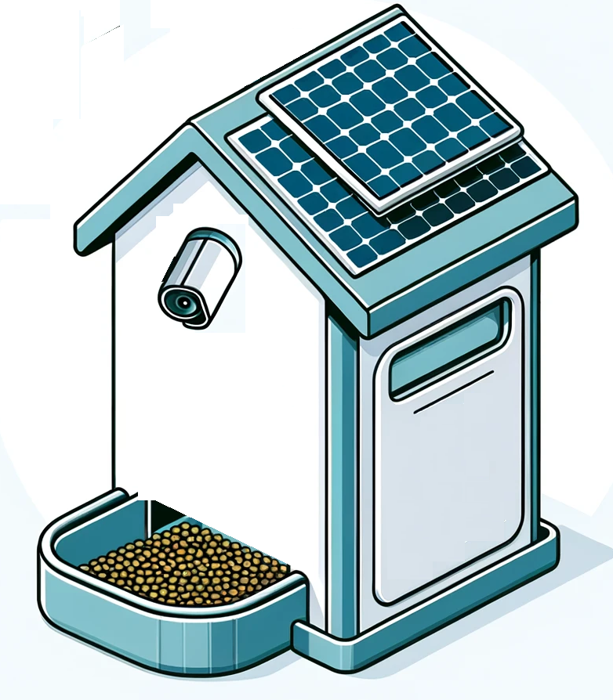
Introduction
Globally, 1 in 3 pets is homeless (Mars Project)
The 2016 cat population in Portugal was estimated at 991,000 (D’Avila)
This project seeks to establish secure feeding boxes for the area's stray cats, ensuring they have consistent access to nutritious food in a safe environment, therefore enhancing their well-being.
991,000 cat population
Avenida do Biribau, Covilhã
Near UBI
Feeding Box Project

Slide 4
Related works

Slide 5
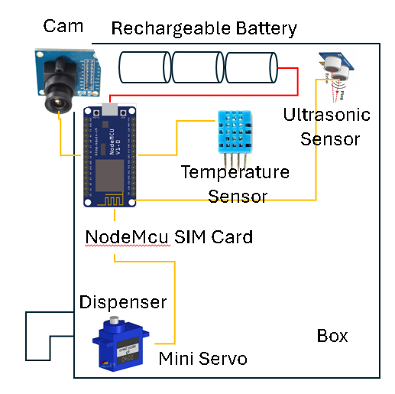
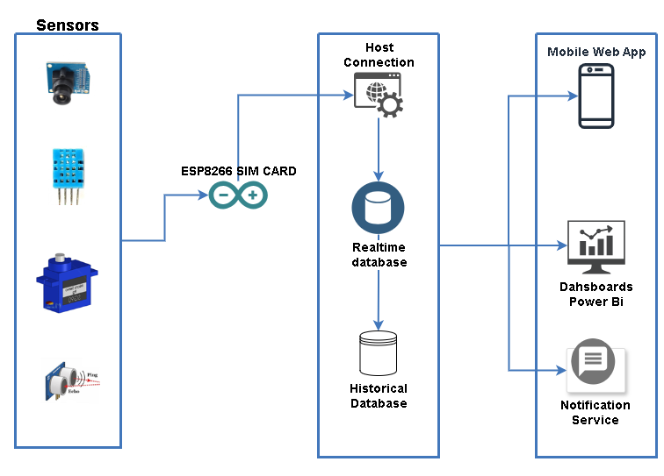

System Architecture
Box components
Architecture Design
Database Sensors

Slide 6
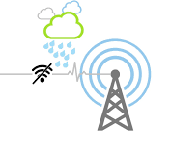
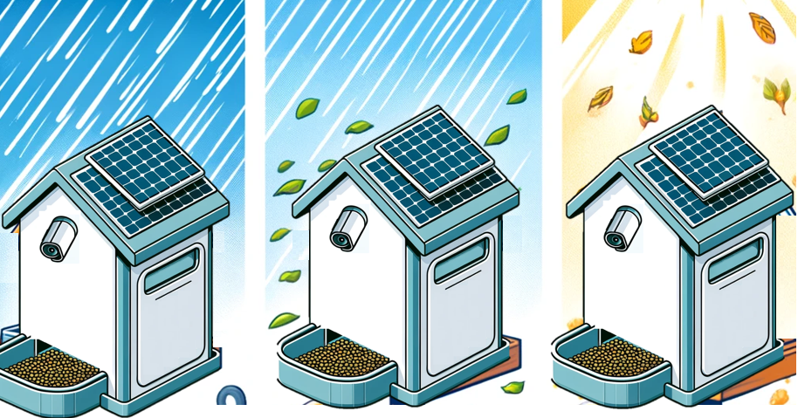
Interoperability
Internet Connection in weather conditions
External Environment

Slide 7
Thanks a million
https://github.com/juscelior
https://github.com/renejerez
2022/2023

