Slide 1

Simply create a MOOC on
Rene Pickhardt, Sebastian Schlicht, Steffen Staab

Slide 2
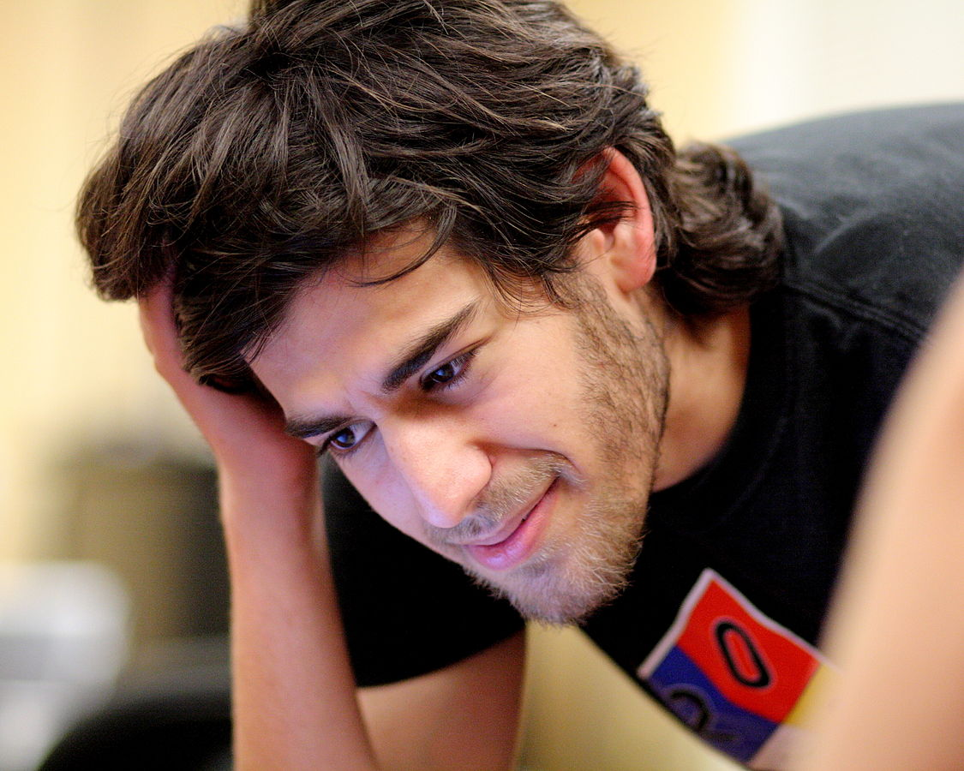
CC-BY-SA 2.0 attribution Sage Ross via wikimedia commons

Slide 3
Outline
Introduction to MOOCs and current trends
Our first “nightmare” experients on Wikiversity
Our new approach (New Frontend)
Summary

Slide 4
Introduction, MOOCs current trends

Slide 5



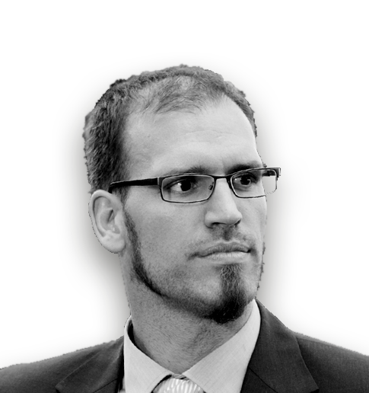
We are
Rene Pickhardt
Sebastian Schlicht
Prof. Dr. Steffen Staab
Robert Naumann
Steffen's PhD Student and driver of this project
Rene's student assistent and main javascript and lua developer
Founder of the Institute for Web Science and Technologies
Video editor responsible for multimedia content

Slide 6
What about you? Who are you?
Who is a
  teacher
  Developer
  Wikipedian
  Politician
  Publisher
Who has created
  Learning materials
  OER
Who has created a MOOC or is planning to do so?

Slide 7
Statement of apology
Apparently I am not so happy about this talk
  Chaotic structure
  Political statements
Obviously the matter is political and those matters seem much harder to discuss and communicate than actual OER like a simple Web Science MOOC

Slide 8
What a Massive Open Online Course should be
Accessible without barriers (for everyone, everywhere)
Free of charge
Give freedom to others to reuse / improve the content
Make use of open formats
Make use of free software
Easy to use → let us do the reality check!

Slide 9
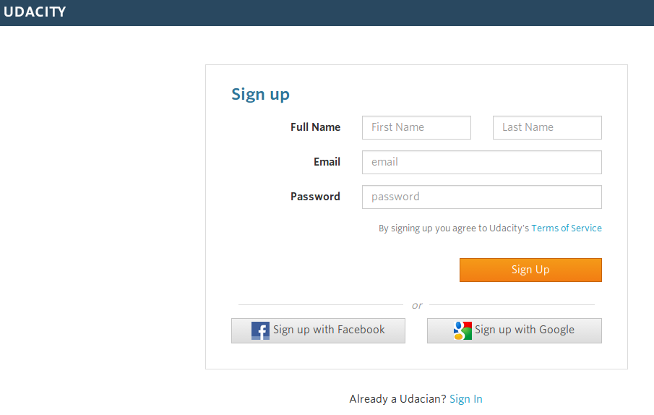
NOT Accessible without barriers
✓

Slide 10
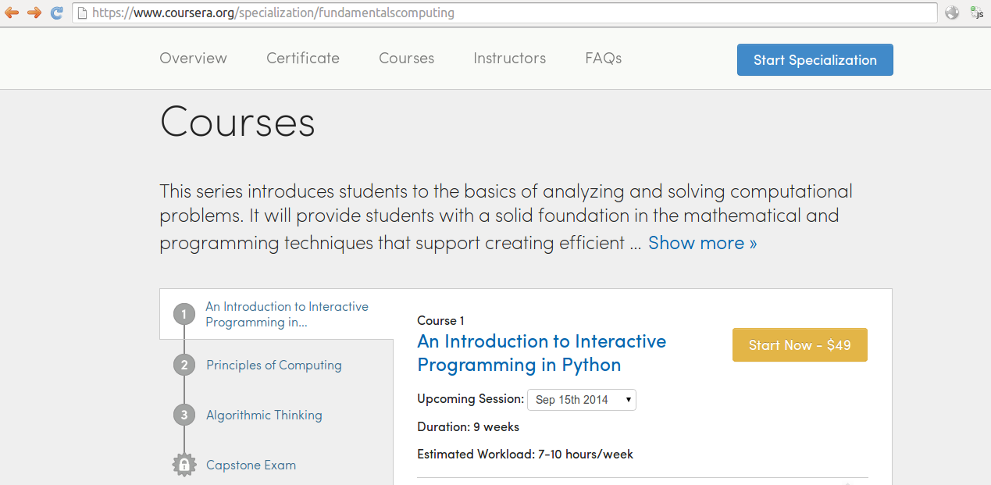
NOT free of charge
Accessible without barriers (for everyone, everywhere)
Free of charge
Give freedom to others to reuse / improve the content
Make use of open formats
Make use of free software

Slide 11
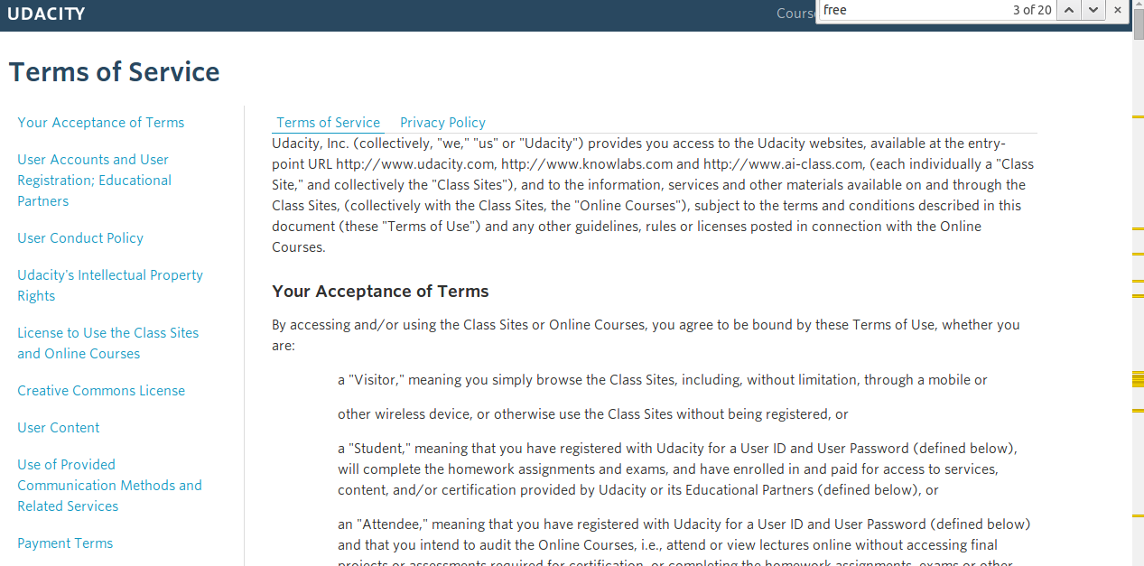
NO freedom to reuse / improve the content

Slide 12
NO freedom to reuse / improve the content
“...With respect to any User Content you submit to Udacity (including for inclusion on the Class Sites or Online Courses) or that is otherwise made available to Udacity, you hereby grant Udacity an irrevocable, worldwide, perpetual, royalty-free and non-exclusive license to use, distribute, reproduce, modify, adapt, publicly perform and publicly display such User Content on the Class Sites or in the Online Courses or otherwise exploit the User Content, with the right to sublicense such rights (to multiple tiers), for any purpose (including for any commercial purpose);
except that, with regard to User Content comprised of a subtitle, caption or translation of Content, you agree that the license granted to Udacity above shall be exclusive. Udacity reserves the right to remove any User Content at any time and for any reason...”
source: https://www.udacity.com/legal/

Slide 13
Little use of Open Formats and free software
No source code for
  Coursera
  Udacity
  Iversity
  Itunes
  ...

Slide 14
Ease of use
Examples of great usability for courses
  Coursera (proprietary)
  Udacity (proprietary)
  Iversity (proprietary)
  Itunes (proprietary)
  Khan Academy (OER? Curated...)
  …
Examples for not so good usability
  Wikiversity (OER)
  Moodle (potentially OER)
  OLAT (potentially OER)
  ...

Slide 15
What a Massive Open Online Course are like
Accessible without barriers (for everyone, everywhere)
Free of charge
Give freedom to others to reuse / improve the content
Make use of open formats (?)
Make use of free software (?)
Easy to use (YES)

Slide 16
Main Problems:
Big difference / large gap between
  what is
  what should be
Teaching is difficult in its own.
  Almost no one creates high quality content
Free platforms often lack usability (#oerde13)
  Seems like the most important factor for adaption
Publishers don't like the OER movement
  Lobbying and pressure on politics

Slide 17
Our first “nightmare” on wikiversity

Slide 18
Our Motivation: Study the Web on the Web
Be truly open
Don't host it ourself
Find a partner that will stay for more than 5 years
Have a good reach to attract new students
→ Khan Academy or Wikiversity / wikimedia
c.f.: http://www.rene-pickhardt.de/comparison-of-open-educational-resources-services-to-host-your-mooc/

Slide 19
The role of Wikimedia (Deutschland)
OER and education is a main focus for Wikimedia
German Wikiversity has a Moodle installation
  one is trying to provide tools for teachers
Improving usability of Mediawiki
  Winter (http://unicorn.wmflabs.org/winter/index.html?page=MOOC)
  Visual editor

Slide 20
We decided for wikiversity
Pro:
  High trust in goals for openness and freedom
  Collaborative: Chances for students to correct materials
  Benefiting from the ecosystem and large user base of Wikipedia (our videos could also enhance wikipedia content)
  A lot of great content already exists in commons, wikipedia, books and wikiversity and can be reused and mixed
Contra:
  Limitations from Mediawiki-Software
  Low usability for students
  Overhead for teachers when creating the course on the site
  No analytics for students and teachers
  Anyone could interfere

Slide 21
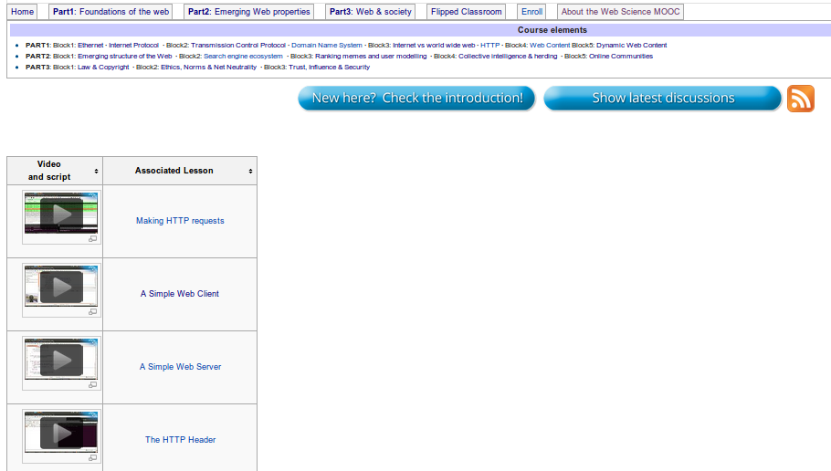
Page layout

Slide 22
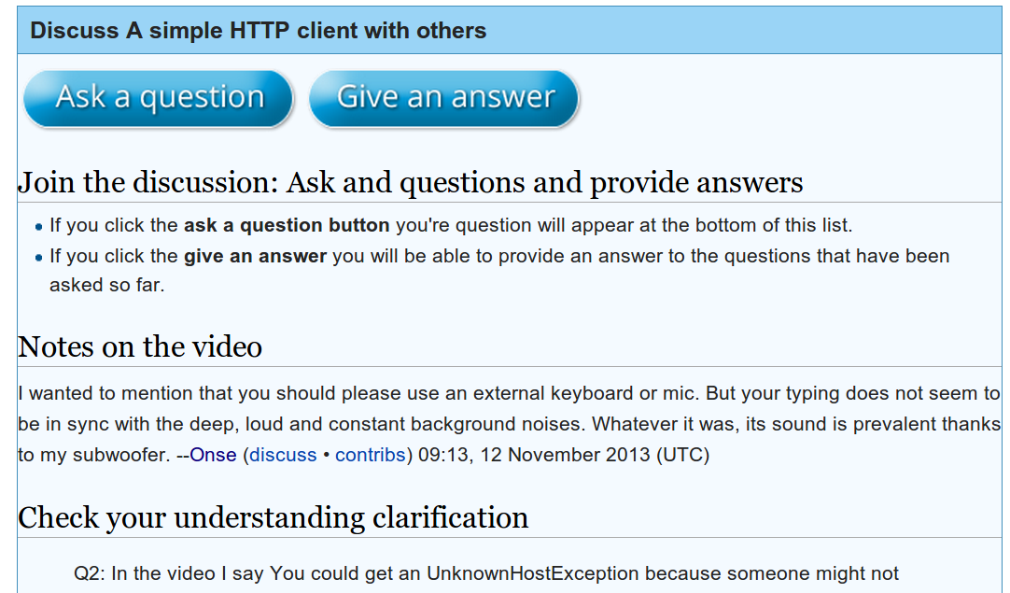
Discussion on the page. What if I click on the blue button?
Pro:
  High trust in goals for openness
  Collaborative: Chances for students to correct materials
  Benefiting from the ecosystem of Wikipedia (our videos could also enhance wikipedia content)
  A lot of great content already exists in commons, wikipedia, books and wikiversity and can be reused and mixed
Contra:
  But was it really possible to conduct a MOOC on wikiversity
  Low usability for students
  Overhead for teachers when creating the course on the site
  No analytics for students and teachers
  Anyone could interfere

Slide 23
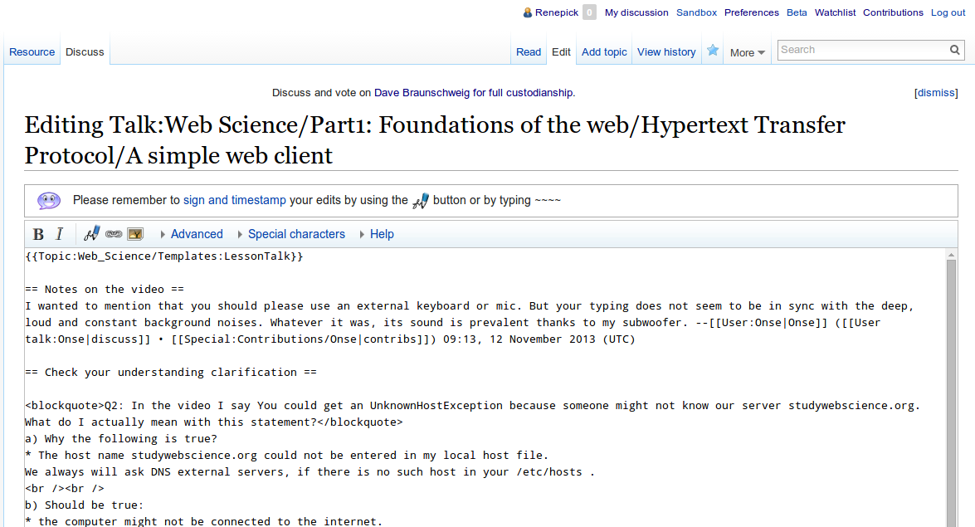
I come to the discussion page (edit mode)

Slide 24
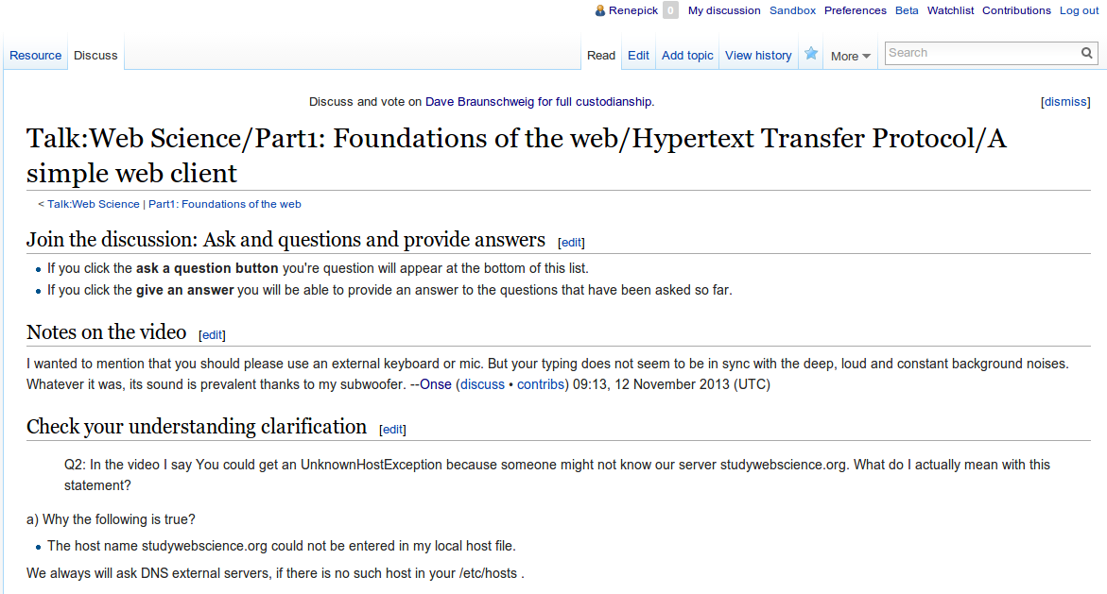
Saving I come to the discussion page (not where I was...)

Slide 25
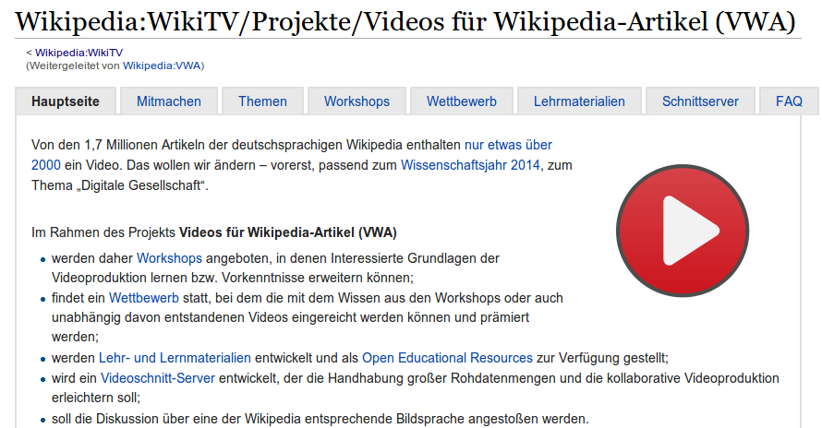
Videos in German wikipedia articles

Slide 26
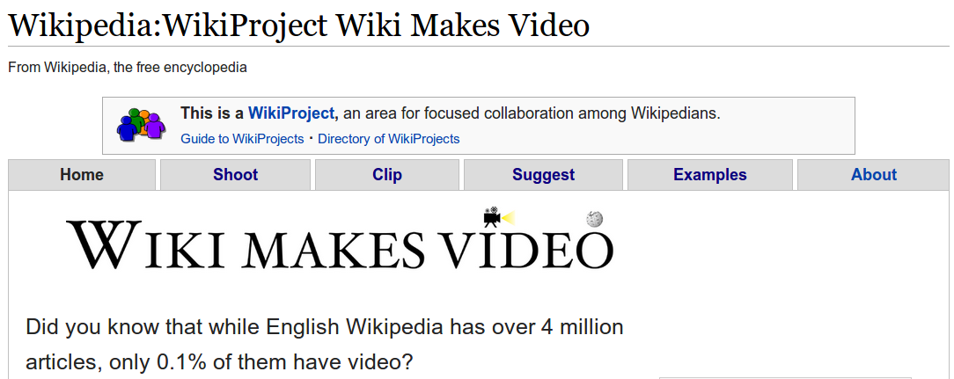
Videos in english wikipedia articles

Slide 27
Videos in wikipedia articles (Reality check)
Taken from: https://en.wikipedia.org/wiki/Talk:Ethernet_frame#Videos
A couple videos have been added to the article by Renepick.[...] I'm not convinced that addition of these is an improvement to the articles. Other opinions?...
I think that how-to videos are not encyclopedic and should not be prominently positioned in Wikipedia articles...
Sure, adding animations to Wikipedia is a good idea, but it doesn't follow that you have to add whole lecture videos. This falls under WP:NOTGUIDE: "The purpose of Wikipedia is to present facts, not to teach subject matter".

Slide 28
Conclusions from our first try
Mooc by wikimedia hosted on third party site
Other teachers not willing to learn our semi automated templating system to create similar courses
High barrier for students to interact with the content
We were considering moving our content to another platform
Other Wikimedia projects did not value our “innovative” (?) content
There was something we must have overseen
  Yes proprietary solutions have great usability

Slide 29
Our new approach

Slide 30
Keep it stupid Simple
Same features as coursera was not enough
People want software that is easy to use
People want to concentrate on their main task and not be distracted by thinking about software
Point and Click instead of learning Mediawiki syntax and processes.

Slide 31
Requirements
K.I.S.S (Keep it stupid simple)
  For both teachers & students
Social (learning is a collaborative approach)
  Again both teachers & students
Interactive / Feedback driven
  Tell the learner what he knows & what he should know
Extending Mediawiki
  without asking the developer / maintainer for permission to do what we plan (create realities)

Slide 32
Features
Discussion system for learning content
Multiple choice quizes
Video embeddings
Easy to use navigation
Automatic process of maintaining course structure
Easily compatible with mediawiki and other course formats

Slide 33
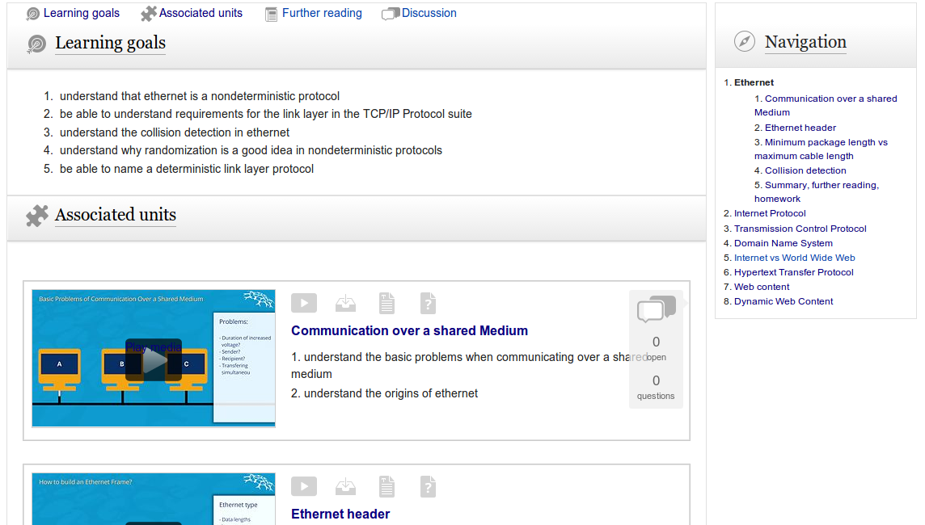
Overall Lesson layout

Slide 34
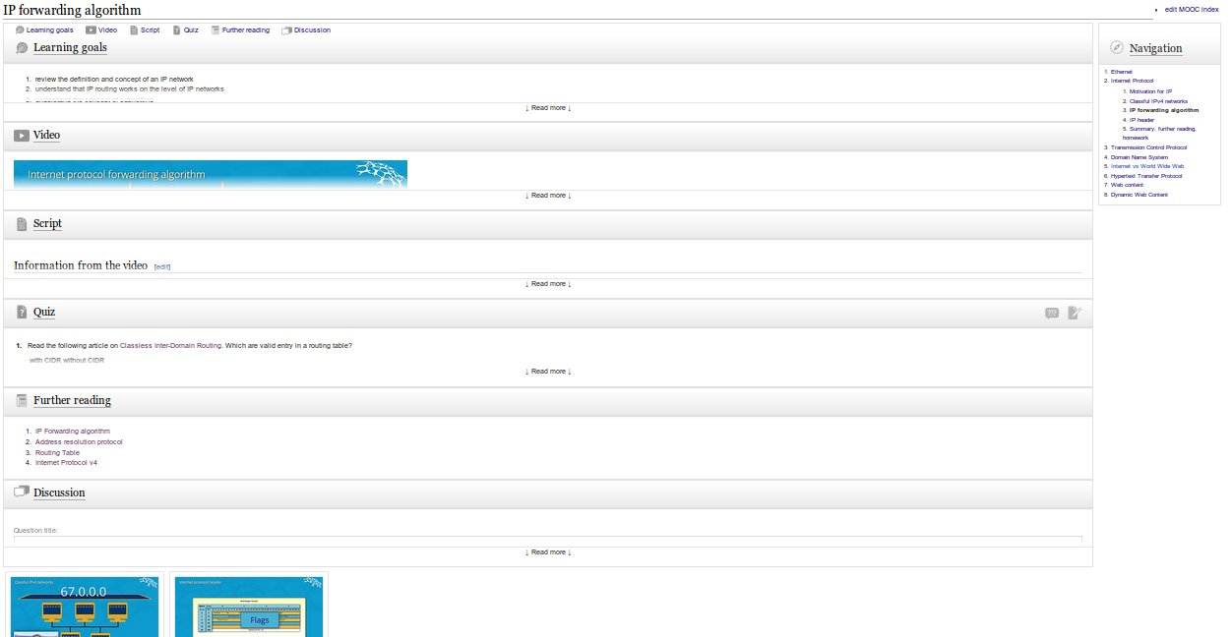
Overall Page layout

Slide 35
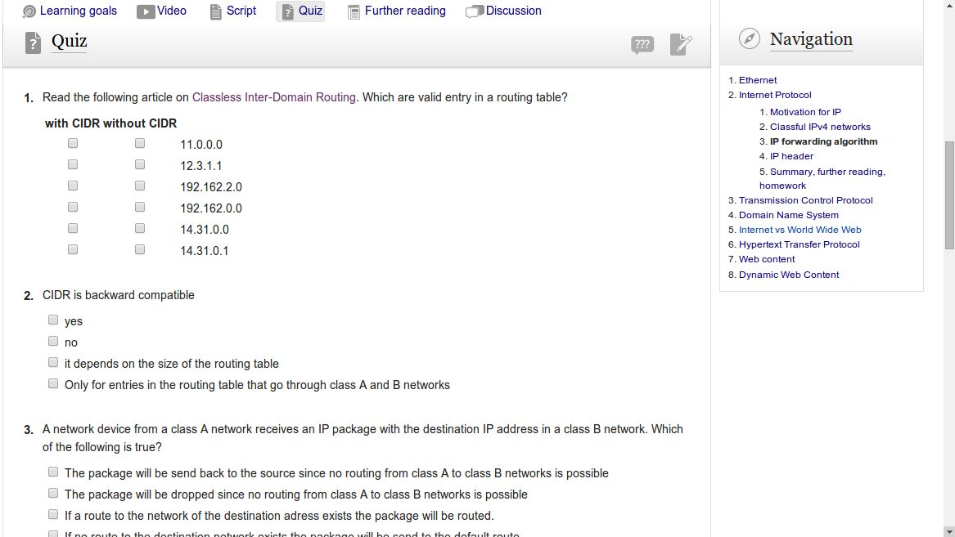
In place editing

Slide 36
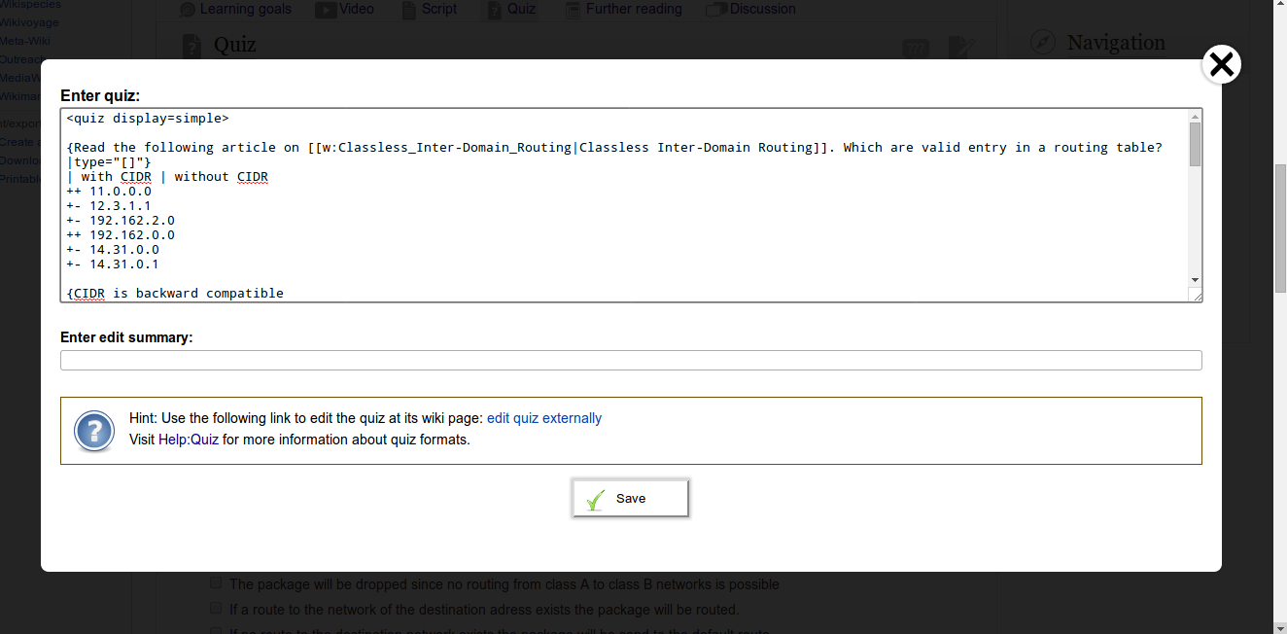
In place editing (2)

Slide 37
How to do it on your own:
Go to https://en.wikiversity.org/wiki/Category:MOOC
Temporarily (due to political and technical reasons):
  Create a user account at wikiversity
  Copy en.wikiversity.org/wiki/User:Renepick/common.js to your common.js file
  Alternative use the following credentials:
    User: mooc-test-account
    Password: mooctest
German Wikiversity users will have to wait until the end of the year.
  Register for email notification right now!

Slide 38
Summary

Slide 39
What have we done?
We created a social learning interface for Mediawiki
It is from the User Experience comparable with proprietary solutions
Effort needed
  Half a year of experience how to not missuse media wiki
  1 Student assistent 6 Month 12 hours per week.
  1 person month of my time for conceptual work
What I am saying: Creating something like this is cheap

Slide 40
Remaining problems
Community is very slow
  Code will break in the hand of the community
  no possibility for software tests
Video collaboration is still missing
Analytics are still missing
There is still a lot of know how required when using our tool
People don't care about the license

Slide 41
Our Roadmap for the project
Obviously hold the Web Science MOOC and a second lecture at university of Koblenz
Find more teachers (content creator)
Deploy the scripts on Wikiversities (include communities)
Try to hand the Maintenance over to Wikimedia Germany
  Server side programming
  Session handling
  Privacy aware Analytics (for students and teachers)
Import tools from open course and learning formats. Standardizing our MoocIndex format.

Slide 42
Conclusion: Continue to fight for free education
Creating OER is hard due to license issues.
Little problem awareness among teachers and students
Creating OER has become a little bit more convenient.
We need more tools to make creation of OER convenient.
We need software that takes up the high standards of proprietary solutions.
Policy makers need to be on board and promote OER
OER is not expensive.

Slide 43
I am on the wrong venue: Our MOOC was not OER ether
22 flipped classroom lectures deleted on wikimedia commons
Copyright violation in Screencasts recorded with microsoft windows
Copyright violation for using proprietary classroom software while making screen casts.
Sorry: We tried hard but have failed you. I am a physicist, mathematician who is doing a PhD in computer science.
  I am not a lawyer :(

Slide 44
Dedicated to
Aaron Swartz (1986 - 2013)
As a symbol for openness and freedom of education for all citizens in the world
Aaron would have loved what we are doing and died way too early because the people benefiting from the injustice did not love his fight for justice.
CC-BY-SA 2.0 attribution Sage Ross via wikimedia commons

Slide 45
Thank you very much!
Questions?
http://www.rene-pickhardt.de
http://twitter.com/renepickhardt
http://github.com/renepickhardt

