Slide 1
Problems with Language Modelling
Rene Pickhardt, Heinrich Hartmann

Slide 2
Outline
Basics / Background
Conjectures
Justification for the strong assumption
Preliminary experimental results
Smoothing methods
Summary

Slide 3
Basics & Background

Slide 4



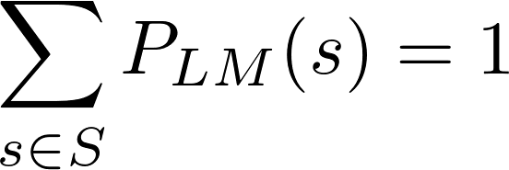
A Language Model assigns each sentence a probability
Probability means the following equation must hold
Example:

Slide 5

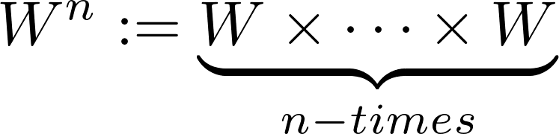

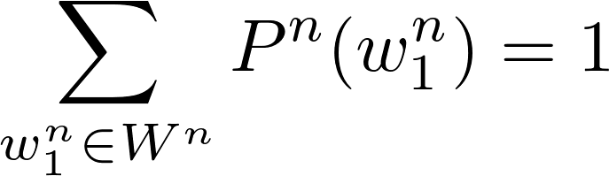
Not to confuse with an n-gram model
Probability means the following equation must hold
Example:

Slide 6
When doing Computing we usually do not have LMs
Even when you see P(s) people can only calculate P^n(s)
  This has some strong impact on the semantics of the formulas in the field (→ later in this talk)
Even over a finite set of words the set of all sentences is of infinite size
N-gram models only estimate Language models
  Together with Heinrich we can: https://github.com/HeinrichHartmann/doc/blob/a6f168119d36ac5e6766bef2e34322b907e8bc4f/LanguageModels.pdf
    Construct n-gram model from Language models
    Construct Language models from n-gram models
    Switch between models of various length
    All just theoretically without doing any statistics and counting

Slide 7
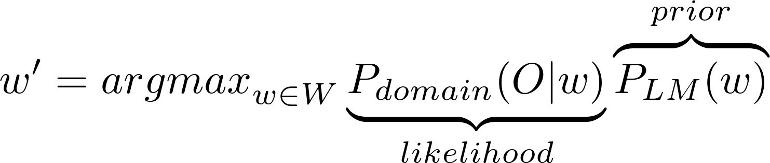
Impact of language models for applications
Noisy channel model
The prior is the Language Model.
More precise language models yield better applications
Obviously P_LM(w)' = cP_LM(w) with c =/= 1 will not change the application (w' will be the same)
Take care with the formula it is not clear if w is just a word!

Slide 8
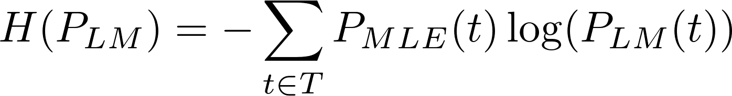
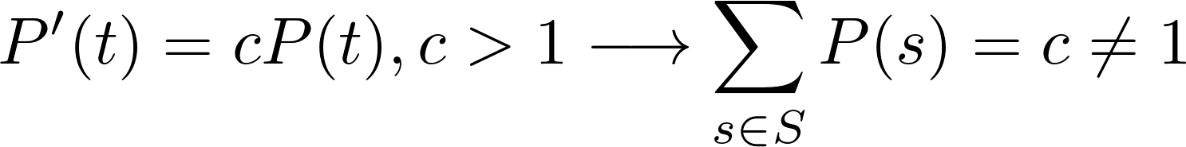

Language Models are evaluated using entropy
Entropy is defined as
T is a Test corpus with test sequences t
The better the Language model predicts the Testcorpus the smaller the entropy → small entropy values are great
But

Slide 9
Chen 1998: Entropy is not a good measure for Language Modeling
Use LMs (n-gram Models) for applications like
  speech recognition (Used in the original paper)
  machine translation
  spell checking
  autocompletion
Entropy of complexly build language models does not correlate with Metrics in applications
This is somehow community knowledge

Slide 10
Common knowledge in the Community
Quote Chen 1998 (Evaluation metrics for Language Models):
  “While perplexities can be calculated efficiently and without access to a speech recognizer, they often do not correlate well with speech recognition word-error rates.”
Alfonseca (Google) in reply to our proposal:
  “As you know, it is not always the case that a decrease in perplexity leads to improvements in an extrinsic evaluation, be it machine translation, speech, or something else”
Stupid backoff (Brants et. al. 2007)

Slide 11
Conjecture

Slide 12
Entropy is an excellent measure for Language Modeling
( and it correlates with metrics from applications )
Reformulation: The Language Models used in the Chen paper and also later have not been proper probability functions. When going to probability functions entropy will work best.
We will see later how we can justify this bold claim:
  In implementation most LMs (n-gram models) are currently not a proper probability function

Slide 13
More questions:
Can we fix the existing Language Models?
What happens to the applications after fixing the LMs?
Might applications with unfixed models still outperform fixed models?

Slide 14
More questions:
Can we fix the existing Language Models?
  (We strongly believe: yes in all cases)
What happens to the applications after fixing the LMs?
  (We expect: that the applications perform better)
Might applications with unfixed models still outperform fixed models?
  If no: perfect! Claim made
  If yes: We should stop putting effort in building probability functions. (Google already stopped)

Slide 15
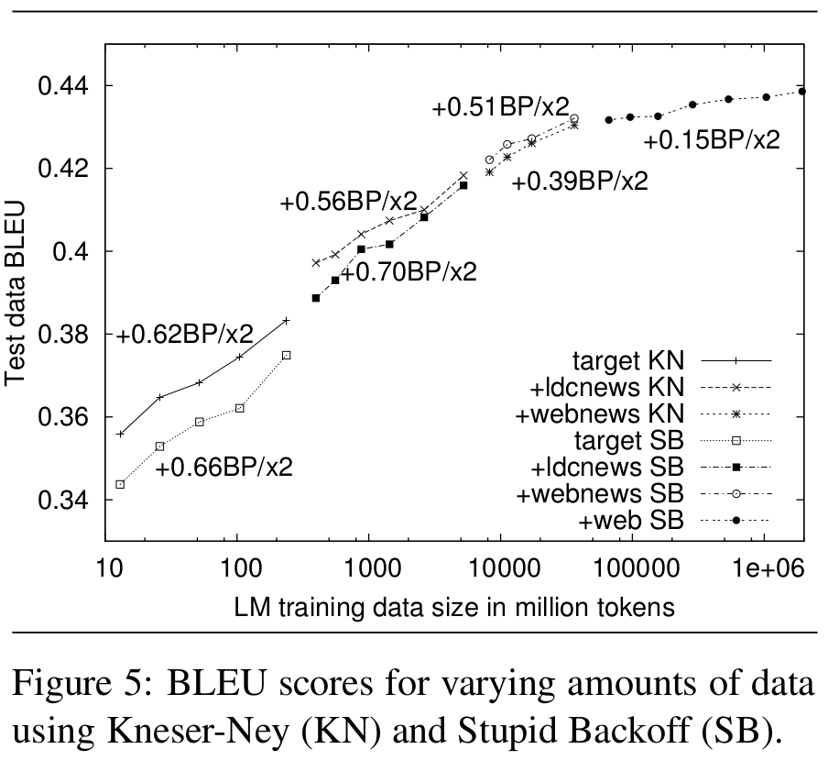
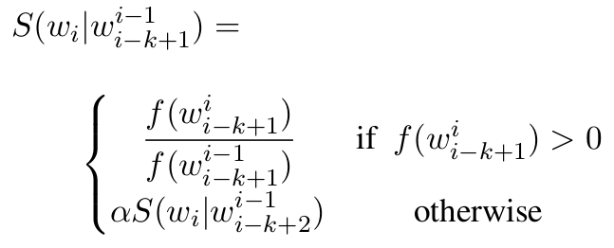
From Brants et. al. 2007: Stupid back off
In general, the backoff factor α may be made to depend on k. Here, a single value is used and heuristically set to α = 0.4 in all our experiments.
The value of 0.4 was chosen empirically based on good results in earlier experiments. Using multiple values depending on the n-gram order slightly improves results.

Slide 16
My interpretation of Brants
Stupid backoff is certainly not a probability function.
  (Not even in theory)
For large scale experiments the results are getting closer since almost no backoff steps take place
Models work better on large scale data not only because of sparsity but also because the implementation mistakes that are being made are becoming less an less
  (large data ==> no backoff necessary)

Slide 17
Justification of Assumptions

Slide 18
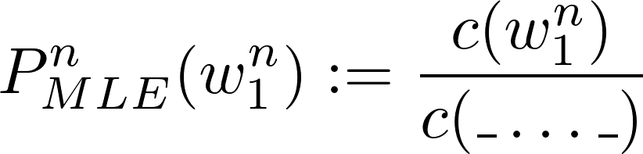
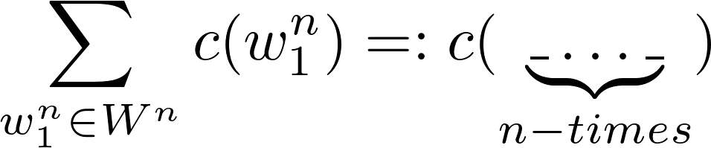
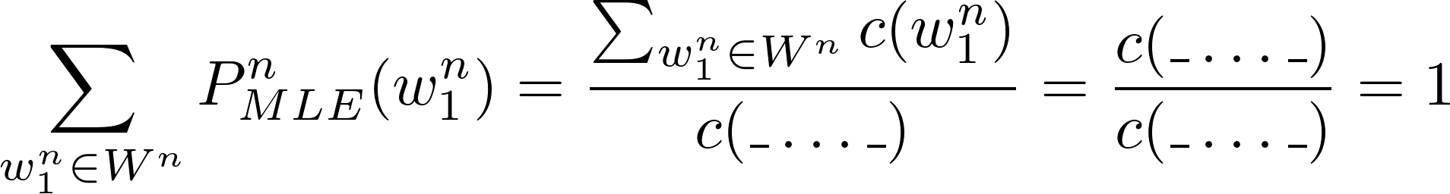
Let us assume a Maximum likelihood n-gram model
with
We test for probability:

Slide 19
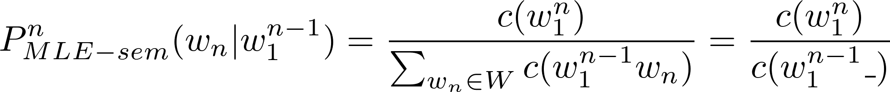
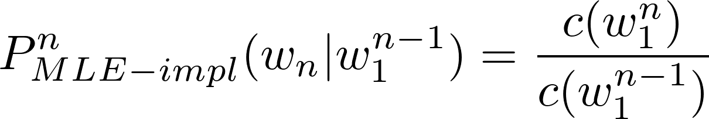
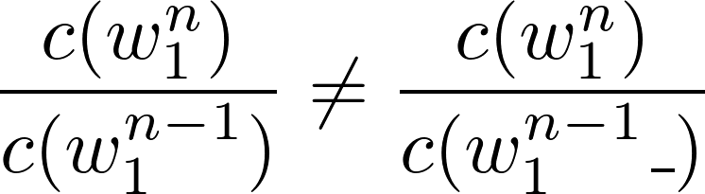
We have the following conditional (?) probabilities
We often see the following implementation
But (!)obviously
The difference over all words can just be measured as the number of sentences in the corpus

Slide 20
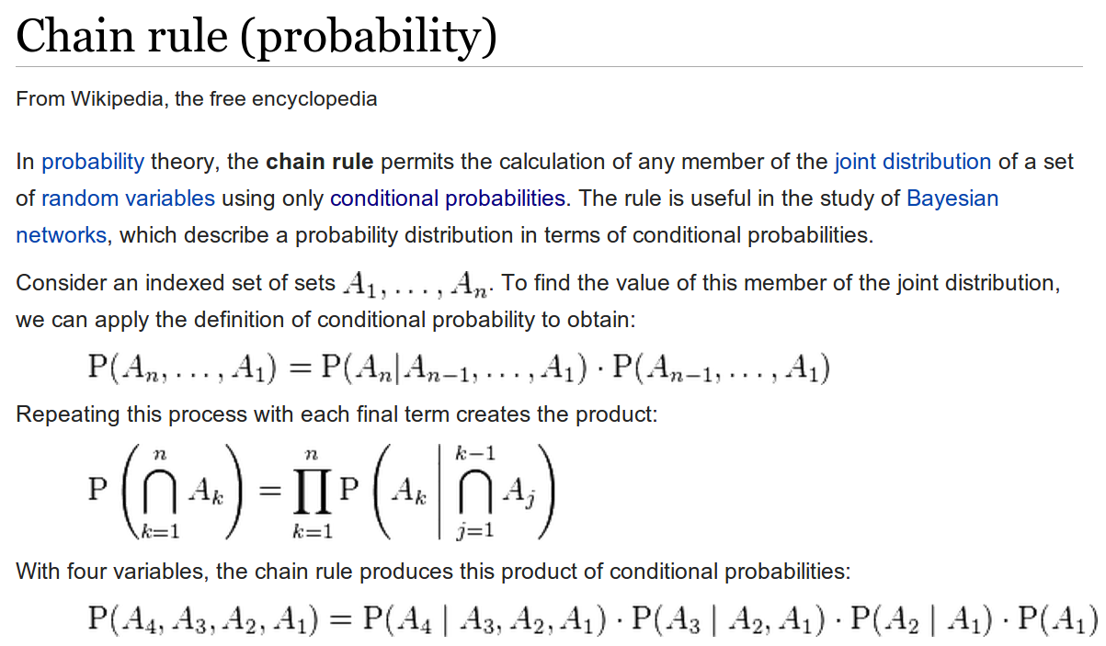
Motiv
References: https://www.ibm.com/developerworks/community/blogs/nlp/entry/the_chain_rule_of_probability

Slide 21

Let us have a look at the chain rule of probability
No Problem for a real language Model but for n-gram models we run into Problems
There are various interpretations for the “?”
  First choice decrease n → (D = decrease)
But there is a problem (no prove here but some data later)

Slide 22
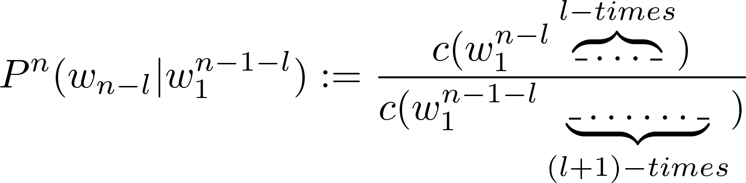

Introduce skips to rescue the chain rule
Define
With this definition we can easily see (prove blackboard) that:

Slide 23
Preliminary test results

Slide 24
Our test corpora
Test 1 (3 Sent, 3 tokens, 18 words)
  a b c a a b
  b a a b c a
  c a b a b a
Moby Dick Corpus (3 Sent, 11 tokens, 15 words)
  JOHN READ MOBY DICK
  MARY READ A DIFFERENT BOOK
  SHE READ A BOOK BY CHER
Wikipedia (very small only entropy)
  (6k Sent, ??? tokens, ~50 k words)

Slide 25
Only MLE with skips is a proper probability distribution
Sum of probabilities for all possible n-grams of various estimated n-gram models
n | SIKP | D | impl
1 | 1.00 | 1.00 | 1.00
2 | 1.00 | 1.00 | 0.83
3 | 1.00 | 1.00 | 0.67
4 | 1.00 | 1.00 | 0.50
5 | 1.00 | 0.82 | 0.33
 | SKIP | D | impl
1 | 1.00 | 1.00 | 1.00
2 | 1.00 | 0.87 | 0.80
3 | 1.00 | 0.67 | 0.60
4 | 1.00 | 0.40 | 0.40
5 | 1.00 | 0.20 | 0.20
ABC Corpus
Moby Dick Corpus
 | SKP | SRILM
1 | 1 | 1
2 | 1 | 0.0037
Wiki corpus (6k sentences)

Slide 26
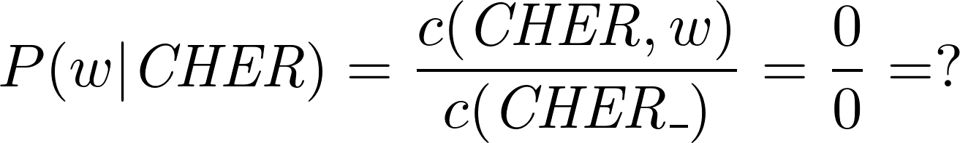
P_D is not a probability function
Problem (rather subtle):
  We divide 0/0 and assign this probability 0
  Double check if current libs make this error too (We guess yes because it is very easy to make that mistake)
What does the following distribution look like?
  JOHN READ MOBY DICK
  MARY READ A DIFFERENT BOOK
  SHE READ A BOOK BY CHER

Slide 27


ABC Corpus sum of probabilities vs Entropy gain

Slide 28
Moby Dick Corpus Entropy in comparison to mistake

Slide 29
Difference in Entropy (attention |T| depends on n) (wiki)

Slide 30

ABC: Entropy & sum of 'probabilities';different estimator
 | SUM | H
1 | 1.00 | 0.52
2 | 1.00 | 0.73
3 | 1.00 | 0.93
4 | 1.00 | 0.92
5 | 1.00 | 0.78
 | SUM | H
1 | 1.00 | 0.52
2 | 1.00 | 0.73
3 | 1.00 | 0.92
4 | 1.00 | 0.92
5 | 0.82 | 0.88
 | SUM | H
1 | 1.00 | 0.52
2 | 0.83 | 0.80
3 | 0.67 | 1.10
4 | 0.50 | 1.22
5 | 0.33 | 1.26
Note: the test corpus consisted of all seen sequences
(in any other case entropy would be infinity)

Slide 31
Mini conclusion
Entropy values are wrong to the disadvantage of the community
  (on large corpora the mistake seems negligible)
Implementation P_impl and fixed implementation P_D don't produce a probability functions
  This can be fixed for P_D
Introducing skips does at least make the Math correctly
  and leads right a way to the notion of generalized language models
We have to make more experiments with standard libs

Slide 32
Smoothing methods

Slide 33
Existing Smoothing methods
Unigram:
  Good Turing
  Laplace
Advanced:
  Absolute discounting
  Backoff methods
  Interpolation methods
  Kneser Ney Smoothing (Absolute discounting)
  Modified Kneser Ney Smoothing
  Witten Bell Smoothing
  Katz Smoothing

Slide 34
Ideas and goals of smoothing
Idea:
  Given probability distribution
  Make it more 'even'
  Lower large probabilities
  Increase low / zero probabilities
Goal for language modeling
  No probability should be 0
    (that might be a hard and also stupid goal)
Goal is needed for applications not to break

Slide 35
Problems with smoothing
In theory those smoothing methods work greatly
  (proves can be received from Heinrich)
In implementations there are many sources for adding to much probability (similar to P_D)
  Sum of all probabilties > 1
  Probably leading to an Entropy drop
    (which should not be there)
Chen, 1998: “Interpol always works better then back off”
  WE: Backoff is certainly a probability function
  Interpol implementations make backoffs when they are not supposed to (again 0/0 is the problem)

Slide 36
Summary

Slide 37
There is still a lot to do
Check all implementations of all toolkits
Disprove Chen (Entropy is a good measure)
Check how big the effects really become in applications and on real size data sets
Fix implementations (give hints what the semantics are and what can be done)
Provide a full mathematical framework / theory of Language modeling and smoothing methods

Slide 38
The community has some “magic tricks”
Including BOS and EOS tokens to scentences
Include UNK tag for unknown words
Smoothing unigram distributions
→ We have to see which of these address the above mentioned problems to which extend

