Slide 1
Salvator-xs DRIF
Hardware modifications
28th oCTOBER 2020
FABRIZIO cASTRO
Senior Staff Engineer
REE／IIBU／SDD／SPD2
Renesas Electronics Corporation

Slide 2
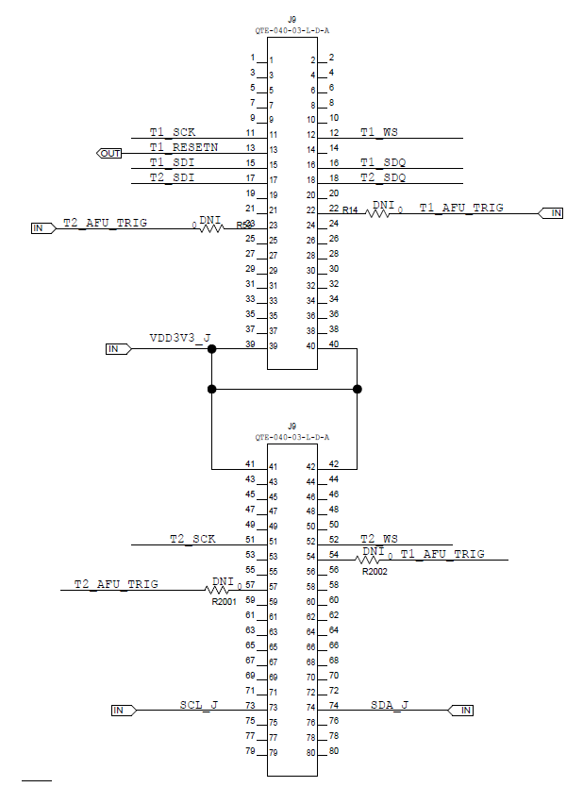
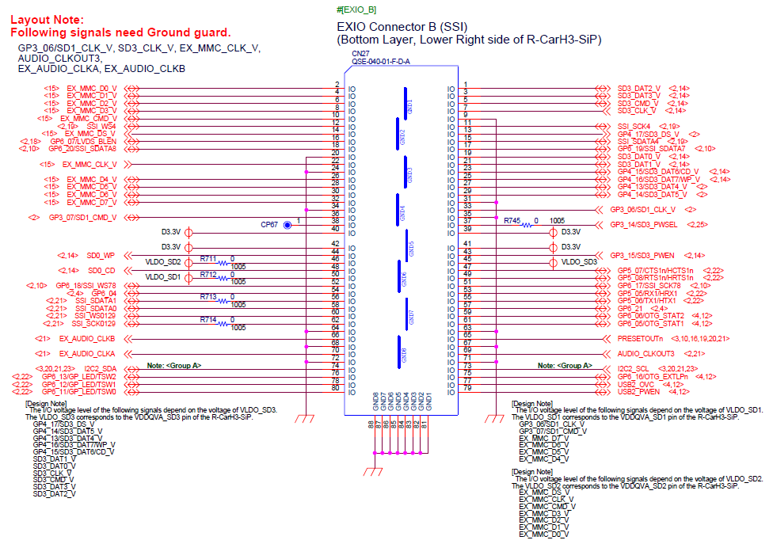
Salvator-xs and DRIF CONNECTORS
Salvator-XS and Salvator-X boards (CN27):
DRIF Board (J9):
Maxim Integrated MAX2175 J5 Demo board Rev C

Slide 3
DRIF Control Signals
DRIF Control | Schematic signal name | Wired | CN27 Pin | DRIF J9 signal name
SCL | I2C2_SCL | << >> | 73 | SCL_J
SDA | I2C2_SDA | << >> | 74 | SDA_J

Slide 4
DRIF Channel 0 and 1
DRIF 0 pins | Schematic signal name | Wired | CN27 Pin | DRIF J9 signal name
CLK_B | SSI_SCK4 | << >> | 11 | T1_SCK
D0_B | SSI_SDATA4 | << >> | 15 | T1_SDI
D1_B | GP6_07/LVDS_BLEN | << >> | 16 | T1_SDQ
SYNC_B | SSI_WS4 | << >> | 12 | T1_WS
DRIF 1 pins | Schematic signal name | Wired | CN27 Pin | DRIF J9 signal name
CLK | GP6_17/SSI_SCK78 | << >> | 51 | T2_SCK
D0 | GP6_19/SSI_SDATA7 | << >> | 17 | T2_SDI
D1 | GP6_20/SSI_SDATA8 | << >> | 18 | T2_SDQ
SYNC | GP6_18/SSI_WS78 | << >> | 52 | T2_WS
Notes:
Remove R638, R639, R640 to isolate the video decoder
Remove R166 to isolate the voltage levelling buffer from BT_PCM_IN
SW14 must be in position 1, Master (out) to avoid being driven by 'BT_PCM_CLK’ through voltage leveling buffer

Slide 5
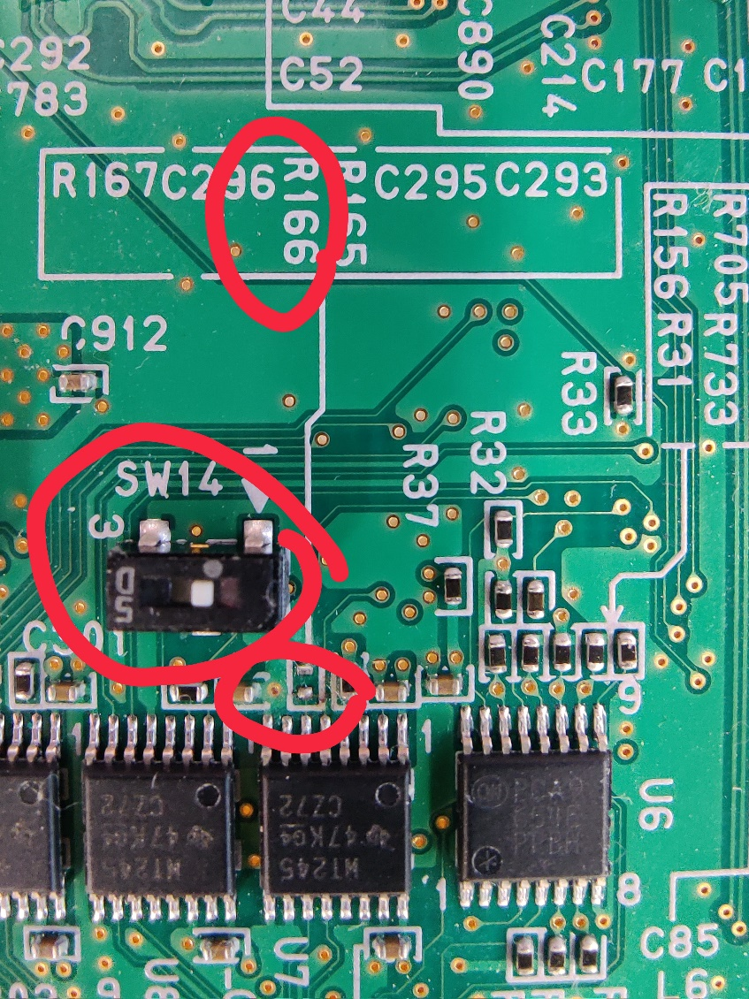
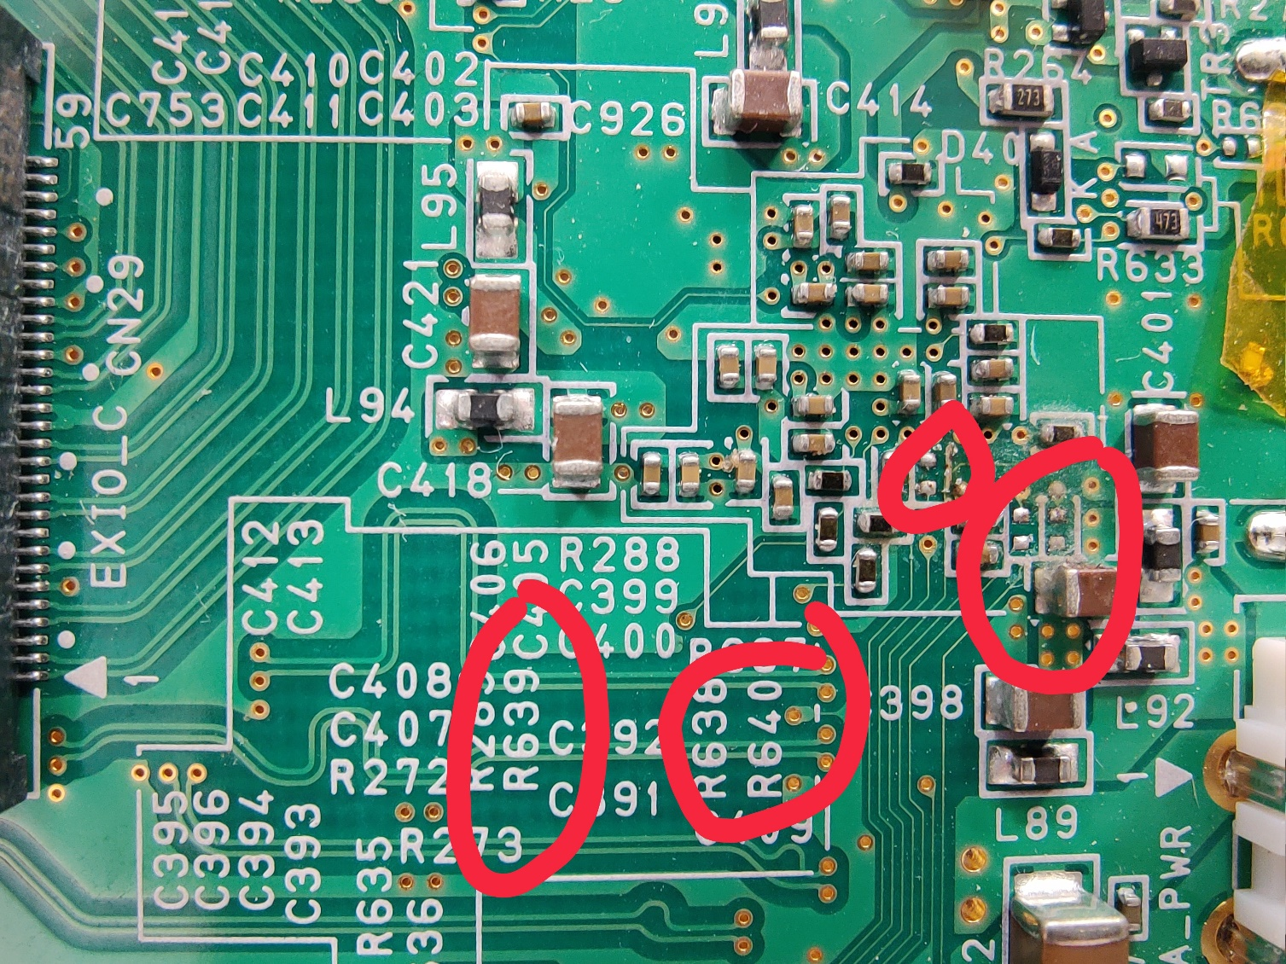
DRIF Channel 0 and 1

Slide 6
Renesas.com

