Slide 1
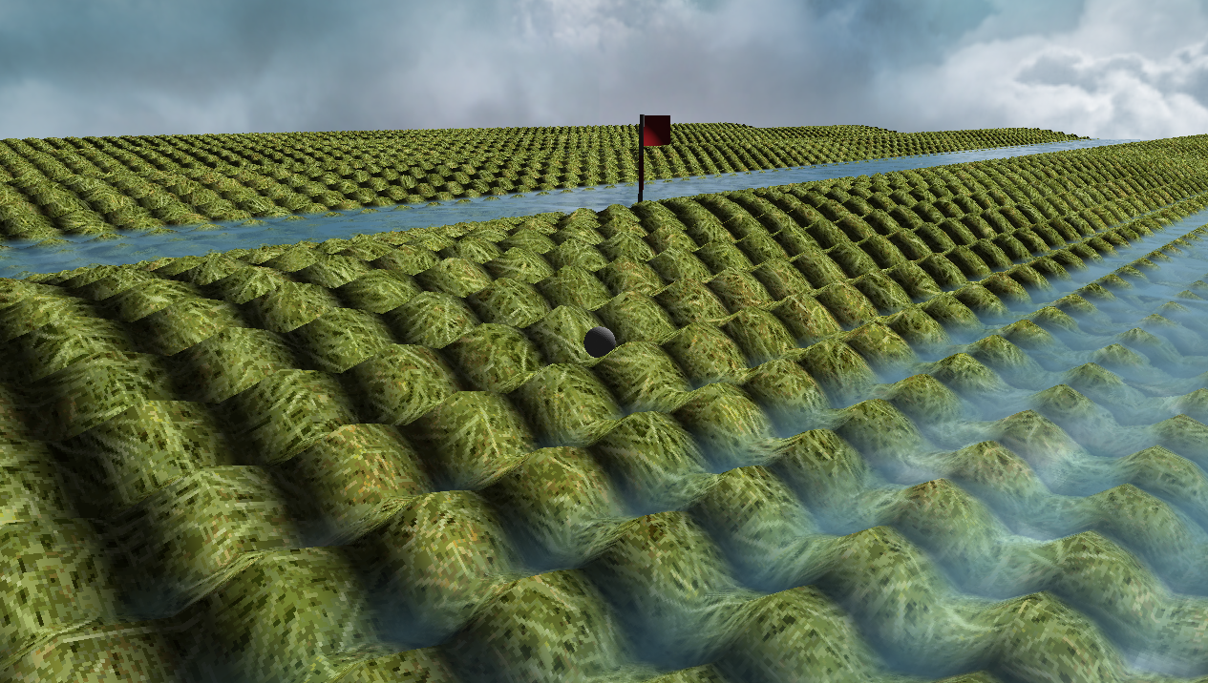
Crazy Putting phase 3
René Steeman
Aaron SchapirA
Ivan Poliakov
Jean Janssen
Matthijs Kusters
Haoran Luan

Slide 2
The challenge
1. Having a random error in the initial position and velocity of the ball, including an analysis of the impact on the bot’s performance.
2. Handling different (unknown) coefficients of friction and making sure the bot can handle them.
3. Allow for balls that can both fly and bounce, as well as improvements to the bot so it can handle these new options.
4. Improve the bot to handle complex terrains like mazes.
5. Implement collision detection.
Notes:
Jean

Slide 3
Table of contents
1. Game Engine
2. Physics and experiments
3. Bots and experiments
4. Collision Detection?
5. Conclusion

Slide 4
Our questions
1. Is it possible to create a realistic putting game that can be played by an AI?
2. What is a good physics solver that can be used in real-time?
3. What kind of AI can be used in order to play the game?
4. What kind of engine is required to show the game, create terrain defined by a height function and allow a human to play?

Slide 5
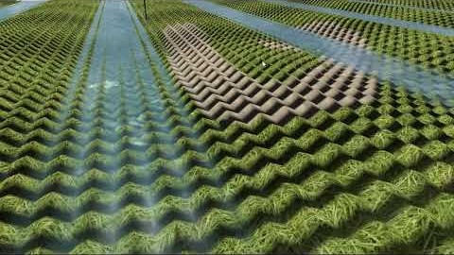
Game Engine
We have made our own openGL-based game engine with support for the following features:
Dynamic terrain generation
Real-time editing
Collision detection
Realistic lighting
Water with special effects (du/dv maps, reflections, depth effect)
3D model support (.obj)
Third person camera

Slide 6
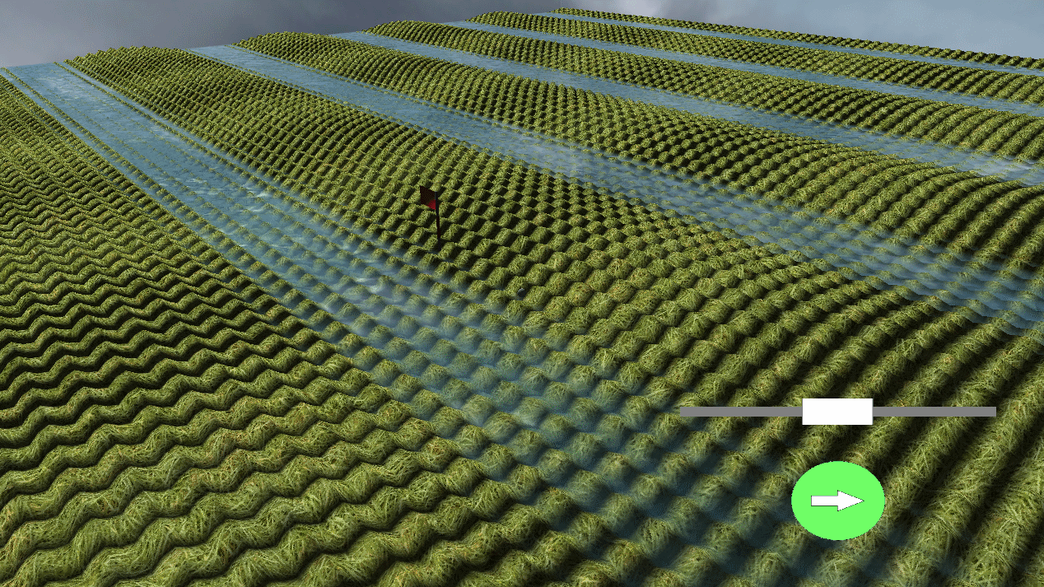
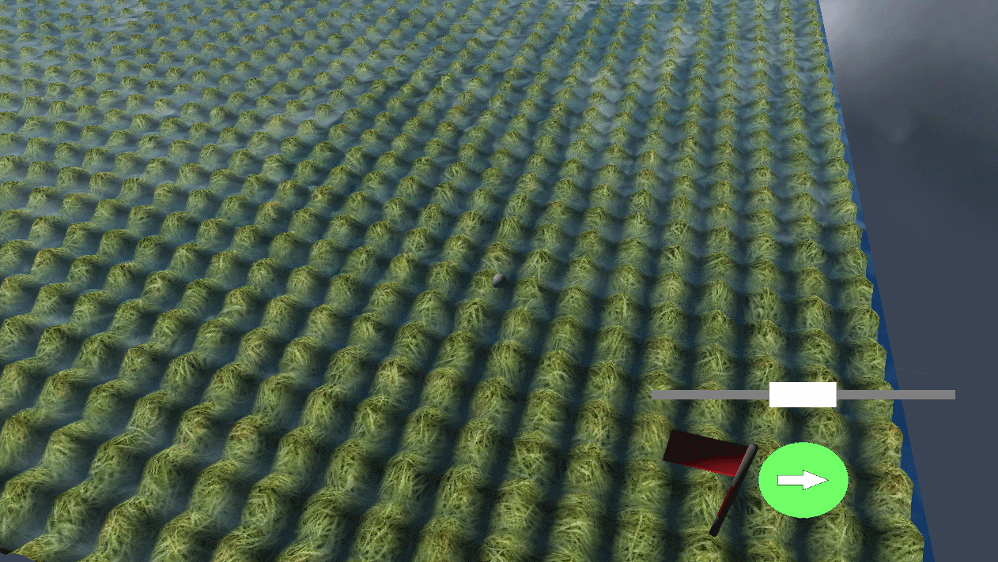
Terrain generation
Given a mathematical function with the variables x and y we can generate a terrain during runtime.

Slide 7
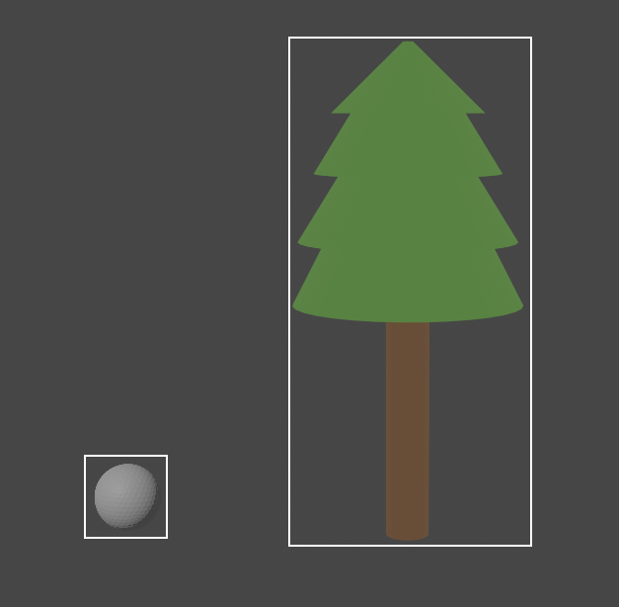
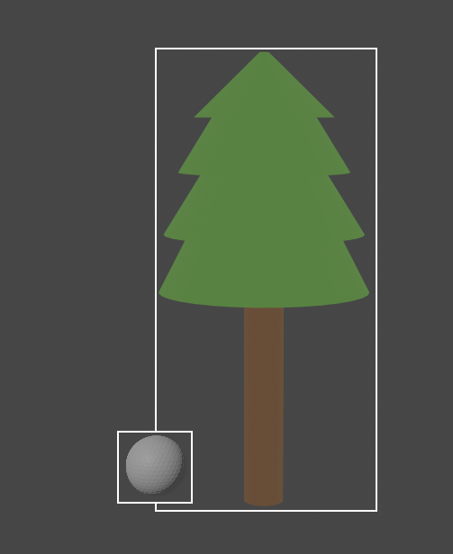
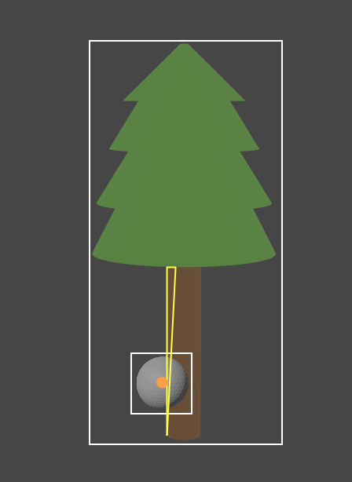
Collision detection
Stages:
1. Check if the smallest possible box around an object, that still contains every point making up the model, overlaps with that of the ball.
2. Check if the actual mesh is colliding with the ball
No collision
Possible collision
Collision

Slide 8
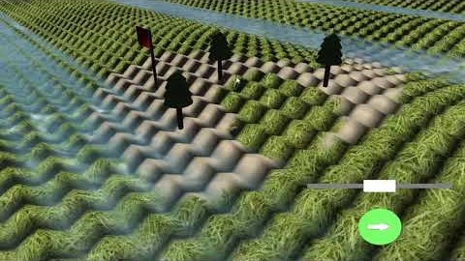
Live saving and loading
Notes:
Should it be there?

Slide 9
Physics
- Flying balls explanation by Matthijs the genius

Slide 10
Experiments
- TODO

Slide 11
Bot
- New bot explanation

Slide 12
Experiments
- TODO

Slide 13
Collision Detection?
- TODO
Notes:
Since it was one of the requirements for this phase I think we should talk about it.
Placement of the slide to check.

Slide 14
Conclusion

